Slide 1
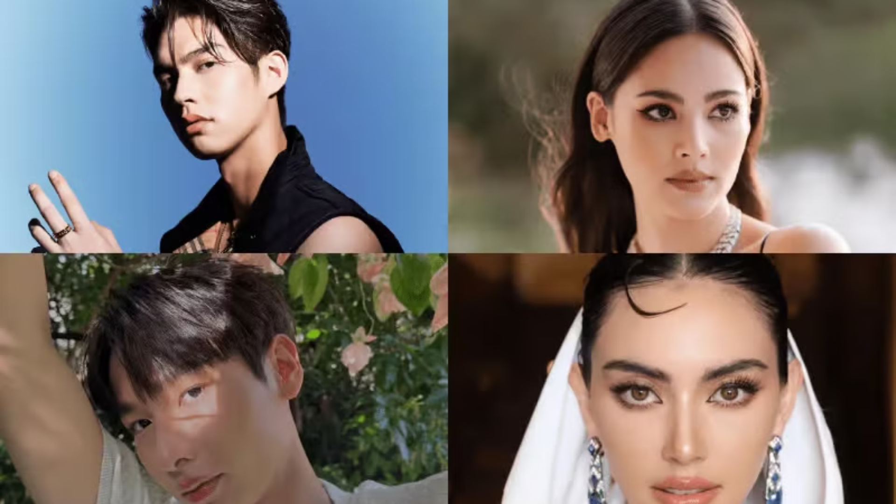
Thai People and Other Popularity that You May Know
Photo Credit: KPROFILES

Slide 2
Thailand in Brief
"Thailand in Brief " has been prepared by the Thailand Foundation to support students, scholars, and the general public who wish to give presentations about Thailand to their audiences—for example, exchange program students and international participants.
The work presents some basic information about Thailand in 11 areas: 1) Geography, 2) History, 3) Politics and Government, 4) Economics, 5) Demographics, 6) Culture, 7) Values, 8) Thai People and Other Popularity That You May Know, 9) Misconceptions about Thailand, 10) Thailand's Role on the Global Stage, and 11) Rankings Related to Thailand.
"Thailand in Brief" is produced in both PDF file (.pdf) and Powerpoint Presentation (.pptx) formats, consisting of xx slides. Users may download and select the topics they wish to present, and may rearrange the sequence of the slides as appropriate. However, the content of this document cannot be edited. Reproduction or use for commercial purposes without permission from the Thailand Foundation is not allowed.
"Thailand in Brief" will be updated every third quarter each year. For inquiries or further suggestions, please contact the Thailand Foundation at info@thailandfoundation.or.th.
27 May 2025

Slide 3
Thailand in Brief
"Thailand in Brief " จัดทำขึ้นโดยมูลนิธิไทย (Thailand Foundation) เพื่ออำนวยความสะดวกแก่ นักเรียน นักศึกษา และผู้สนใจทั่วไป นำไปใช้ประโยชน์ อาทิ ในการบรรยาย หรือให้ความรู้เกี่ยวกับประเทศไทยในด้านต่าง ๆ แก่ชาวต่างประเทศ เช่น กรณีนักศึกษาแลกเปลี่ยนที่ไปเรียนในต่างประเทศที่ต้องนำเสนอเรื่องราวเกี่ยวกับประเทศไทยในสถาบันที่ไปศึกษาอยู่ เป็นต้น
งานชิ้นนี้เสนอข้อมูลเกี่ยวกับประเทศไทยโดยสังเขป 11 ด้าน ได้แก่ 1) ภูมิศาสตร์ (Geography) 2) ประวัติศาสตร์ (History) 3) การเมืองการปกครอง (Politics and Government) 4) เศรษฐกิจ (Economics) 5) ประชากร (Demographics) 6) วัฒนธรรม (Culture) 7) ค่านิยม (Values) 8) คนไทยและสื่อที่คุณอาจรู้จัก (Thai people and other popularity that you may know) 9) ความเข้าใจผิดเกี่ยวกับประเทศไทย (Misconceptions) 10) บทบาทของไทยในเวทีโลก (Thailand’s role on the Global Stage) และ 11) การจัดอันดับที่เกี่ยวกับประเทศไทย (Rankings related to Thailand)
"Thailand in Brief " นี้จัดทำเป็นสไลด์ จำนวน xx สไลด์ ในรูปแบบ .pdf และ .pptx สามารถดาวน์โหลดและเลือกใช้หัวข้อที่นำเสนอ และสลับลำดับการนำเสนอได้ตามความเหมาะสม อย่างไรก็ดี ผู้ใช้งานไม่สามารถดัดแปลงเนื้อหาในเอกสารได้ และห้ามผลิตซ้ำ หรือนำไปใช้เพื่อผลประโยชน์เชิงพาณิชย์โดยไม่ได้รับอนุญาตจากมูลนิธิไทย
"Thailand in Brief " จะได้รับการปรับปรุงให้ทันสมัยในทุกไตรมาสที่ 3 ของปี หากมีข้อสงสัยและข้อเสนอแนะเพิ่มเติม กรุณาติดต่อมูลนิธิไทย อีเมล info@thailandfoundation.or.th
27 พฤษภาคม 2568

Slide 4
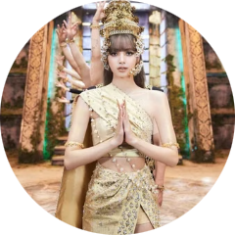
Thai Musicians: A Global Presence in Music and Fashion
LISA (Lalisa Manobal)
Phum Viphurit
MILLI (Danupha Khanatheeraku)
Global Influence: Member of BLACKPINK, one of the most successful K-pop girl groups globally.
International Recognition: Known for his indie-pop style, Phum gained worldwide fame with his hit "Lover Boy."
Trailblazing Achievements: First Thai rapper to perform at Coachella (2022), where she created a sensation with her performance of "Mango Sticky Rice."
Achievements: First non-Korean artist signed by YG Entertainment and the first solo artist to have a debut album reach over 1 billion streams on Spotify.
Touring: Phum has toured internationally, including a successful Europe and North America tour.
Bold Performances: Known for her fearless and witty lyrics, MILLI represents a new wave of Thai hip-hop globally.
Photo Credit: Thai Outfit, Guitar.com and Sanook

Slide 5
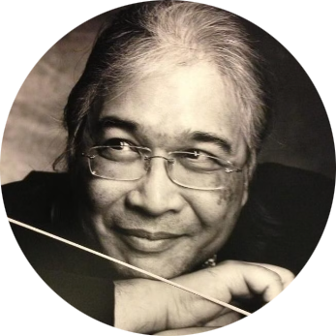
Lumyai Haitongkum (Supansa Wedkama)
S. P. Somtow (Somtow Sucharitkul)
Folk Music Icon: A leading figure in the Mor Lam (traditional Thai folk) genre, Supansa is known for her energetic performances.
Cultural Ambassador: A renowned composer and conductor, blending Thai cultural themes with Western classical music.
Global Stage: Has performed in various international festivals, bringing Thai folk music to a broader audience.
Global Influence: His works have been performed by major orchestras worldwide, and he has been instrumental in promoting Thai music on the global classical stage.
Awards: Regarding his efforts to present and promote Thai culture and Thai identity through Western art, S.P. Somtow was honored with the title of National Artist in the field of music and contemporary composition in 2023 and received the Thailand’s Public Diplomacy Award in 2024.
Photo Credit: Thai2Music, Opera Siam

Slide 6
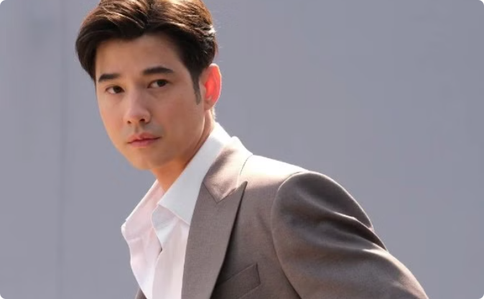
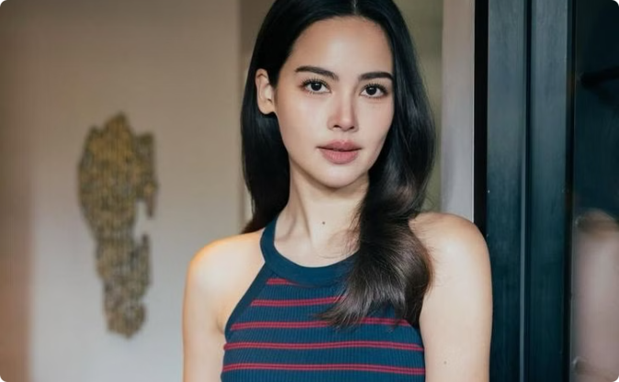
Thai Actors and Actresses: Stars of the Screen
Mario Maurer
Yaya (Urassaya Sperbund)
Versatile Actor: Known for his roles in Love of Siam and Pee Mak, Mario has starred in numerous Thai and international films.
Acting Talent: Starred in popular dramas like The Crown Princess and Kiss Me; a favorite among Thai drama fans.
Model and Advocate: In addition to acting, Yaya is a well-regarded model and has participated in numerous charity projects.
International Recognition: His appeal spans across Asia, earning him accolades and a loyal fan base worldwide.
Photo Credit: Manager Online and Sanook

Slide 7
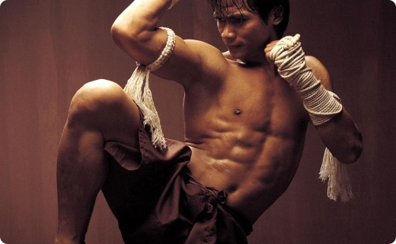
Mai (Davika Hoorne)
Nadech Kugimiya
Tony Jaa
Star Power: Famous for her role in Pee Mak, which became Thailand's highest-grossing film of all time.
Heartthrob: Known for his starring roles in Game Rai Game Rak and The Crown Princess, Nadech has a massive fan following.
Martial Arts Star: Known worldwide for his roles in Ong-Bak and Tom-Yum-Goong, Tony Jaa revolutionized action cinema with his groundbreaking martial arts stunts.
International Success: She has become a model for international fashion brands and has expanded her reach to global audiences.
Awards and Recognition: Multiple award winner for his acting skills across Thai television and film.
Global Appeal: He has starred in Hollywood films such as Fast and Furious 7 and continues to influence the action genre globally.
Photo Credit: Tatler Asia, Matichon and Whistlekick Martian Art Radio

Slide 8
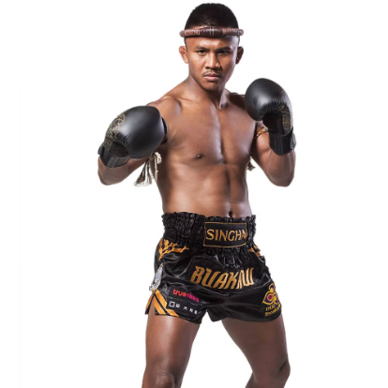
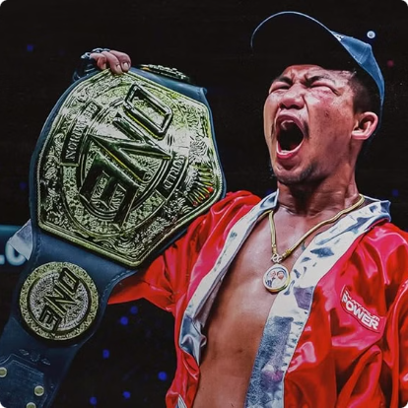
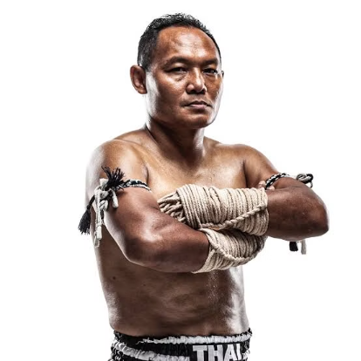
Thai Athletes: Redefining Excellence in Sports
Buakaw Banchamek
Rodtang Jitmuangnon
Saenchai
Muay Thai Legend: A multiple-time world champion, Buakaw is credited with popularizing Muay Thai globally, earning recognition in major international events.
Muay Thai Champion: A dominant force in ONE Championship, Rodtang is known for his relentless and aggressive fighting style.
Muay Thai Icon: Renowned for his agility and creativity, Saenchai is a well-known champion at Lumpinee Boxing Stadium for defeating larger opponents several times and entertaining fans worldwide.
Photo credit: Bangkok Post, Prime Video and Thai Fight

Slide 9
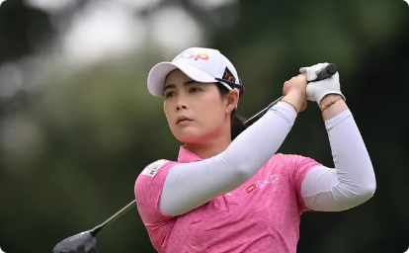
Atthaya "Jeeno" Thitikul
May (Ariya Jutanugarn)
Mo (Moriya Jutanugarn)
Made history at 14 as the youngest winner of a professional tournament.
First Thai golfer to win a major championship in 2016.
LPGA Tour Rookie of the Year in 2013.
Won team event with sister Ariya, creating a powerful family legacy.
Reached World No. 1 ranking at the age of 19.
Former World No. 1 with multiple LPGA Tour victories.
Regarding a remarkable success at the LPGA Tour winning major tournaments and inspiration to new generations of professional golfers to pursue their dreams and become champions, she was one of the recipients of the Thailand's Public Diplomacy Award 2023.
She was awarded the Thailand’s Public Diplomacy Award 2023 together with her sister, Moriya Jutanugarn, due to their continuous contributions in the promotion of Thailand through their outstanding achievements in the international ladies’ golf arena.
Photo credit: Bangkok Post, LPGA, Golfweek

Slide 10
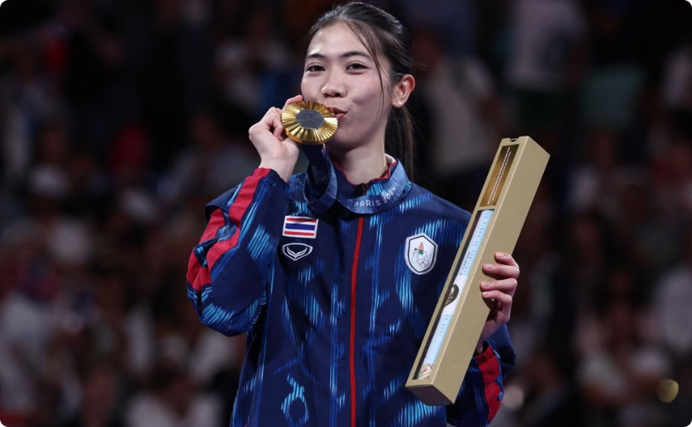
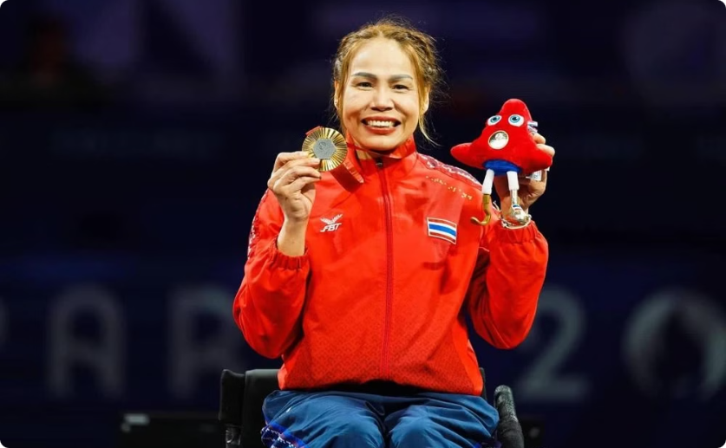
Tennis (Panipak Wongpattanakit)
Saysunee Jana
Olympic Champion: Gold medalist in Taekwondo at the Tokyo 2020 Olympics and the Paris 2024 Olympics, Panipak is one of Thailand's most celebrated athletes.
Paralympic Hero: A multiple-time medalist (since Athens 2004) in fencing, Saisunee continues to inspire many with her determination, overcoming physical challenges to compete at the highest levels of sport.
Photo credit: Bangkok Post

Slide 11
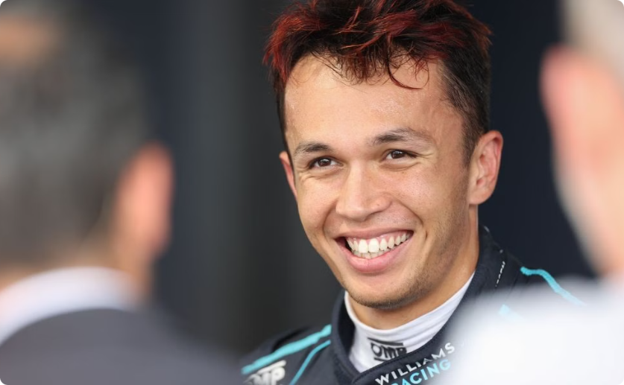
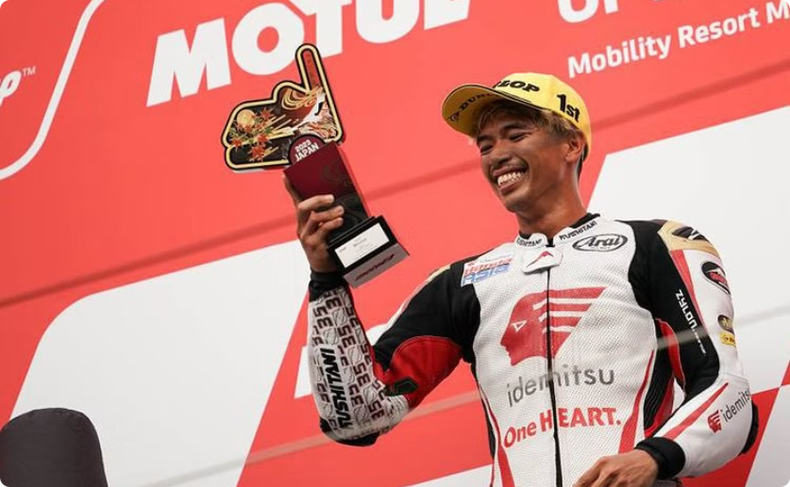
Alex Albon
Somkiat Chantra
Thai-British F1 driver representing Thailand for Williams Racing since 2022.
First Thai rider to win a Grand Prix in the Moto2 class.
Historic victories in Indonesia (2022) and Japan (2023)
Made his F1 debut with Toro Rosso in 2019
Set to debut in MotoGP with Honda LCR in 2025
Signed multi-year extension with Williams in 2024
Photo credit: Blackbook Motorsport, Bolasport.com

Slide 12
More Thai Films Making Waves on the Global Stage
How To Make Millions Before Grandma Dies
Pee Mak
Uncle Boonmee Who Can Recall His Past Lives
A horror-comedy based on the Mae Nak legend, Pee Mak became one of the most successful Thai films of all time, blending humor with the supernatural.
A heartfelt family drama, following a grandson who becomes the unlikely caregiver of his terminally ill grandmother, only to uncover the true meaning of family amidst hidden motives and painful truths.
Directed by Apichatpong Weerasethakul, this Cannes Palme d'Or winner explores spiritual themes and Thai culture, earning global critical acclaim.
Main Actors: Mario Maurer, Davika Hoorne
Main Actor: Thanapat Saisaymar
Main Actors: Billkin, Usha Seamkhum
Photo credit: Mydramalist

Slide 13
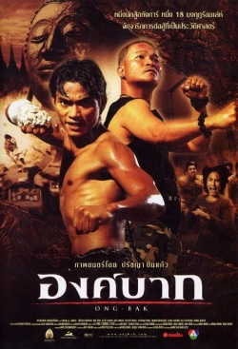
Thai Films That Shaped the Industry
Shutter
Ong Bak
Bad Genius
A classic Thai horror film about a photographer haunted by a ghostly presence, regarded as one of the scariest Asian horror films.
An action-packed martial arts film that showcased the talents of Tony Jaa and brought Muay Thai to international audiences.
A thriller about a high school student running an exam-cheating business, Bad Genius was praised for its smart social commentary and gripping plot.
Main Actors: Ananda Everingham, Natthaweeranuch Thongmee.
Main Actor: Tony Jaa
Main Actors: Chutimon Chuengcharoensukying, Teeradon Supapunpinyo.
Photo credit: Mydramalist

Slide 14
Thailand Leading the Way in BL Series
A category of TV dramas, films, and online series that focus on romantic relationships between male characters
2gether: The Series
TharnType: The Series
KinnPorsche
SOTUS
A romance between two college students who fake a relationship that turns into genuine love.
A passionate love story between two university students from very different backgrounds.
A mafia-themed BL series with action and romance, appealing to both drama fans and action lovers.
A popular BL series about an engineering student who falls for his senior in a tough university environment.
Main Actors: Bright Vachirawit, Win Metawin.
Main Actors: Gulf Kanawut, Mew Suppasit.
Main Actors: Mile Phakphum, Apo Nattawin
Main Actors: Singto Prachaya, Krist Perawat.
Photo Credit: Mydramalist

Slide 15
GL Dramas: Expanding Representation in Thai Media
GAP The Series
The Secret of Us
23.5
A slow-burn office romance that explores power, class, and hidden feelings as a young woman lands a job under the strong, distant boss she’s secretly admired since childhood.
A heartfelt romantic drama that follows a guarded doctor whose world is upended when her free-spirited ex-girlfriend reenters her life, forcing her to confront old wounds and the love she tried to forget.
A charming coming-of-age romance about a shy high school girl who hides behind a fake online identity to get closer to her cheerful classmate, leading to a tangled web of secrets, friendship, and first love.
Main Actors: Freen Sarocha and Becky Armstrong.
Main Actors: Lingling Kwong and Aom Kornnaphat
Main Actors: Pansa Vosbien, Pattranite Limpatiyakorn
Photo Credit: Mydramalist

Slide 16
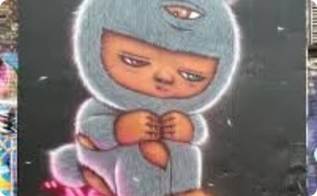
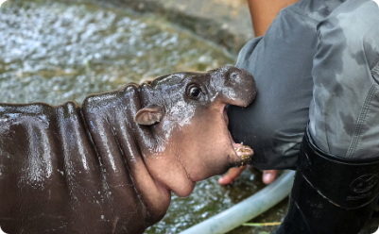
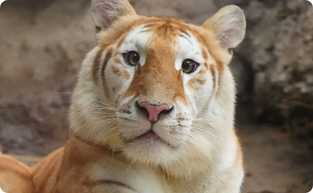
Other Famous Personalities
Alex Face
Moo Deng
Ava
Butterbear
Patcharapon Tangruen creates thought-provoking street art featuring his signature character.
This pygmy hippopotamus calf became an overnight internet sensation in 2024.
This rare golden tigress captivates visitors at Chiang Mai Night Safari.
"Nong Noey" rose to fame through charming TikTok dance videos.
Her playful antics at Khao Kheow Open Zoo draw visitors from across the globe.
Her unique coat and charismatic personality have earned her viral fame.
This adorable bear mascot has transformed a local bakery into a cultural phenomenon.
His three-eyed child in a bunny suit adorns walls across Thailand and beyond.
Photo credit: Alex Face, The New York Times, Lifestyleasia.com and Bangkok Post

Slide 17
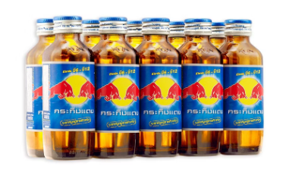
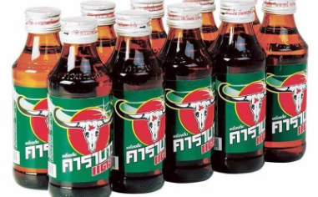
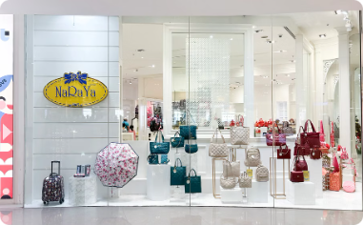
Thai Brands with Global Impact
Krating Daeng
Carabao
Hongthai
NaRaYa
Introduced in 1976 by Chaleo Yoovidhya, this non-carbonated energy drink inspired the global Red Bull brand.
Launched in 2002 by rock star Aed Carabao and entrepreneur Sathien Setthasit. Named after the water buffalo, it sponsors the English football Carabao Cup.
Traditional Thai herbal brand famous for nasal inhalers and aromatic oils. Uses essential oils to relieve congestion and boost alertness.
Lifestyle brand established in 1989, known for handcrafted fabric bags. Affordable yet stylish accessories beloved by tourists and locals alike.
Photo credit: Taraad, Big C, Tops and NaRaYa

Slide 18
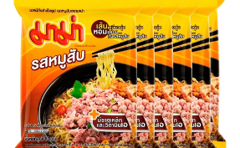
Thailand's Global Brand Leaders
Jim Thompson
Mitr Phol
Transformed traditional Thai silk into global luxury since the 1950s.
Asia's sugar production leader with international operations.
Now synonymous with premium textiles and elegant décor worldwide.
Innovator in renewable energy through ethanol and biomass solutions.
Mama Noodles
Panpuri
Beloved instant noodles introducing Thai flavors globally since 1972.
Premium wellness brand blending Thai ingredients with modern luxury.
Famous Tom Yum flavor serves as gateway to authentic Thai cuisine.
Showcases Thailand's natural resources through high-end beauty products.
Photo credit: Sineha Bangkok, Brandage, Big C and PANPURI

Slide 19
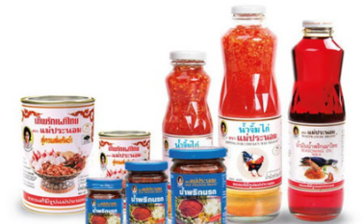
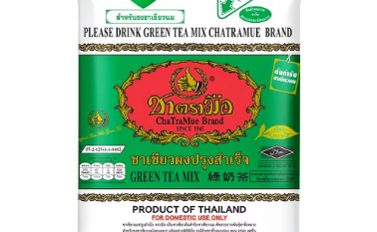
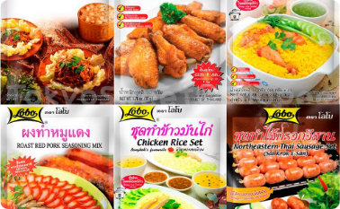
Thailand's Culinary Icons
Maepranom (Est. 1959)
ChaTraMue (Est. 1945)
Founded by Pranom Daengsupha, this brand delivers authentic Thai chili pastes worldwide.
Thailand's iconic milk tea brand has expanded globally with signature cafés.
Their traditional flavors maintain Thai culinary heritage with modern production standards.
Their distinctive red label tea leaves have become synonymous with Thai tea culture.
Lobo
THANN (Est. 2002)
These ready-to-cook seasoning mixes bring authentic Thai flavors to kitchens worldwide.
This eco-friendly brand blends Asian botanicals with modern skincare science.
Lobo simplifies complex Thai recipes without compromising traditional taste profiles.
THANN products showcase Thailand's rich botanical heritage through luxury wellness offerings.
Photo credit: Sanook, Big C, Tops and THANN

Slide 20
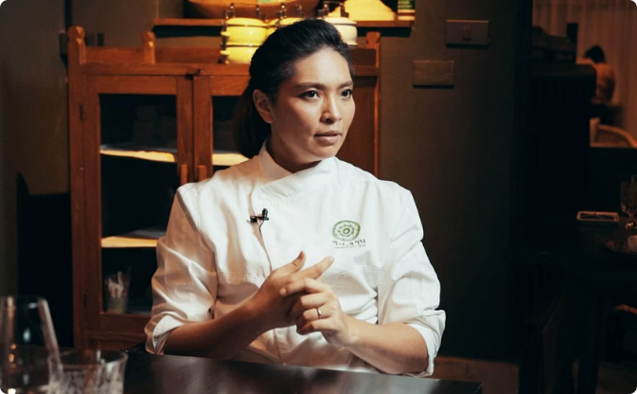
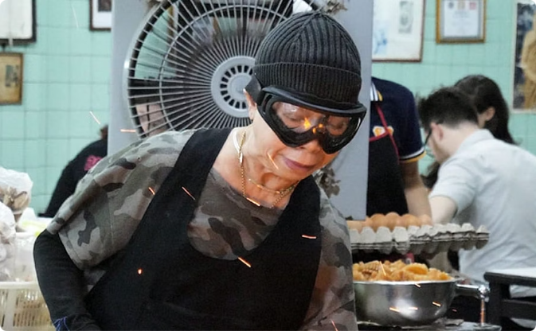
Thailand's Culinary Icons
Duangporn "Bo" Songvisava
Supinya "Jay Fai" Junsuta
Co-founder of Bo.lan, a Michelin-starred restaurant celebrating authentic Thai cuisine.
Street food legend who transformed humble roadside cooking into Michelin-starred cuisine.
Named Asia's Best Female Chef in 2013
First Bangkok street vendor awarded a Michelin star
Featured on Netflix's Chef's Table
Famous for her crab omelette
Champion of sustainable, farm-to-table practices
Icon Award winner at Asia's 50 Best Restaurants
Photo credit: Time Out and MICHELIN Guide

