Slide 1
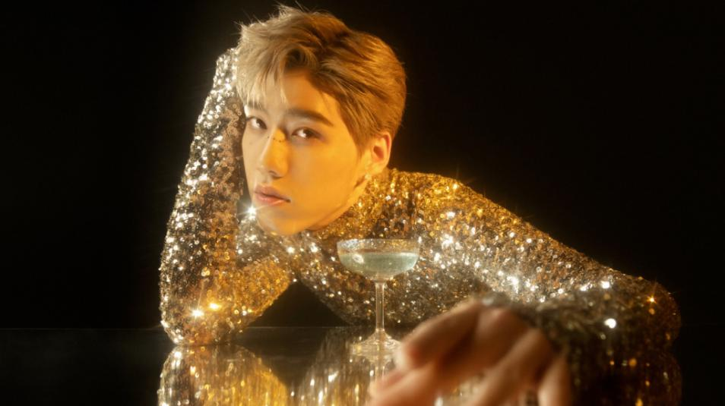


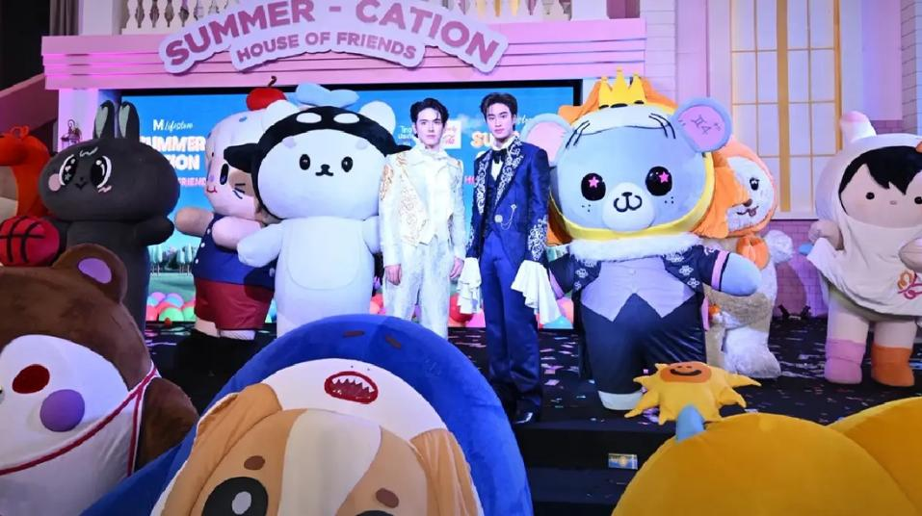
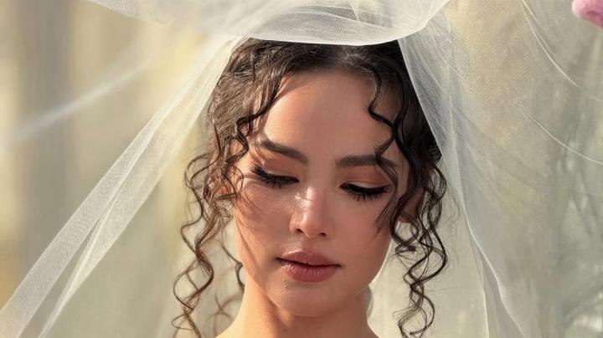
Thai People and Other Popularity
that You May Know
Photo Credit: Time, poysian, The Nation, SabuyWedding
Notes:
1

Slide 2

Thailand in Brief
"Thailand in Brief " has been prepared by the Thailand Foundation to support students, scholars, and the general public who wish to give presentations about Thailand to their audiences4for example, exchange program students and international participants.
The work presents some basic information about Thailand in 11 areas: 1) Geography, 2) History, 3) Politics and Government, 4) Economics, 5) Demographics, 6) Culture, 7) Values, 8) Thai People and Other Popularity That You May Know, 9) Misconceptions about Thailand, 10) Thailand's Role on the Global Stage, and 11) Rankings Related to Thailand.
"Thailand in Brief" is produced in both PDF file (.pdf) and Powerpoint Presentation (.pptx) formats, consisting of
400 slides. Users may download and select the topics they wish to present, and may rearrange the sequence of the slides as appropriate. However, the content of this document cannot be edited. Reproduction or use for commercial purposes without permission from the Thailand Foundation is not allowed.
"Thailand in Brief" will be updated every third quarter each year. For inquiries or further suggestions, please contact the Thailand Foundation at info@thailandfoundation.or.th.
July 2026

Slide 3
Thailand in Brief
"Thailand in Brief " จัดทำขึ้นโดยมูลนิธิไทย (Thailand Foundation) เพื่ออำนวยความสะดวกแก่ นักเรียน นักศึกษา และผู้สนใจทั่วไป นำไปใช้ประโยชน์ อาทิ ในการบรรยาย หรือให้ความรู้เกี่ยวกับประเทศไทยในด้านต่าง ๆ แก่ชาวต่างประเทศ เช่น กรณีนักศึกษาแลกเปลี่ยนที่ไปเรียนในต่างประเทศที่ต้องนำเสนอเรื่องราวเกี่ยวกับประเทศไทยในสถาบันที่ไปศึกษาอยู่ เป็นต้น
งานชิ้นนี้เสนอข้อมูลเกี่ยวกับประเทศไทยโดยสังเขป 11 ด้าน ได้แก่ 1) ภูมิศาสตร์ (Geography) 2) ประวัติศาสตร์ (History) 3) การเมืองการปกครอง (Politics and Government) 4) เศรษฐกิจ (Economics) 5) ประชากร (Demographics) 6) วัฒนธรรม (Culture) 7) ค่านิยม (Values) 8) คนไทยและสื่อที่คุณอาจรู้จัก (Thai people and other popularity that you may know) 9) ความเข้าใจผิดเกี่ยวกับประเทศไทย (Misconceptions) 10) บทบาทของไทยในเวทีโลก (Thailand’s role on the Global Stage) และ 11) การจัดอันดับที่เกี่ยวกับประเทศไทย (Rankings related to Thailand)
"Thailand in Brief " นี้จัดทำเป็นสไลด์ จำนวน 400 สไลด์ ในรูปแบบ .pdf และ .pptx สามารถดาวน์โหลดและเลือกใช้หัวข้อที่นำเสนอ และสลับลำดับการนำเสนอได้ตามความเหมาะสม อย่างไรก็ดี ผู้ใช้งานไม่สามารถดัดแปลงเนื้อหาในเอกสารได้ และห้ามผลิตซ้ำ หรือนำไปใช้เพื่อผลประโยชน์เชิงพาณิชย์โดยไม่ได้รับอนุญาตจากมูลนิธิไทย
"Thailand in Brief " จะได้รับการปรับปรุงให้ทันสมัยในทุกไตรมาสที่ 3 ของปี หากมีข้อสงสัยและข้อเสนอแนะเพิ่มเติม กรุณาติดต่อมูลนิธิไทย
อีเมล info@thailandfoundation.or.th
กรกฎาคม 2569

Slide 4
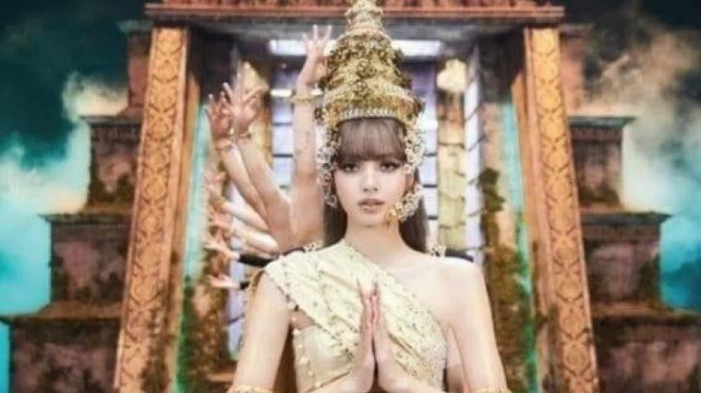
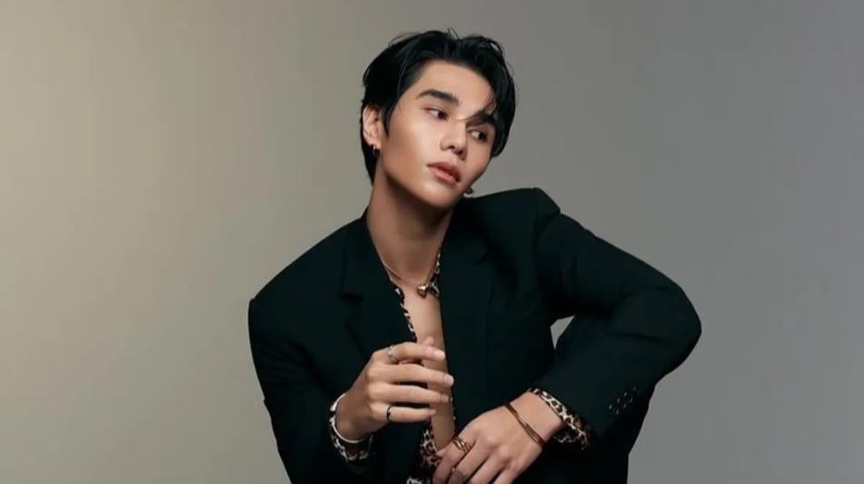
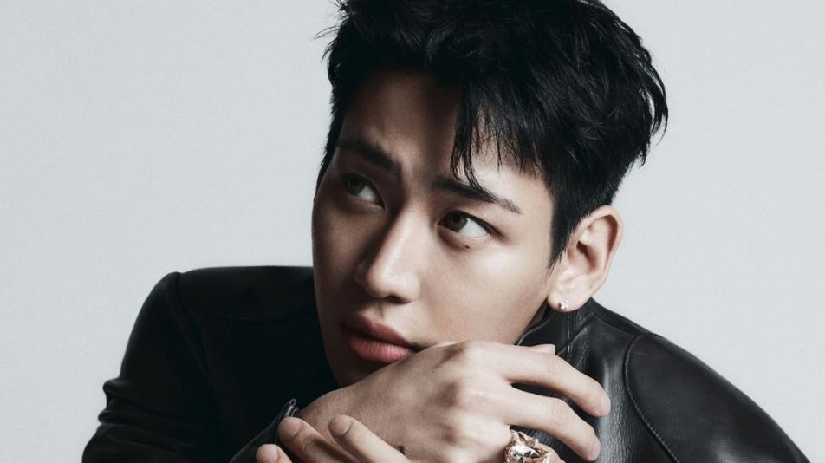

Thai Icons: A Global Presence in Entertainment, Music, and Fashion
Photo Credit: Thaipost, Wattpad, billboardphilippines, Bangkok Music City
Notes:
1

Slide 5
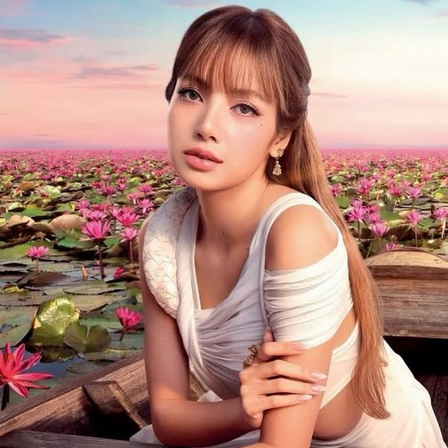
Thai Singers & Musicians: A Global Presence in Music and Fashion
LISA (Lalisa Manobal)
  Global Influence: A dominant cultural icon bridging music, Hollywood, and sports, highlighted by performing at the 2026 FIFA World Cup opening ceremony and starring in HBO's The White Lotus Season 3.
  Achievements: As the first solo K-pop artist to hit 1 billion Spotify streams, she has evolved into a global powerhouse, serving on the 2026 Met Gala Host Committee, expanding her elite portfolio (Louis Vuitton, Bulgari, Nike), and launching a co-designed collection with Kith.
Photo credit: Amazing Thailand

Slide 6

Thai Singers & Musicians: A Global Presence in Music and Fashion
MILLI (Danupha Khanatheeraku)
  Global Influence: A trailblazing Gen Z icon and global festival headliner who seamlessly bridges Thai hip-hop culture with international music and fashion.
  Achievements: Making history as the first Thai musical artist appointed as an Official Goodwill Ambassador to South Korea in 2026, she continues to command major brand partnerships, leveraging her immense viral appeal to unite the global music and fashion industries.
Photo credit: Matichon

Slide 7
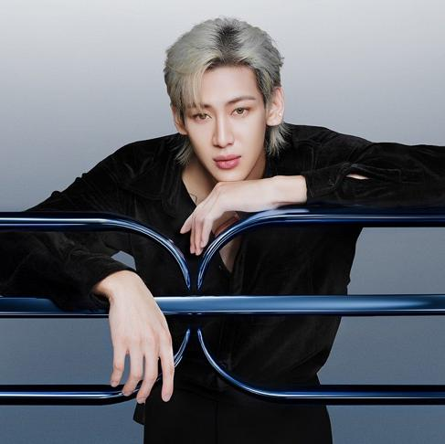
Thai Singers & Musicians: A Global Presence in Music and Fashion
BAMBAM (Kanpimuk Phuwakul)
  Global Influence: A K-Pop/Solo powerhouse who sold out stadiums worldwide on his AREA 52 tour and made history as the first Thai artist to perform at an NBA Halftime Show.
  Achievements: Appointed as a Louis Vuitton Global Brand Ambassador, driving millions in media value at Paris Fashion Week with his iconic, gender-fluid style.
Photo credit: Forbes Thailand

Slide 8
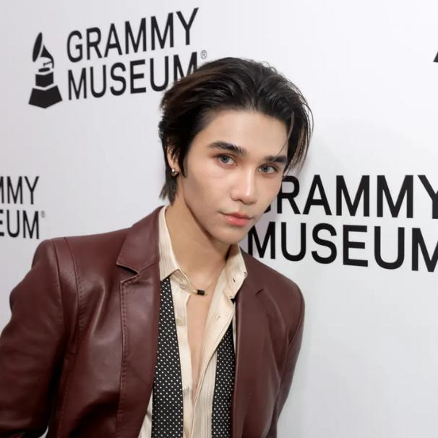
Thai Singers & Musicians: A Global Presence in Music and Fashion
JEFF SATUR (Worakamol Satur)
  Global Influence: A multi-talented actor and singer driving the international T-Wave through global concert tours and breakout roles in hit series.
  Achievements: Recognized as a "People of the Year" honoree in 2026, the award-winning singer-songwriter and producer boasts over 360 million streams, multiple "Solo Artist of the Year" titles, and serves as a premium global ambassador for luxury houses like Cartier and Valentino.
Photo credit: Forbes

Slide 9
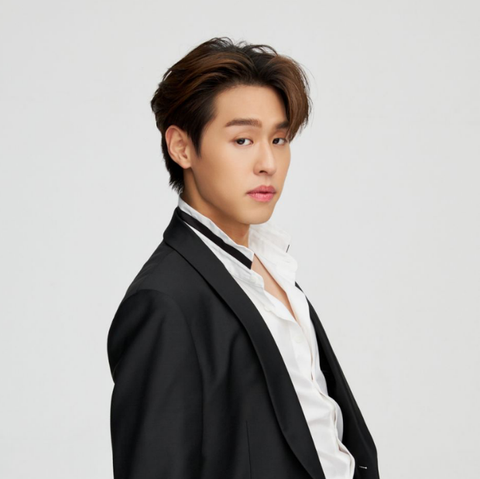
Thai Singers & Musicians: A Global Presence in Music and Fashion
BILLKIN (Putthipong Assaratanakul)
  Global Influence: A generational powerhouse who captivated global audiences as the lead of the cinematic phenomenon How to Make Millions Before Grandma Dies, bridging international cinema with his acclaimed pop music career.
  Achievements: Driving record-breaking box office success across Asia and Western markets, he dominates the commercial industry as an elite brand ambassador and international fashion week fixture.
Photo credit: Tatler Asia

Slide 10
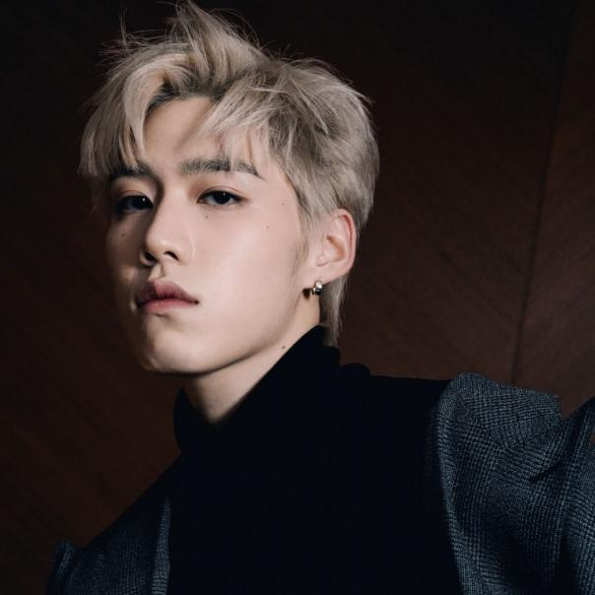
Thai Singers & Musicians: A Global Presence in Music and Fashion
PP (Krit Amnuaydechkorn)
  Global Influence: A commanding force in global fashion and entertainment driving the T-Pop movement, he captures immense international media attention, commanding millions in earned media value at events like Paris Fashion Week.
  Achievements: Making history as Balenciaga's first Asian brand ambassador, he officially joined Cartier as a brand ambassador in early 2026, while solidifying his elite presence by winning major honors at the 2026 Weibo International Entertainment Awards.
Photo credit: Tatler Asia

Slide 11
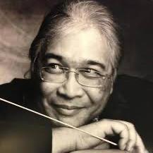
Thai Musicians: A Global Presence in Music
S. P. Somtow (Somtow Sucharitkul)
  Cultural Ambassador: A renowned composer and conductor, blending Thai cultural themes with Western classical music.
  Global Influence: His works have been performed by major orchestras worldwide, and he has been instrumental in promoting Thai music on the global classical stage.
  Awards: Honored as a Thai National Artist (2023) and recipient of Thailand’s Public Diplomacy Award (2024) for promoting Thai culture through Western contemporary music.
Photo credit: Opera Siam

Slide 12
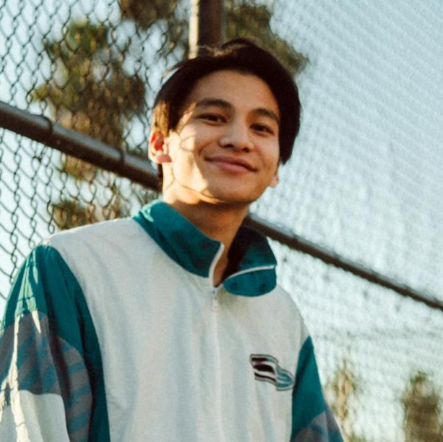
Thai Musicians: A Global Presence in Music
Phum Viphurit
  Global Influence: A pioneer of the global indie-pop scene who put Thai alternative music on the world map, captivating international audiences through viral hits and extensive world tours.
  Achievements: The first Thai indie artist to achieve massive global streaming success, leading international festival lineups and collaborating with top-tier global musicians and lifestyle brands.
Photo credit: Rolling Stone

Slide 13
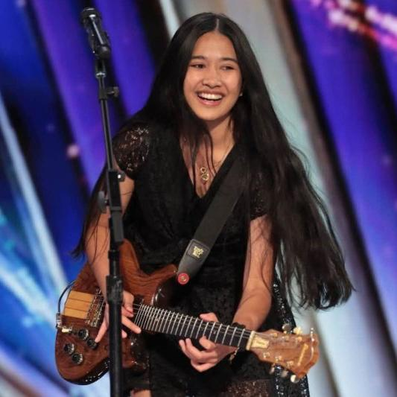
Thai Singers & Musicians: A Global Presence in Music
Nene Royal (Rattikarn Amloy)
  Global Influence: A 16-year-old rock prodigy from Phuket who became a global sensation on America's Got Talent Season 21. Her jaw-dropping rendition of "Zombie" featuring an advanced two-hand guitar tapping technique made history on July 12, 2026, amassing over 129 million views on AGT's official TikTok.
  Achievements: A powerhouse 16-year-old rock artist who transformed from a Phuket street busker into a globally recognized musical icon, breaking international social media viewing records overnight while earning official recognition from national leaders as a prominent cultural ambassador.
Photo credit: Bangkok Post

Slide 14
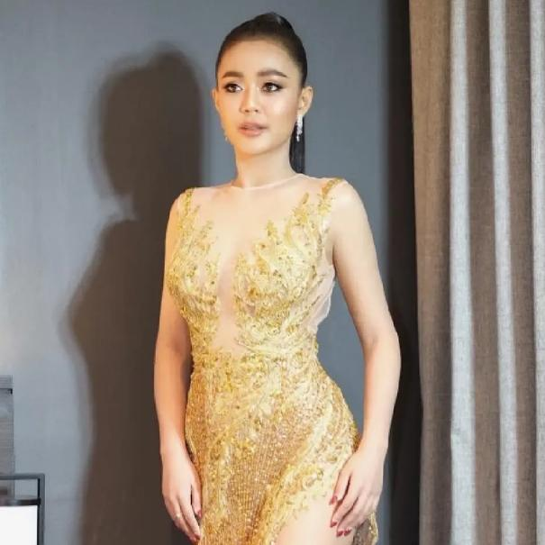
Thai Singers & Musicians: A Global Presence in Music
Lumyai Haitongkum
(Supansa Wedkama)
  Folk Music Icon: A leading figure in the Mor Lam (traditional Thai folk) genre, Supansa is known for her energetic performances.
  Global Stage: Has performed in various international festivals, bringing Thai folk music to a broader audience.
Photo credit: BangkokbizNews

Slide 15
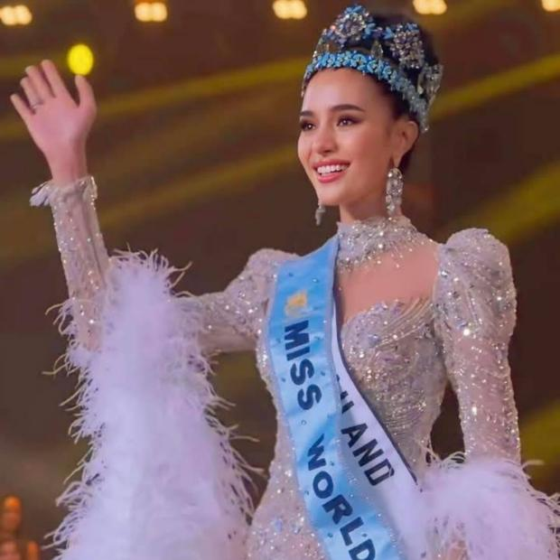
Global Beauty Icons: A Presence in Pageantry, Philanthropy, and Fashion
OPAL (Suchata Chuangsri)
  Global Influence: A phenomenal Global beauty queen and empowering global icon who captivated millions on the Miss Universe stage, commanding a massive international fanbase through her historic placement, unmatched eloquence, and profound advocacy for breast cancer awareness and women's health.
  Achievements: High-engagement social media titan and highly sought-after global ambassador who consistently generates immense Earned Media Value (EMV), effortlessly bridging the worlds of high-fashion luxury, philanthropic leadership, and elite beauty brands.
Photo credit: thairath

Slide 16

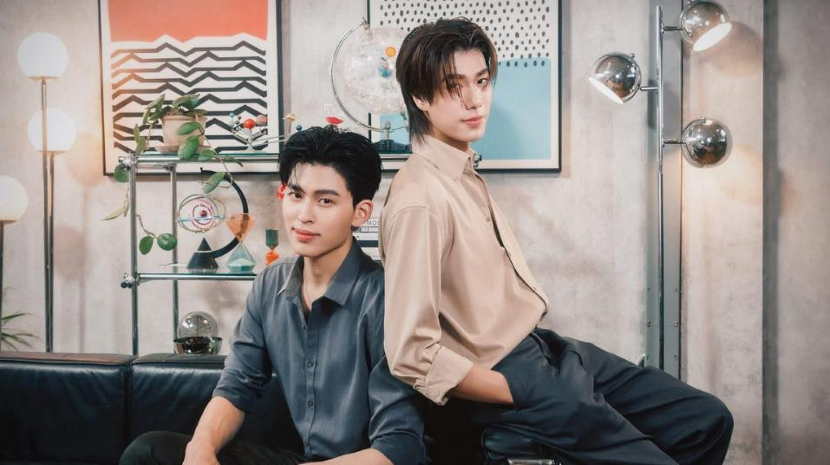
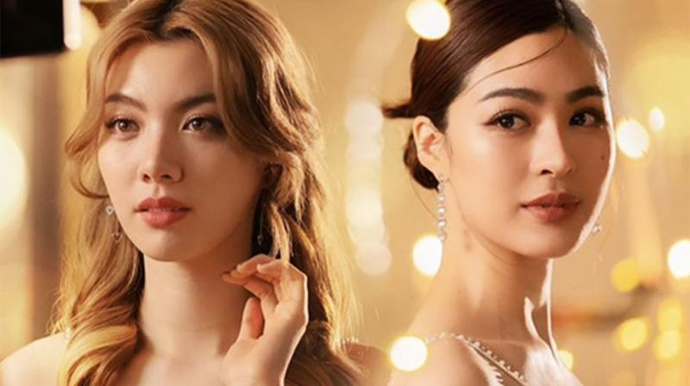
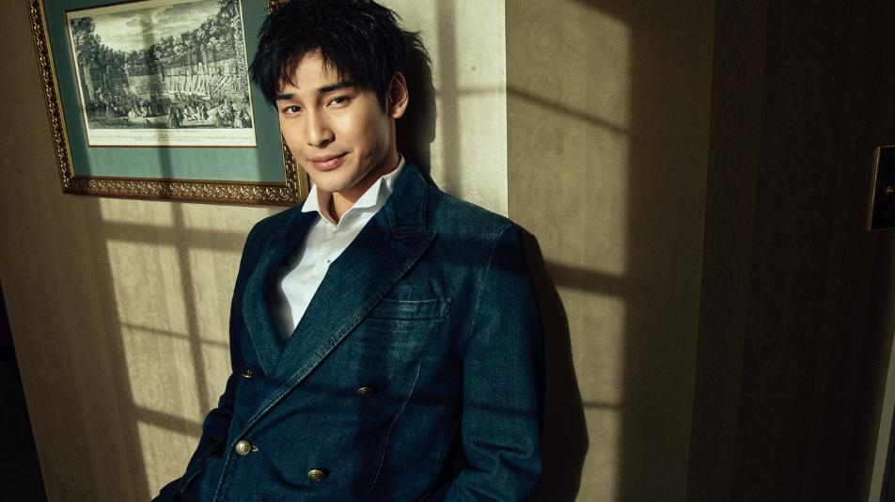
Thai Actors and Actresses: Stars of the Screen
Photo Credit: StarENews, GMMTV Official, Bangkok Post, Mint Magazine Thailand
Notes:
1

Slide 17
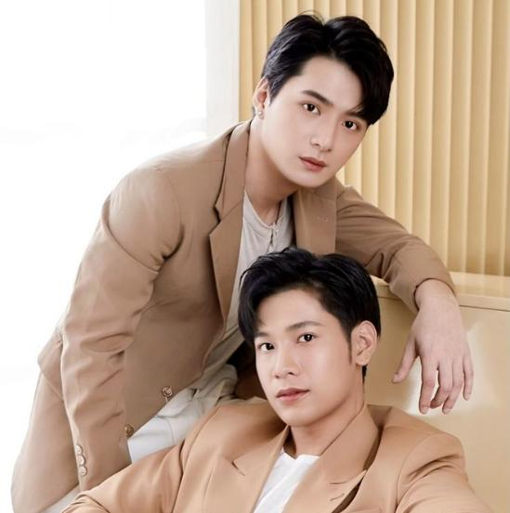
Thailand's Boys' Love (BL) Actors: Stars of the Screen
KrisSingto
(Krist Perawat Sangpotirat and Singto Prachaya Ruangroj)
  Global Influence: A legendary GMMTV Boys' Love (BL) duo and the ultimate pioneers of the global T-Wave movement, ignite-starting a historic craze across multiple countries and commanding a massive, deeply devoted international fanbase through their iconic, genre-defining hits and continuous sold-out worldwide fan meetings and tours.
  Achievements: High-engagement social media titans who consistently generate immense Earned Media Value (EMV), serving as highly coveted ambassadors and front-row fixtures for elite global fashion and beauty brands.
Photo credit: Pinterest

Slide 18
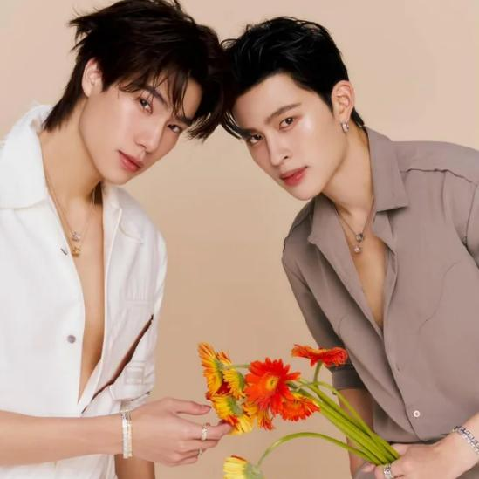
Thailand's Boys' Love (BL) Actors: Stars of the Screen
PondPhuwin
(Pond Naravit Lertratkosum and Phuwin Tangsakyuen)
  Global Influence: A power GMMTV Boys' Love (BL) duo of the global T-Wave movement, commanding a massive, intensely dedicated international fanbase; their latest hit series, Peach and Me, spectacularly topped global streaming charts across hundreds of countries alongside their three-consecutive-day sold-out arena tours.
  Achievements: High-engagement social media titans who consistently generate immense Earned Media Value (EMV), serving as highly coveted ambassadors and front-row fixtures for elite global fashion and beauty brands.
Photo credit: Reddit

Slide 19
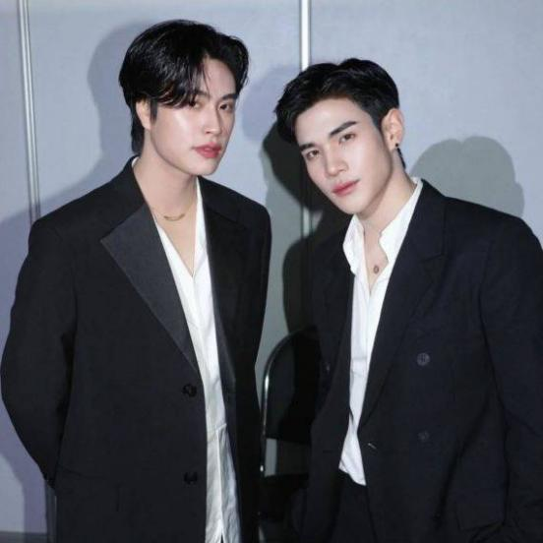
Thailand's Boys' Love (BL) Actors: Stars of the Screen
GeminiFourth
(Gemini Norawit Titicharoenrak and Fourth Nattawat Jirochtikul)
  Global Influence: A power Thailand's Boys' Love (BL) duo of the global T-Wave movement from GMMTV Co., Ltd. , commanding a massive international fanbase; their latest hit series, Ticket to Heaven, spectacularly topped global streaming charts across hundreds of countries alongside their sold-out worldwide arena tours.
  Achievements: High-engagement social media titans who consistently generate immense Earned Media Value (EMV), serving as highly coveted ambassadors and front-row fixtures for elite global fashion and beauty brands.
Photo credit: GMMTV

Slide 20
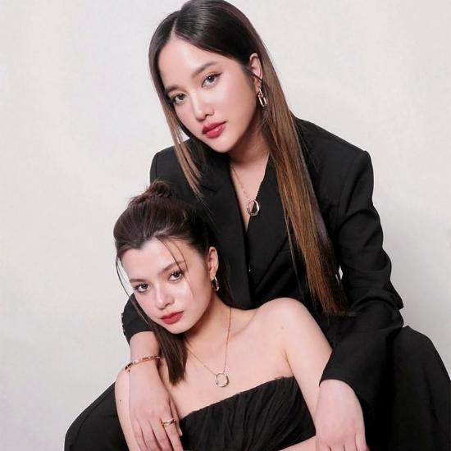
Thailand's Girls' Love (GL) Actresses: Stars of the Screen
FreenBecky
(Freen Sarocha Chankimha and Becky Rebecca Armstrong)
  Global Influence: A power duo from Idol Factory Co., Ltd. and major catalysts of the global Thailand's Girls' Love (GL) phenomenon, commanding an unmatched international fanbase across Asia, Europe, and the Americas through hit acting roles, music, and sold-out worldwide stadium tours..
  Achievements: Highly sought-after global brand ambassadors who frequently dominate international fashion weeks, leveraging their massive social media engagement to bridge luxury fashion with Gen Z culture.
Photo credit: Thairath Online

Slide 21
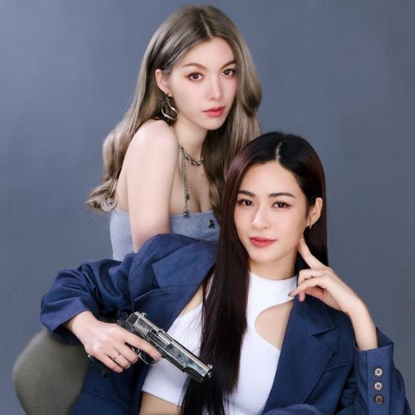
Thailand's Girls' Love (GL) Actresses: Stars of the Screen
LinglingOrm
(Lingling Sirilak Kwong and Orm Kornnaphat Sethratanapong)
  Global Influence: A power duo and major catalysts of the global GL phenomenon from Channel 3 HD, commanding a massive international fanbase across Asia, Europe, and the Americas through hit series and sold-out worldwide tours.
  Achievements: Highly sought-after brand ambassadors who dominate social media trends and fashion spaces, effortlessly bridging luxury brands with Gen Z culture while sweeping major entertainment awards.
Photo credit: Sanook

Slide 22
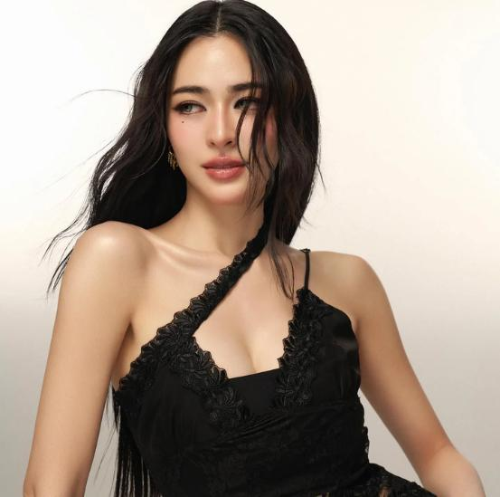
Thai Actresses : Stars of the Screen
Lingling Sirilak Kwong
  Global Influence: A breakthrough powerhouse in the global Girls' Love (GL) landscape who skyrocketed to international fame via The Secret of Us and Only You, commanding immense social media dominance across China and Southeast Asia and winning the global title of Most Beautiful Woman Alive 2026 by Netizens Choice Magazine.
  Achievements: A multi-award-winning Thai actress recognized across premier regional stages (Maya TV, Howe, Weibo), serving as a high-conversion commercial muse and top-tier brand ambassador across major beauty, lifestyle, and luxury fashion campaigns.
Photo credit: prestigeonline

Slide 23
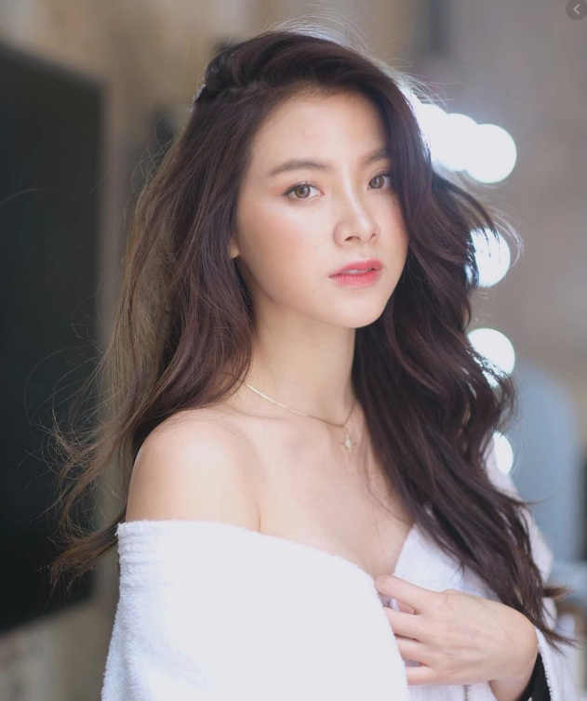
Thai Actresses : Stars of the Screen
BAIFERN (Pimchanok Luevisadpaibul)
  Global Influence: A timeless powerhouse of Asian cinema who achieved legendary status through First Love (A Little Thing Called Love), consistently captivating massive international audiences across China and Southeast Asia with her versatile acting roles.
  Achievements: A prominent multi-award-winning actress who dominates the commercial market, serving as a highly coveted global brand ambassador for luxury fashion house Loewe and elite international beauty brands.
Photo credit: Naver Blog

Slide 24
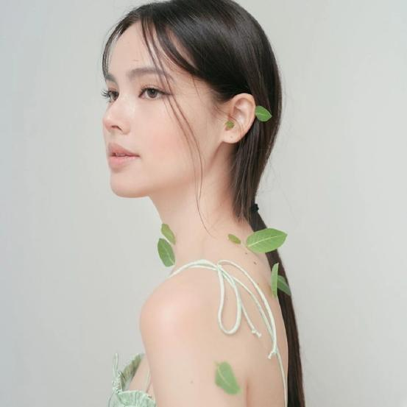
Thai Actresses : Stars of the Screen
YAYA (Urassaya Sperbund)
  Global Influence: A premier Thai-Norwegian icon celebrated for hit dramas like The Crown Princess, bridging Southeast Asian entertainment with global cinema and high-profile charity advocacy in 2026.
  Achievements: A longtime Louis Vuitton global ambassador who continues to anchor international fashion campaigns in 2026, leveraging her status as one of Asia's top models and commercial powerhouses.
Photo credit: Post Today

Slide 25
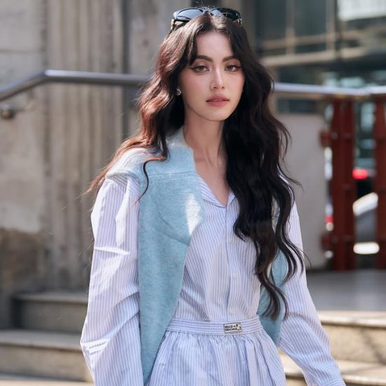
Thai Actresses : Stars of the Screen
MAI (Davika Hoorne)
  Global Influence: A timeless superstar of Asian cinema celebrated for the historic blockbuster Pee Mak, bridging Thai entertainment with global cinema and cross-border music projects in 2026.
  Achievements: She has become a model for international fashion brands and has expanded her reach to global audiences.
Photo credit:Tatler Asia

Slide 26
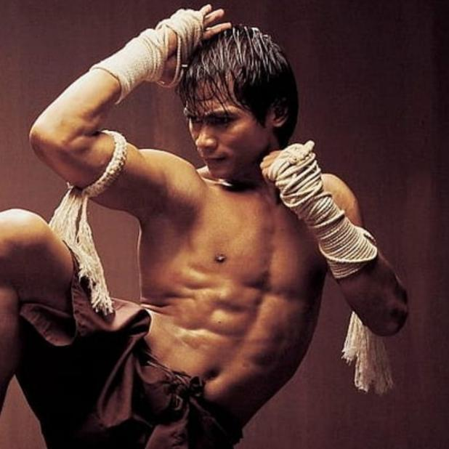
Thai Actors : Stars of the Screen
TONY JAA (Tatchakorn Yeerum)
  Global Influence: Known worldwide for his roles in Ong-Bak and Tom-Yum-Goong, Tony Jaa revolutionized action cinema with his groundbreaking martial arts stunts.
  Achievements: Revolutionized global action cinema with Ong-Bak, continuing his Hollywood dominance in 2026 as a premier icon alongside franchises like Fast and Furious 7.
Photo credit: Whistlekick Martian Art Radio

Slide 27
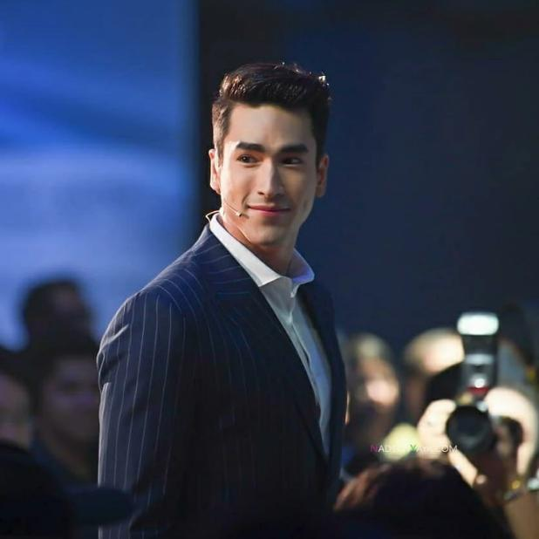
Thai Actors : Stars of the Screen
NADECH (Nadech Kugimiya)
  Global Influence: A top-tier Asian heartthrob celebrated for The Crown Princess and the global box-office horror franchise Tee Yod (Death Whisperer), expanding his international appeal in 2026.
  Achievements: One of Thailand's most decorated, multi-award-winning actors who continues to dominate 2026 as a premier commercial king and highly sought-after brand ambassador across Southeast Asia.
Photo credit: lakorn-thai-world.fandom

Slide 28
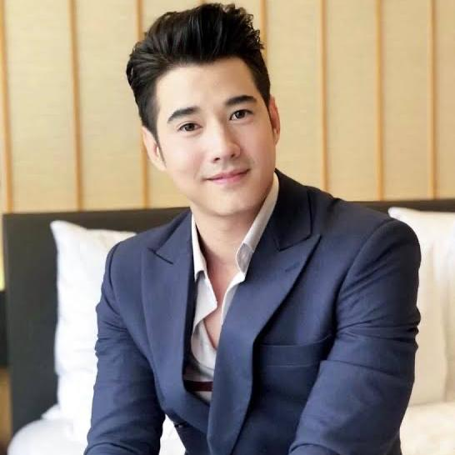
Thai Actors : Stars of the Screen
MARIO (Mario Maurer)
  Global Influence: A timeless pioneer of Asian cinema celebrated for Love of Siam and the historic blockbuster Pee Mak, maintaining a massive international fanbase in 2026.
  Achievements: An acclaimed, multi-award-winning actor with highly successful cross-border film collaborations, he continues to dominate 2026 as a premier commercial icon and long-standing ambassador for top-tier international fashion and lifestyle brands.
Photo credit: aFamily

Slide 29
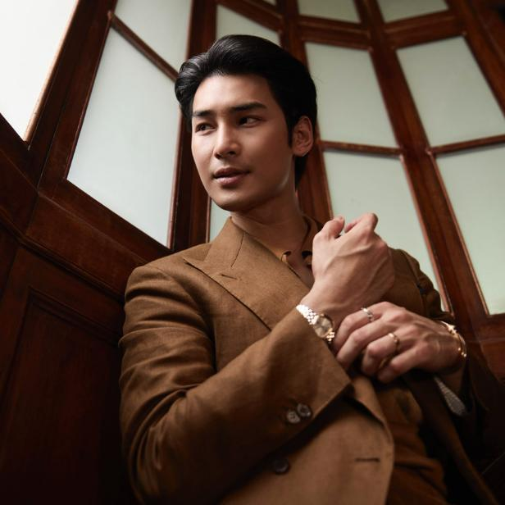
Thai Actors : Stars of the Screen
APO (Nattawin Wattanagitiphat)
  Global Influence: Well-known BL actor who transitioned into an international cinematic icon, captivating massive worldwide audiences through hit projects like KinnPorsche and acclaimed feature films.
  Achievements: Ranked among the top global influencers driving record-breaking media value at international fashion weeks, he serves as a prestigious global ambassador for Dior and high-end jewelry house Piaget.
Photo credit: lofficielthailand

Slide 30
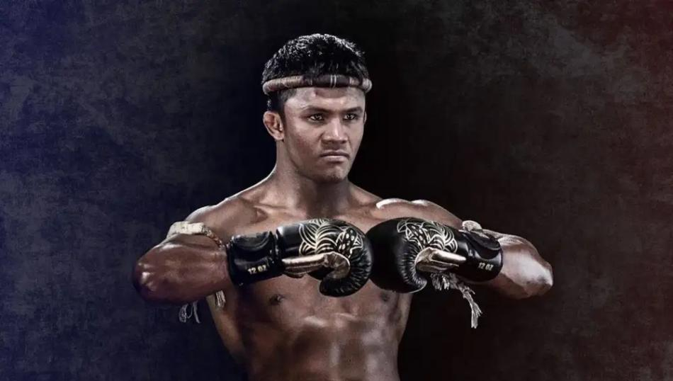
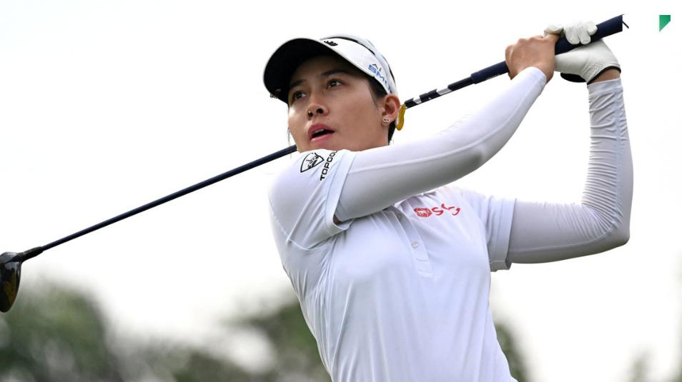
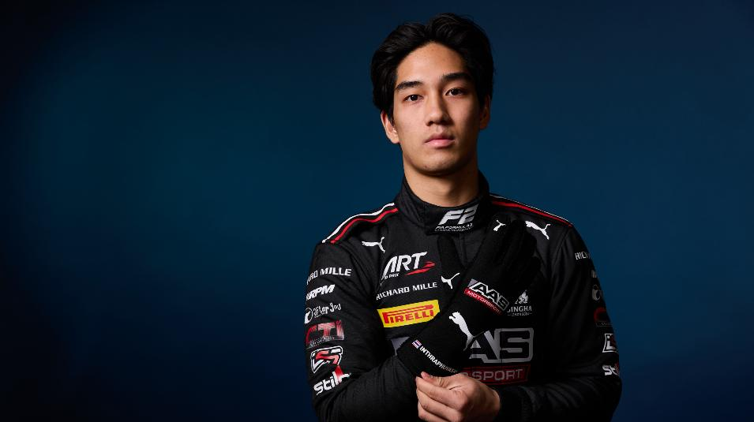
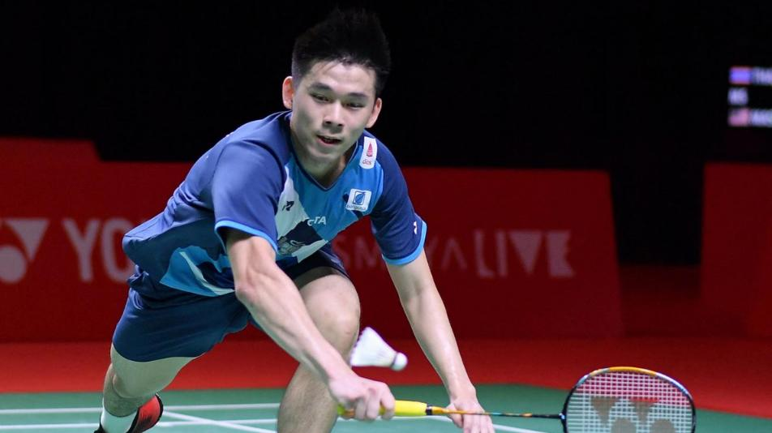
Thai Athletes:
Redefining Excellence in Sports
Photo Credit: ryt9, Matichon, Formula 2, Bangkok Post
Notes:
1

Slide 31
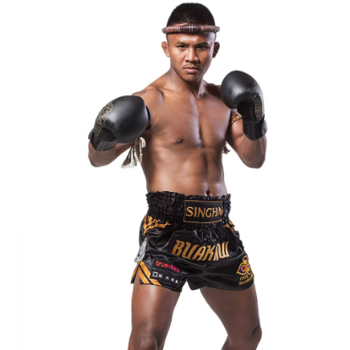
Thai Athletes: Redefining Excellence in Sports
Buakaw Banchamek
  Muay Thai Legend: A multiple-time world champion, Buakaw is credited with popularizing Muay Thai globally, earning recognition in major international events.
Photo credit: Bangkok Post

Slide 32
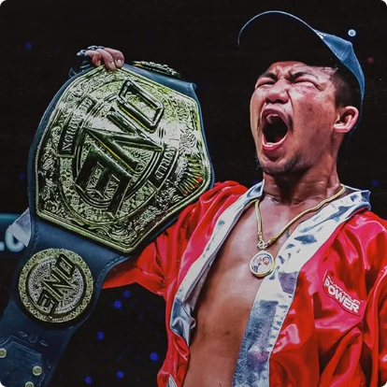
Thai Athletes: Redefining Excellence in Sports
Rodtang Jitmuangnon
  Muay Thai Champion: A dominant force in ONE Championship, Rodtang is known for his relentless and aggressive fighting style.
Photo credit: Prime Video

Slide 33
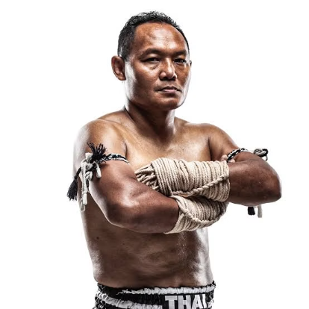
Thai Athletes: Redefining Excellence in Sports
Saenchai
  Muay Thai Icon: Renowned for his agility and creativity, Saenchai is a well-known champion at Lumpinee Boxing Stadium for defeating larger opponents several times and entertaining fans worldwide.
Photo credit: Thai Fight

Slide 34
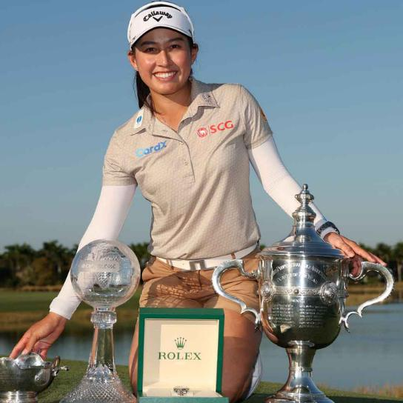
Thai Athletes: Redefining Excellence in Sports
JEENO (Atthaya Thitikul)
  Global Influence: A dominant sports icon driving the international golf scene, she captures massive global media attention and inspires Gen Z athletes worldwide through her electric performances on the LPGA Tour.
  Achievements: Making history at 14 as the youngest professional tournament winner and reaching World No. 1 at 19, she became the only pro to win two 2025 PGA championship titles, clinched the October 2025 Buick LPGA Shanghai, and continues her elite form in 2026.
Photo credit: LPGA

Slide 35
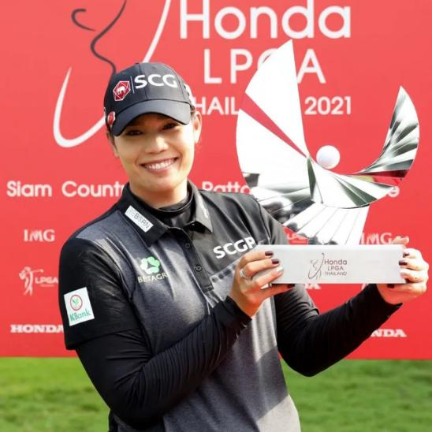
Thai Athletes: Redefining Excellence in Sports
MAY (Ariya Jutanugarn)
  Global Influence: A trailblazing sports icon who revolutionized Thai golf on the world stage, elevating Thailand's international presence in the ladies’ golf arena and inspiring countless athletes globally.
  Achievements: The first Thai golfer to win a major championship in 2016 and reach World No. 1, she boasts multiple LPGA Tour victories and was honored with Thailand’s Public Diplomacy Award 2023 for her continuous global contributions.
Photo credit: Prestige Online

Slide 36
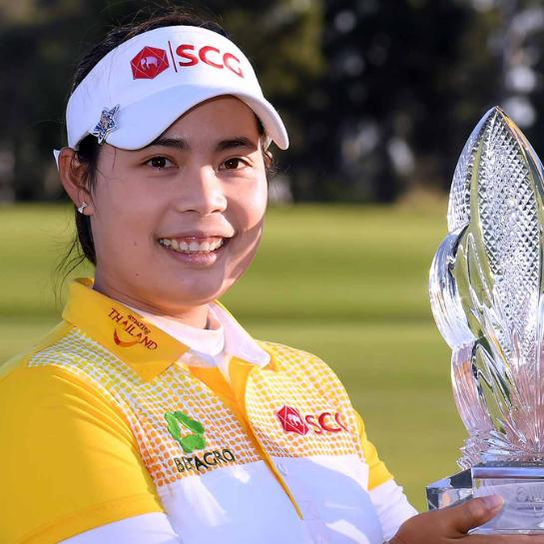
Thai Athletes: Redefining Excellence in Sports
MO (Moriya Jutanugarn)
  Global Influence: A pioneering sports icon who paved the way for Thai athletes on the world stage, inspiring new generations of professional golfers globally to pursue their dreams and become champions.
  Achievements: The 2013 LPGA Rookie of the Year and recipient of Thailand's Public Diplomacy Award 2023, she cemented a powerful family legacy by winning a historic LPGA team event alongside her sister Ariya.
Photo credit: LPGA

Slide 37
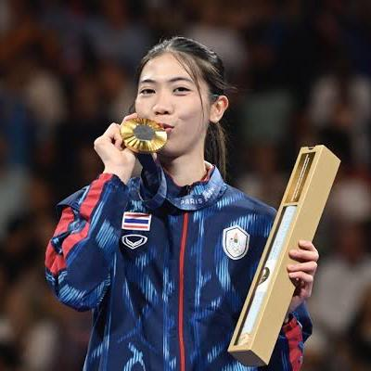
Thai Athletes: Redefining Excellence in Sports
TENNIS (Panipak Wongpattanakit)
Olympic Champion: Gold medalist in Taekwondo at the Tokyo 2020 Olympics and the Paris 2024 Olympics, Panipak is one of Thailand's most celebrated athletes.
Photo credit: The Standard

Slide 38
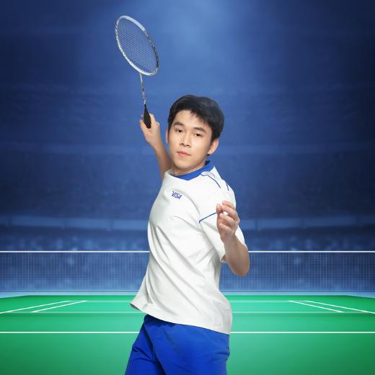
Thai Athletes: Redefining Excellence in Sports
VIEW (Kunlavut Vitidsarn)
Badminton World Champion: A history-making athlete who captured the 2023 Men's Singles World Championship title and won a historic silver medal at the Paris 2024 Olympics, inspiring a new generation with his exceptional defensive skill and elite sportsmanship.
Photo credit: ThaiPR

Slide 39
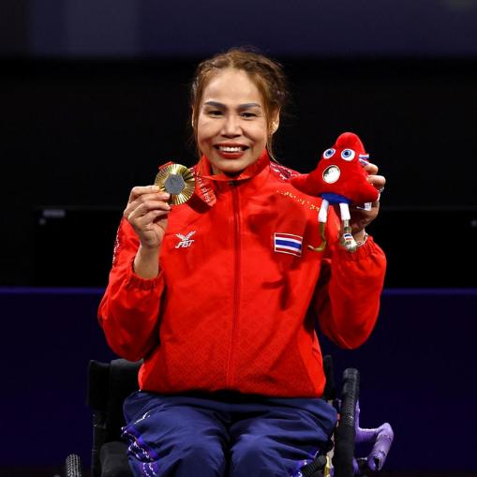
Thai Athletes: Redefining Excellence in Sports
WAEW (Saysunee Jana)
Paralympic Hero: A multiple-time medalist (since Athens 2004) in fencing, Saisunee continues to inspire many with her determination, overcoming physical challenges to compete at the highest levels of sport.
Photo credit: ThaiPR

Slide 40
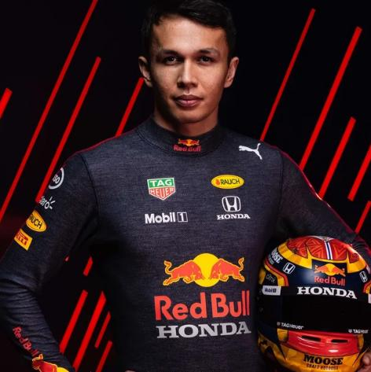
Thai Athletes: Redefining Excellence in Sports
Alex Albon
Formula 1 Trailblazer: Debuting in 2019 and racing for Williams Racing since 2022, the Thai-British driver solidified his long-term future with a
multi-year contract extension, continuing to wave the Thai flag on the global motorsport stage throughout the 2026 season.
  Made his F1 debut with Toro Rosso in 2019
  Signed multi-year extension with Williams in 2024
Photo credit: British GQ

Slide 41
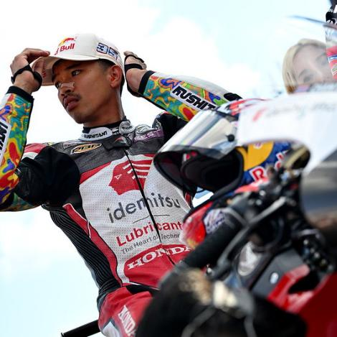
Thai Athletes: Redefining Excellence in Sports
Somkiat Chantra
MotoGP History-Maker: The first Thai rider to win a Moto2 Grand Prix with historic victories in Indonesia and Japan, he elevated his career by debuting in the premier MotoGP class with Honda LCR, competing at the highest level of world motorcycle racing through the 2026 season.
  Historic victories in Indonesia (2022) and Japan (2023)
  Set to debut in MotoGP with Honda LCR in 2025
  Competing in the 2026 Superbike World Championship (WorldSBK) as a factory rider for the Honda HRC team
Photo credit: paddock-gp

Slide 42
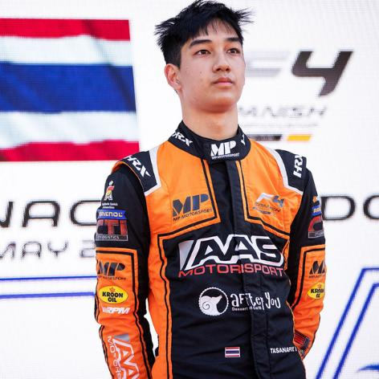
Thai Athletes: Redefining Excellence in Sports
Tasanapol Inthraphuvasak
Formula 2 Rising Star: Graduating to the FIA Formula 2 Championship with ART Grand Prix for his rookie season, the young Thai prospect made waves by securing a strong double-points finish at the 2026 season opener in Melbourne, continuing his steady and promising ascent toward Formula 1.
  First Thai driver to secure multiple victories in the FIA Formula 3 Championship.
  Promoted to the prestigious FIA Formula 2 Championship with ART Grand Prix for 2026.
  Secured a historic double-points finish at the 2026 season opener in Melbourne.
Photo credit: F1

Slide 43
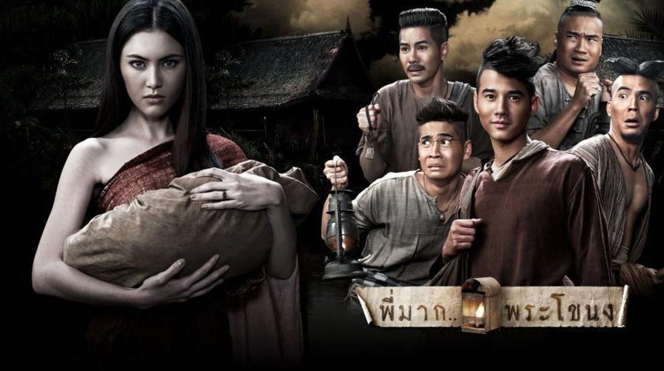
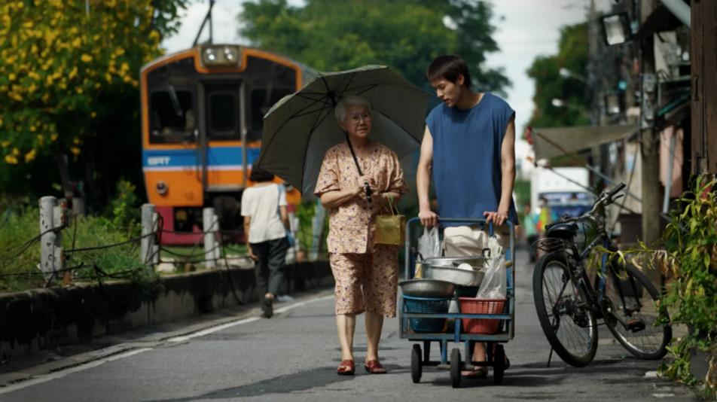


Thai movies and Dramas
You Shouldn't Miss
Photo Credit: parapuan, Lifestyle Asia Hong Kong, Major Cineplex, mgr online
Notes:
1

Slide 44


More Thai Films Making Waves on the Global Stage
Uncle Boonmee Who Can Recall His Past Lives
Directed by Apichatpong Weerasethakul, this Cannes Palme d'Or winner explores spiritual themes and Thai culture, earning global critical acclaim.
  Main Actor: Thanapat Saisaymar
Photo credit: IMDB

Slide 45


More Thai Films Making Waves on the Global Stage
Pee Mak
A horror-comedy based on the Mae Nak legend, Pee Mak became one of the most successful Thai films of all time, blending humor with the supernatural.
  Main Actors: Mario Maurer, Davika Hoorne
Photo credit: IMDB

Slide 46


More Thai Films Making Waves on the Global Stage
How To Make Millions Before Grandma Dies
A heartfelt family drama, following a grandson who becomes the unlikely caregiver of his terminally ill grandmother, only to uncover the true meaning of family amidst hidden motives and painful truths.
  Main Actors: Billkin, Usha Seamkhum
Photo credit: IMDB

Slide 47


Thai Films That Shaped the Industry
Love Destiny: The Movie
A massive hit Thai period romantic-comedy that reunites the beloved onscreen couple in a reborn destiny, following two star-crossed lovers in the early Bangkok era who must overcome historical chaos and rivals to find their way back to each other.
  Main Actors: Thanavat Vatthanaputi, Ranee Campen.
Photo credit: IMDB

Slide 48

Thai Films That Shaped the Industry
Ong Bak
An action-packed martial arts film that showcased the talents of Tony Jaa and brought Muay Thai to international audiences.
  Main Actor: Tony Jaa
Photo credit: IMDB

Slide 49

Thai Films That Shaped the Industry
Bad Genius
A thriller about a high school student running an exam-cheating business, Bad Genius was praised for its smart social commentary and gripping plot.
  Main Actors: Chutimon Chuengcharoensukying, Teeradon Supapunpinyo.
Photo credit: IMDB

Slide 50

Thai Horror Films That Shaped the Industry
Shutter
A classic Thai horror film about a photographer haunted by a ghostly presence, regarded as one of the scariest Asian horror films.
  Main Actors: Ananda Everingham, Natthaweeranuch Thongmee.
Photo credit: IMDB

Slide 51

Thai Horror Films That Shaped the Industry
Death Whisperer (Tee Yod)
A gripping Thai horror-thriller set in a remote village, based on a terrifying true story. The plot follows a family targeted by a bloodthirsty demonic spirit that possesses the middle daughter, causing her to fall mysteriously ill while horrifying, rhythmic chants of "Tee Yod" echo through the night.
  Main Actors: Nadech Kugimiya, Denise Jelilcha Kapaun, Rattanawadee Wongthong
Photo credit: IMDB

Slide 52

Thai Horror Films That Shaped the Industry
The Undertaker
A cultural phenomenon and box-office record breaker, this horror-comedy-drama follows a young law graduate who unexpectedly becomes an apprentice to an undertaker, exploring the deep-rooted Isan beliefs regarding life, death, and the grief of those left behind.
  Main Actors: Chatchai Chinasi, Sahaphap Srisomkit.
Photo credit: IMDB

Slide 53


Thailand Leading the Way in BL Series
  A category of TV dramas, films, and online series that focus on romantic relationships between male characters
SOTUS
A popular BL series about an engineering student who falls for his senior in a tough university environment.
  Main Actors: Singto Prachaya, Krist Perawat.
Photo credit: IMDB

Slide 54

Thailand Leading the Way in BL Series
  A category of TV dramas, films, and online series that focus on romantic relationships between male characters
2gether: The Series
A romance between two college students who fake a relationship that turns into genuine love.
  Main Actors: Bright Vachirawit, Win Metawin.
Photo credit: IMDB

Slide 55

Thailand Leading the Way in BL Series
  A category of TV dramas, films, and online series that focus on romantic relationships between male characters
KinnPorsche
A mafia-themed BL series with action and romance, appealing to both drama fans and action lovers.
  Main Actors: Mile Phakphum, Apo Nattawin
Photo credit: IMDB

Slide 56

Thailand Leading the Way in BL Series
  A category of TV dramas, films, and online series that focus on romantic relationships between male characters
Me and Thee
A romantic comedy BL series about an eccentric, drama-obsessed ex-mafia heir who hires a calm freelance photographer to be his love coach, only to unexpectedly fall for the coach himself.
  Main Actors: Naravit Lertratkosum and Phuwin Tangsakyuen
Photo credit: GMMTV

Slide 57

GL Dramas: Expanding Representation in Thai Media
  A category of TV dramas, films, and online series that focus on romantic relationships between female characters
The Secret of Us
A slow-burn office romance that explores power, class, and hidden feelings as a young woman lands a job under the strong, distant boss she’s secretly admired since childhood.
  Main Actors: Freen Sarocha and Becky Armstrong.
Photo credit: Mydramalist

Slide 58

GL Dramas: Expanding Representation in Thai Media
  A category of TV dramas, films, and online series that focus on romantic relationships between female characters
The Secret of Us
A heartfelt romantic drama that follows a guarded doctor whose world is upended when her free-spirited ex-girlfriend reenters her life, forcing her to confront old wounds and the love she tried to forget.
  Main Actors: Lingling Kwong and Aom Kornnaphat
Photo credit: Mydramalist

Slide 59

GL Dramas: Expanding Representation in Thai Media
  A category of TV dramas, films, and online series that focus on romantic relationships between female characters
23.5
A charming coming-of-age romance about a shy high school girl who hides behind a fake online identity to get closer to her cheerful classmate, leading to a tangled web of secrets, friendship, and first love.
  Main Actors: Pansa Vosbien, Pattranite Limpatiyakorn
Photo credit: Mydramalist

Slide 60

GL Dramas: Expanding Representation in Thai Media
  A category of TV dramas, films, and online series that focus on romantic relationships between female characters
Enemies With Benefits
A captivating workplace Girls' Love (GL) romance that follows the tense yet passionate dynamic between two office rivals. What begins as a fierce professional rivalry transforms into a secret arrangement of "friends with benefits," leading to a tangled journey where corporate competition collides with hidden affections on and off the clock.
  Main Actors: Ployshompoo Supasap, Jingjing Yu
Photo credit: Mydramalist

Slide 61




Thailand's Other Famous Personalities
Photo Credit: sank, GMMTV, moneyandbanking, The Guardian
Notes:
1

Slide 62



Other Famous Personalities
ALEX FACE
Patcharapon Tangruen creates thought-provoking street art featuring his signature character.
  His three-eyed child in a bunny suit adorns walls across Thailand and beyond.
Photo credit: sanook, verticalgallery

Slide 63


Other Famous Personalities
MOO DENG
This pygmy hippopotamus calf became an overnight internet sensation in 2024.
  Her playful antics at Khao Kheow Open Zoo draw visitors from across the globe.
Photo credit: sanook, The Guardian

Slide 64



Other Famous Personalities
AVA
This rare golden tigress captivates visitors at Chiang Mai Night Safari.
  Her unique coat and charismatic personality have earned her viral fame.
Photo credit: Thai PBS World, lifestyleasia

Slide 65



Other Famous Personalities among Thai Mascots
BAR B GON
  Bar B Gon (Nong Gon) rose to fame as the iconic, lovable green dragon mascot of Bar B Q Plaza, transforming a restaurant chain's marketing symbol into a beloved cultural pop-culture figure in Thailand.
  Beyond greeting diners at the front of every branch, he has starred in numerous heartwarming and witty advertising campaigns that deeply resonated with Thai audiences, elevating him from a mere corporate mascot to a symbol of family warmth and joy.
Photo credit: The Standard, mgronline

Slide 66



Other Famous Personalities among Thai Mascots
NONG OONJAI (AIS)
An iconic corporate mascot representing AIS (Advanced Info Service), Thailand's leading telecom company. With its cute, round, and friendly appearance, Nong Oonjai has become a staple of Thai tech advertising, easily recognizable across the country for over a decade.
Photo credit: spacebar, AIS

Slide 67


Other Famous Personalities among Thai Mascots
BANANA KRUNGSRI
The iconic mascot of Krungsri, this cheerful and friendly yellow banana is well-known across Thailand. The character represents friendly financial services and is frequently seen at promotional events, parades, and in engaging digital campaigns.
Photo credit: ThaiPR, Krungsri

Slide 68


Other Famous Personalities among Thai Mascots
BUTTERBEAR
Butter Bear (Nong Noey) rose to fame through viral TikTok dance videos, transforming a local bakery into a cultural phenomenon. Beyond dancing to K-Pop hits, she officially debuted as a T-Pop artist with hit singles like "It’s Butterbear" and "Our Diary." Her massive popularity has driven phenomenal meet-and-greet events, leading to her first milestone solo concert in late 2024.
Photo credit: moneyandbanking, lifestyleasia

Slide 69


Other Famous Personalities among Thai Mascots
POLCASAN
Polcasan, the iconic whale-polar bear mascot representing GMMTV's popular BL duo Tay-New, has grown into a massive brand. The character features in major music videos, hosts global fan meetings, and boasts a successful merchandise line. Within GMMTV's interconnected mascot universe, Polcasan frequently shares the stage with other fandom icons like Permpoon (Pond-Phuwin) etc.
Photo credit: Naewna, GMMTV

Slide 70




Thailand's Culinary Icons
Photo Credit: thairath, Time Out, lofficielthailand, The Standard
Notes:
1

Slide 71

Thailand's Culinary Icons
PANG (Chumpol Jangprai)
Co-founder of R-Haan, a two-Michelin-starred restaurant showcasing authentic royal Thai cuisine.
  Appointed as the official global Ambassador of Thai Cuisine
  Long-standing legendary champion on Iron Chef Thailand
  Head chef for the historic APEC 2022 Gala Dinner
  Dedicated to 100% sustainable, locally sourced Thai ingredients
Photo credit: Time Out

Slide 72

Thailand's Culinary Icons
JAY FAI (Supinya Junsuta)
Street food legend who transformed humble roadside cooking into Michelin-starred cuisine.
  First Bangkok street vendor awarded a Michelin star
  Famous for her crab omelette
  Icon Award winner at Asia's 50 Best Restaurants
Photo credit: thairath

Slide 73

Thailand's Culinary Icons
TON (Thitid Tassanakajohn)
The culinary mastermind behind Le Du and Nusara, both ranked among the best restaurants in Asia.
  Renowned as a prominent judge on Top Chef Thailand and a regular culinary icon on television.
  Successfully earned Michelin stars, showcasing modern Thai cuisine with sophisticated Western techniques.
  Champions Thai flavors on the world stage, elevating local ingredients to fine-dining status.
Photo credit: lofficielthailand

Slide 74

Thailand's Culinary Icons
PAM (Pichaya Soontornyanakij)
A culinary trailblazer who transformed her family's historic shophouse into POTONG, Bangkok’s award-winning progressive Thai-Chinese fine dining destination.
  First Asian and Thai female chef awarded The World's Best Female Chef (2025)
  1 Michelin Star recipient and youngest female chef to win the Michelin Thailand Opening of the Year Award
  Asia’s Best Female Chef winner at Asia's 50 Best Restaurants (2024)
Photo credit: theworlds50best

Slide 75

Thailand's Culinary Icons
TAM (Chudaree Debhakam)
The brilliant Chef-Owner of Baan Tepa, a two-Michelin-starred restaurant in Bangkok known for modern Thai fine dining.
  Made history as the youngest and first-ever winner of Top Chef Thailand (Season 1).
  Renowned for elevating traditional Thai flavors into contemporary culinary art, making her one of the most influential figures in modern Thai cuisine.
Photo credit: Michelin Guide

Slide 76


Thai Brands with Global Impact
Maepranom (Est. 1959)
Lobo
  Founded by Pranom Daengsupha, this brand delivers authentic Thai chili pastes worldwide.
  Their traditional flavors maintain Thai culinary heritage with modern production standards.
  These ready-to-cook seasoning mixes bring authentic Thai flavors to kitchens worldwide.
  Lobo simplifies complex Thai recipes without compromising traditional taste profiles.
Photo credit: Sanook, Shopee

Slide 77


Thai Brands with Global Impact
ChaTraMue (Est. 1945)
Mitr Phol
  Thailand's iconic milk tea brand has expanded globally with signature cafés.
  Their distinctive red label tea leaves have become synonymous with Thai tea culture.
  Asia's sugar production leader with international operations.
  Innovator in renewable energy through ethanol and biomass solutions.
Photo credit: atlasobscura, mitrpholsugar

Slide 78


Thai Brands with Global Impact
Krating Daeng
Carabao
  Introduced in 1976 by Chaleo Yoovidhya, this non-carbonated energy drink inspired the global Red Bull brand.
  Launched in 2002 by rock star Aed Carabao and entrepreneur Sathien Setthasit.
  Named after the water buffalo, it sponsors the English football Carabao Cup.
Photo credit: tcp, carabaogreece
Notes:
18

Slide 79


Thai Brands with Global Impact
Mama Noodles
Poysian
  Beloved instant noodles introducing Thai flavors globally since 1972.
  Famous Tom Yum flavor serves as gateway to authentic Thai cuisine.
  Thailand's ultimate iconic inhaler brand, globally loved for its instant relief from congestion and fatigue using a refreshing blend of essential oils.
Photo credit: ThaibyNature, poysian
Notes:
18

Slide 80


Thai Brands with Global Impact
Jim Thompson
NaRaYa
  Transformed traditional Thai silk into global luxury since the 1950s.
  Now synonymous with premium textiles and elegant décor worldwide.
  Lifestyle brand established in 1989, known for handcrafted fabric bags.
  Affordable yet stylish accessories beloved by tourists and locals alike.
Photo credit: mgronline, Brandage
Notes:
18

Slide 81


Thai Brands with Global Impact
Panpuri
THANN (Est. 2002)
  Premium wellness brand blending Thai ingredients with modern luxury.
  Showcases Thailand's natural resources through high-end beauty products.
  This eco-friendly brand blends Asian botanicals with modern skincare science.
  THANN products showcase Thailand's rich botanical heritage through luxury wellness offerings.
Photo credit: PANPURI,
Notes:
18

