Slide 1
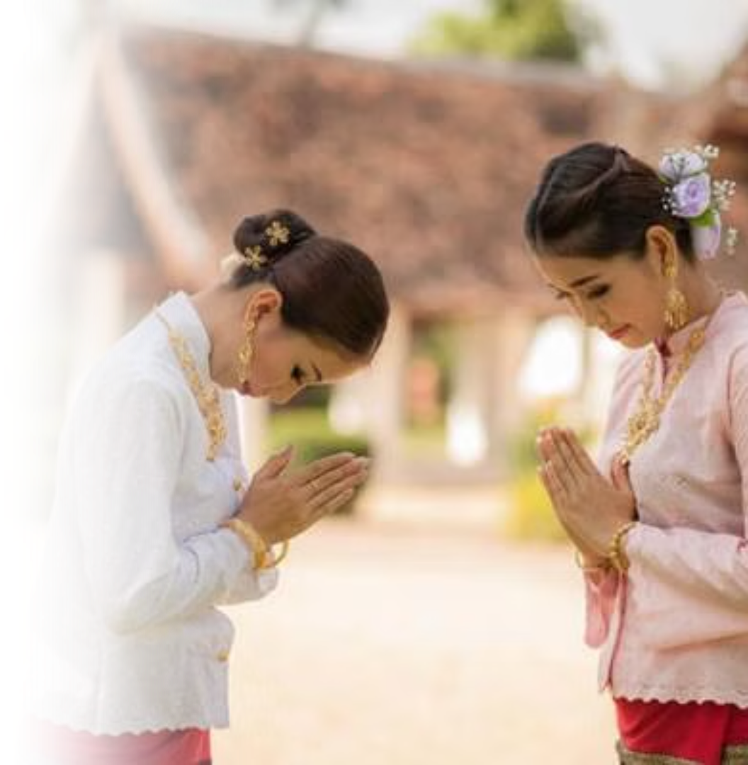
Thai Values: The Heart of Thainess
Photo credit: Thailand Elite Visas

Slide 2
Thailand in Brief
"Thailand in Brief " has been prepared by the Thailand Foundation to support students, scholars, and the general public who wish to give presentations about Thailand to their audiences—for example, exchange program students and international participants.
The work presents some basic information about Thailand in 11 areas: 1) Geography, 2) History, 3) Politics and Government, 4) Economics, 5) Demographics, 6) Culture, 7) Values, 8) Thai People and Other Popularity That You May Know, 9) Misconceptions about Thailand, 10) Thailand's Role on the Global Stage, and 11) Rankings Related to Thailand.
"Thailand in Brief" is produced in both PDF file (.pdf) and Powerpoint Presentation (.pptx) formats, consisting of xx slides. Users may download and select the topics they wish to present, and may rearrange the sequence of the slides as appropriate. However, the content of this document cannot be edited. Reproduction or use for commercial purposes without permission from the Thailand Foundation is not allowed.
"Thailand in Brief" will be updated every third quarter each year. For inquiries or further suggestions, please contact the Thailand Foundation at info@thailandfoundation.or.th.
27 May 2025

Slide 3
Thailand in Brief
"Thailand in Brief " จัดทำขึ้นโดยมูลนิธิไทย (Thailand Foundation) เพื่ออำนวยความสะดวกแก่ นักเรียน นักศึกษา และผู้สนใจทั่วไป นำไปใช้ประโยชน์ อาทิ ในการบรรยาย หรือให้ความรู้เกี่ยวกับประเทศไทยในด้านต่าง ๆ แก่ชาวต่างประเทศ เช่น กรณีนักศึกษาแลกเปลี่ยนที่ไปเรียนในต่างประเทศที่ต้องนำเสนอเรื่องราวเกี่ยวกับประเทศไทยในสถาบันที่ไปศึกษาอยู่ เป็นต้น
งานชิ้นนี้เสนอข้อมูลเกี่ยวกับประเทศไทยโดยสังเขป 11 ด้าน ได้แก่ 1) ภูมิศาสตร์ (Geography) 2) ประวัติศาสตร์ (History) 3) การเมืองการปกครอง (Politics and Government) 4) เศรษฐกิจ (Economics) 5) ประชากร (Demographics) 6) วัฒนธรรม (Culture) 7) ค่านิยม (Values) 8) คนไทยและสื่อที่คุณอาจรู้จัก (Thai people and other popularity that you may know) 9) ความเข้าใจผิดเกี่ยวกับประเทศไทย (Misconceptions) 10) บทบาทของไทยในเวทีโลก (Thailand’s role on the Global Stage) และ 11) การจัดอันดับที่เกี่ยวกับประเทศไทย (Rankings related to Thailand)
"Thailand in Brief " นี้จัดทำเป็นสไลด์ จำนวน xx สไลด์ ในรูปแบบ .pdf และ .pptx สามารถดาวน์โหลดและเลือกใช้หัวข้อที่นำเสนอ และสลับลำดับการนำเสนอได้ตามความเหมาะสม อย่างไรก็ดี ผู้ใช้งานไม่สามารถดัดแปลงเนื้อหาในเอกสารได้ และห้ามผลิตซ้ำ หรือนำไปใช้เพื่อผลประโยชน์เชิงพาณิชย์โดยไม่ได้รับอนุญาตจากมูลนิธิไทย
"Thailand in Brief " จะได้รับการปรับปรุงให้ทันสมัยในทุกไตรมาสที่ 3 ของปี หากมีข้อสงสัยและข้อเสนอแนะเพิ่มเติม กรุณาติดต่อมูลนิธิไทย อีเมล info@thailandfoundation.or.th
27 พฤษภาคม 2568

Slide 4
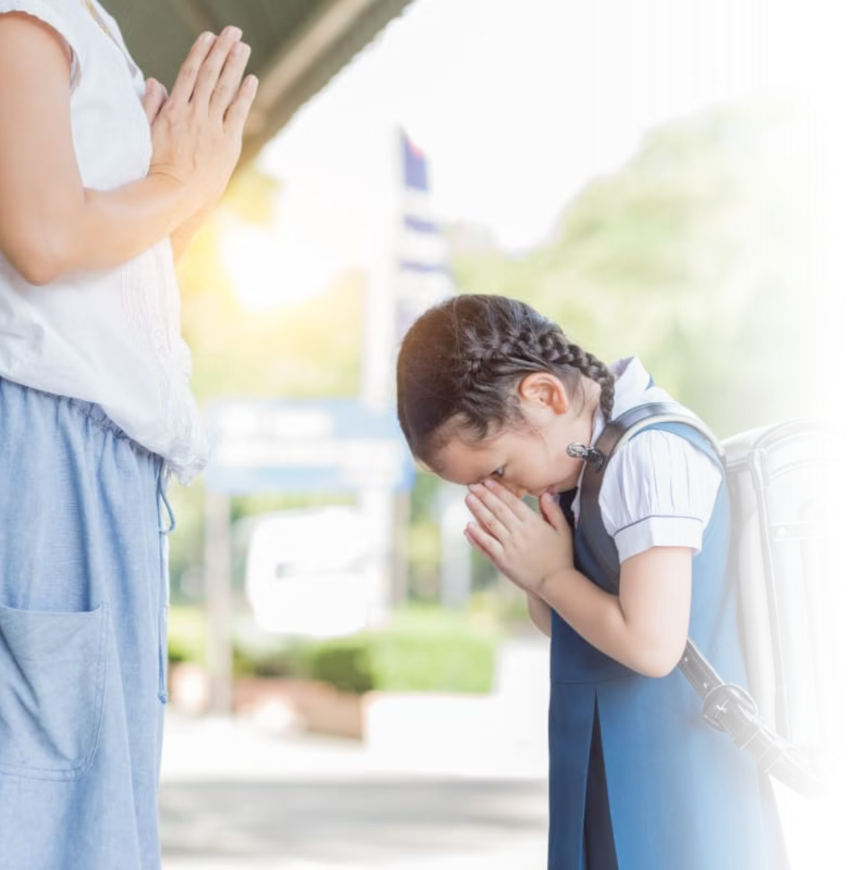
1. Respect
In Thai culture, respect is a core value deeply embedded in everyday life. Thai people show respect not only toward themselves and others, but also to places, religious objects, and spiritual forces. Respect is expressed through actions like the wai (ไหว้), polite speech, and mindful behavior, reflecting a deep sense of social harmony.
Photo credit: Dek-D

Slide 5
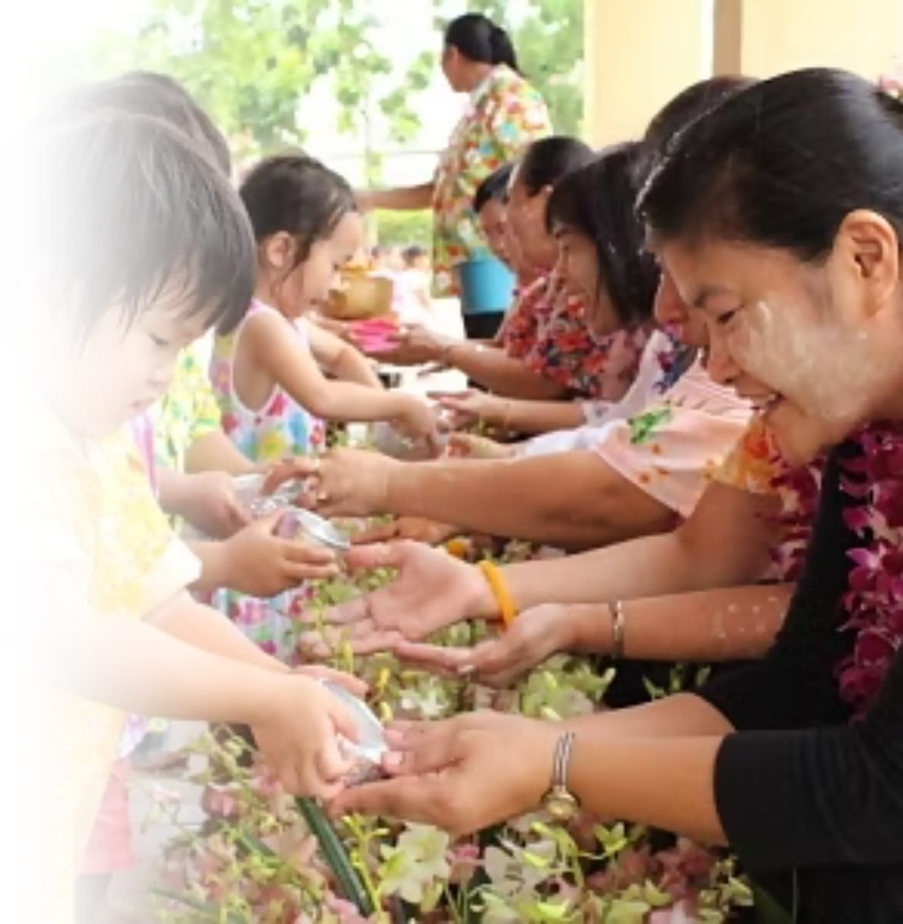
Seniority
Seniority plays an important role in Thai culture, where elders or those of higher seniority, such as teachers, are respected for their age and experience. While younger people show deference, elders or seniors are expected to offer care and guidance in return—making respect a reciprocal and valued part of Thai society.
Photo credit: mjulibrary

Slide 6
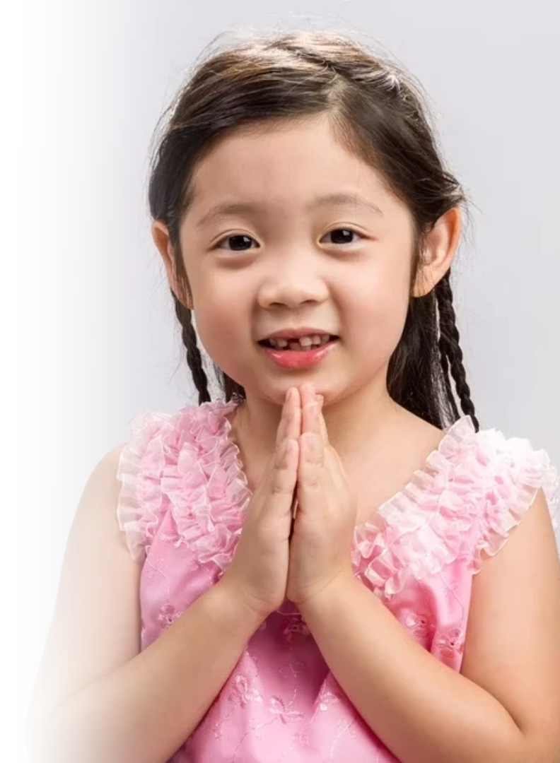
How Seniority is Expressed
Language & Titles:
Use of familial terms even outside family (e.g., Phee (พี่) for older, Nong (น้อง) for younger).
These reflect warmth, respect, and social connectedness.
Body Language:
Bowing when passing elders.
Using the wai gesture with appropriate level based on the other person's status.
Rituals & Traditions:
Rod Nam Dam Hua (รดน้ำดำหัว): A Songkran tradition where younger people pour water over elders’ hands to show respect and receive blessings.
Photo credit: thaihealth.or.th

Slide 7
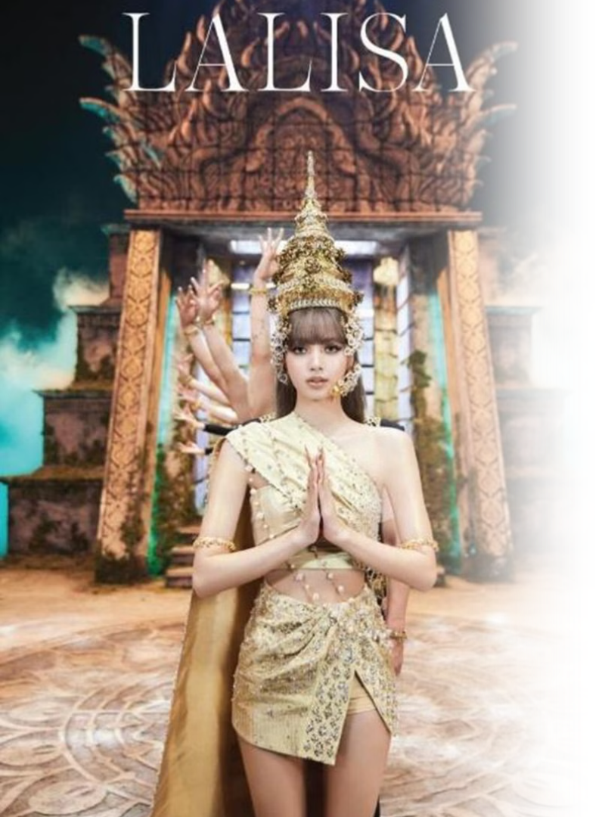
Wai – Thai Gesture of Respect
Wai (ไหว้) is the traditional Thai gesture for greeting, gratitude, and reverence.
Used for various purposes:
Greeting others
Showing respect
Expressing worship or prayer
Apologizing
Photo credit: Pinterest

Slide 8
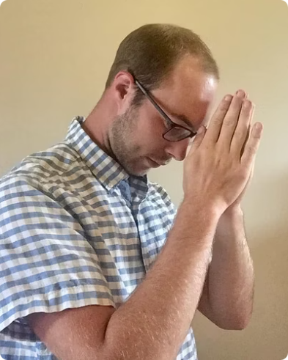
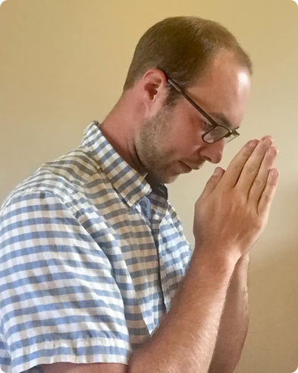
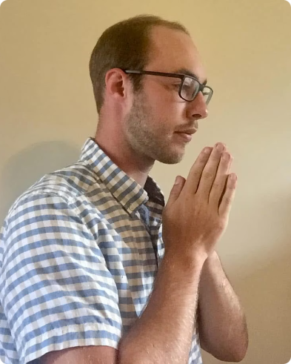
Levels of Wai
Thumbs between the eyebrows
Thumbs at the tip of the nose
Thumbs at the tip of the chin
For worship, prayer, and paying respect to monks/religious figures
For elders, seniors, teachers, and respected individuals
For friends, younger people, or people of social standing
Photo credit: Facebook: Thai Culture to the World

Slide 9
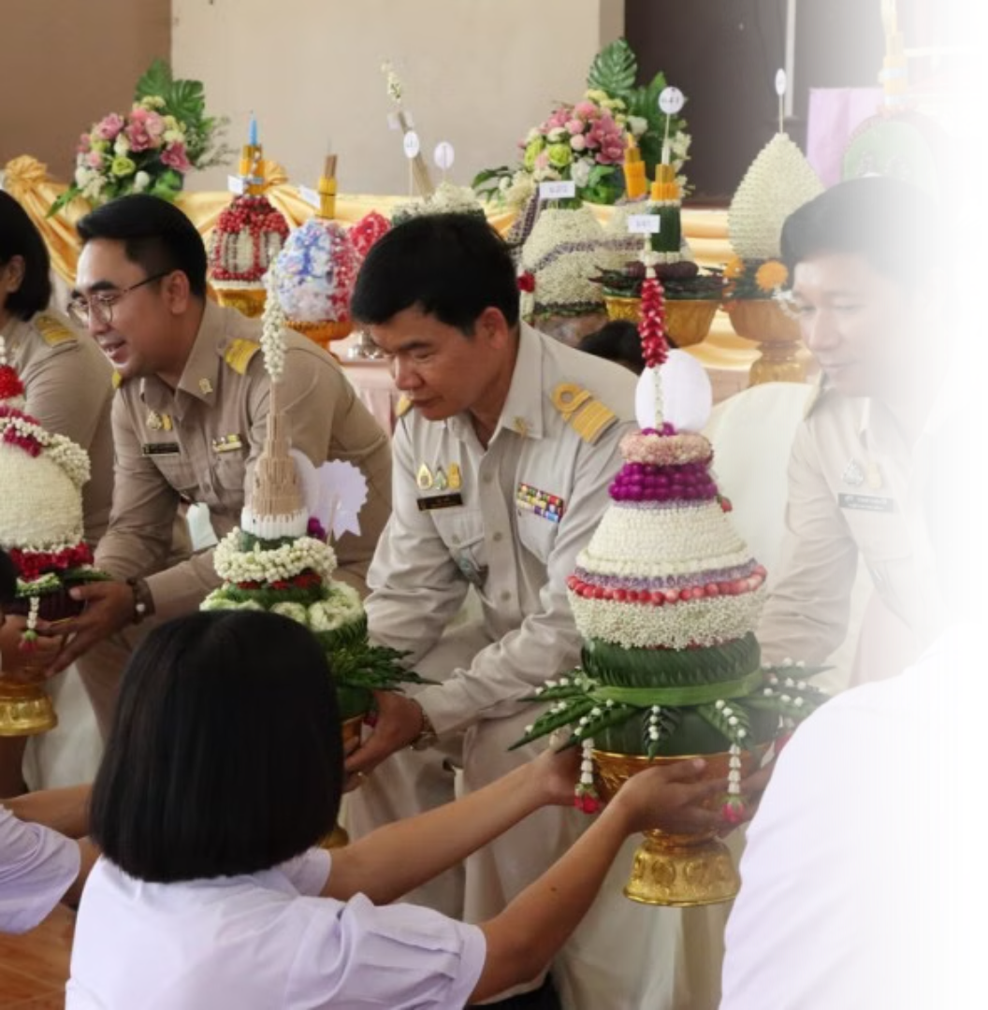
Wai in Rituals
"Wai" also extends to the attitude of respect that can be expressed in traditions like Wai Khru – a ceremony where students express gratitude toward their teachers for giving them knowledge.
Photo credit: Bangrakamwittayasuksa School

Slide 10
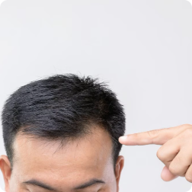
Head & Feet
The Head
The Feet
The most sacred part of the body
The lowest part of the body
Do not touch someone's head without permission.
Do not point feet at others or sacred objects (e.g., Buddha statues).
Remove shoes before entering homes or sacred areas' temples.
Avoid placing respected objects like books on the floor.
Photo credit: princsuvarnabhumi, samitivejhospital

Slide 11
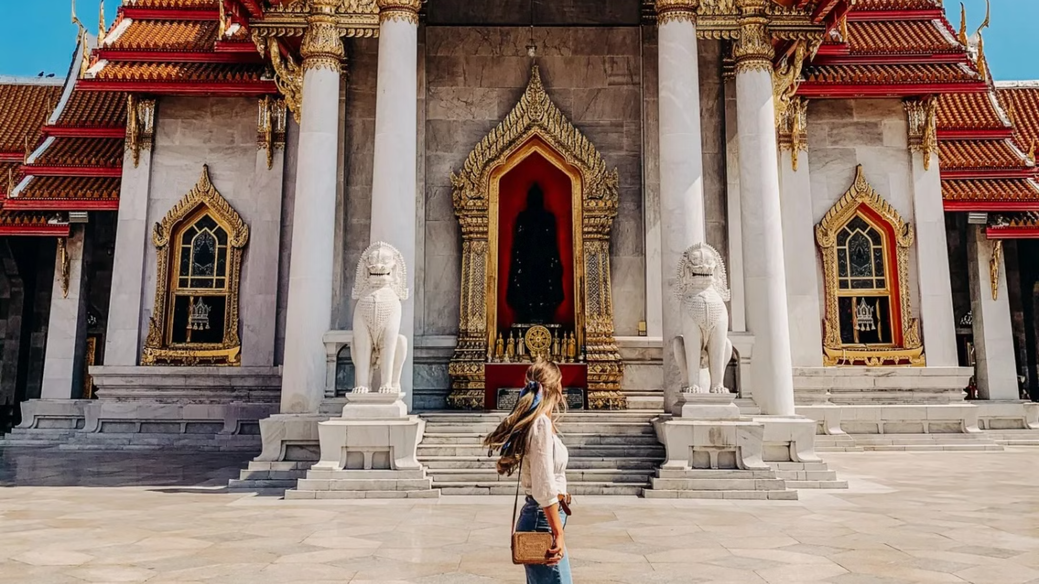
Temple Etiquette
Dress Modestly
Remove Shoes
No PDA
Cover shoulders & knees.
Before entering sacred areas.
Avoid public displays of affection.
Speak Softly
Sit Properly
Avoid loud talking & laughing.
Legs tucked to the side or cross-legged.
Mind Your Feet
Avoid Touching Monks
Don't point them at Buddha statues or monks.
Especially for women.
Photo credit: The Kalon Blog

Slide 12
Compassion & Generosity
Rooted in Buddhist teachings, compassion is an important aspect of Thai social values, fostering kindness, empathy, and harmonious relationships within communities.
Photo credit: Freepik

Slide 13
Tum Boon – Making Merit
A core Buddhist practice to gain good karma.
Common ways to make merit:
Giving alms to monks
Donating to temples and the needy
Helping the poor
Releasing animals such as birds, fishes, etc.
Merit-making on Special Occasions
Birthdays, weddings, funerals, etc.
Many Thais make merit daily, such as praying before bed.
Photo credit :Sanook

Slide 14
Openness & Diversity
Thai people have an attitude of cultural openness, embracing diversity in ways that reflect its rich traditions and evolving modernity. Thai society fosters a welcoming atmosphere for different beliefs, lifestyles, and identities.
Photo credit: Clever Thai

Slide 15
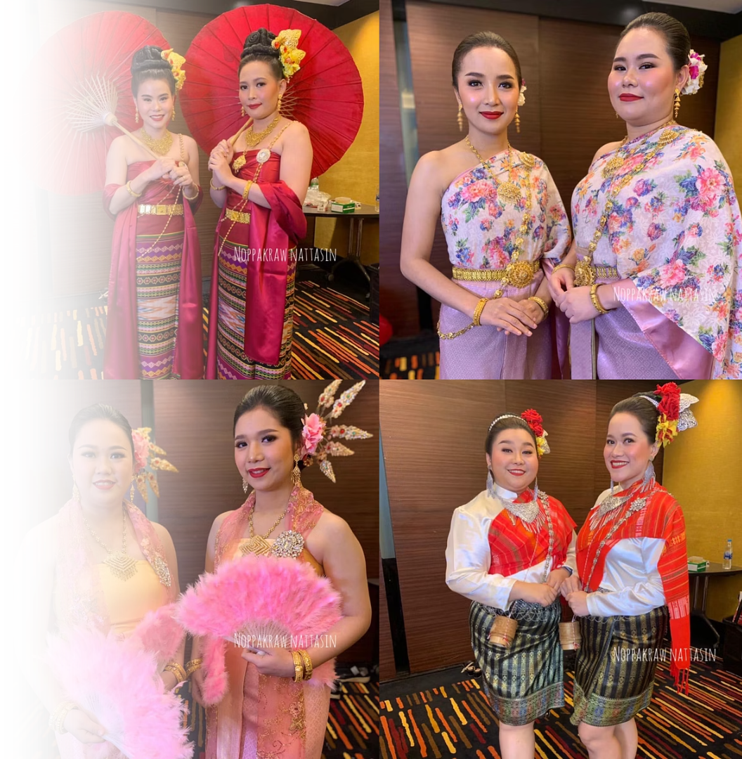
Cultural Diversity
Thailand’s cultural diversity is a vibrant tapestry of ethnic groups, traditions, beliefs, and lifestyles. This openness has shaped a society where different identities not only coexist harmoniously, but also blend into a unique Thai identity.
Photo credit: Noppakraw

Slide 16
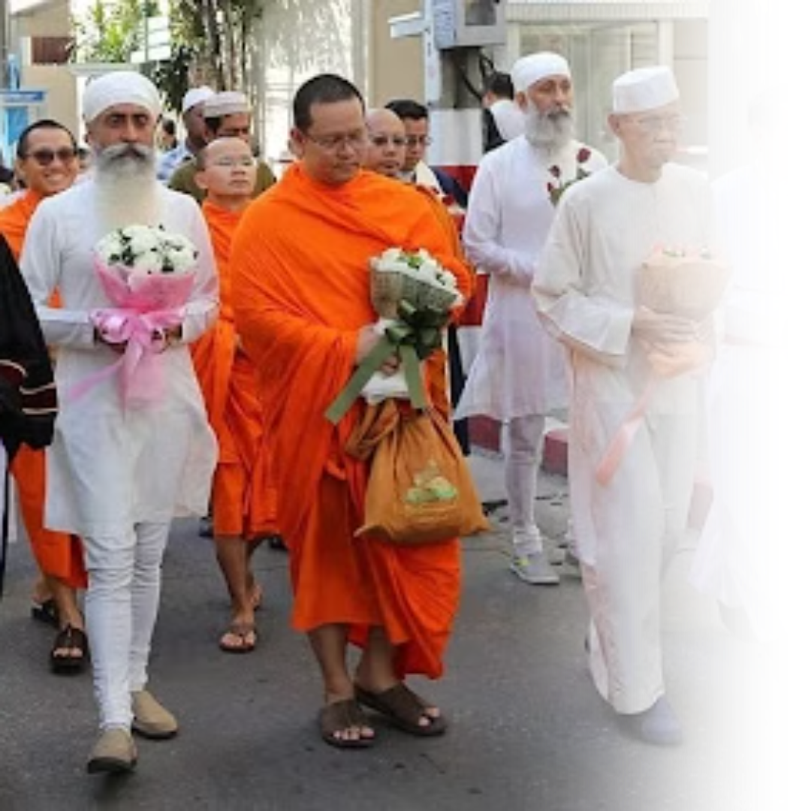
Religions
Thailand is known for its religious tolerance, with the Buddhist majority population living harmoniously alongside Muslim, Christian, Hindu, and other religious communities, fostering a culture of mutual respect and inclusivity.
Photo credit: Clever Thai

Slide 17
LGBTQ+
o Thailand is widely regarded as one of the most LGBTQ+ friendly countries in Asia, with visible representation and acceptance in the media and everyday life.
o Thailand is the first country in Southeast Asia to legalize same-sex marriage in 2024.
Photo credit: The Standard

Slide 18
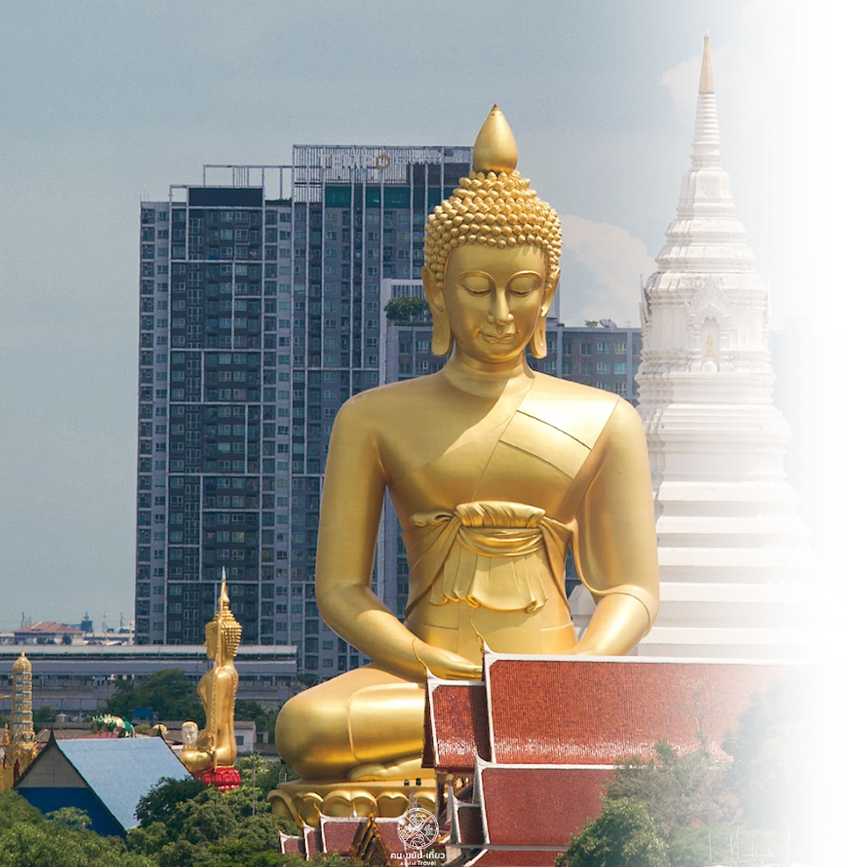
Old and New
In Thailand, traditional culture thrives alongside modernity, with ancient temples standing proudly amidst skyscrapers and bustling cityscapes. The seamless integration of age-old customs with contemporary lifestyles reflects the nation's adaptability and respect for its cultural heritage.
Pictured: The "Big Buddha" at Wat Paknam Phasi Charoen, Bangkok Photo credit: MGR Online

Slide 19
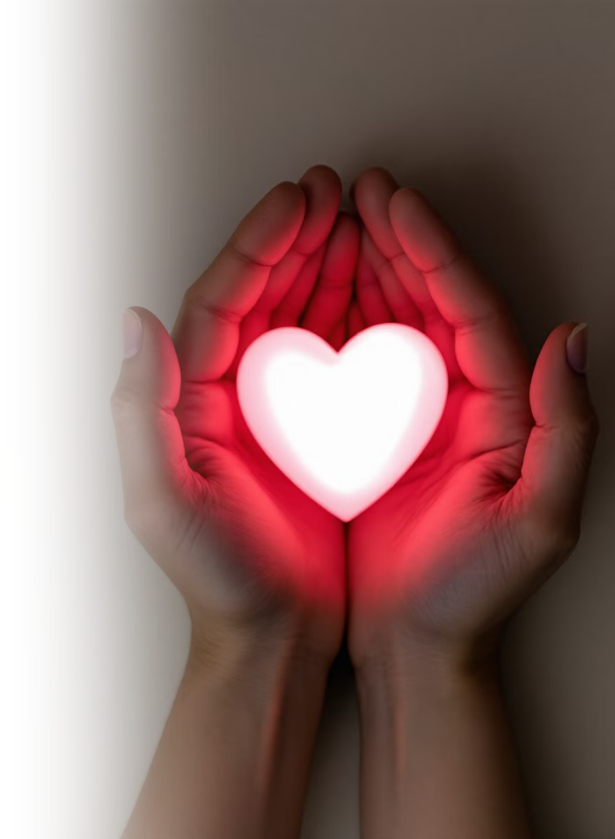
Jai : The Heart
In Thai, "jai" (ใจ) means "heart" or "mind," but its meaning extends far beyond the physical organ. It represents emotions, thoughts, and the inner self, reflecting the importance of maintaining social harmony through being mindful of others’ thoughts and feelings.

Slide 20
Jai in the Thai Language
There are countless terms in Thai that includes the word jai, but two key examples include
1
Nam Jai (น้ำใจ)
2
Kreng Jai (เกรงใจ)
The value of generosity, sharing, and helping others without expecting anything in return, such as bringing back gifts for friends and loved ones when returning from trips.
The value of being mindful against causing others discomfort.

Slide 21
Refinedness
La-iat orn (ละเอียดอ่อน), meaning "delicate" or "sensitive," refers to the attitude of refinement, intricacy, and attention to detail.
Photo credit: fotoinfo.online

Slide 22
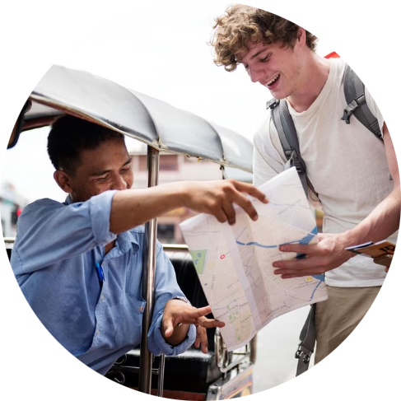
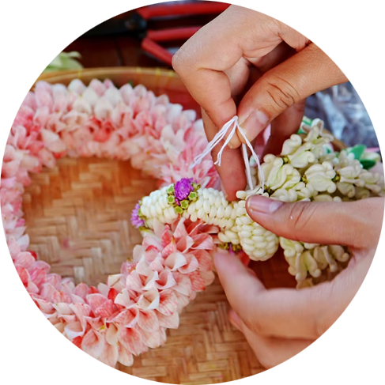
Social Interactions
The Arts
In social setting, la-iat orn, can refer to being mindful to social ques and the emotions of others.
In the realm of Thai arts, la-iat orn is a key focus, whereby artists place great importance on details and refinedness.
Photo credit: Sawasdee Thailand, Nairobroo

