Slide 1
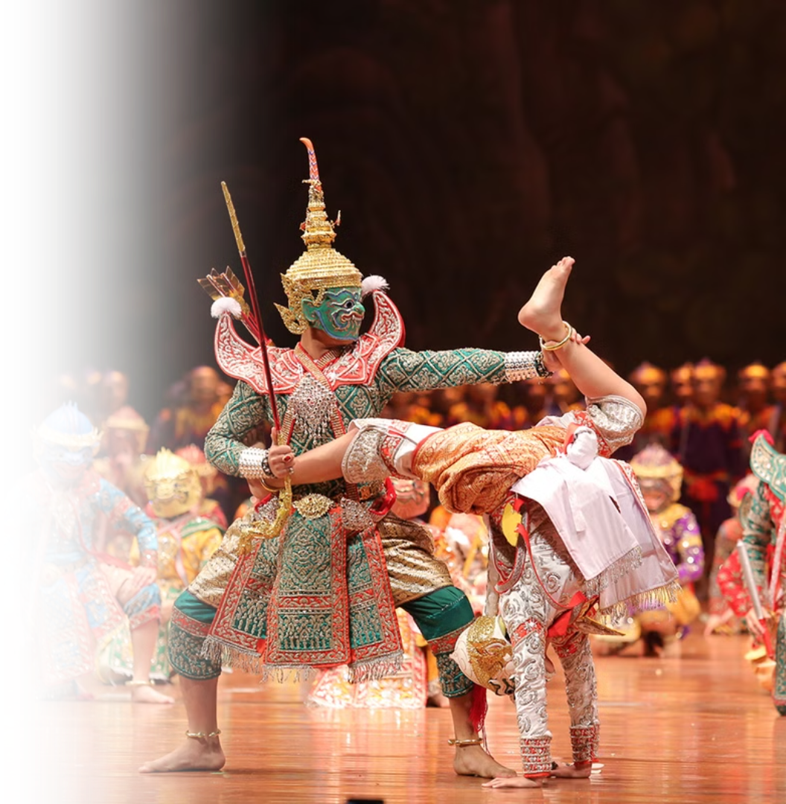
Thai Culture: A Journey Through Heritage and Traditions
Photo credit: Lets Tour Bangkok

Slide 2
Thailand in Brief
"Thailand in Brief " has been prepared by the Thailand Foundation to support students, scholars, and the general public who wish to give presentations about Thailand to their audiences—for example, exchange program students and international participants.
The work presents some basic information about Thailand in 11 areas: 1) Geography, 2) History, 3) Politics and Government, 4) Economics, 5) Demographics, 6) Culture, 7) Values, 8) Thai People and Other Popularity That You May Know, 9) Misconceptions about Thailand, 10) Thailand's Role on the Global Stage, and 11) Rankings Related to Thailand.
"Thailand in Brief" is produced in both PDF file (.pdf) and Powerpoint Presentation (.pptx) formats, consisting of xx slides. Users may download and select the topics they wish to present, and may rearrange the sequence of the slides as appropriate. However, the content of this document cannot be edited. Reproduction or use for commercial purposes without permission from the Thailand Foundation is not allowed.
"Thailand in Brief" will be updated every third quarter each year. For inquiries or further suggestions, please contact the Thailand Foundation at info@thailandfoundation.or.th.
27 May 2025

Slide 3
Thailand in Brief
"Thailand in Brief " จัดทำขึ้นโดยมูลนิธิไทย (Thailand Foundation) เพื่ออำนวยความสะดวกแก่ นักเรียน นักศึกษา และผู้สนใจทั่วไป นำไปใช้ประโยชน์ อาทิ ในการบรรยาย หรือให้ความรู้เกี่ยวกับประเทศไทยในด้านต่าง ๆ แก่ชาวต่างประเทศ เช่น กรณีนักศึกษาแลกเปลี่ยนที่ไปเรียนในต่างประเทศที่ต้องนำเสนอเรื่องราวเกี่ยวกับประเทศไทยในสถาบันที่ไปศึกษาอยู่ เป็นต้น
งานชิ้นนี้เสนอข้อมูลเกี่ยวกับประเทศไทยโดยสังเขป 11 ด้าน ได้แก่ 1) ภูมิศาสตร์ (Geography) 2) ประวัติศาสตร์ (History) 3) การเมืองการปกครอง (Politics and Government) 4) เศรษฐกิจ (Economics) 5) ประชากร (Demographics) 6) วัฒนธรรม (Culture) 7) ค่านิยม (Values) 8) คนไทยและสื่อที่คุณอาจรู้จัก (Thai people and other popularity that you may know) 9) ความเข้าใจผิดเกี่ยวกับประเทศไทย (Misconceptions) 10) บทบาทของไทยในเวทีโลก (Thailand’s role on the Global Stage) และ 11) การจัดอันดับที่เกี่ยวกับประเทศไทย (Rankings related to Thailand)
"Thailand in Brief " นี้จัดทำเป็นสไลด์ จำนวน xx สไลด์ ในรูปแบบ .pdf และ .pptx สามารถดาวน์โหลดและเลือกใช้หัวข้อที่นำเสนอ และสลับลำดับการนำเสนอได้ตามความเหมาะสม อย่างไรก็ดี ผู้ใช้งานไม่สามารถดัดแปลงเนื้อหาในเอกสารได้ และห้ามผลิตซ้ำ หรือนำไปใช้เพื่อผลประโยชน์เชิงพาณิชย์โดยไม่ได้รับอนุญาตจากมูลนิธิไทย
"Thailand in Brief " จะได้รับการปรับปรุงให้ทันสมัยในทุกไตรมาสที่ 3 ของปี หากมีข้อสงสัยและข้อเสนอแนะเพิ่มเติม กรุณาติดต่อมูลนิธิไทย อีเมล info@thailandfoundation.or.th
27 พฤษภาคม 2568

Slide 4
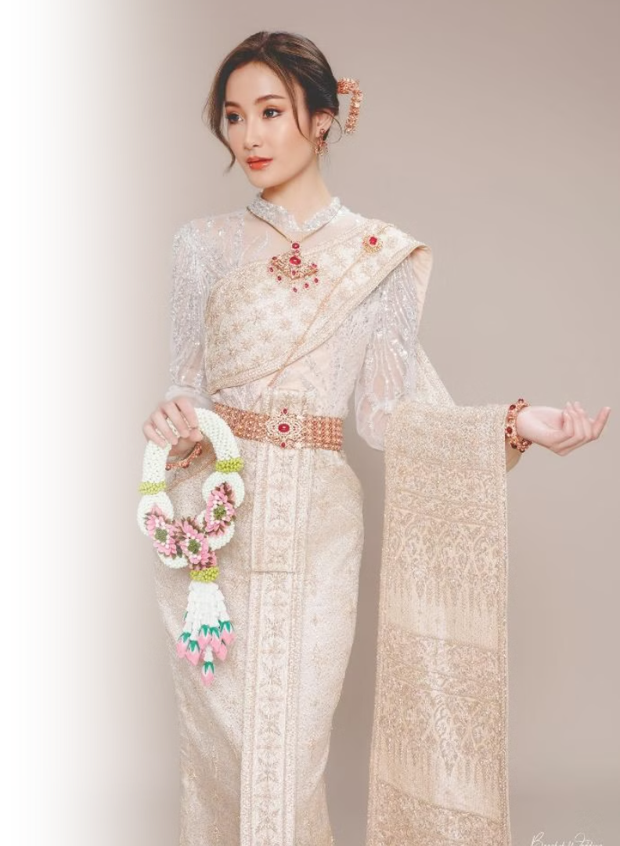
Chut Thai – Traditional Thai Clothing
Chut Thai (ชุดไทย) refers to traditional Thai clothing. Chut Thai can be worn for ceremonies, formal functions, cultural occasions, or even for fashion and recreation.
Photo credit: Bangkok Wedding Studio

Slide 5
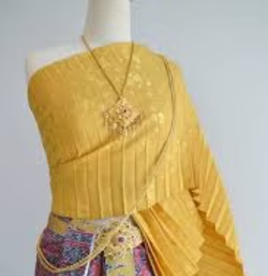
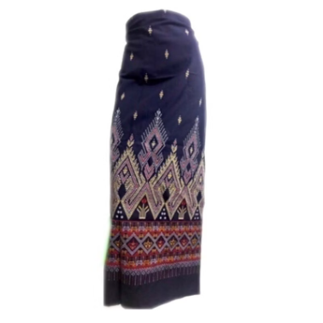
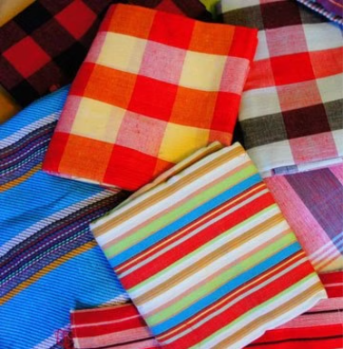
Some Elements of Thai Traditional Clothing
Sabai (สไบ)
Chong Kraben (โจงกระเบน)
Pha Sin (ผ้าซิ่น)
Pha Khao Ma (ผ้าขาวม้า)
Cloth/shawl worn across the chest
Traditional tube skirt
Multipurpose, checkered cloth
Lower garment wrapped around the waist
Photo credit: สะพักไทย สไบ-ชุดไทย, Amaze Multistore, TH My Best, กรมหม่อนไหม

Slide 6
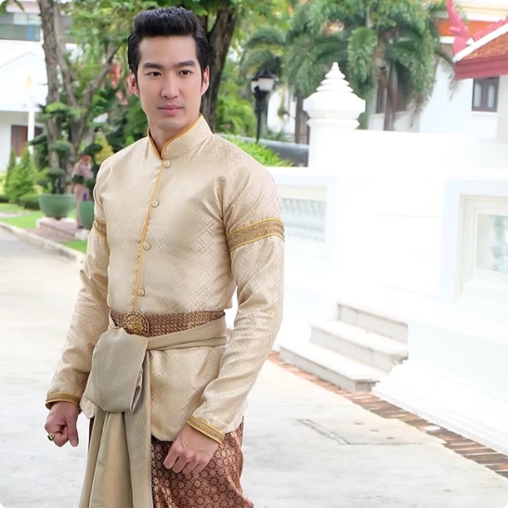
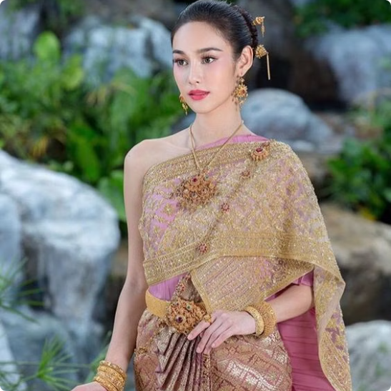
Men's Clothing
Women's Clothing
Chong kraben with shirt
Sabai with skirt or chong kraben
Photo credit: Men Kapook, Pinterest

Slide 7
Thai Silk
Luxury Fabric
Modern Applications
Thai silk is globally renowned as luxury fabric due to its fine quality, vibrant colors, and exquisite weaving patterns.
Today, Thai silk is used in both traditional garments and contemporary fashion, showcasing Thailand's blend of heritage and innovation.
Where to Purchase
Thai silk can be purchased through brands such as Jim Thompson or from craftsmen through organizations like the Sustainable Arts and Institute of Thailand (SACIT).
Photo credit: MGR Online

Slide 8
Thai Art
Thai art is known for its delicateness and intricate details, often seen in traditional paintings, temple murals, and carvings, where every element reflects deep craftsmanship and cultural symbolism. In recent years, modern Thai art has flourished, blending traditional themes with contemporary styles.
Photo credit: DailyNews

Slide 9
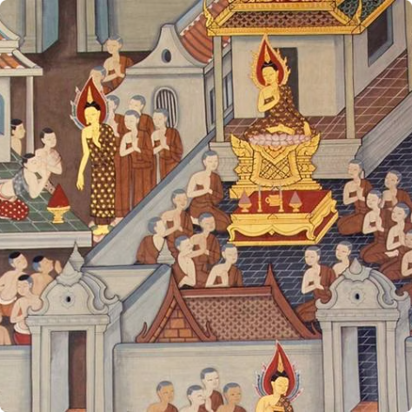
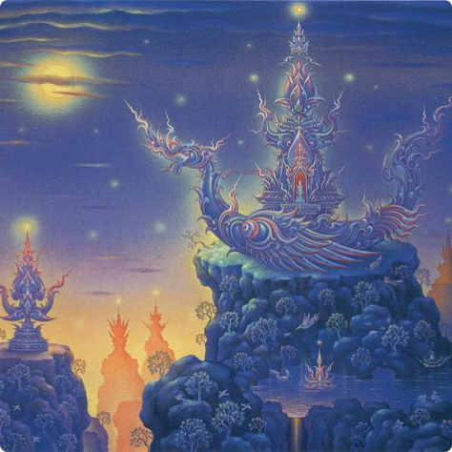
Thai Painting
Traditional Painting
Contemporary Painting
Traditional Thai painting follows the structured system of lai Thai (ลายไทย) patterns and is rich with deep symbolism that reflects religious beliefs and cultural values.
Contemporary Thai painting blends traditional themes with global influences, featuring both realistic forms and abstract expressions to explore old and new concepts.
Pictured: Traditional Thai Painting at Wat Pho
Pictured: Painted by Chalermchai Kositpipat
Photo credit: UME Travel, bkstationery

Slide 10
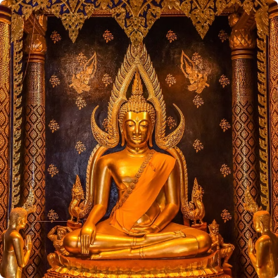
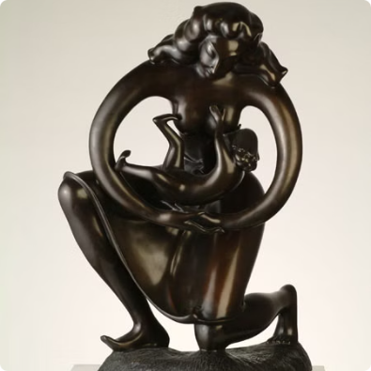
Thai Sculpture
Traditional Sculpture
Contemporary Sculpture
Traditional Thai sculpture features idealistic forms with graceful postures and intricate details, most famously seen in elegant and serene Buddha statues.
Contemporary Thai sculpture blends traditional elements with both realistic and abstract forms, reflecting modern perspectives while honoring cultural roots.
Pictured: Buddha Chinnarat housed in Wat Phra Si Rattana Mahathat, Phitsanulok
Pictured: The "Protector" sculpture created by Ajarn Khien Yimsiri
Photo credit: Palungjit, Ratchadamnoen Contemporary Art Center

Slide 11
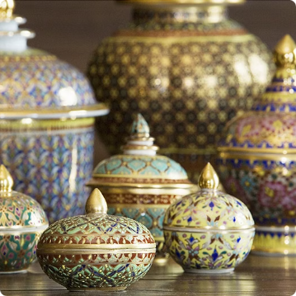
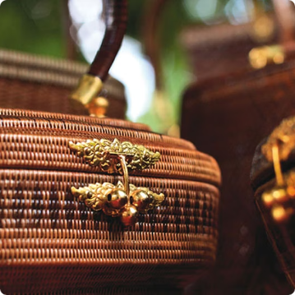
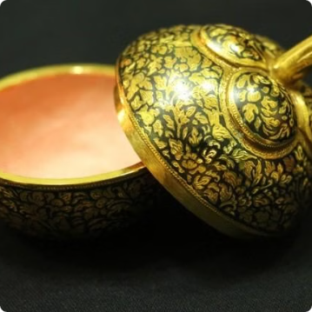
Thai Handicrafts
Benjarong Ceramics
Yaan Liphao Baskets
Thai Nielloware
Benjarong ceramics are traditional Thai porcelain of royal origin, known for their intricate hand-painted designs in vibrant colors and gold accents.
Yaan liphao baskets are finely woven Thai handicrafts made from a type of natural vine from Southern Thailand, prized for their elegant patterns and durability.
Thai nielloware is a traditional metalcraft featuring black inlay designs on silver or gold surfaces, admired for its delicate patterns and high craftsmanship.
Photo credit: Flickr, Nairobroo, The Encyclopedia of Crafts in WCC-Asia Pacific Region

Slide 12
Thai Spirituality
Thai spirituality is a complex blend of Buddhism, Hinduism-Brahmanism, and local animistic beliefs.
Pictured: Rajaguru gives the new King (Rama X) sanctified river water to bathe with during Coronation Ceremonies Photo credit: Hinduismtoday

Slide 13
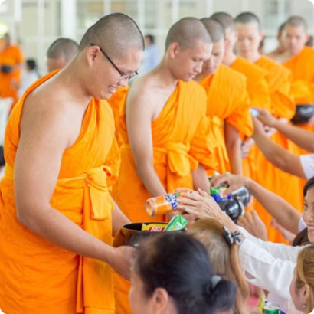
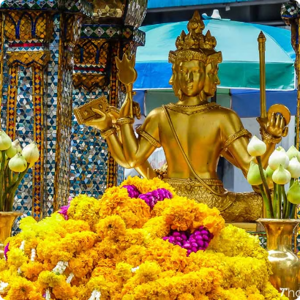
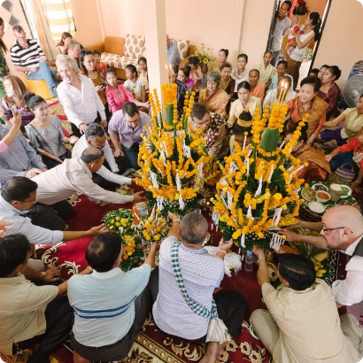
Buddhism
Hinduism
Animism
Over 90% of Thai people are Buddhist.
Thais worship Hindu gods alongside the Buddha.
Animism is the original belief of the Thai people.
Buddhist teachings greatly impact Thai social values and way of life.
Pictured: The famous Erawan Shrine in Bangkok, dedicated to Hindu God Brahma.
Believe in spirits that inhabit nature, object, places, and more.
Photo credit: kalyanamitra, Thaizer, Princess Maha Chakri Sirindhorn Anthropology Centre

Slide 14
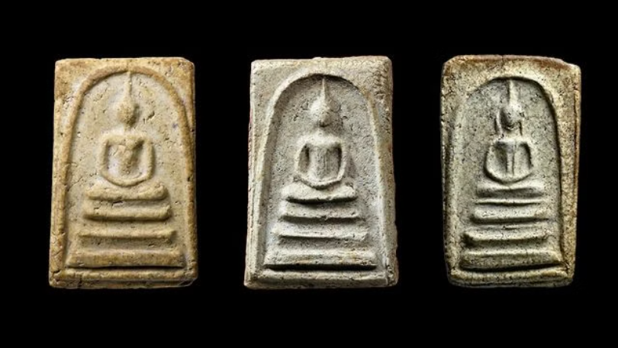
Thai Amulets (พระเครื่อง)
Depict sacred figures such as the Buddha and famous monks.
Worn on the body or venerated at homes and business places.
Believed to grant protection and bring good luck.
Some prized amulets can reach millions of dollars!
Photo credit: Thairath

Slide 15
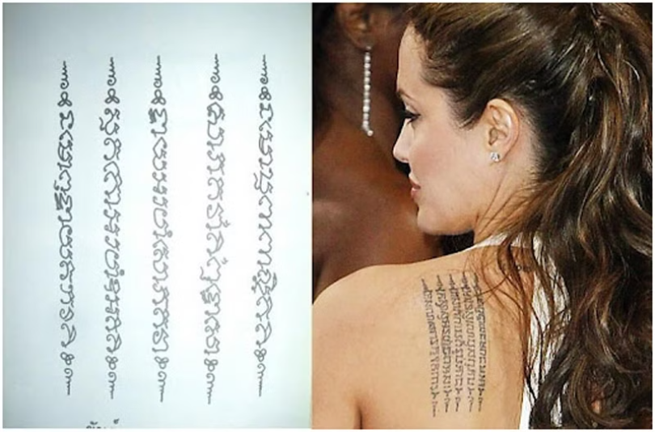
Sak Yant: Yantra Tattoo (สักยันต์)
Yantra are sacred symbols and geometric patterns in Hindu and Buddhist beliefs.
Yantra tattoos depict numbers, symbols, patterns, figures, prayers, and spells, believed to grant protection, charm, and prosperity.
Photo credit: BrandAge

Slide 16
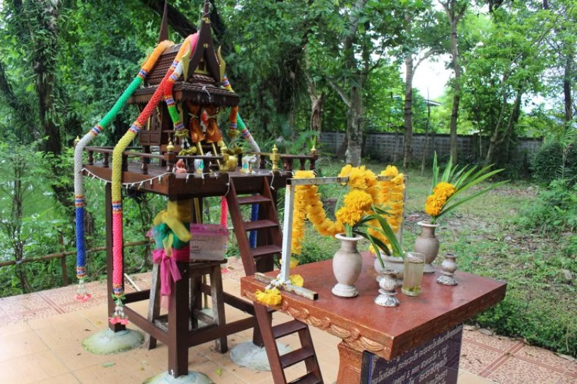
Spirits and Supernatural Forces
Belief in spirits or phi (ผี) is deeply rooted in Thai culture. Spirits can be associated with places and natural features, or can represent ancestors and deceased inviduals. Spirit houses are found inside homes and businesses, where people honor the spirits for blessings and protection.
Photo credit: Wazzadu

Slide 17
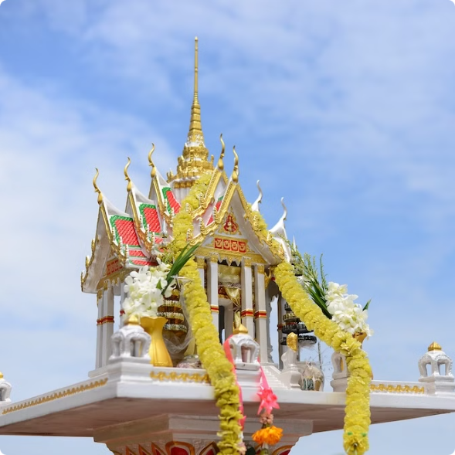
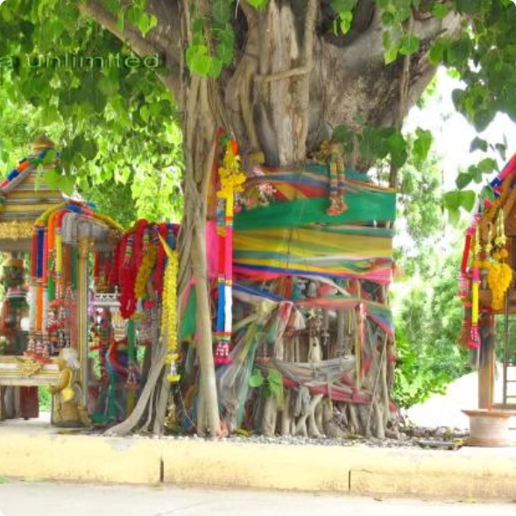
Spirit Houses
Sacred Trees
Dwelling place for the spirit that protects the land
Old trees are believed to be the dwelling place of spirits
Photo credit: Areeya Property Public Company Limited, Pattaya Unlimited

Slide 18
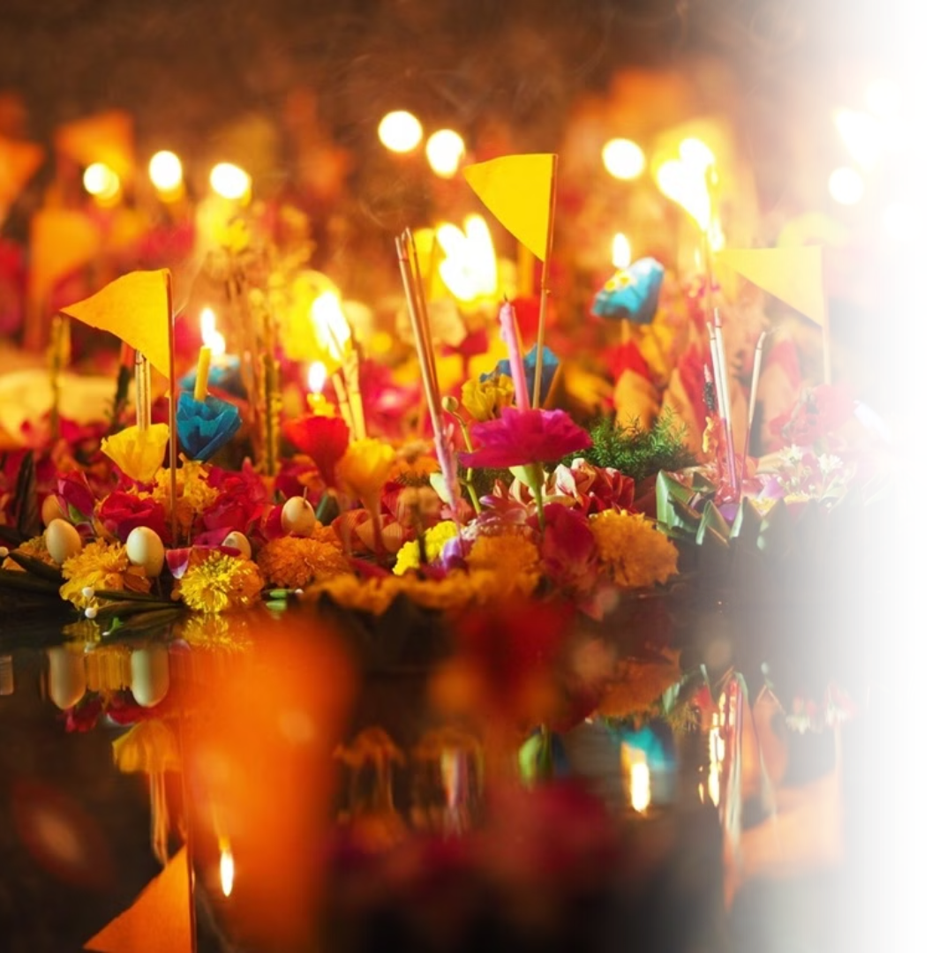
Thai Festivals
Thailand is home to numerous festivals reflecting seasonal changes, Buddhist traditions, local ways of life, and openness towards other cultures.
Photo credit: Everyday Bangkok Hostel

Slide 19
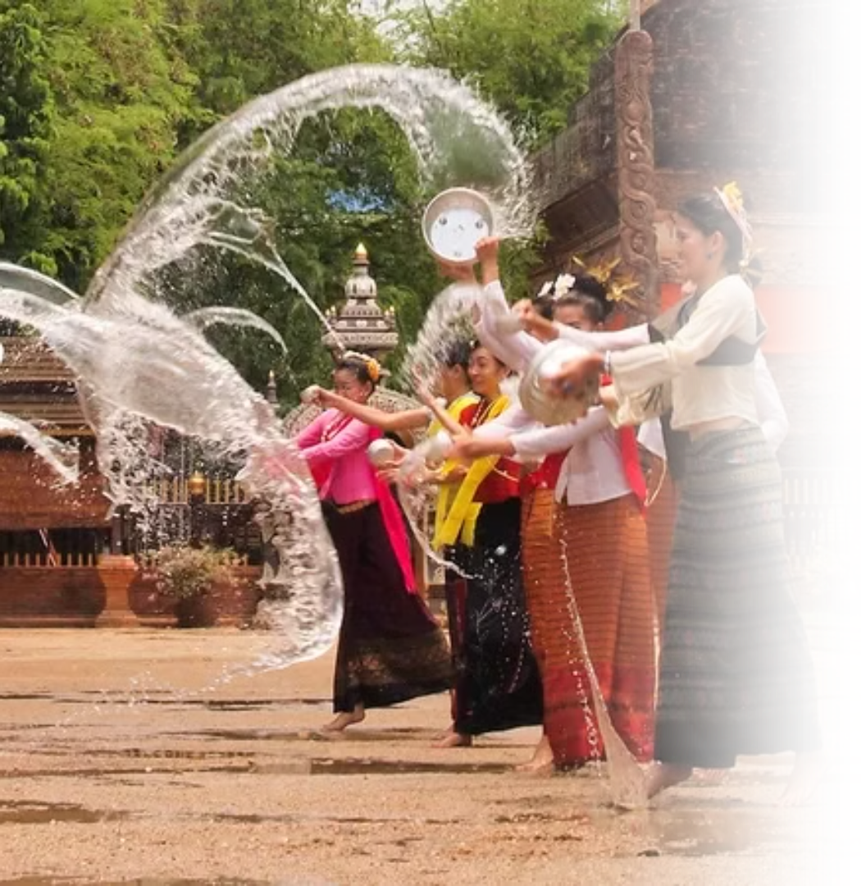
Songkran
Songkran (สงกรานต์) is the traditional Thai New Year festival, celebrated annually from April 13–15. It marks a time of renewal, family gatherings, and religious observances, as well as the famous water splashing festivities.
Activities
Water splashing
Pouring water on the hands of elders to show respect
Bathing of Buddha statues
Merit-making at temples
Photo credit: Britanica

Slide 20
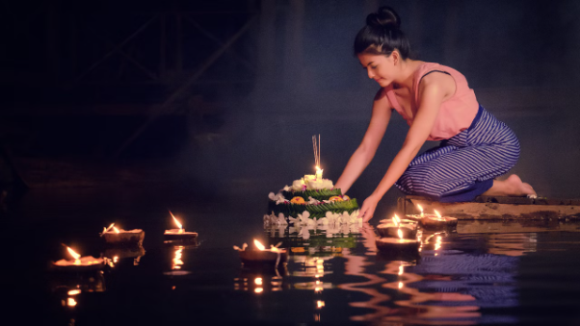
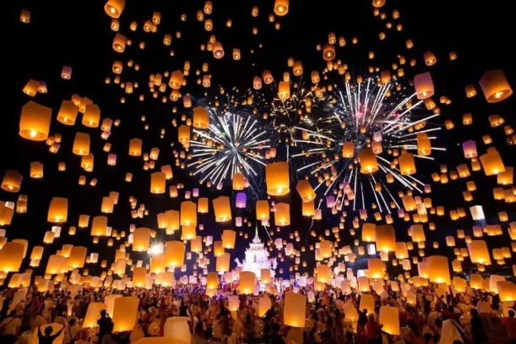
Loy Krathong
Loy Krathong (ลอยกระทง) is celebrated on the night of the full moon in November. People gather around rivers, canals, and lakes to float decorated baskets called krathong (กระทง), made from banana leaves, flowers, candles, and incense.
The act of floating a krathong symbolizes letting go of past negativity, paying respect to the Goddess of Water, and making wishes for the future
Activities
Krathong floating
Sky lantern floating (in Northern Thailand)
Merit-making at temples
Photo credit: Thairath, KKDay

Slide 21
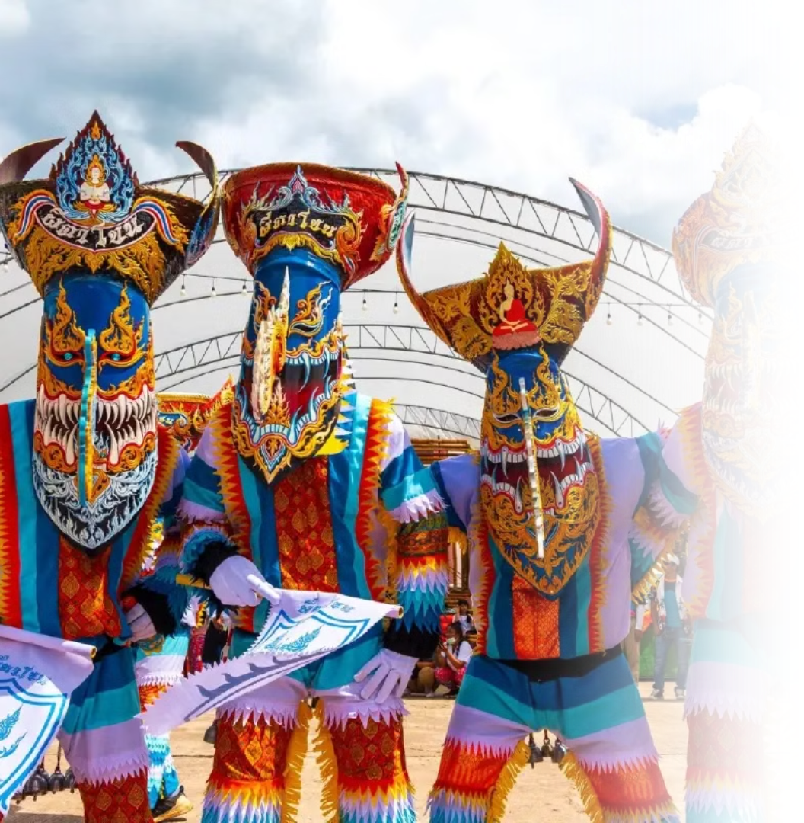
Phi Ta Khon
Phi Ta Khon (ผีตาโขน) is a vibrant and unique festival celebrated in Dan Sai District, Loei Province, in Northeastern Thailand. It usually takes place in June or July. Often called the “Ghost Festival,” locals dress up in elaborate ghost costumes with tall, colorful masks made from coconut husks and rice baskets.
Activities
Ghost parade
Merit-making at temples
Photo credit: Bangkokbiznews

Slide 22
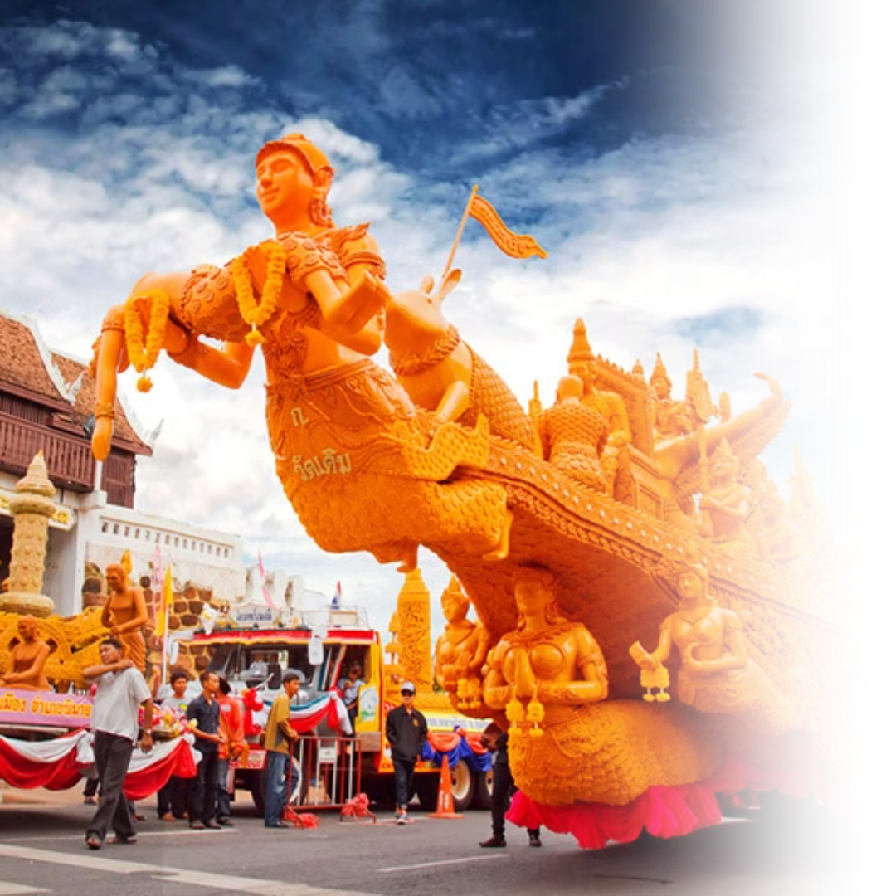
Candle Festival
The Thai Candle Festival (เทศกาลแห่เทียนพรรษา) is a traditional celebration held to mark the beginning of Buddhist Lent (Khao Phansa), typically in July. The festival features elaborate parades of giant wax candles, intricately carved to depict scenes from Buddhist mythology, Thai literature, and local folklore. These candles are offered to temples to provide light for monks during the three-month rainy retreat.
Activities
Candle parade
Merit-making at temples
Photo credit: My Life Graphic

Slide 23
Modern Festivals
While Thailand holds its traditions close, its openness to global influences has led to the widespread embrace of international celebratioans. In urban areas, New Year and Christmas are marked with festive cheer, while Valentine’s Day is a beloved occasion for couples. Thailand also proudly celebrates Pride Festivals, reflecting its growing support for LGBTQ+ communities.
Photo credit: Nation Thailand

Slide 24
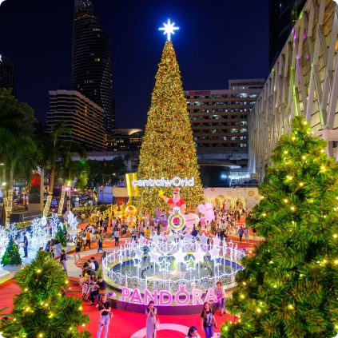
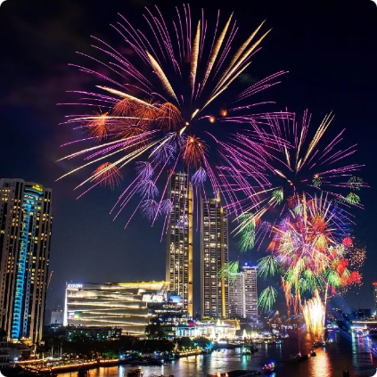
Christmas
New Year's Eve
Christmas is celebrated mainly in urban areas and commercial spaces, where malls and streets are decorated with festive lights, trees, and ornaments. While it’s not a public holiday or a religious occasion, it’s embraced as a fun and joyful time for gift-giving, parties, and spreading cheer, especially among young people and families.
New Year's Eve in Thailand feature fun festivities and world-class countdown events in major cities like Bangkok, Chiang Mai, and Pattaya. At the same time, many people visit temples to pray, reflect, and make merit, hoping to start the year with good luck and positive energy.
Photo credit: Thailand Insider, bangkokbiznews

Slide 25
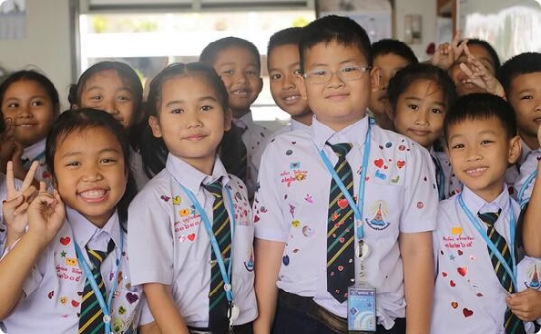
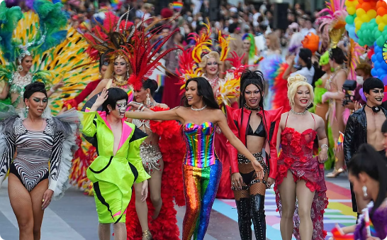
Valentine's Day
Pride Month
Valentine’s Day is a popular celebration, especially among students, young people and couples. In schools and universities, it’s common for students to stick heart-shaped stickers on friends’ uniforms as a playful sign of affection. Couples also exchange gifts, flowers, and go on romantic outings to mark the occasion.
Pride in Thailand is celebrated with vibrant parades and events that showcase the country’s diversity and support for the LGBTQ+ community, especially in cities like Bangkok and Chiang Mai. Thailand is the first country in Southeast Asia to legalize same-sex marriage, marking a historic milestone for equality and LGBTQ+ rights in the country.
Photo credit: Richard Barrow, Go Thai Be Free

Slide 26
Thai Cuisine: The Harmony of Flavors
Thai food is one of the most well-known aspects of Thai culture. Celebrated for its bold and balanced flavors, many Thai dishes are now beloved by people all over the world.
Photo credit: realasset

Slide 27
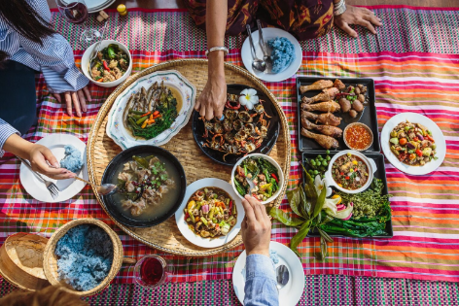
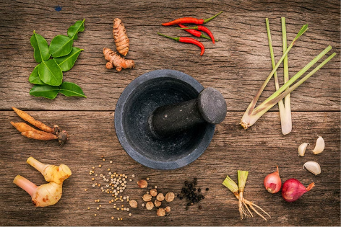
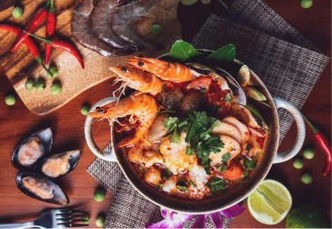
Characteristics of Thai Food
1
2
3
Rice Culture and Food Sharing
Harmony of Flavors
Global Fame
Rice is the main staple of Thai people, forming the heart of almost all meals. Meals are typically eaten together, with rice served alongside a variety of shared accompanying dishes, reflecting the communal nature of Thai dining.
Thai food is famous for its complex blends of flavors, such as sweet, sour, salty, and spicy.
Many Thai dishes are now popular and beloved worldwide.
Photo credit: Expatica, De Siam Cuisine, Quandoo

Slide 28
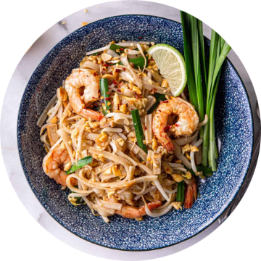
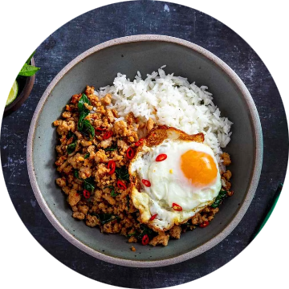
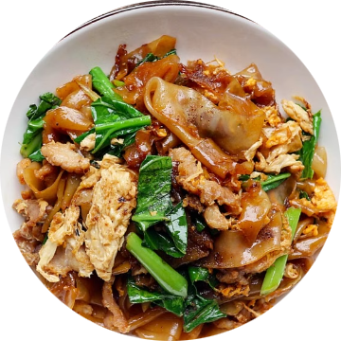
Famous Thai Dishes
Pad Thai
Pad Krapao
Pad See Ew
A famous stir-fried noodle dish made with rice noodles, dried shrimps, tofu, eggs, peanuts, and a tangy-sweet tamarind sauce.
A flavorful stir-fry made with minced meat, holy basil, garlic, and chili, typically served over rice with a fried egg on top.
A savory stir-fried noodle dish made with wide rice noodles, soy sauce, Chinese broccoli, and your choice of meat.
Photo credit: Inquiring Chef, Food and Wine, MICHELIN Guide

Slide 29
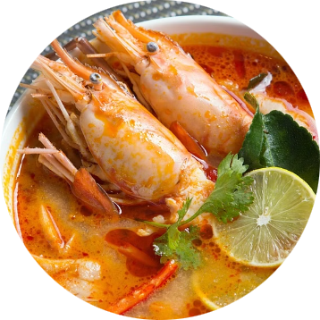
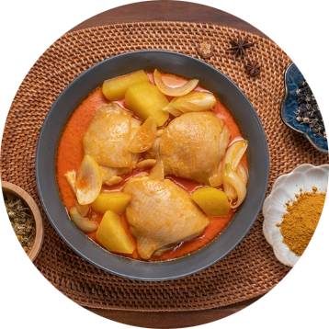
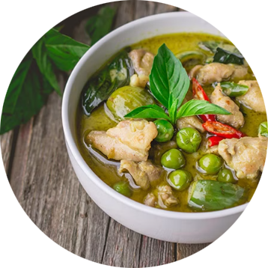
Famous Thai Dishes
Tom Yum Kung
Massaman Curry
Green Curry
A hot and sour soup made with shrimp, lemongrass, lime, chili, and fragrant herbs, known for its bold and refreshing flavor.
A rich and mildly spicy curry with Persian influence, made with tender meat, potatoes, peanuts, and aromatic spices.
A creamy and spicy curry made with green chili paste, coconut milk, meat, and Thai basil, offering a vibrant and aromatic taste.
Photo credit: MICHELIN Guide, Kapook

Slide 30
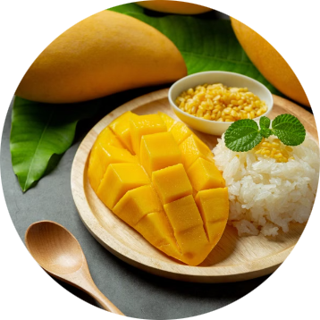
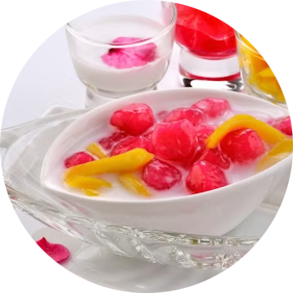
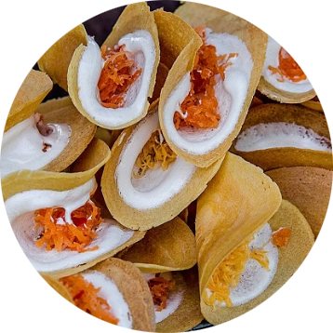
Famous Thai Dishes
Mango Sticky Rice
Thubthim Krop
Khanom Bueang
A popular dessert made with sweet sticky rice, ripe mango slices, and a drizzle of rich coconut milk.
A refreshing Thai dessert featuring crunchy water chestnuts coated in red syrup and served in sweetened coconut milk with crushed ice.
A crispy Thai crepe filled with sweet or savory toppings, often made with coconut cream, shredded egg yolk, and grated coconut.
Photo credit: OfficeMate, khunkaekanomwan, Kapook

Slide 31
Nuad Thai: Thai Traditional Massage
Nuad Thai (นวดไทย), or traditional Thai massage, is an ancient healing practice that combines acupressure, assisted stretches, and energy line work to promote physical and mental well-being. Recognized by UNESCO as an Intangible Cultural Heritage, Nuad Thai is deeply rooted in Thai medicine and spirituality, focusing on restoring balance and harmony in the body.
Photo credit: Thailand Insider

Slide 32
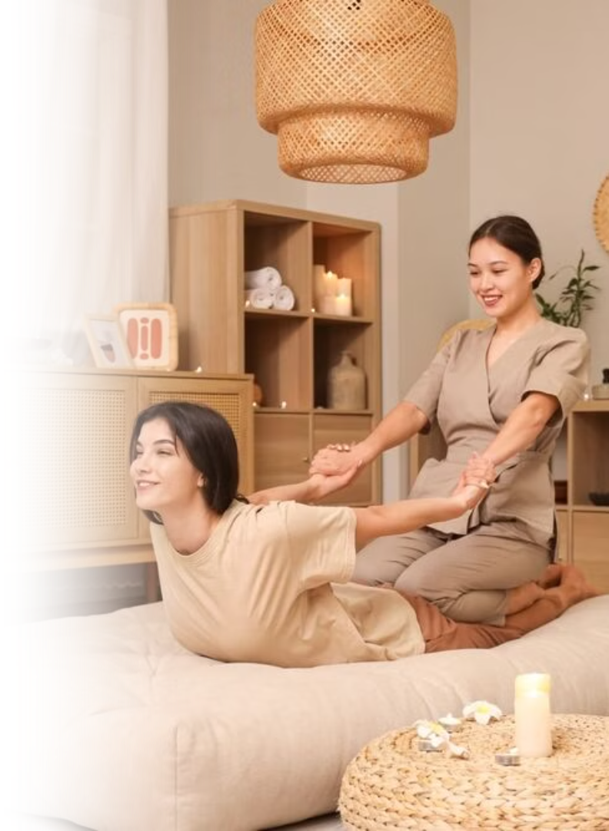
Characteristics of Nuad Thai
Focus on Energy Lines The practice is based on the concept of invisible energy pathways in the body, known as sen (เส้น) lines, with pressure applied to stimulate energy flow and restore balance.
Combination of Acupressure and Stretching Nuad Thai integrates rhythmic acupressure with assisted stretches to enhance flexibility, release tension, and improve circulation.
Holistic Health Benefits The massage promotes physical relaxation, relieves muscle tension, supports better posture, and enhances overall energy and well-being.
Rooted in Thai Healing Traditions Nuad Thai is deeply connected to Thai traditional medicine and Buddhist teachings, emphasizing mindfulness, compassion, and the balance of body and spirit.
Photo credit: Andamanda Phuket

Slide 33
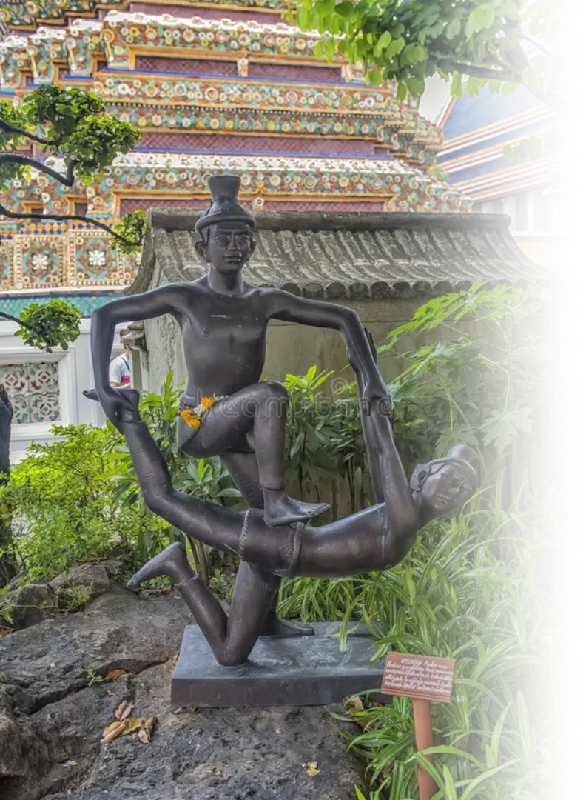
Wat Pho
Wat Pho is also considered a center of Nuad Thai where techniques of Thai massage and traditional medicine have been taught for centuries. This makes it a major hub for those seeking to learn or try out authentic Nuad Thai.
Pictured: Statues of hermit at showing a posture of massage therapy at Temple of Reclining Buddha or Wat Pho, Bangkok Photo credit: Wat Pho

Slide 34
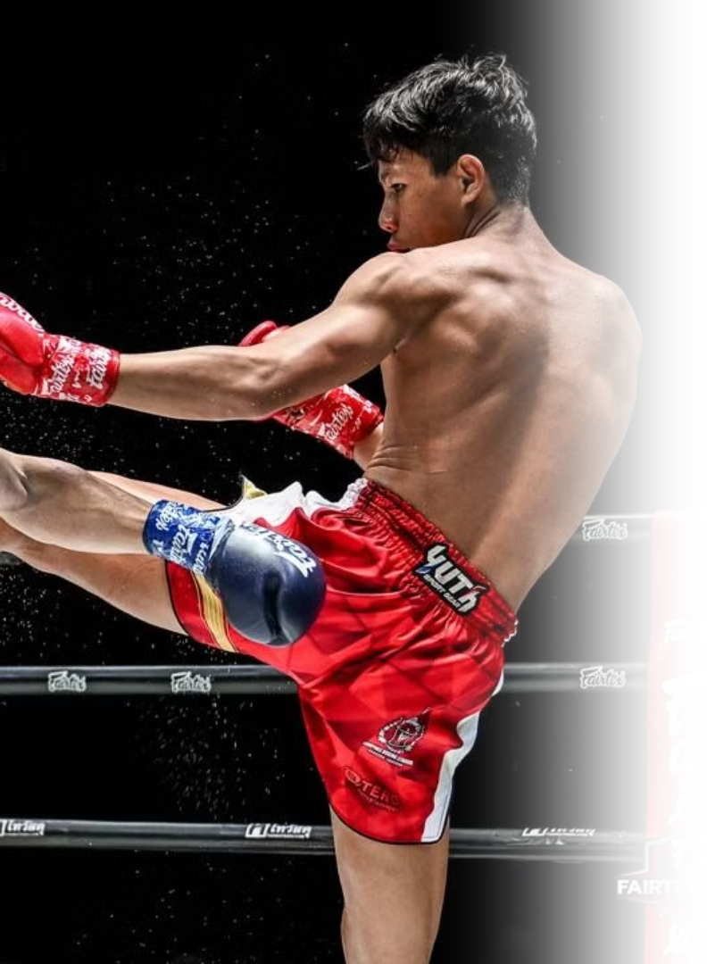
Muay Thai: The Art of Eight Limbs
Muay Thai is Thailand's renowned martial art, known as the "Art of Eight Limbs" for its powerful use of fists, elbows, knees, and shins. Celebrated worldwide for its striking techniques, Muay Thai is also deeply rooted in values of respect, discipline, and self-improvement.
Photo credit: Naewna

Slide 35
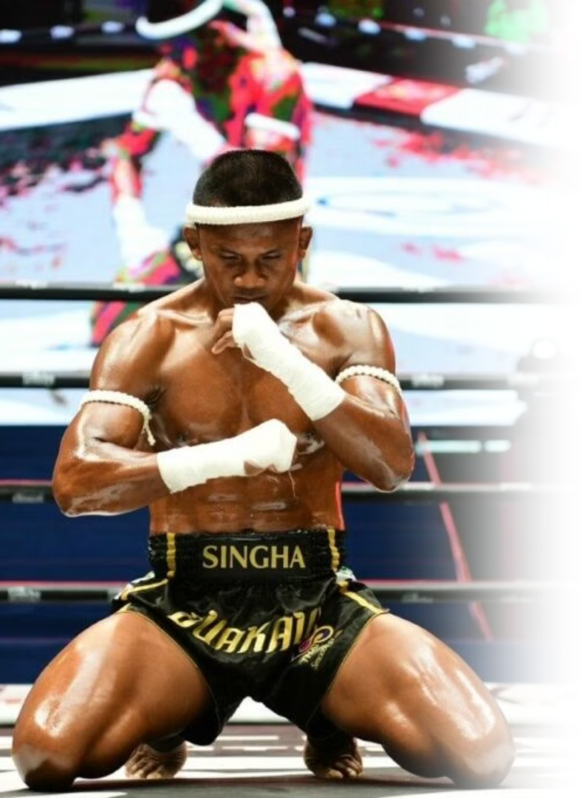
Wai Khru Ram Muay
Wai khru ram muay (ไหว้ครูรำมวย) is a traditional pre-fight ritual performed by Muay Thai fighters to show respect to their teachers and the sacred forces they believe in. Combining graceful movements with symbolic gestures, the ritual reflects the fighter's gratitude, humility, and mental preparation before combat. It is an important cultural expression that connects Muay Thai to its spiritual and historical roots.
Pictured: Buakaw Banchamek Thai muay thai fighter and kickboxer Photo credit: Huahin Living

Slide 36
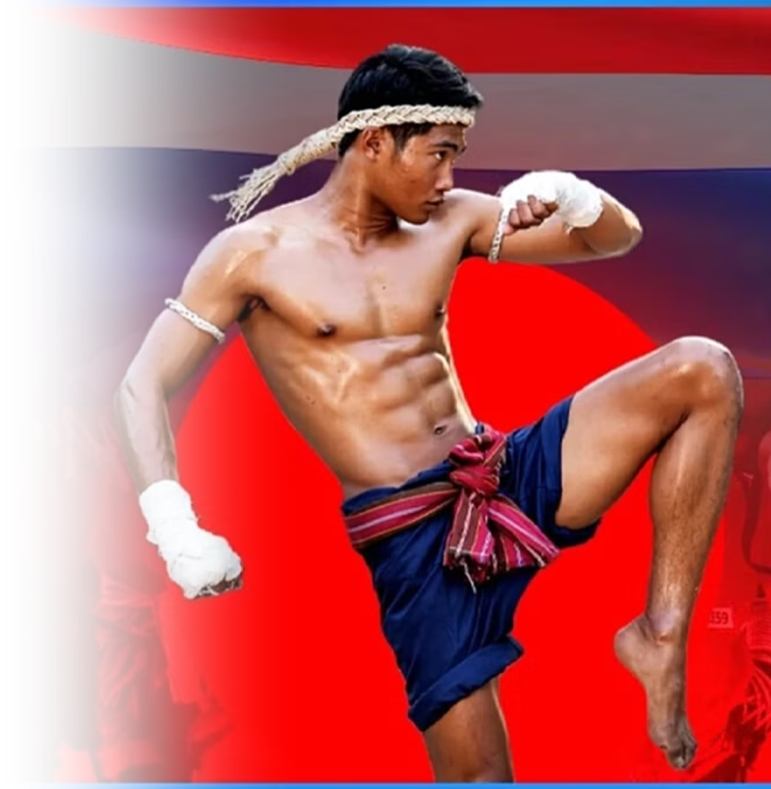
Art of Eight Limbs
Muay Thai utilizes the fists, elbows, knees, and shins. Muay Thai techniques are traditionally divided into two categories: mae mai (major techniques) and luk mai (minor techniques). Mae mai includes the fundamental moves such as powerful punches, elbows, knees, and kicks that form the foundation of the art. Luk mai, on the other hand, consists of more advanced or refined techniques, often involving counters, feints, and strategic movements used to gain an advantage over an opponent. Together, these techniques showcase the depth, precision, and tactical richness of Muay Thai.
Photo credit: bangkokbiznews

Slide 37
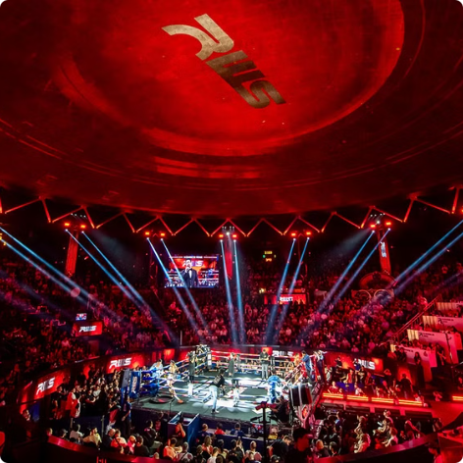
Famous Muay Thai Stadiums
Rajadamnern Stadium
Lumpinee Stadium
Rajadamnern Stadium is the oldest Muay Thai stadium in Thailand, offering an authentic and historic atmosphere for fans to experience traditional Thai boxing.
Lumpinee Stadium is one of Thailand’s most iconic Muay Thai arenas, known for hosting top-level fights such as ONE Lumphinee and showcasing the sport’s finest athletes.
Photo credit: Rajadamnern Stadium, muaythai2000

