Slide 1
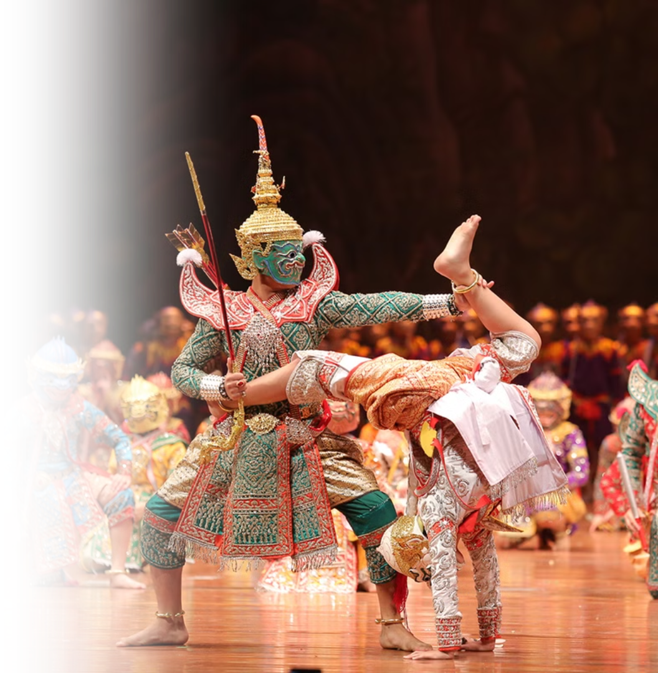

Thai Culture:
A Journey Through Heritage and Traditions
Photo credit: Lets Tour Bangkok
Notes:
1

Slide 2
Thailand in Brief
"Thailand in Brief " has been prepared by the Thailand Foundation to support students, scholars, and the general public who wish to give presentations about Thailand to their audiences—for example, exchange program students and international participants.
The work presents some basic information about Thailand in 11 areas: 1) Geography, 2) History, 3) Politics and Government, 4) Economics, 5) Demographics, 6) Culture, 7) Values, 8) Thai People and Other Popularity That You May Know,
9) Misconceptions about Thailand, 10) Thailand's Role on the Global Stage, and 11) Rankings Related to Thailand.
"Thailand in Brief" is produced in both PDF file (.pdf) and Powerpoint Presentation (.pptx) formats, consisting of 394 slides. Users may download and select the topics they wish to present, and may rearrange the sequence of the slides as appropriate. However, the content of this document cannot be edited. Reproduction or use for commercial purposes without permission from the Thailand Foundation is not allowed.
"Thailand in Brief" will be updated every third quarter each year. For inquiries or further suggestions, please contact the Thailand Foundation at info@thailandfoundation.or.th.
22 July 2026
Notes:
2

Slide 3
Thailand in Brief
"Thailand in Brief " จัดทำขึ้นโดยมูลนิธิไทย (Thailand Foundation) เพื่ออำนวยความสะดวกแก่ นักเรียน นักศึกษา และผู้สนใจทั่วไป นำไปใช้ประโยชน์
อาทิ ในการบรรยาย หรือให้ความรู้เกี่ยวกับประเทศไทยในด้านต่าง ๆ แก่ชาวต่างประเทศ เช่น กรณีนักศึกษาแลกเปลี่ยนที่ไปเรียนในต่างประเทศที่ต้องนำเสนอเรื่องราว
เกี่ยวกับประเทศไทยในสถาบันที่ไปศึกษาอยู่ เป็นต้น
งานชิ้นนี้เสนอข้อมูลเกี่ยวกับประเทศไทยโดยสังเขป 11 ด้าน ได้แก่ 1) ภูมิศาสตร์ (Geography) 2) ประวัติศาสตร์ (History) 3) การเมืองการปกครอง
(Politics and Government) 4) เศรษฐกิจ (Economics) 5) ประชากร (Demographics) 6) วัฒนธรรม (Culture) 7) ค่านิยม (Values)
8) คนไทยและสื่อที่คุณอาจรู้จัก (Thai people and other popularity that you may know) 9) ความเข้าใจผิดเกี่ยวกับประเทศไทย (Misconceptions)
10) บทบาทของไทยในเวทีโลก (Thailand’s role on the Global Stage) และ 11) การจัดอันดับที่เกี่ยวกับประเทศไทย (Rankings related to Thailand)
"Thailand in Brief " นี้จัดทำเป็นสไลด์ จำนวน 394 สไลด์ ในรูปแบบ .pdf และ .pptx สามารถดาวน์โหลดและเลือกใช้หัวข้อที่นำเสนอ และสลับลำดับการนำเสนอได้
ตามความเหมาะสม อย่างไรก็ดี ผู้ใช้งานไม่สามารถดัดแปลงเนื้อหาในเอกสารได้ และห้ามผลิตซ้ำ หรือนำไปใช้เพื่อผลประโยชน์เชิงพาณิชย์โดยไม่ได้รับอนุญาตจากมูลนิธิไทย
"Thailand in Brief " จะได้รับการปรับปรุงให้ทันสมัยในทุกไตรมาสที่ 3 ของปี หากมีข้อสงสัยและข้อเสนอแนะเพิ่มเติม กรุณาติดต่อมูลนิธิไทย
อีเมล info@thailandfoundation.or.th
22 กรกฎาคม 2569
Notes:
3

Slide 4
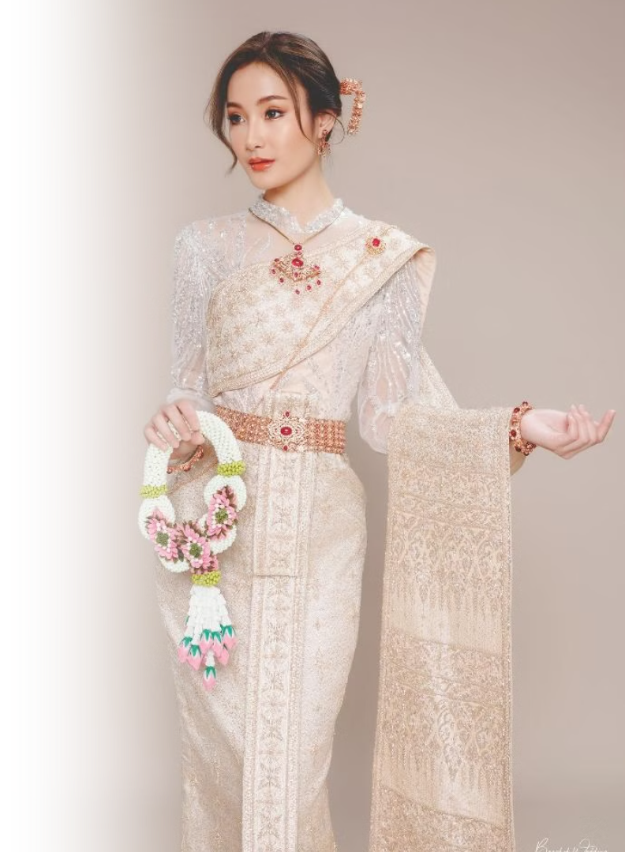
Chud Thai –
Traditional Thai
Clothing
Chud Thai (ชุดไทย) refers to traditional Thai clothing.
Chud Thai can be worn for ceremonies, formal functions,
cultural occasions, or even for fashion and recreation.
Traditional Thai clothing was featured internationally through
La Mode en Majesté: Royal Thai Dress From Tradition to Modernity
at the Musée des Arts Décoratifs, Paris from 13 May–1 November 2026.
The exhibition also supports Thailand’s efforts to propose Chud Thai Phra Ratcha Niyom (Royal Thai National Dress) for UNESCO intangible cultural heritage recognition.
Photo credit: Bangkok Wedding Studio
Notes:
4

Slide 5
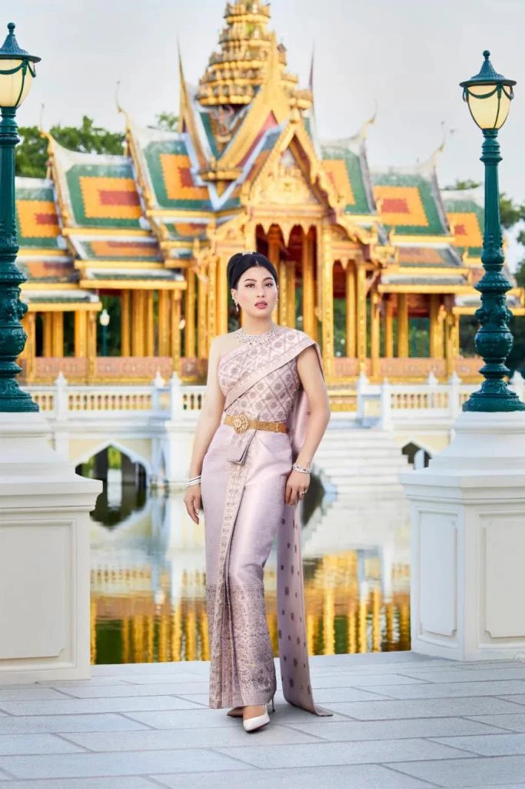
The Eight Styles of Chud Thai Phra Ratcha Niyom
(Royal Thai National Dress)
Chud Thai Phra Ratcha Niyom (ชุดไทยพระราชนิยม) refers to eight royally endorsed styles of Thai national dress, reflecting Thai textile craftsmanship, elegance, and cultural identity.
1
Thai Chakri Dress (ชุดไทยจักรี)
Named after Chakri Maha Prasat Throne Hall in the Grand Palace, Bangkok. A formal evening style with a one-shoulder sabai (Cloth/shawl worn across the chest) and pleated silk skirt, often used for weddings and receptions.
Pictured: Her Royal Highness Princess Sirivannavari Nariratana Rajakanya
Photo credit: Official Facebook Page of HRH Princess Sirivannavari Nariratana Rajakanya
Notes:
4

Slide 6
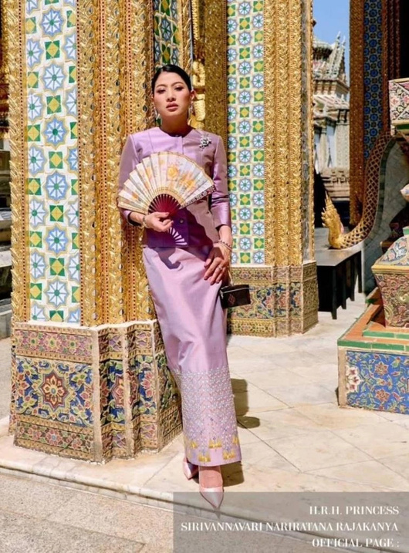
The Eight Styles of Chud Thai Phra Ratcha Niyom
(Royal Thai National Dress)
2
Thai Ruean Ton Dress (ชุดไทยเรือนต้น)
Named after Ruean Ton Residential Hall in Dusit Palace,
Bangkok. A more casual style for informal occasions, usually featuring a simple blouse and ankle-length wrap skirt.
Pictured: Her Royal Highness Princess Sirivannavari Nariratana Rajakanya
Photo credit: Official Facebook Page of HRH Princess Sirivannavari Nariratana Rajakanya
Notes:
4

Slide 7
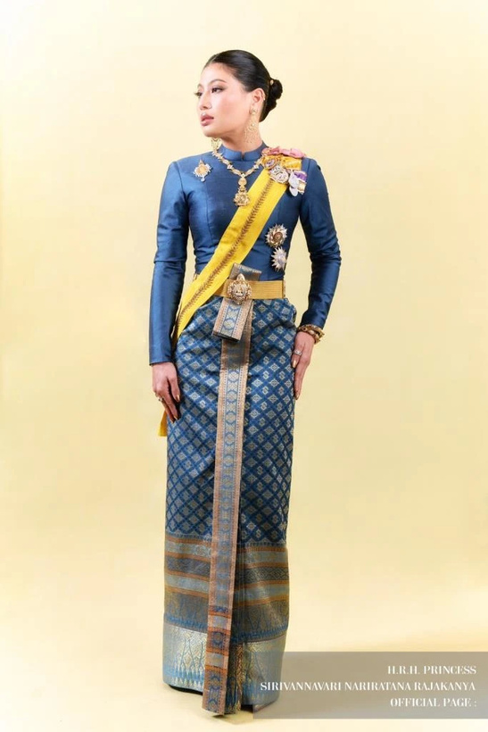
The Eight Styles of Chud Thai Phra Ratcha Niyom
(Royal Thai National Dress)
3
Thai Boromphiman Dress (ชุดไทยบรมพิมาน)
Named after Boromphiman Throne Hall in the Grand Palace, Bangkok. A formal evening or royal ceremony style with a long-sleeved blouse and skirt sewn together as one elegant dress.
Pictured: Her Royal Highness Princess Sirivannavari Nariratana Rajakanya
Photo credit: Official Facebook Page of HRH Princess Sirivannavari Nariratana Rajakanya
Notes:
4

Slide 8
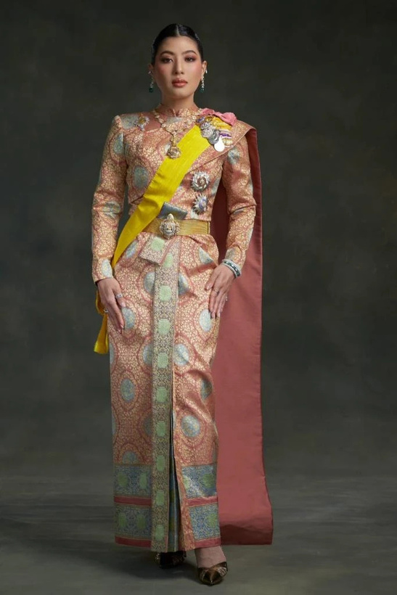
The Eight Styles of Chud Thai Phra Ratcha Niyom
(Royal Thai National Dress)
4
Thai Siwalai Dress (ชุดไทยศิวาลัย)
Named after Siwalai Garden in the Grand Palace, Bangkok.
A formal ceremonial style similar to Boromphiman, but with an added shoulder cloth or sabai.
Pictured: Her Royal Highness Princess Sirivannavari Nariratana Rajakanya
Photo credit: Official Facebook Page of HRH Princess Sirivannavari Nariratana Rajakanya
Notes:
4

Slide 9
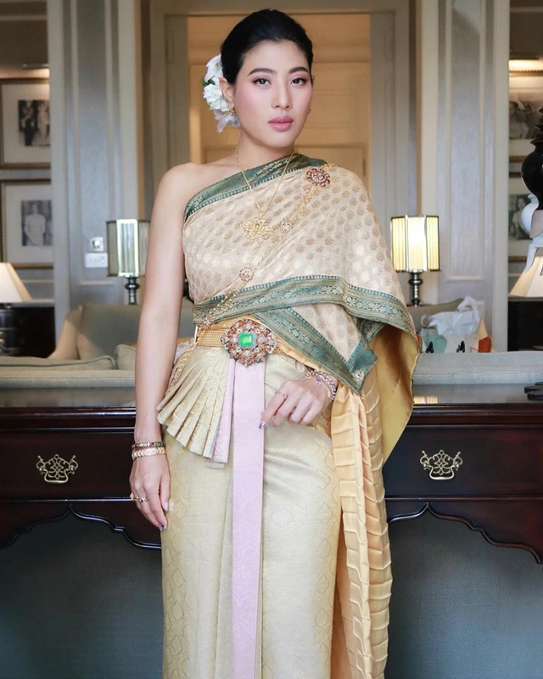
The Eight Styles of Chud Thai Phra Ratcha Niyom
(Royal Thai National Dress)
5
Thai Chakkraphat Dress (ชุดไทยจักรพรรดิ)
Named after Chakkraphat Phiman Throne Hall in the Grand Palace, Bangkok. The most formal style, worn for grand evening ceremonies, with layered shoulder cloths and richly decorated silk.
Pictured: Her Royal Highness Princess Sirivannavari Nariratana Rajakanya
Photo credit: Official Facebook Page of HRH Princess Sirivannavari Nariratana Rajakanya
Notes:
4

Slide 10
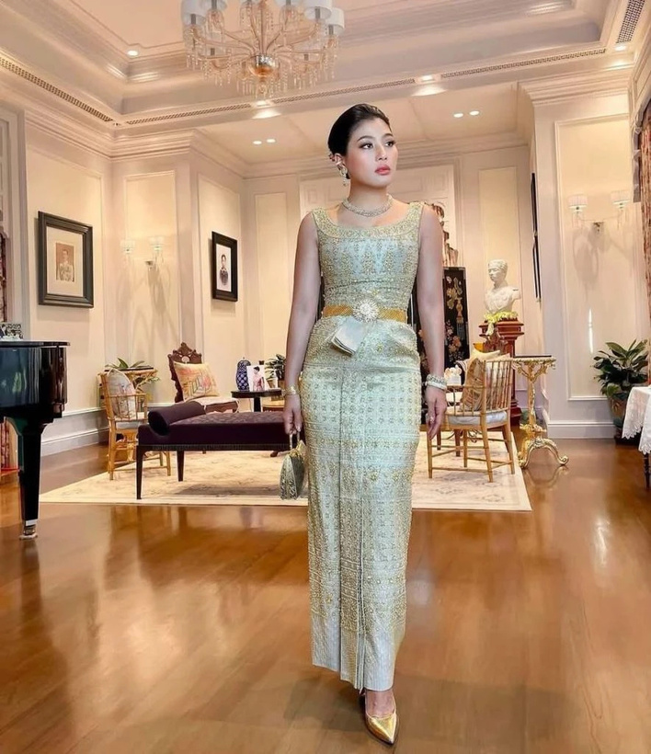
The Eight Styles of Chud Thai Phra Ratcha Niyom
(Royal Thai National Dress)
6
Thai Dusit Dress (ชุดไทยดุสิต)
Named after Dusit Maha Prasat Throne Hall in
the Grand Palace, Bangkok. A full formal evening style with
a sleeveless, wide-neck top and richly woven silk skirt.
Pictured: Her Royal Highness Princess Sirivannavari Nariratana Rajakanya
Photo credit: Official Facebook Page of HRH Princess Sirivannavari Nariratana Rajakanya
Notes:
4

Slide 11
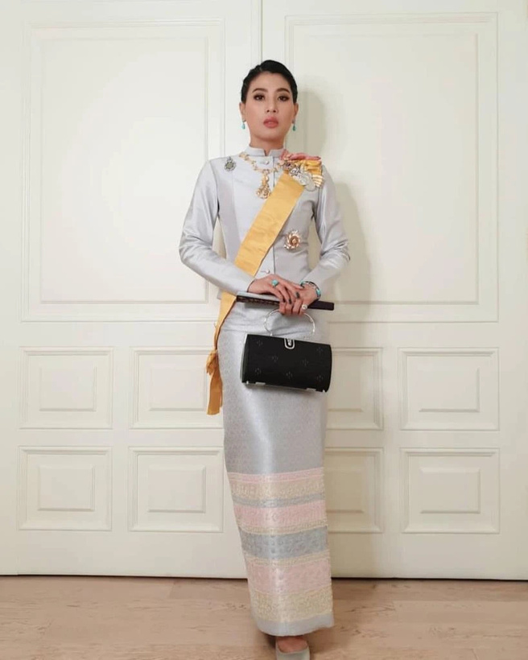
The Eight Styles of Chud Thai Phra Ratcha Niyom
(Royal Thai National Dress)
7
Thai Chitlada Dress (ชุดไทยจิตรลดา)
Named after Chitralada Villa Royal Residence, Bangkok.
A formal daytime style, often worn for ceremonies, with a long-sleeved blouse and silk wrap skirt.
Pictured: Her Royal Highness Princess Sirivannavari Nariratana Rajakanya
Photo credit: Official Facebook Page of HRH Princess Sirivannavari Nariratana Rajakanya
Notes:
4

Slide 12
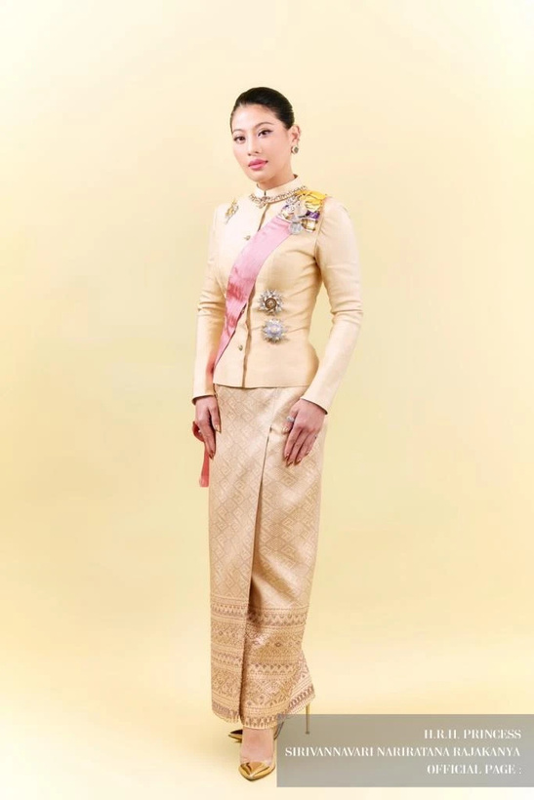
The Eight Styles of Chud Thai Phra Ratcha Niyom
(Royal Thai National Dress)
8
Thai Amarin Dress (ชุดไทยอมรินทร์)
Named after Amarin Winitchai Throne Hall in the Grand Palace, Bangkok. A formal evening or royal ceremony style, similar to
Chitlada but made with more luxurious brocaded silk.
Pictured: Her Royal Highness Princess Sirivannavari Nariratana Rajakanya
Photo credit: Official Facebook Page of HRH Princess Sirivannavari Nariratana Rajakanya
Notes:
4

Slide 13
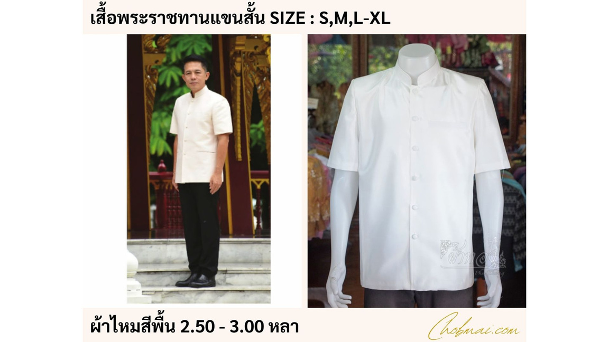
The Three Styles of Suea Phraratchathan:
Thai National Attire for Men
1
Suea Phraratchathan (เสื้อพระราชทาน), or
the royally bestowed shirt, is a formal Thai national attire for men. It is usually worn with formal trousers and is suitable for official, ceremonial, and cultural occasions.
The style is known for its standing collar, front buttons, neat tailoring, and elegant simplicity.
Photo credit: Chob Mai Silk
Short-Sleeved Suea Phraratchathan
The least formal style, suitable for general occasions, daytime events, or semi-formal cultural functions.
Notes:
4

Slide 14
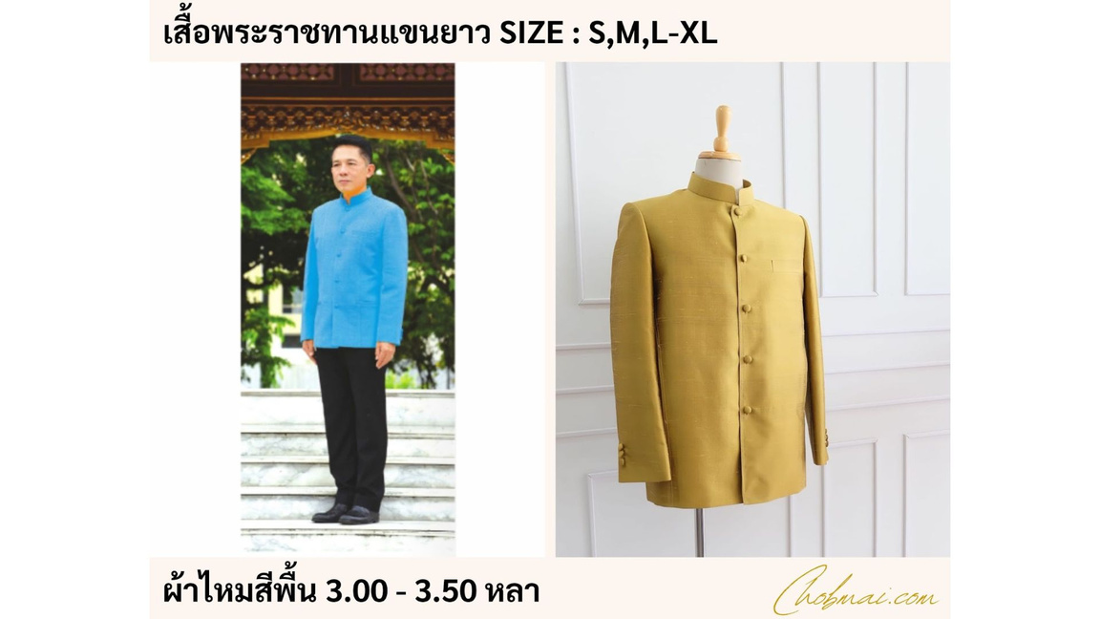
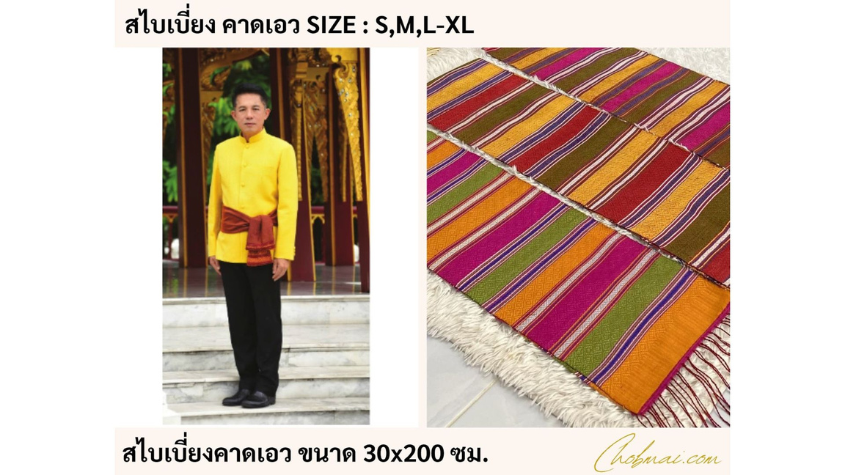
The Three Styles of Suea Phraratchathan:
Thai National Attire for Men
2
3
Long-Sleeved Suea Phraratchathan
A more formal style, suitable for official ceremonies, receptions, and formal daytime or evening events.
Long-Sleeved Suea Phraratchathan with Sash
The most formal style, featuring a waist sash tied on the wearer’s left side, suitable for important ceremonial occasions.
Photo credit: Chob Mai Silk
Notes:
4

Slide 15
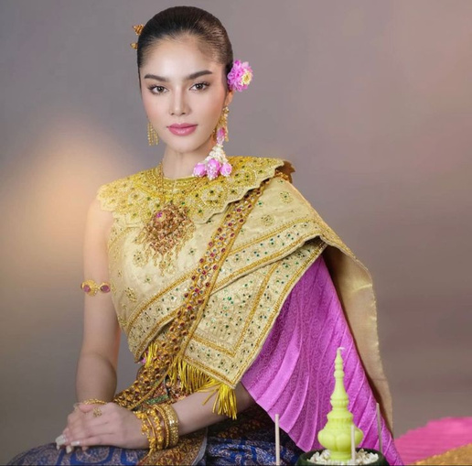
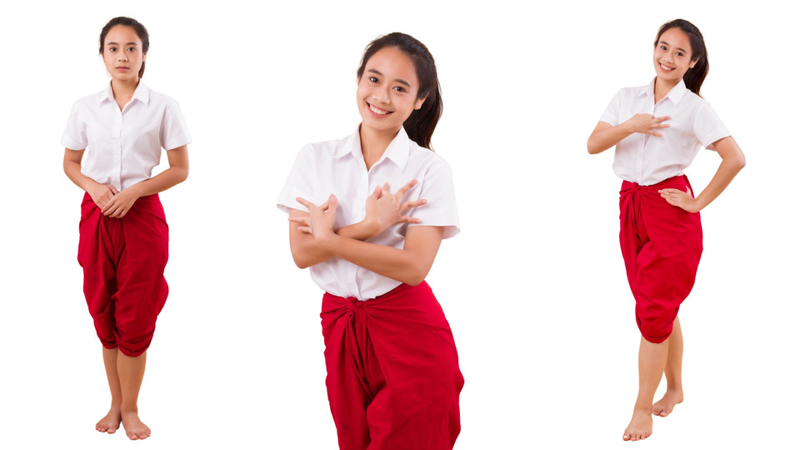
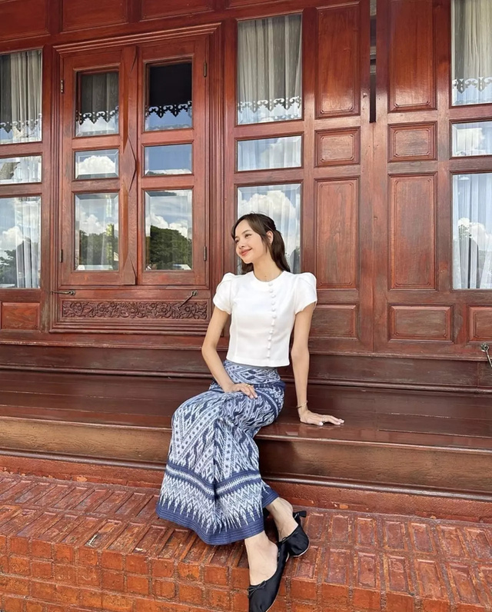
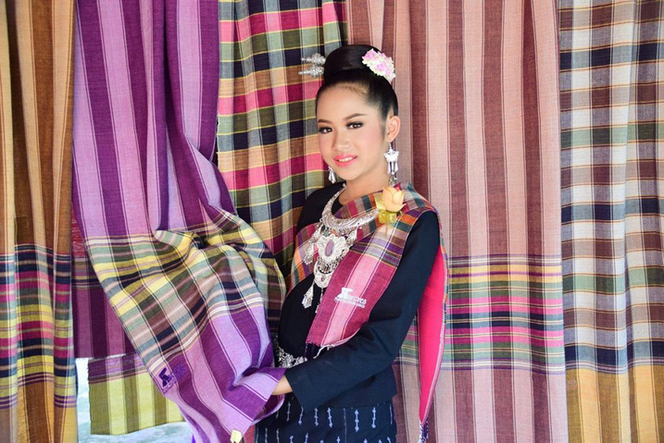
Some Elements of Thai Traditional Clothing
Sabai (สไบ)
Chong Kraben (โจงกระเบน)
Pha Sin (ผ้าซิ่น)
Pha Khao Ma (ผ้าขาวม้า)
Cloth/shawl worn across the chest
Lower garment wrapped around the waist
Traditional tube skirt
Multipurpose,
checkered cloth
Photo credit: Praew Wedding, Chobmai Silk, lalalalisa_m on Instagram, anurakmag
Notes:
5

Slide 16
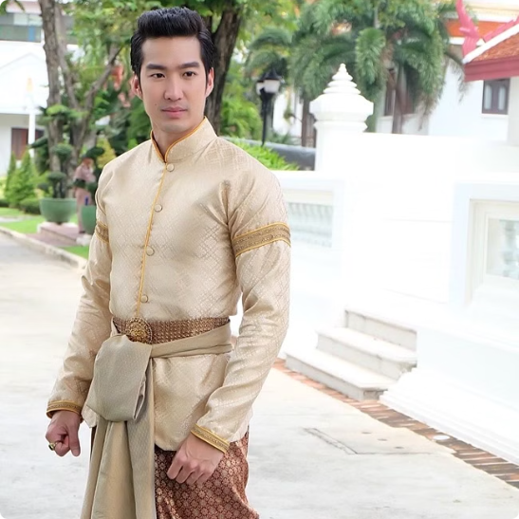
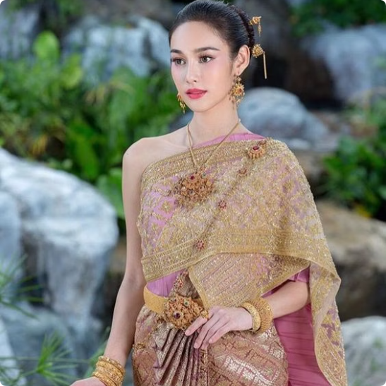
Men's Clothing
Women's Clothing
Chong kraben with shirt
Sabai with skirt or chong kraben
Photo credit: Men Kapook, Pinterest
Notes:
6

Slide 17
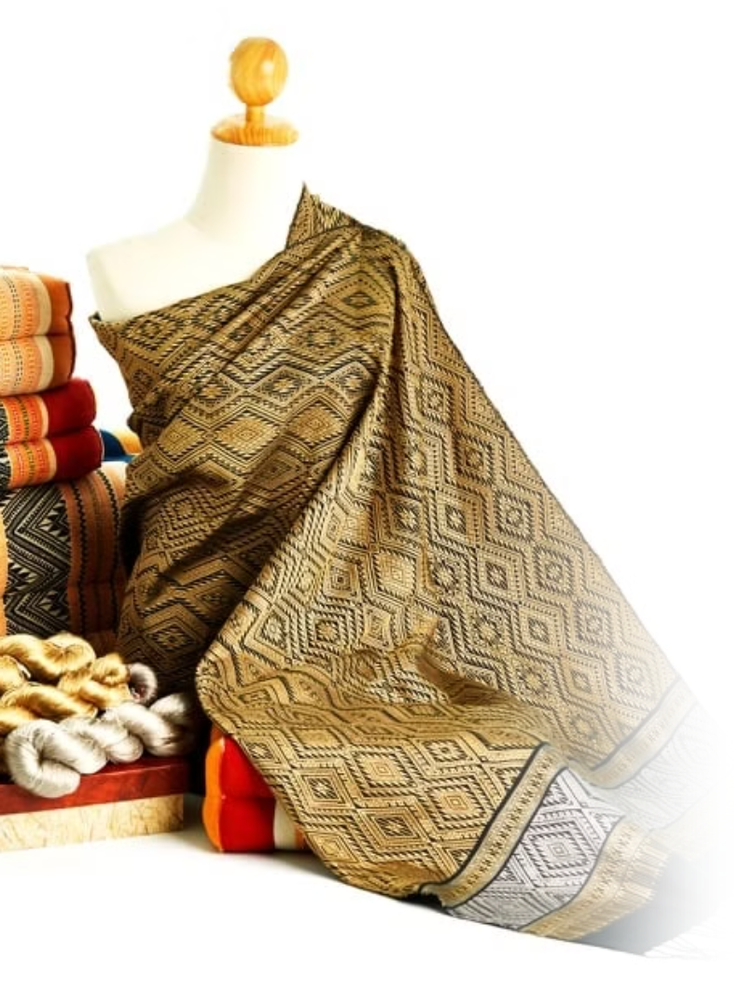
Thai Silk
Luxury Fabric
Modern Applications
Thai silk is globally renowned as luxury fabric due to its fine quality, vibrant colors, and exquisite weaving patterns.
Today, Thai silk is used in both traditional garments and contemporary fashion, showcasing Thailand's blend of heritage and innovation.
Where to Purchase
Thai silk can be purchased through brands such as Jim Thompson or from craftsmen through organizations like the Sustainable Arts and Institute of Thailand (SACIT).
Photo credit: MGR Online
Notes:
7

Slide 18
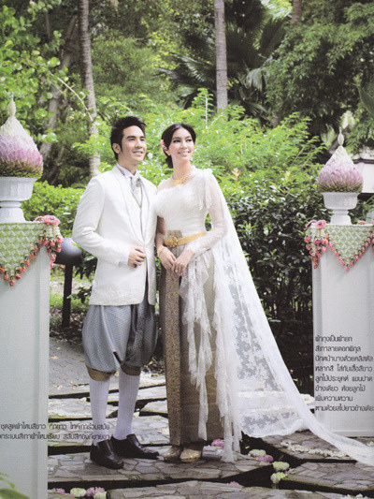
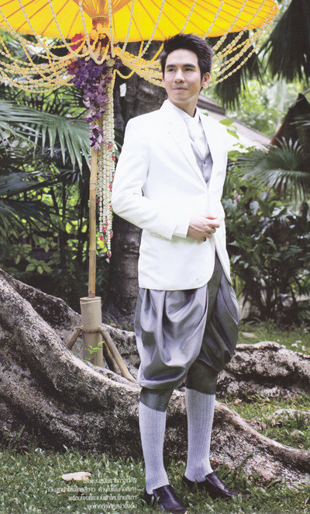
Chong Kraben and Blazer: Modern Thai Fusion Attire
A contemporary Thai fashion style pairs
a Western-style blazer or suit jacket with chong kraben, blending modern tailoring with traditional Thai attire.
Often seen in Thai weddings and formal fashion, this look reflects how Thai clothing continues to evolve while preserving cultural identity.
Photo credit: Kapook
Notes:
6

Slide 19
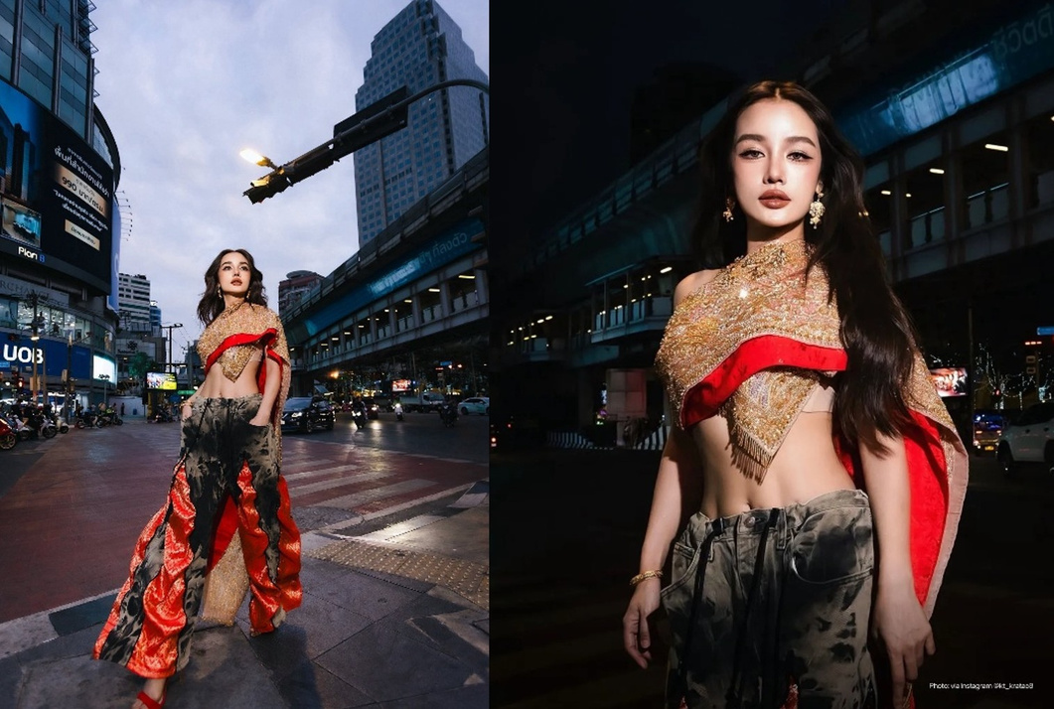
Sabai and Jeans: Tradition Meets Modern Streetwear
Hom Sabai Sai Jeans (ห่มสไบ ใส่ยีนส์) is a 2026 fashion trend that pairs the traditional Thai sabai with modern denim jeans.
The trend became popular among young people, influencers, and travelers, showing how Thai cultural heritage can be creatively reinterpreted in everyday fashion.
Pictured: Kratae Rsiam wearing a sabai paired with jeans in a music video promoting the song Bangkok City
Photo credit: Khaosod & VOGUE Thailand
Notes:
6

Slide 20
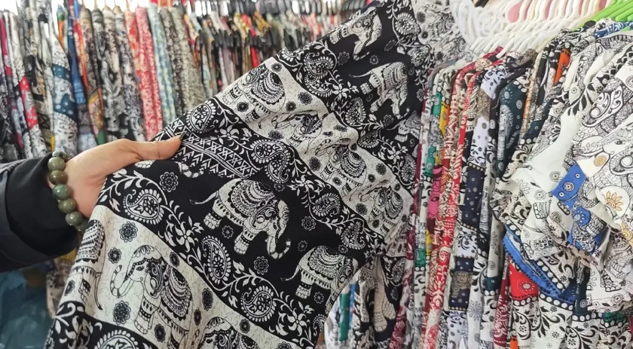
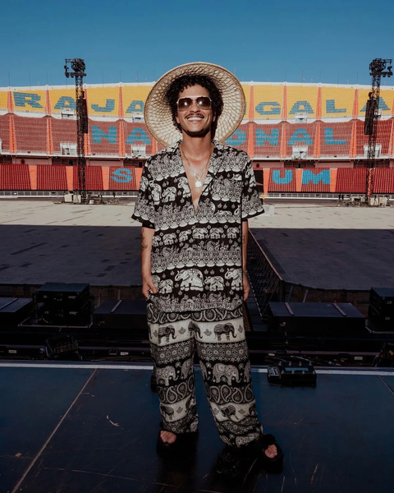
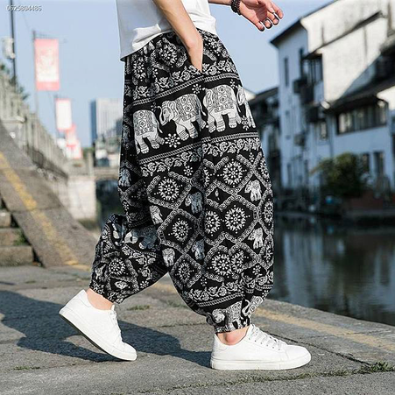
Thai Elephant Pants:
Functional Fashion
Thai elephant pants (กางเกงช้าง) are loose, lightweight trousers known for their elephant-print patterns. Popular among both locals and visitors, they are comfortable, affordable, and well suited to Thailand’s hot climate.
More than a souvenir, elephant pants have become an everyday cultural fashion item, reflecting Thai values of practicality, creativity, playfulness, and openness. Recent designs also feature local provincial icons, turning simple clothing into a platform for cultural storytelling.
Photo credit: nationtv.tv, gqthailand.com, idgthailand.com
Notes:
6

Slide 21
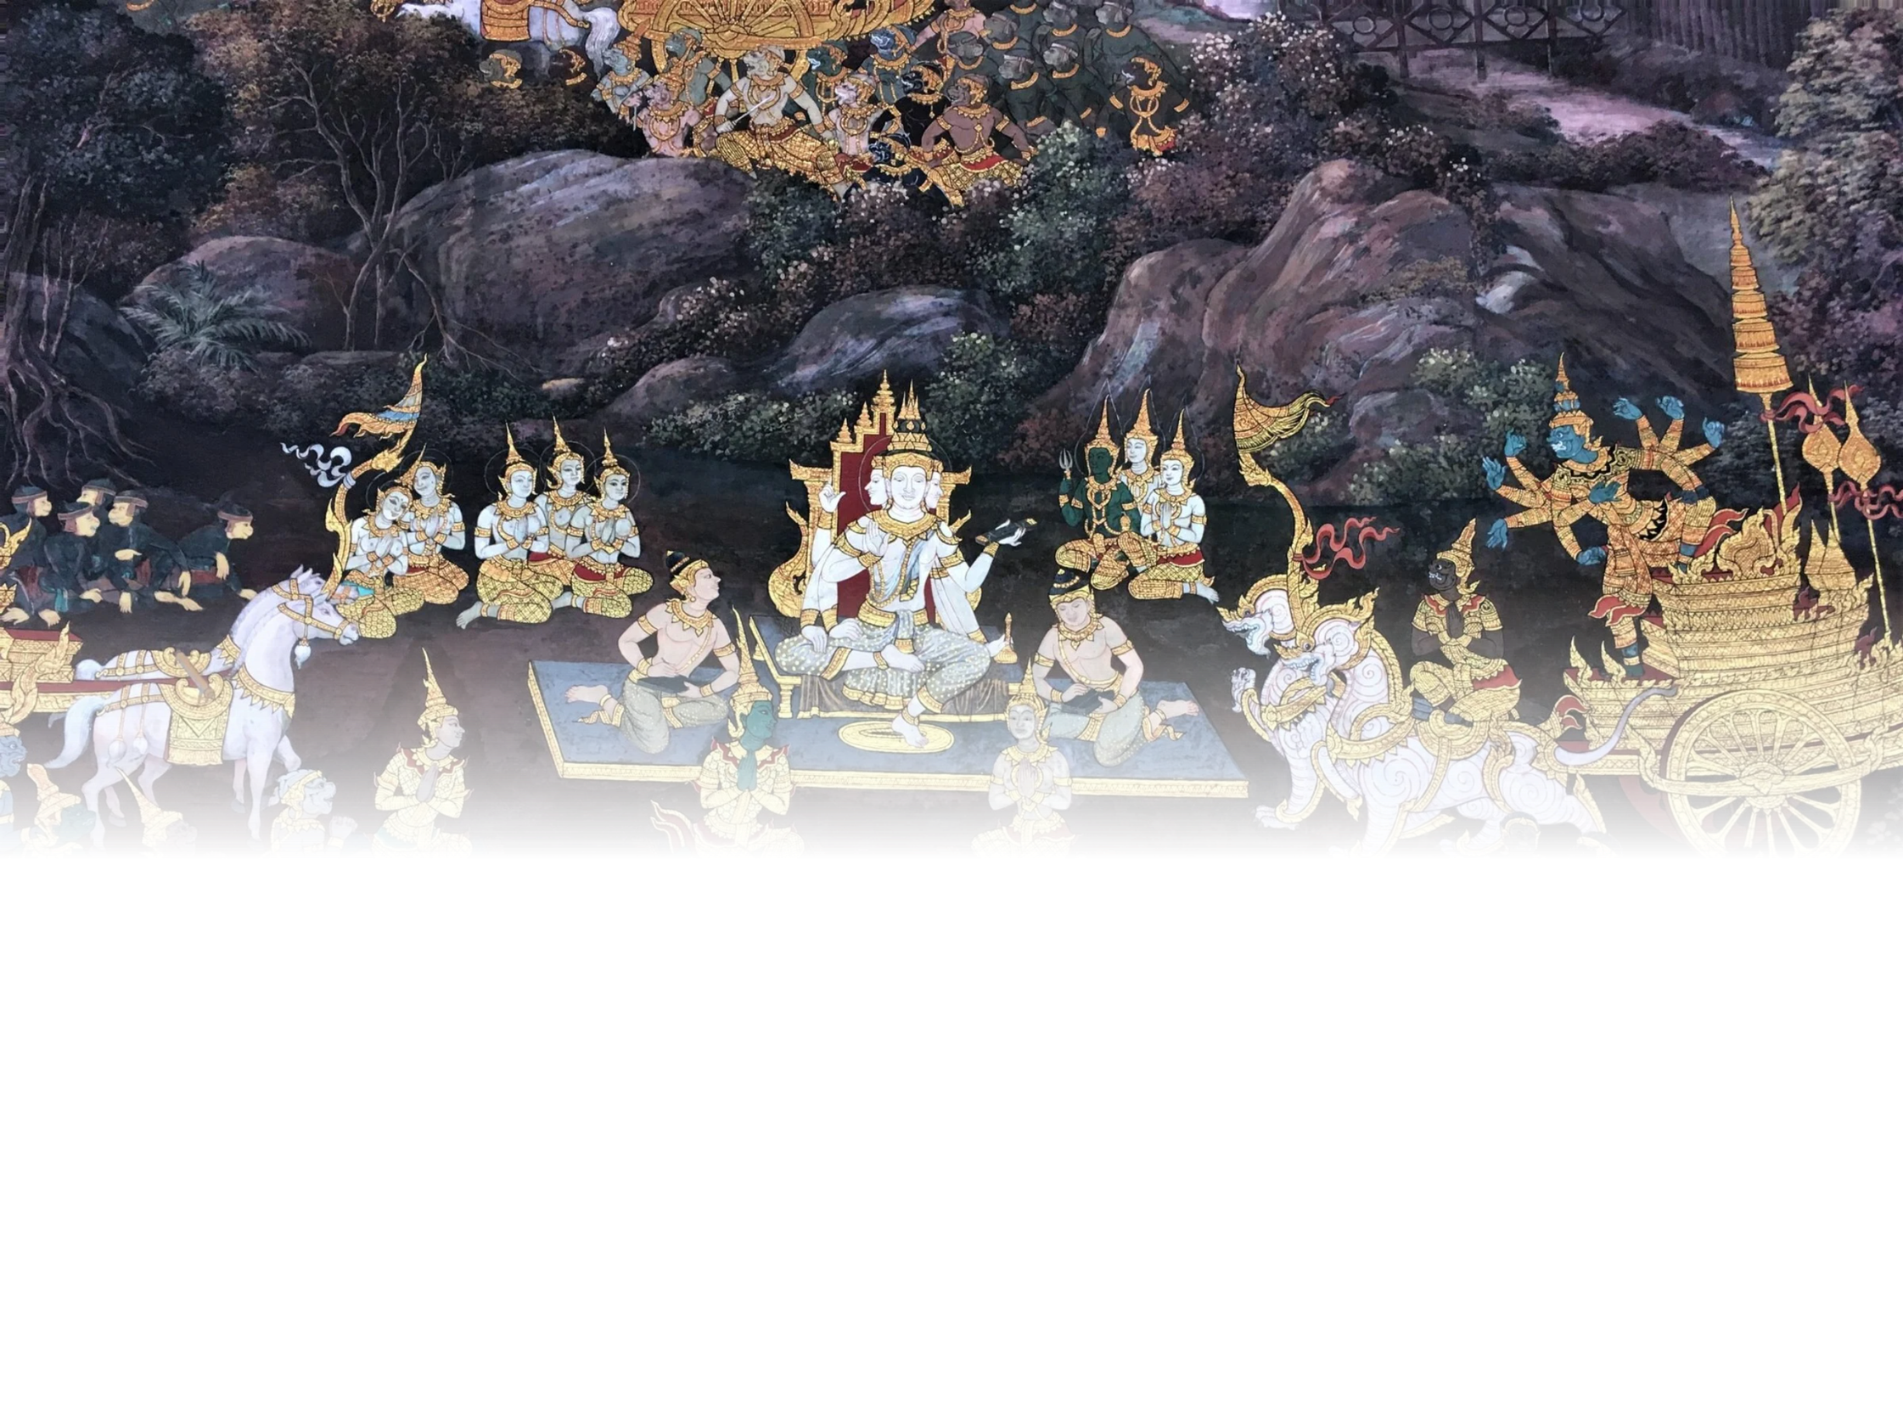



Thai Art
Thai art is known for its delicateness and intricate details, often seen in traditional paintings, temple murals, and carvings, where every element reflects deep craftsmanship and cultural symbolism. In recent years, modern Thai art has flourished, blending traditional themes with contemporary styles.
Photo credit: flickr.com
Explore Thai Art
Scan to discover more stories about Thai Art
on the Thailand Foundation website.
Notes:
8

Slide 22
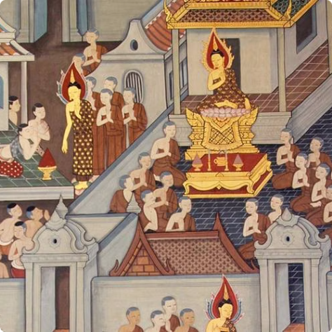
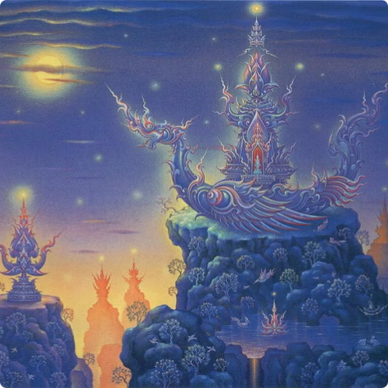
Thai Painting
Traditional Painting
Contemporary Painting
Traditional Thai painting follows the structured system of
lai Thai (ลายไทย) patterns and is rich with deep symbolism
that reflects religious beliefs and cultural values.
Contemporary Thai painting blends traditional themes with global influences, featuring both realistic forms and abstract expressions to explore old and new concepts.
Pictured: Traditional Thai Painting at Wat Pho
Pictured: Painted by Chalermchai Kositpipat
Photo credit: UME Travel, bkstationery
Notes:
9

Slide 23
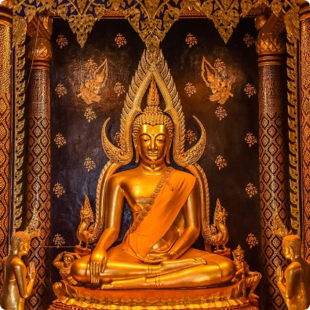
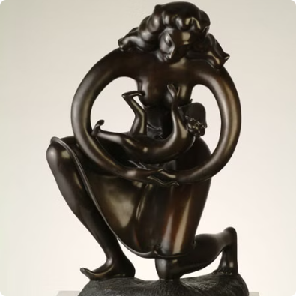
Thai Sculpture
Traditional Sculpture
Contemporary Sculpture
Traditional Thai sculpture features idealistic forms with graceful postures and intricate details, most famously
seen in elegant and serene Buddha statues.
Contemporary Thai sculpture blends traditional elements with both realistic and abstract forms, reflecting
modern perspectives while honoring cultural roots.
Pictured: Buddha Chinnarat housed in Wat Phra Si Rattana Mahathat, Phitsanulok
Photo credit: Palungjit, Ratchadamnoen Contemporary Art Center
Pictured: The "Protector" sculpture created by Ajarn Khien Yimsiri
Notes:
10

Slide 24
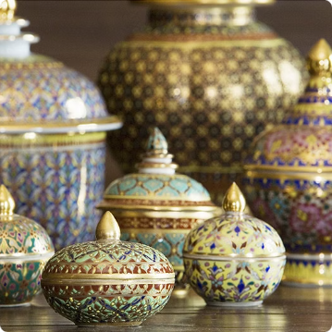
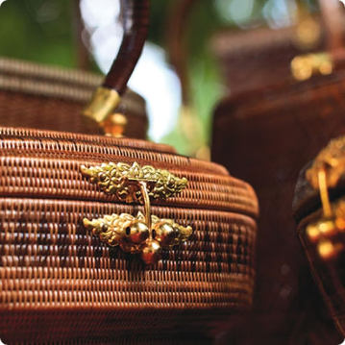
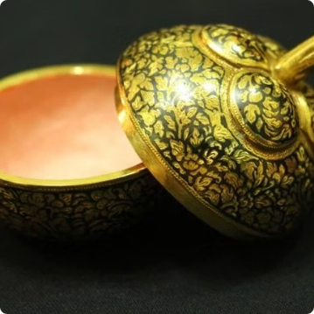
Thai Handicrafts
Benjarong Ceramics
Yaan Liphao Baskets
Thai Nielloware
Benjarong ceramics are traditional Thai porcelain of royal origin, known for their intricate hand-painted designs in vibrant colors
and gold accents.
Yaan liphao baskets are finely woven Thai handicrafts made from a type of natural vine from Southern Thailand, prized for their elegant patterns
and durability.
Thai nielloware is a traditional metalcraft featuring black inlay designs on silver or gold surfaces, admired for its delicate patterns
and high craftsmanship.
Photo credit: Flickr, Nairobroo, The Encyclopedia of Crafts in WCC-Asia Pacific Region
Notes:
11

Slide 25
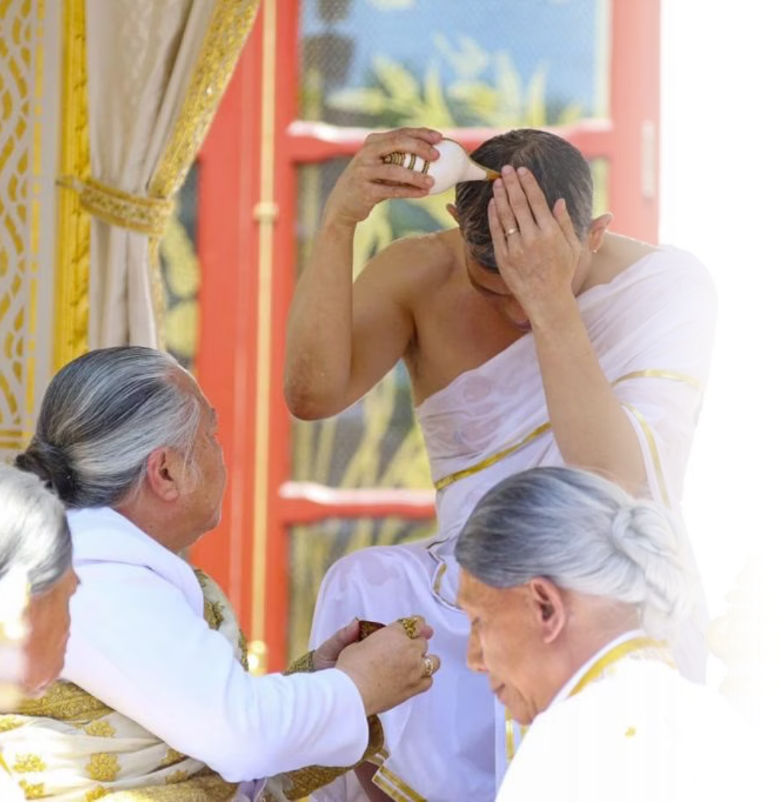
Thai Spirituality
Thai spirituality is a complex blend of Buddhism, Hinduism-Brahmanism, and local animistic beliefs.
Pictured: Rajaguru gives the new King (H.M. KingRama X) sanctified river water to bathe with during Coronation Ceremonies
Photo credit: Hinduismtoday
Notes:
12

Slide 26
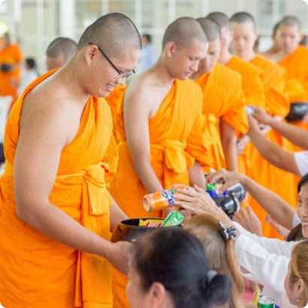
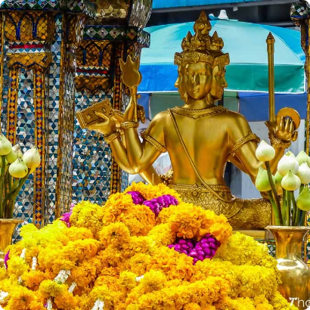
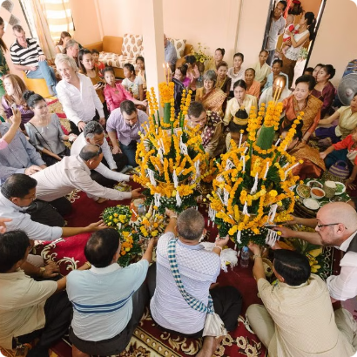
Buddhism
Hinduism
Animism
  Over 90% of Thai people are Buddhist.
  Thais worship Hindu gods alongside the Buddha.
  Animist beliefs have long been part of Thai culture.
  Buddhist teachings greatly impact Thai social values and way of life.
Pictured: The famous Erawan Shrine in Bangkok, dedicated to Hindu God Brahma.
  These beliefs include spirits associated with nature, objects, places, ancestors, and daily life.
Photo credit: kalyanamitra, Thaizer, Princess Maha Chakri Sirindhorn Anthropology Centre
Notes:
13

Slide 27
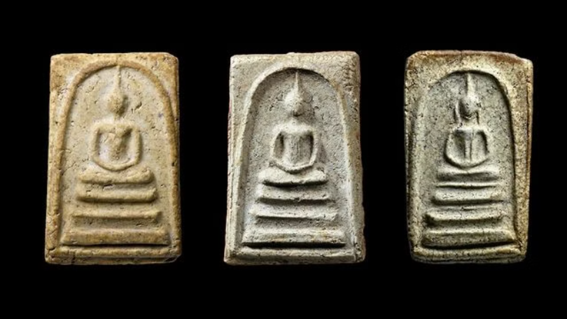
Thai Amulets (พระเครื่อง)
  Depict sacred figures such as the Buddha and famous monks.
  Worn on the body or venerated at homes and business places.
  Believed to grant protection and bring good luck.
  Some prized amulets can reach
millions of dollars!
Photo credit: Thairath
Notes:
14

Slide 28
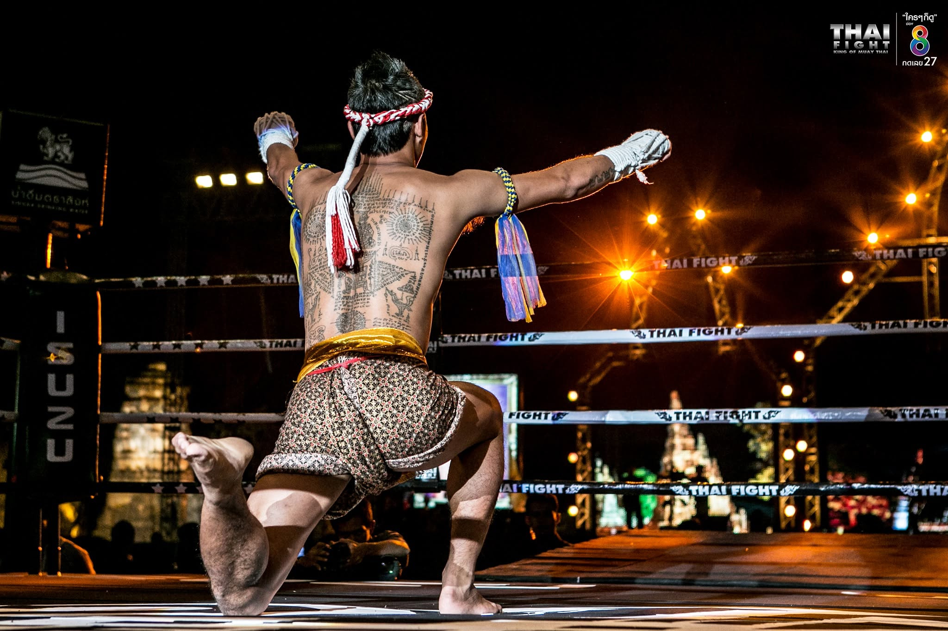
Sak Yant: Yantra Tattoo
(สักยันต์)
  Yantra are sacred symbols and geometric patterns in Hindu and Buddhist beliefs.
  Yantra tattoos depict numbers, symbols, patterns, figures, prayers, and spells, believed to grant protection, charm, and prosperity.
Photo credit: Thai Fight : King Of Muay Thai
Notes:
15

Slide 29
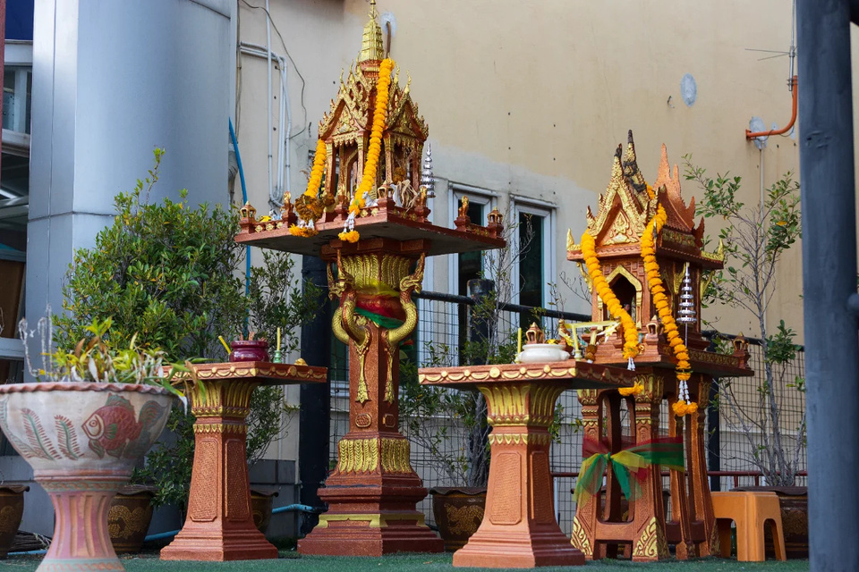
Spirits and Supernatural Forces
Belief in spirits or phi (ผี) is deeply rooted in Thai culture. Spirits can be associated with places and natural features, or can represent ancestors and deceased individuals. Spirit houses are found inside homes and businesses, where people honor the spirits for blessings and protection.
Photo credit: kt-spirithouse
Notes:
16

Slide 30
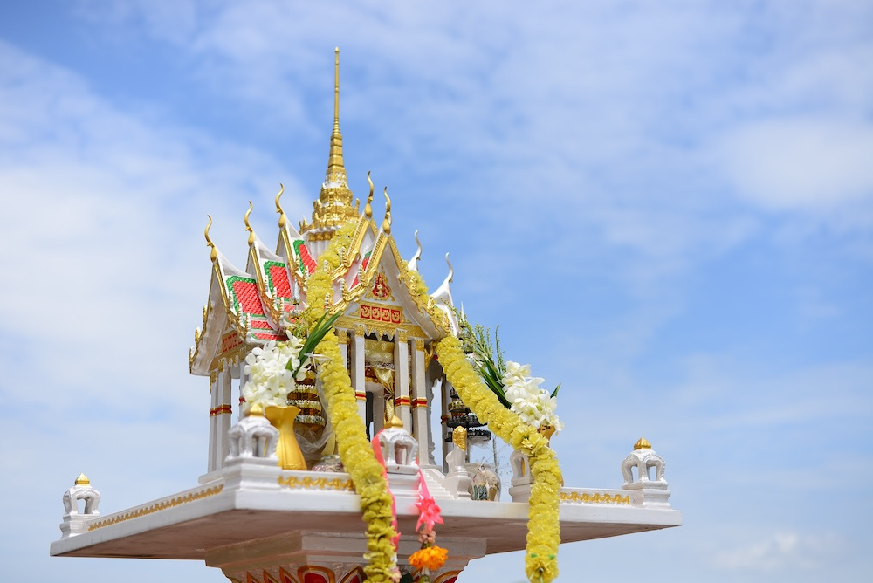
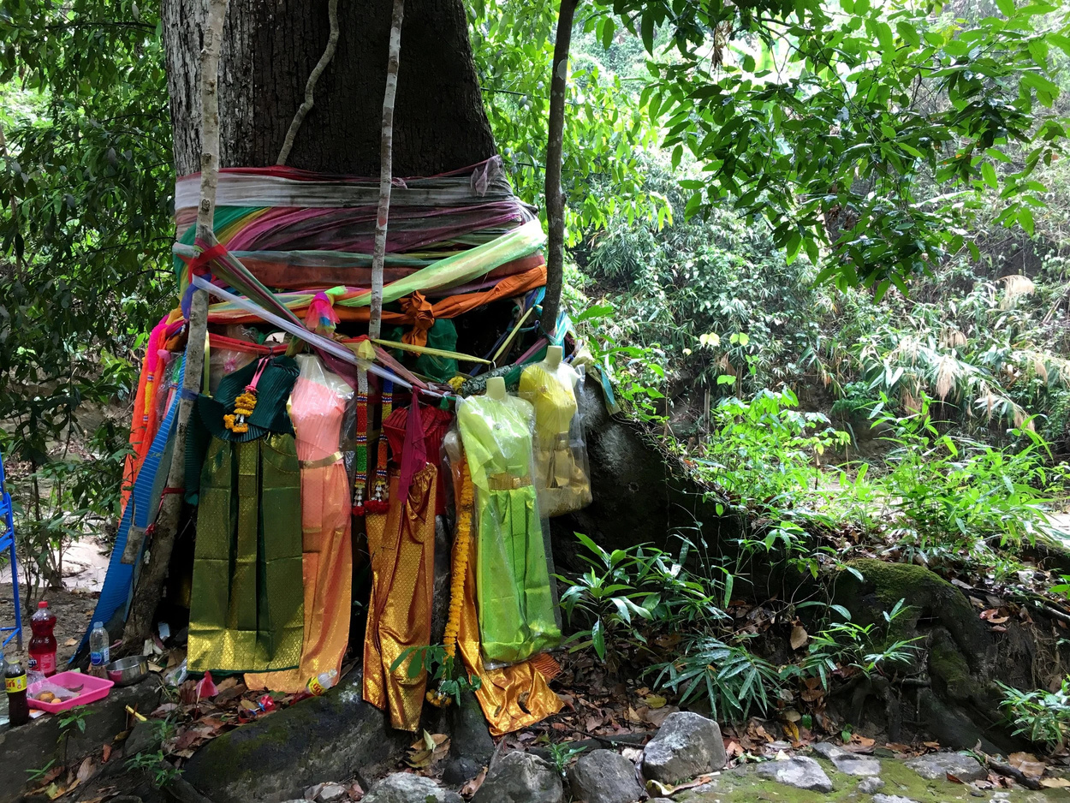
Spirit Houses
Sacred Trees
Dwelling place for the spirit that protects the land
Old trees are believed to be the dwelling place of spirits
Photo credit: Areeya Property Public Company Limited, thenotsoinnocentsabroad
Notes:
17

Slide 31
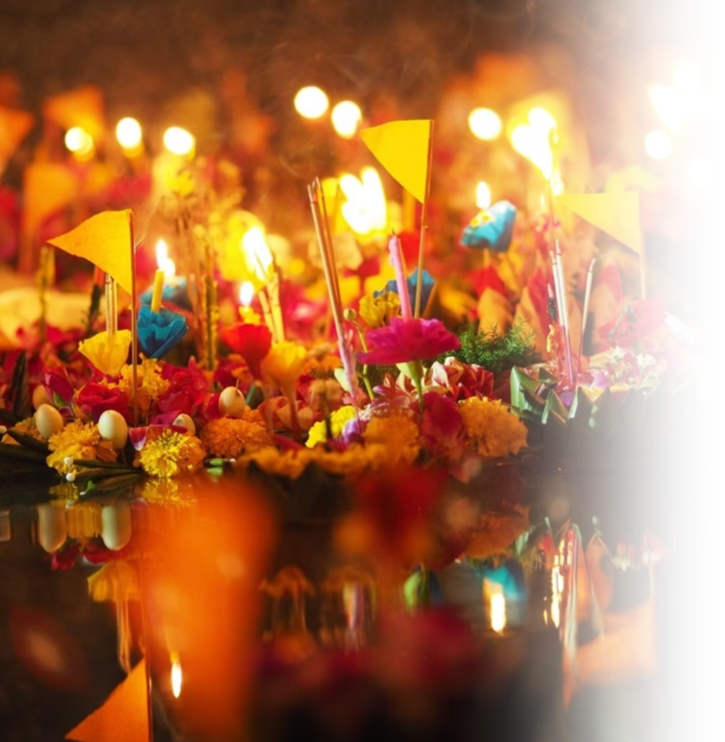

Thai Festivals
Thailand is home to numerous festivals reflecting seasonal changes, Buddhist traditions, local ways of life, and openness towards other cultures.
Photo credit: Everyday Bangkok Hostel
Explore Thai Festivals
Scan to discover more stories about Thai Festivals
on the Thailand Foundation website.
Notes:
18

Slide 32
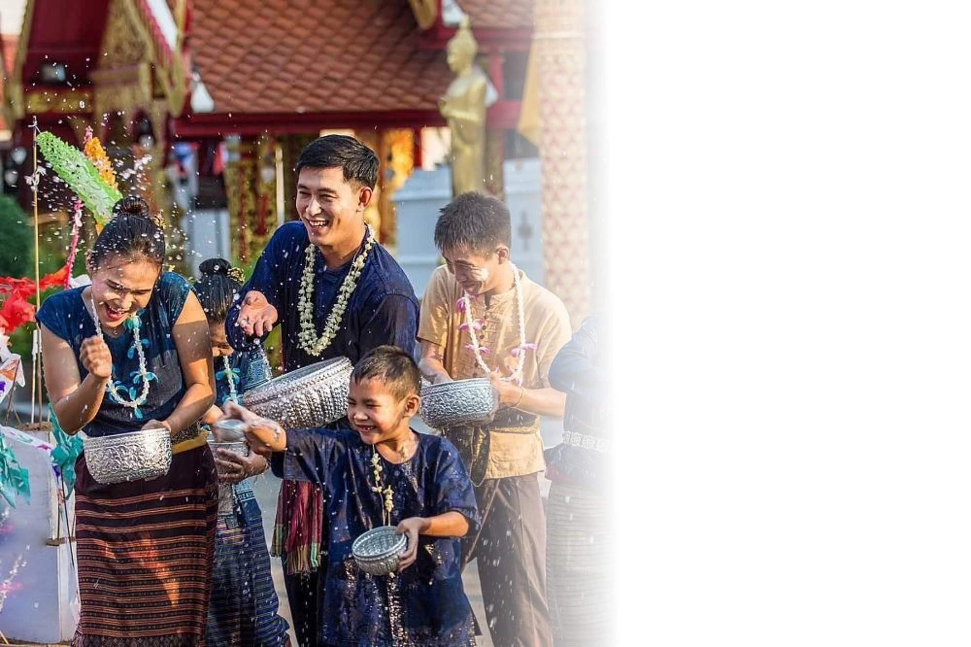
Songkran
Songkran (สงกรานต์) is the traditional Thai New Year festival, celebrated annually from April 13–15. It marks a time of renewal, family gatherings, and religious observances, as well as the famous water splashing festivities.
In 2023, Songkran was inscribed on UNESCO’s Representative List of the Intangible Cultural Heritage of Humanity, recognizing its cultural significance and its role in strengthening family and community bonds.
Activities
  Water splashing
  Pouring water on the hands of elders to show respect
  Bathing of Buddha statues
  Merit-making at temples
Photo credit: Royal Thai Embassy Washington DC
Notes:
19

Slide 33
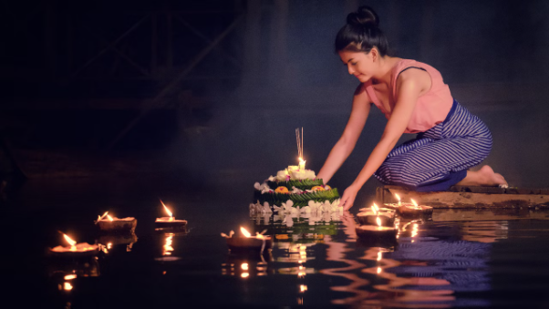
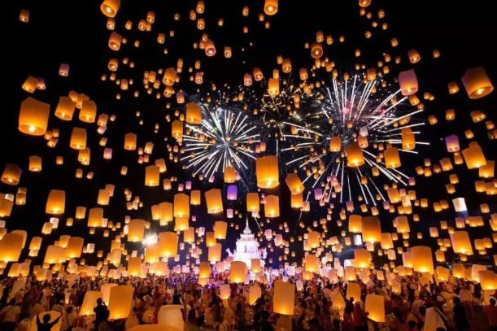
Loy Krathong
Loy Krathong (ลอยกระทง) is celebrated on the night of the full moon in November. People gather around rivers, canals, and lakes to float decorated baskets called krathong (กระทง), made from banana leaves, flowers, candles, and incense.
The act of floating a krathong symbolizes letting go of past negativity, paying respect to the Goddess of Water, and making wishes for the future.
Activities
  Krathong floating
  Sky lantern floating (in Northern Thailand)
  Merit-making at temples
Photo credit: Thairath, KKDay
Notes:
20

Slide 34
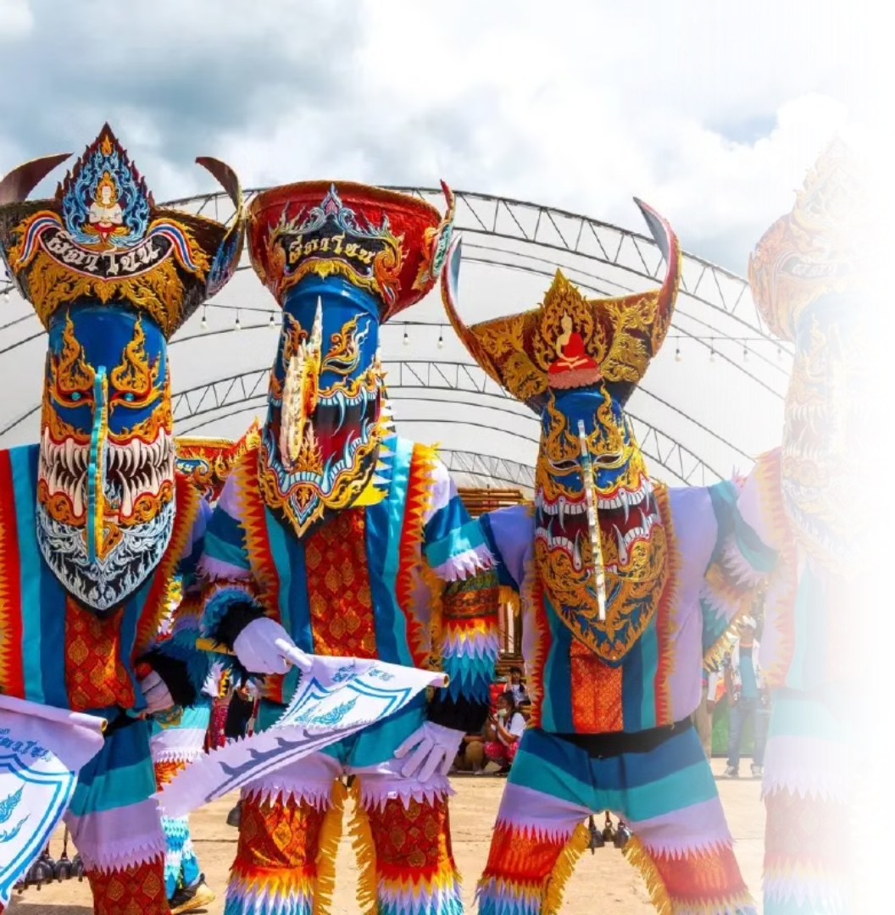
Phi Ta Khon
Phi Ta Khon (ผีตาโขน) is a vibrant and unique festival celebrated in Dan Sai District, Loei Province, in Northeastern Thailand. It usually takes place in June or July. Often called the “Ghost Festival,” locals dress up in elaborate ghost costumes with tall, colorful masks made from coconut husks and rice baskets.
Activities
  Ghost parade
  Merit-making at temples
Photo credit: Bangkokbiznews
Notes:
21

Slide 35
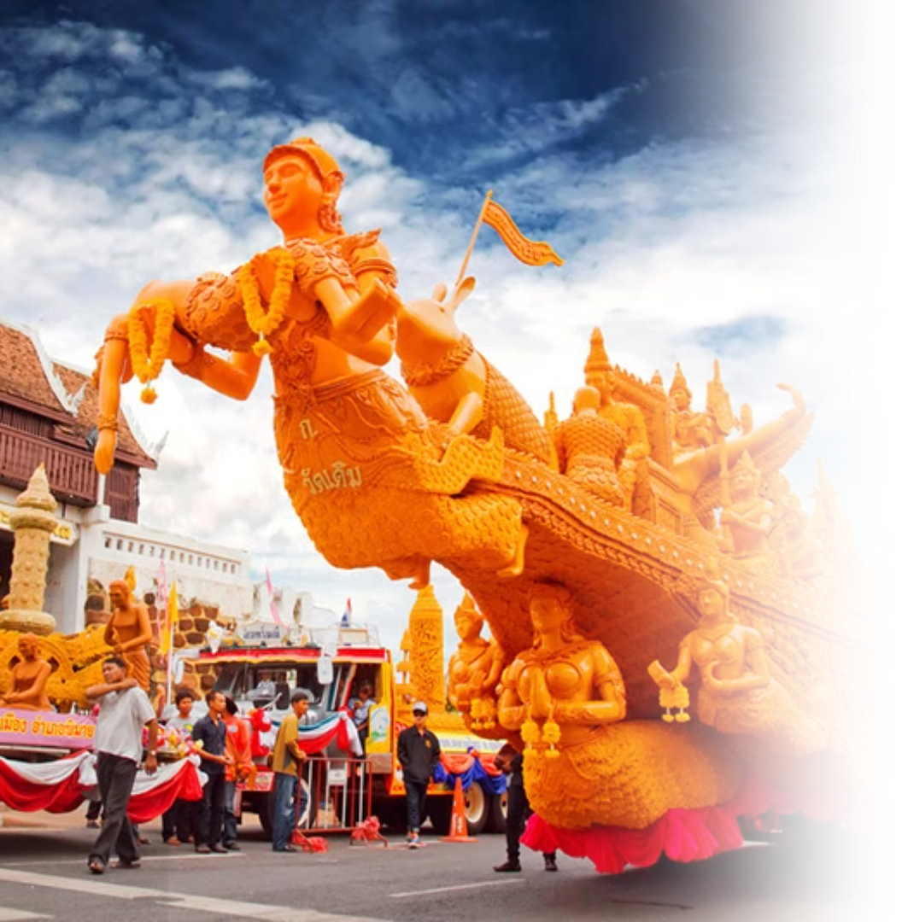
Candle Festival
The Thai Candle Festival (เทศกาลแห่เทียนพรรษา) is a traditional celebration held to mark the beginning of Buddhist Lent (Khao Phansa), typically in July. The festival features elaborate parades of giant wax candles, intricately carved to depict scenes from Buddhist mythology, Thai literature, and local folklore. These candles are offered to temples to provide light for monks during the three-month rainy retreat.
Activities
  Candle parade
  Merit-making at temples
Photo credit: My Life Graphic
Notes:
22

Slide 36
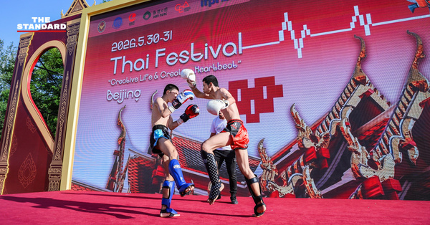


Thai Festivals
Around the World
Thai festivals are organized overseas by the Ministry of Foreign Affairs, Royal Thai Embassies, Consulates-General, and Thai communities abroad.
In 2026, Thai Festival activities continued to promote Thailand’s soft power internationally, showcasing Thai food, music, performing arts, Muay Thai, creative products, tourism, and community activities.
Thai Fest 2026 in Beijing, China
2026 Highlight
China: Thai Fest 2026 in Shanghai and Beijing highlighted Thai food, fruits, creative crafts, Muay Thai, and modern Thai creativity.
South Korea: Sawasdee Seoul Thai Festival 2026 was held in Seoul under the theme “Land of Living Creativity.”
The Netherlands: Thailand Grand Festival 2026 in The Hague welcomed over 20,000 visitors, showcasing Thai cuisine, cultural performances, Muay Thai, tourism, hospitality, and a Chud Thai exhibition.
Sawasdee Seoul Thai Festival 2026
in Seoul, Korea
Thailand Grand Festival 2026
in The Hague, the Netherlands
Photo credit: The Standard, Thairath, Royal Thai Embassy, the Hague
Notes:
22

Slide 37

Modern Festivals
While Thailand holds its traditions close, its openness to global influences has led to the widespread embrace of international celebrations. In urban areas, New Year and Christmas are marked with festive cheer, while Valentine’s Day is a beloved occasion for couples. Thailand also proudly celebrates Pride Festivals, reflecting its growing support for LGBTQ+ communities.
Photo credit: Nation Thailand
Notes:
23

Slide 38


Christmas
New Year's Eve
Christmas is celebrated mainly in urban areas and commercial spaces, where malls and streets are decorated with festive lights, trees, and ornaments. While it’s not a public holiday or a religious occasion, it’s embraced as a fun and joyful time for gift-giving, parties, and spreading cheer, especially among young people and families.
New Year's Eve in Thailand features lively festivities and world-class countdown events in major cities like Bangkok, Chiang Mai, and Pattaya. At the same time, many people visit temples to pray, reflect, and make merit, hoping to start the year with good luck and positive energy.
Photo credit: Bangkok Attractions Tickets, GetYourGuide
Notes:
24

Slide 39


Valentine's Day
Pride Month
Valentine’s Day is a popular celebration, especially among students, young people and couples. In schools and universities, it’s common for students to stick heart-shaped stickers on friends’ uniforms as a playful sign of affection. Couples also exchange gifts, flowers, and go on romantic outings to mark the occasion.
Pride in Thailand is celebrated with vibrant parades and events that showcase the country’s diversity and support for the LGBTQ+ community, especially in cities like Bangkok and Chiang Mai. Thailand is the first country in Southeast Asia to legalize same-sex marriage, marking a historic milestone for equality and LGBTQ+ rights in the country.
Photo credit: Richard Barrow, Go Thai Be Free
Notes:
25

Slide 40

Road to WorldPride 2030
Thailand is launching a nationwide campaign to support
its bid for WorldPride 2030, bringing together Pride events, local communities, and partners across the country.
Through this campaign, Thailand showcases its openness, creativity, LGBTQIA+ inclusion, and readiness to welcome the world.
Join Thailand on the road to WorldPride 2030, where diversity, culture, and celebration come together.
Source: Bangkok Post, Pride City Network Thailand
Photo Credit: Pride City Network Thailand
Notes:
25

Slide 41

Thailand as a Global Cultural Platform
Bangkok Music City 2026
24–25 January 2026, Bangkok
Thailand’s leading music conference and showcase festival, connecting Asian artists with global music industry opportunities in Bangkok’s Charoenkrung Creative District.
Sources: Bangkok Music City
Photo Credit: Bangkok Music City
Notes:
25

Slide 42

Thailand as a Global Cultural Platform
Thailand International
Choral Festival 2026
3–7 August 2026, Bangkok
An international choir festival bringing together choirs from around the world
through competitions, performances,
masterclasses, and cultural exchange.
Sources: Thai ICF
Photo Credit: KMUTT
Notes:
25

Slide 43

Thailand as a Global Cultural Platform
Wonderfruit 2026
3–7 December 2026, Chonburi
A Thai-born international festival celebrating music, art, food, wellness, sustainability, and creative culture, with its first overseas chapter in Kyoto.
Sources: wonderfruit.co
Photo Credit: The Standard
Notes:
25

Slide 44

Thailand as a Global Cultural Platform
Tomorrowland Thailand 2026
11–13 December 2026, Chonburi
The first full-scale Tomorrowland festival in Asia, highlighting Thailand as a global hub for music, creative tourism, and international events.
Sources: Tomorrowland
Photo Credit: Tourism Thailand
Notes:
25

Slide 45

Thailand as a Global Cultural Platform
International Horticultural Expo 2026
1 November 2026–14 March 2027, Udon Thani
A major international expo under the theme “Diversity of Life,” highlighting nature, sustainability, local identity, and Thailand’s connection with the Mekong region.
Sources: Udon Thani Expo
Photo Credit: Udon Thani Expo
Notes:
25

Slide 46

Thai Cuisine: The Harmony of Flavors
Thai food is one of the most well-known aspects of Thai culture. Celebrated for its bold and balanced flavors, many Thai dishes are now beloved by people all over the world.
Photo credit: realasset
Notes:
26

Slide 47



Characteristics of Thai Food
Rice Culture and Food Sharing
Harmony of Flavors
Global Fame
Rice is the main staple of Thai people, forming the heart of almost all meals. Meals are typically eaten together, with rice served alongside a variety of shared accompanying dishes, reflecting the communal nature of Thai dining.
Thai food is famous for its complex blends of flavors, such as sweet, sour, salty, and spicy.
Many Thai dishes are now popular and beloved worldwide.
Photo credit: Expatica, De Siam Cuisine, Quandoo
Notes:
27

Slide 48



Famous Thai Dishes
Pad Thai
Pad Krapao
Pad See Ew
A famous stir-fried noodle dish made with rice noodles, dried shrimps, tofu, eggs, peanuts, and a tangy-sweet tamarind sauce.
A flavorful stir-fry made with minced meat, holy basil, garlic, and chili, typically served over rice with a fried egg on top.
A savory stir-fried noodle dish made with wide rice noodles, soy sauce, Chinese broccoli, and your choice of meat.
Photo credit: Inquiring Chef, Food and Wine, MICHELIN Guide
Notes:
28

Slide 49



Famous Thai Dishes
Tom Yum Kung
Massaman Curry
Green Curry
A hot and sour soup made with shrimp, lemongrass, lime, chili, and fragrant herbs, known for its bold and refreshing flavor.
It was inscribed on UNESCO’s Representative List of the Intangible Cultural Heritage of Humanity in 2024.
A rich and mildly spicy curry with Persian influence, made with tender meat, potatoes, peanuts, and aromatic spices.
A creamy and spicy curry made with green chili paste, coconut milk, meat, and Thai basil, offering a vibrant and aromatic taste.
Photo credit: MICHELIN Guide, Kapook
Notes:
29

Slide 50



Famous Thai Desserts
Mango Sticky Rice
Thubthim Krop
Khanom Bueang
A popular dessert made with sweet sticky rice, ripe mango slices, and
a drizzle of rich coconut milk.
A refreshing Thai dessert featuring crunchy water chestnuts coated in red syrup and served in sweetened coconut milk with crushed ice.
A crispy Thai crepe filled with sweet or savory toppings, often made with coconut cream, shredded egg yolk, and grated coconut.
Photo credit: OfficeMate, khunkaekanomwan, Kapook
Notes:
30

Slide 51

Nuad Thai: Thai Traditional Massage
Nuad Thai (นวดไทย), or traditional Thai massage, is an ancient healing practice that combines acupressure, assisted stretches, and energy line work to promote physical and mental well-being. Recognized by UNESCO
as an Intangible Cultural Heritage in 2019, Nuad Thai is deeply rooted in Thai medicine and spirituality, focusing on restoring balance and harmony in the body.
Photo credit: senate.go.th
Notes:
31

Slide 52

Characteristics of Nuad Thai
  Focus on Energy Lines
  The practice is based on the concept of invisible energy pathways in the body, known as sen (เส้น) lines, with pressure applied to stimulate energy flow and restore balance.
  Combination of Acupressure and Stretching
  Nuad Thai integrates rhythmic acupressure with assisted stretches to enhance flexibility, release tension, and improve circulation.
  Holistic Health Benefits
  The massage promotes physical relaxation, relieves muscle tension, supports better posture, and enhances overall energy and well-being.
  Rooted in Thai Healing Traditions
  Nuad Thai is deeply connected to Thai traditional medicine and Buddhist teachings, emphasizing mindfulness, compassion, and the balance of body and spirit.
Photo credit: Andamanda Phuket
Notes:
32

Slide 53

Wat Pho
Wat Pho is also considered a center of Nuad Thai where techniques of Thai massage and traditional medicine have been taught for centuries. This makes it a major hub for those seeking to learn or try out authentic Nuad Thai.
Pictured: Statues of hermit at showing a posture of massage therapy
at Temple of Reclining Buddha or Wat Pho, Bangkok
Photo credit: Wat Pho
Notes:
33

Slide 54

Muay Thai:
The Art of Eight Limbs
Muay Thai is Thailand's renowned martial art, known as the "Art of Eight Limbs" for its powerful use of fists, elbows, knees, and shins. Celebrated worldwide for its striking techniques, Muay Thai is also deeply rooted in values of respect, discipline, and self-improvement.
Photo credit: Naewna
Notes:
34

Slide 55

Wai Khru Ram Muay
Wai khru ram muay (ไหว้ครูรำมวย) is a traditional pre-fight ritual performed by Muay Thai fighters to show respect to their teachers and the sacred forces they believe in. Combining graceful movements with symbolic gestures, the ritual reflects the fighter's gratitude, humility, and mental preparation before combat. It is an important cultural expression that connects Muay Thai to its spiritual and historical roots.
Pictured: Buakaw Banchamek, Muay Thai fighter and kickboxer
Photo credit: Huahin Living
Notes:
35

Slide 56

Art of Eight Limbs
Muay Thai utilizes the fists, elbows, knees, and shins.
Muay Thai techniques are traditionally divided into two categories: mae mai (major techniques) and
luk mai (minor techniques). Mae mai includes the fundamental moves such as powerful punches, elbows, knees, and kicks that form the foundation of the art. Luk mai, on the other hand, consists of more advanced or refined techniques, often involving counters, feints, and strategic movements used to gain an advantage over an opponent. Together, these techniques showcase the depth, precision, and tactical richness of Muay Thai.
Photo credit: Royal Thai Embassy, Seoul
Notes:
36

Slide 57


Famous Muay Thai Stadiums
Rajadamnern Stadium
Lumpinee Stadium
The oldest Muay Thai stadium in Thailand, offering an authentic and historic atmosphere for fans to experience traditional Thai boxing.
One of Thailand’s most iconic Muay Thai arenas, known for hosting top-level fights such as ONE Lumphinee and showcasing the sport’s finest athletes.
Photo credit: Rajadamnern Stadium, Tripadvisor
Notes:
37

Slide 58

Thailand’s UNESCO-Recognized Living Heritage
UNESCO’s Representative List of the Intangible Cultural Heritage of Humanity recognizes living traditions, knowledge, and practices passed down through communities. Thailand’s inscribed elements include:
Khon (2018)
A classical Thai masked dance drama that combines dance, music, narration, literature, ritual, and elaborate costumes.
Photo credit: Kapook
Notes:
11

Slide 59

Thailand’s UNESCO-Recognized Living Heritage
Nuad Thai (2019)
A traditional Thai healing practice that combines massage, pressure techniques, assisted stretching, and knowledge of energy lines to promote balance and well-being.
Photo credit: Thairath
Notes:
11

Slide 60

Thailand’s UNESCO-Recognized Living Heritage
Nora (2021)
A lively dance drama from Southern Thailand, known for its expressive movements, singing, colorful costumes, and strong connection to local beliefs
and community traditions.
Photo credit: Workpoint Today
Notes:
11

Slide 61

Thailand’s UNESCO-Recognized Living Heritage
Songkran (2023)
Thailand’s traditional New Year festival, marked by family reunions, merit-making, paying respect to elders, bathing Buddha images, and water-related rituals symbolizing cleansing and renewal.
Photo credit: Holiday Inn
Notes:
11

Slide 62

Thailand’s UNESCO-Recognized Living Heritage
Tom Yum Kung (2024)
A spicy and sour Thai shrimp soup that reflects Thailand’s culinary heritage through its use of local herbs, bold flavors, and shared food culture.
Photo credit: Hot Thai Kitchen
Notes:
11

