Slide 1


Thai Economy
Photo credit: Thai PBS World
Notes:
1

Slide 2
Thailand in Brief
"Thailand in Brief " has been prepared by the Thailand Foundation to support students, scholars, and the general public who wish to give presentations about Thailand to their audiences—for example, exchange program students and international participants.
The work presents some basic information about Thailand in 11 areas: 1) Geography, 2) History, 3) Politics and Government, 4) Economics, 5) Demographics, 6) Culture, 7) Values, 8) Thai People and Other Popularity That You May Know,
9) Misconceptions about Thailand, 10) Thailand's Role on the Global Stage, and 11) Rankings Related to Thailand.
"Thailand in Brief" is produced in both PDF file (.pdf) and Powerpoint Presentation (.pptx) formats, consisting of 400 slides. Users may download and select the topics they wish to present, and may rearrange the sequence of the slides as appropriate. However, the content of this document cannot be edited. Reproduction or use for commercial purposes without permission from the Thailand Foundation is not allowed.
"Thailand in Brief" will be updated every third quarter each year. For inquiries or further suggestions, please contact the Thailand Foundation at info@thailandfoundation.or.th.
July 2026
Notes:
2

Slide 3
Thailand in Brief
"Thailand in Brief " จัดทำขึ้นโดยมูลนิธิไทย (Thailand Foundation) เพื่ออำนวยความสะดวกแก่ นักเรียน นักศึกษา และผู้สนใจทั่วไป นำไปใช้ประโยชน์ อาทิ ในการบรรยาย หรือให้ความรู้เกี่ยวกับประเทศไทยในด้านต่าง ๆ แก่ชาวต่างประเทศ เช่น กรณีนักศึกษาแลกเปลี่ยนที่ไปเรียนในต่างประเทศที่ต้องนำเสนอเรื่องราวเกี่ยวกับประเทศไทยในสถาบันที่ไปศึกษาอยู่ เป็นต้น
งานชิ้นนี้เสนอข้อมูลเกี่ยวกับประเทศไทยโดยสังเขป 11 ด้าน ได้แก่ 1) ภูมิศาสตร์ (Geography) 2) ประวัติศาสตร์ (History) 3) การเมืองการปกครอง (Politics and Government) 4) เศรษฐกิจ (Economics) 5) ประชากร (Demographics) 6) วัฒนธรรม (Culture) 7) ค่านิยม (Values) 8) คนไทยและสื่อที่คุณอาจรู้จัก (Thai people and other popularity that you may know) 9) ความเข้าใจผิดเกี่ยวกับประเทศไทย (Misconceptions)
10) บทบาทของไทยในเวทีโลก (Thailand’s role on the Global Stage) และ 11) การจัดอันดับที่เกี่ยวกับประเทศไทย (Rankings related to Thailand)
"Thailand in Brief " นี้จัดทำเป็นสไลด์ จำนวน 400 สไลด์ ในรูปแบบ .pdf และ .pptx สามารถดาวน์โหลดและเลือกใช้หัวข้อที่นำเสนอ และสลับลำดับการนำเสนอได้ตามความเหมาะสม อย่างไรก็ดี ผู้ใช้งานไม่สามารถดัดแปลงเนื้อหาในเอกสารได้ และห้ามผลิตซ้ำ หรือนำไปใช้เพื่อผลประโยชน์เชิงพาณิชย์โดยไม่ได้รับอนุญาตจากมูลนิธิไทย
"Thailand in Brief " จะได้รับการปรับปรุงให้ทันสมัยในทุกไตรมาสที่ 3 ของปี หากมีข้อสงสัยและข้อเสนอแนะเพิ่มเติม กรุณาติดต่อมูลนิธิไทย
อีเมล info@thailandfoundation.or.th
กรกฎาคม 2569
Notes:
3

Slide 4

Overview of Thai Economy
  Thailand is a development success story, having transformed rapidly from an economy dominated by agriculture to one that is
modern, industrialized, and export-led.
Sources: World Bank
Photo credit: King Power Mahanakhon
Notes:
4

Slide 5
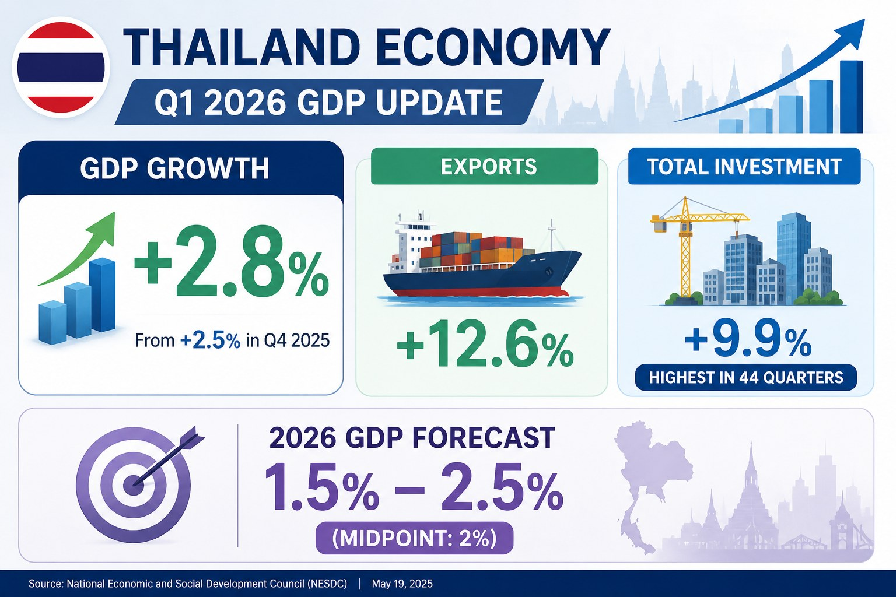

Slide 6

Thailand's Economic Performance
Notes:
5

Slide 7
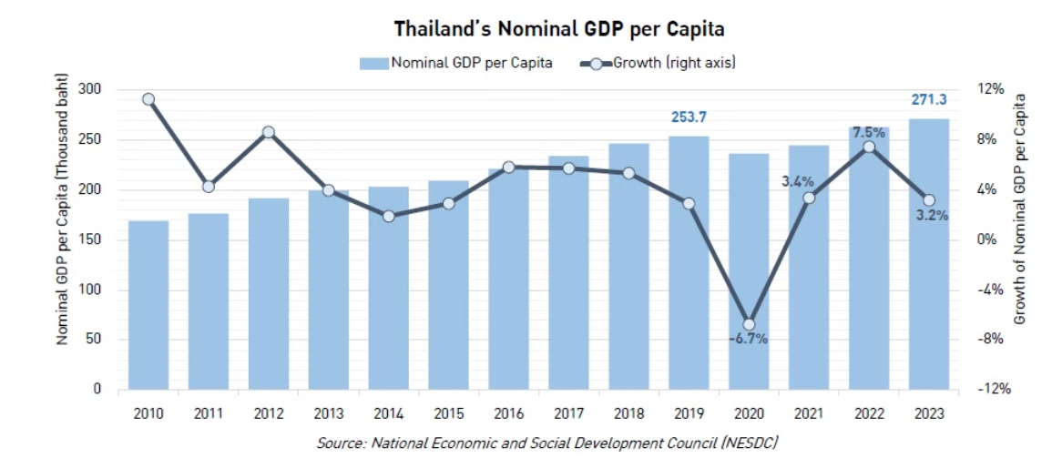
Thailand is the 2nd largest economy in Southeast Asia
Thailand is the second largest economy in Southeast Asia after Indonesia, in terms of nominal GDP
(gross domestic product) value. However, its nominal per capita is higher than that of Indonesia.
Source: National Economic and Social Development Council, Thailand Development Research Institute, Proprogess
Notes:
6

Slide 8

Thailand's Key Economic Indicators (2025)
Thailand maintains steady economic growth
despite global challenges.
Nominal GDP
577 billion US dollars
GDP per Capita
8,200.9 US dollars
Source: The National Economic and Social Development Council (NESDC)
Photo credit: The Nation
Notes:
7

Slide 9
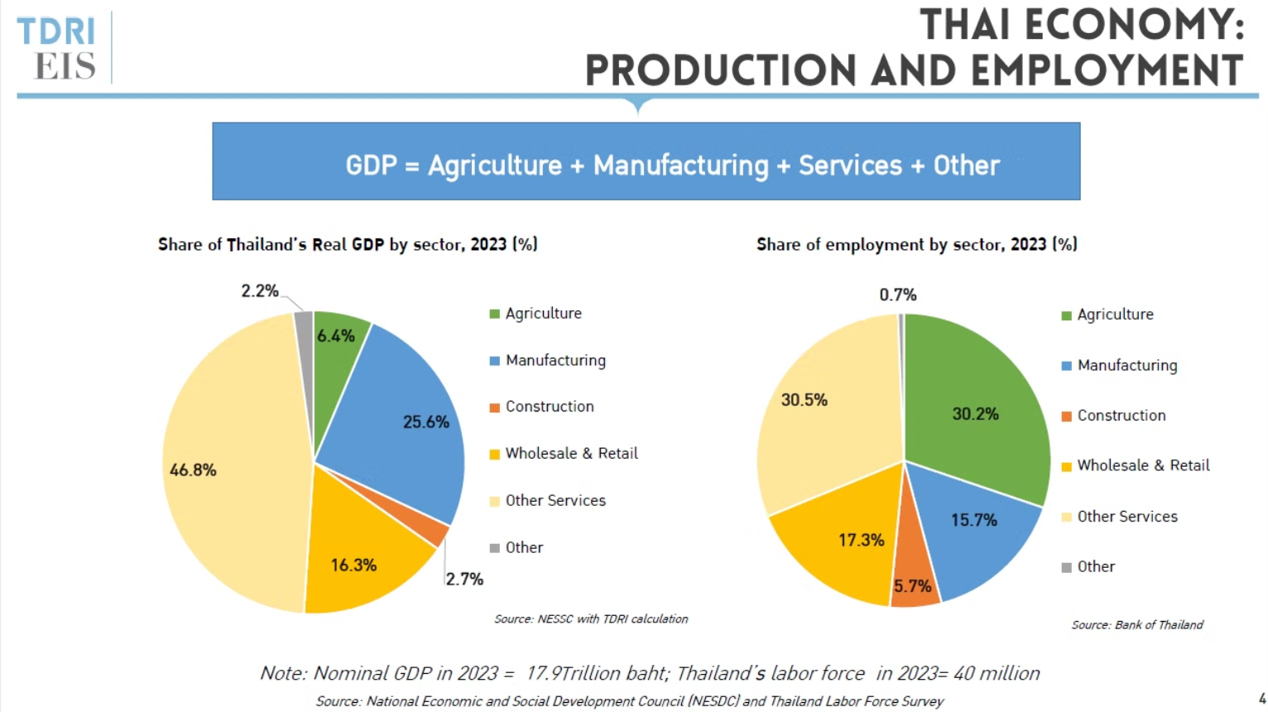
Source: National Economic and Social Development Council, Thailand Development Research Institute
Notes:
8

Slide 10

Top 5 Export Destinations (2025)
Top 5 Export Products (2025)
  USA 21.31%
  Automatic data processing machines 11.78%
  China 11.70%
  Motor cars, parts and accessories 9.27%
  Japan 6.94%
  Precious stones and jewellery 7.93%
  India 4.67%
  Rubber products 4.60%
  Singapore 3.54%
  Machinery and parts thereof 3.51%
Source: Trade Policy and Strategy Office, Ministry of Commerce
Photo credit: Freepik
Notes:
9

Slide 11

Top 5 Import Origins (2025)
Top 5 Import Products (2025)
  China 31.17%
  Electronic integrated circuits 9.97%
  Japan 8.60%
  Electrical machinery and parts 9.24%
  Taiwan 7.38%
  Crude oil 7.97%
  USA 6.13%
  Jewellery including silver bars and gold 7.42%
  UAE 4.97%
  Machinery and parts 7.41%
Source: Trade Policy and Strategy Office, Ministry of Commerce
Photo Credit: Freepik
Notes:
10

Slide 12
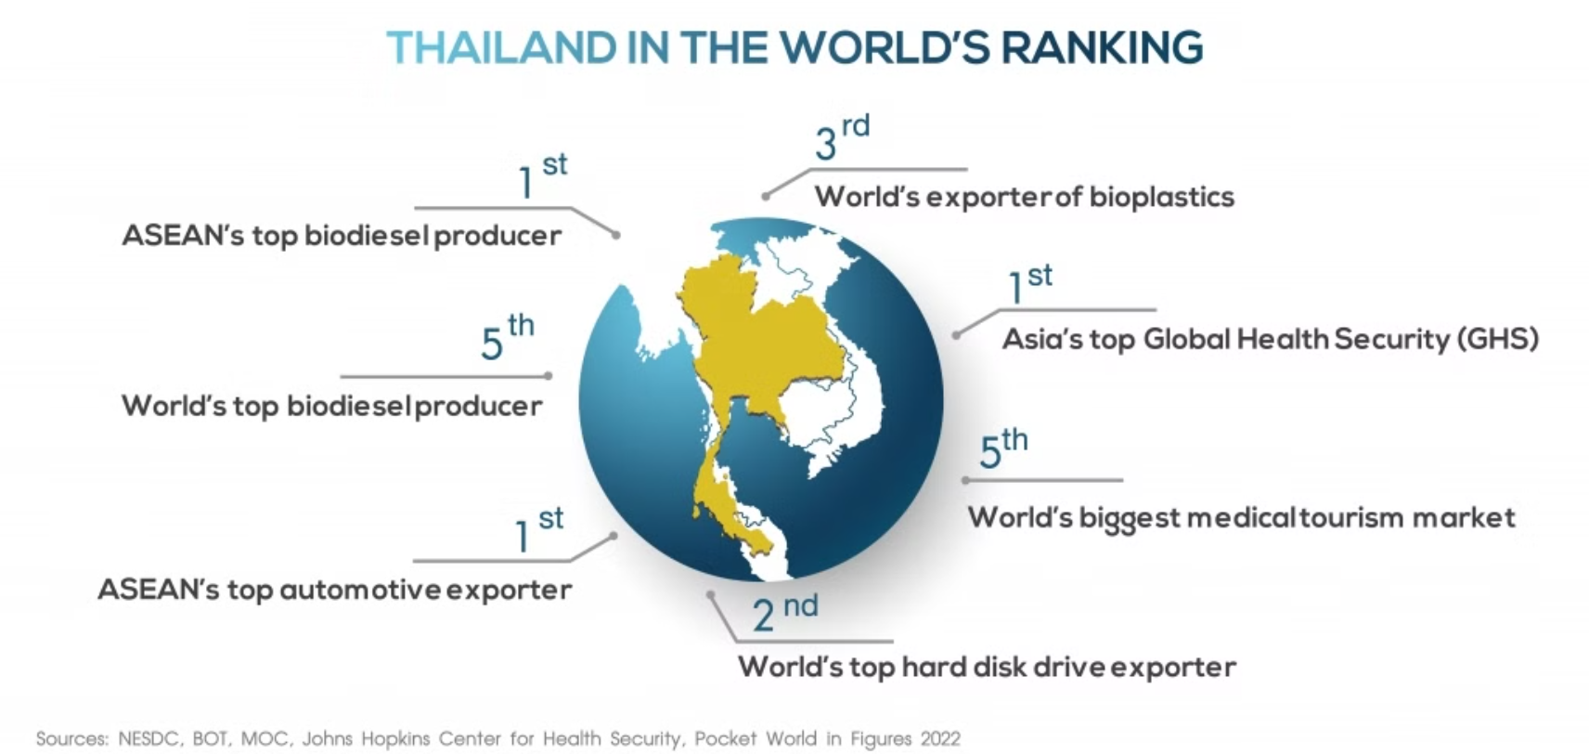
Source: Board of Investment
Notes:
11

Slide 13
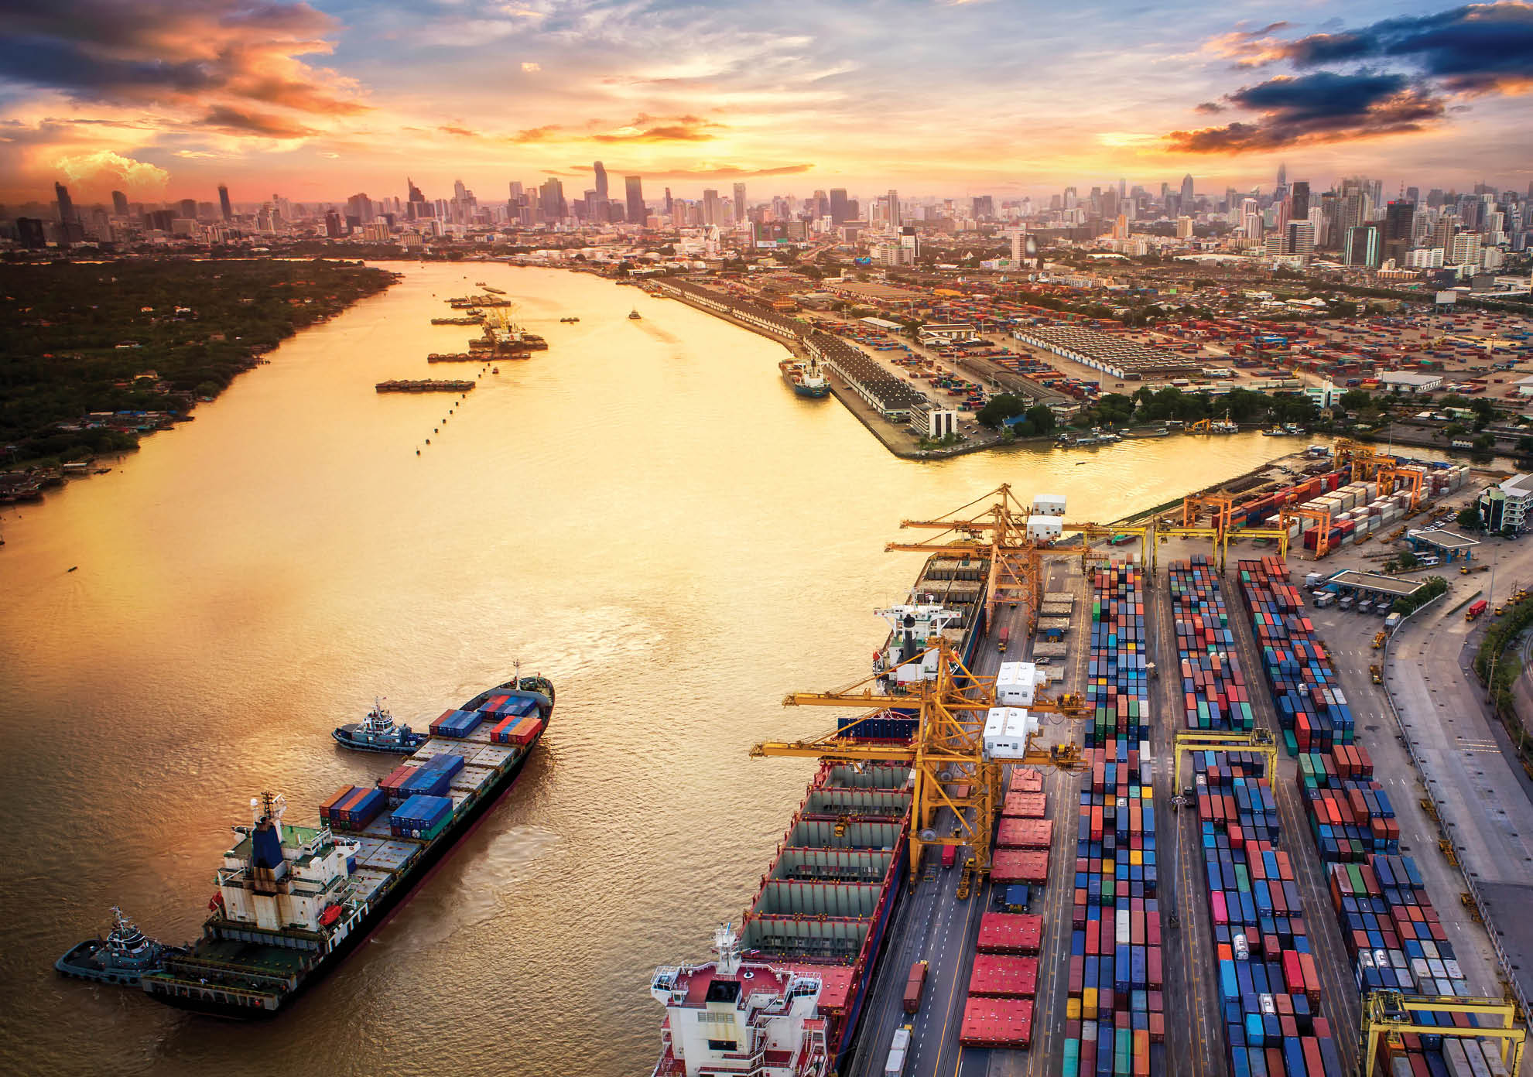
Thailand ranked Top 25
of the World in the 2026 FDI Index
The 2026 Foreign Direct Investment (FDICI) index survey by Kearney
indicates that Thailand has returned to the top 25 in the world.
It reflects a recovery in confidence among senior executives worldwide amidst structural changes in global supply chains.
Source: Kearney, Money & Banking Online
Photo credit: We are CP​

Slide 14

Thailand ranks
among the World’s Four Largest Exporters
of AI-related hardware
Thailand has been ranked among the world’s four largest exporters of AI-related hardware by
the International Monetary Fund (IMF), underscoring the Kingdom’s growing role in global technology supply chains,
as it pushes to transform itself into a regional hub for AI and semiconductor manufacturing.
Source: Thailand Now, PR Thai Government
Photo credit: Citi Group​

Slide 15



Examples of the Leading Thai Companies
with Global Presence
CP ALL
Petroleum Authority of Thailand
Siam Cement Group
established by
the Charoen Pokphan Group to operate the convenience store business in Thailand under “7-Eleven” trademark
a Thai state-owned
SET-listed petroleum and natural gas company
Thailand’s largest and oldest cement and building materials company
Source: The Stock Exchange of Thailand (SET), TNN Wealth, Line Today
Notes:
เรียงตามset + อ้างอิง
12

Slide 16




Examples of the Leading Thai Companies
with Global Presence
Thai Beverage
Kasikorn Bank
Central Retail
leading beverage producer and distributor in South-East Asia and among the largest in Thailand.
Thailand's leading financial institutions
the leading multi-format and multi-category retailing platform in Thailand
Source: The Stock Exchange of Thailand (SET), TNN Wealth, Line Today
Notes:
เรียงตามset + อ้างอิง
12

Slide 17



Examples of the Leading Thai Companies
with Global Presence
Thai Union
Ban Pu
Indorama Ventures PCL
Seafood producer and
canned seafood products
A energy provider company
Sustainable chemical company and PET and fibers
Source: The Stock Exchange of Thailand (SET), TNN Wealth, Line Today
Notes:
เรียงตามset + อ้างอิง
12

Slide 18




Examples of the Leading Thai Companies with Global Presence
Electricity Generating PCL
AAPICO Hitech PCL
Delta Electronics
AMATA
Manufacturers and distributors of power supplies and electronic equipment and parts
Developer and operator
of industrial parks
Power producer in Thailand
Manufacture of OEM parts and Car Retailing
  Source: The Stock Exchange of Thailand (SET), TNN Wealth, Line Today
Notes:
เรียงตามset + อ้างอิง
13

Slide 19

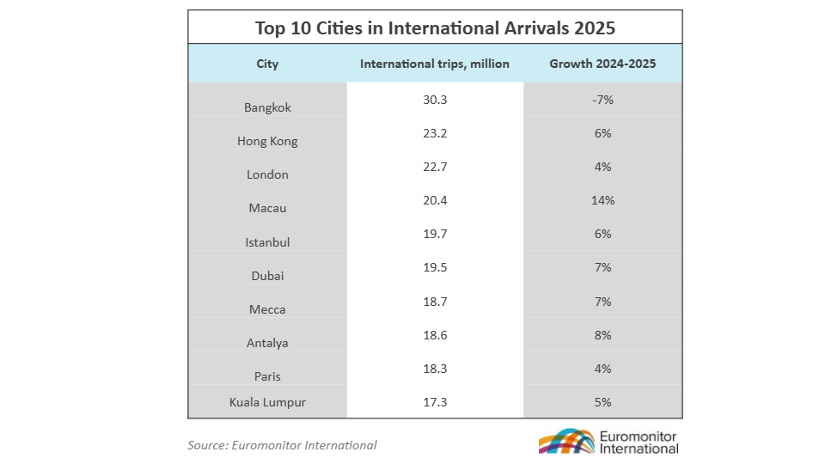
Bangkok Tops the List
of the World's Most Visited Cities in 2025
Source: Euromonitor, Tourism Authority of Thailand
Notes:
15

Slide 20
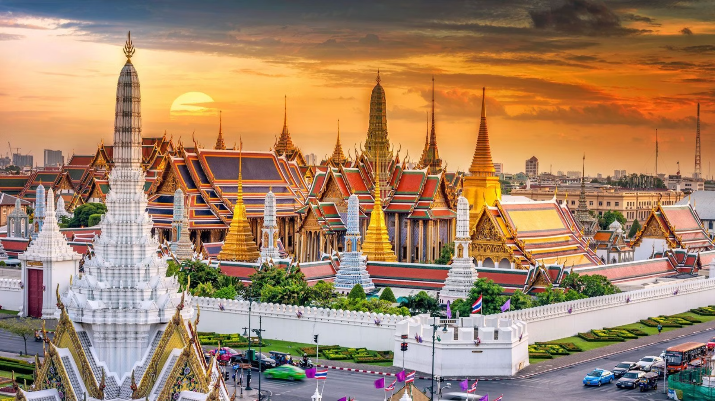

International Tourist Arrivals to Thailand (2025)
32.97 Millions
Rank
Country
Numbers of visitors
1
Malaysia
4,520,856
2
China
4,473,992
3
India
2,487,319
4
Russia
1,898,837
5
South Korea
1,555,227
Source: The National Economic and Social Development Council (NESDC), Ministry of Tourism and Sports (MOTS)
Photo credit: Le Cordon Bleu
Notes:
14

Slide 21
International Tourist Arrivals to Thailand (2025)
32.97 Millions
Rank
Country
Numbers of visitors
6
Japan
1,091,227
7
The United Kingdom
1,083,162
8
The United States of America
1,081,929
9
Taiwan
987,633
10
Singapore
967,341
Source: The National Economic and Social Development Council (NESDC), Ministry of Tourism and Sports (MOTS)
Photo credit: Le Cordon Bleu
Notes:
14

Slide 22

International Tourist Arrivals to Thailand
(Jan-May 2026)
Rank
Country
Numbers of visitors
1
China
2,318,312
2
Malaysia
1,737,938
3
India
1,056,729
4
Russia
946,732
5
South Korea
539,848
Source: The National Economic and Social Development Council (NESDC), Ministry of Tourism and Sports (MOTS)
Photo credit: Le Cordon Bleu
Notes:
14

Slide 23
International Tourist Arrivals to Thailand
(๋Jan-May 2026)
Rank
Country
Numbers of visitors
6
The United Kingdom
497,589
7
The United States of America
471,254
8
Germany
449,076
9
Taiwan
443,997
10
Japan
434,980
Source: The National Economic and Social Development Council (NESDC), Ministry of Tourism and Sports (MOTS)
Photo credit: Le Cordon Bleu
Notes:
14

