Slide 1
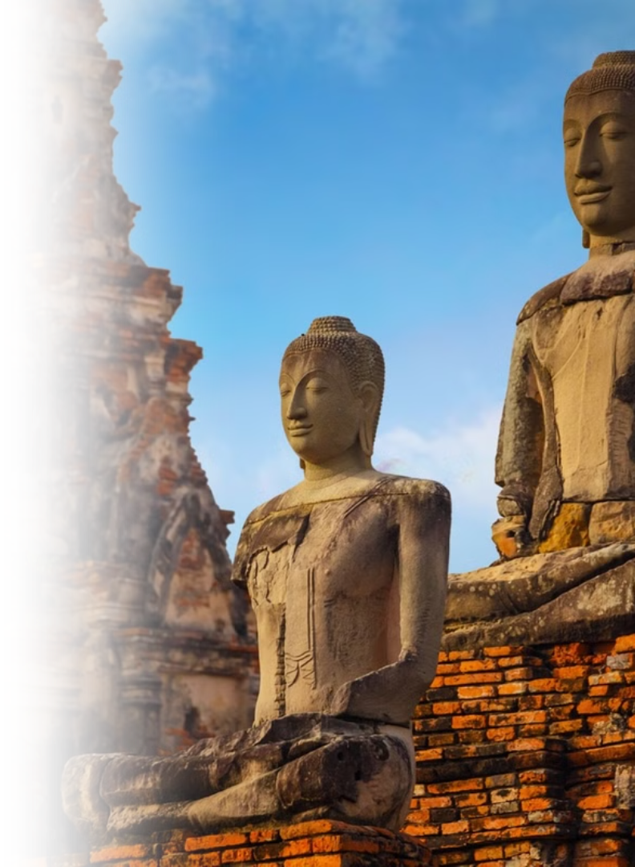
Thailand's History
Photo credit: Thailand Insider

Slide 2
Thailand in Brief
"Thailand in Brief " has been prepared by the Thailand Foundation to support students, scholars, and the general public who wish to give presentations about Thailand to their audiences—for example, exchange program students and international participants.
The work presents some basic information about Thailand in 11 areas: 1) Geography, 2) History, 3) Politics and Government, 4) Economics, 5) Demographics, 6) Culture, 7) Values, 8) Thai People and Other Popularity That You May Know, 9) Misconceptions about Thailand, 10) Thailand's Role on the Global Stage, and 11) Rankings Related to Thailand.
"Thailand in Brief" is produced in both PDF file (.pdf) and Powerpoint Presentation (.pptx) formats, consisting of xx slides. Users may download and select the topics they wish to present, and may rearrange the sequence of the slides as appropriate. However, the content of this document cannot be edited. Reproduction or use for commercial purposes without permission from the Thailand Foundation is not allowed.
"Thailand in Brief" will be updated every third quarter each year. For inquiries or further suggestions, please contact the Thailand Foundation at info@thailandfoundation.or.th.
27 May 2025

Slide 3
Thailand in Brief
"Thailand in Brief " จัดทำขึ้นโดยมูลนิธิไทย (Thailand Foundation) เพื่ออำนวยความสะดวกแก่ นักเรียน นักศึกษา และผู้สนใจทั่วไป นำไปใช้ประโยชน์ อาทิ ในการบรรยาย หรือให้ความรู้เกี่ยวกับประเทศไทยในด้านต่าง ๆ แก่ชาวต่างประเทศ เช่น กรณีนักศึกษาแลกเปลี่ยนที่ไปเรียนในต่างประเทศที่ต้องนำเสนอเรื่องราวเกี่ยวกับประเทศไทยในสถาบันที่ไปศึกษาอยู่ เป็นต้น
งานชิ้นนี้เสนอข้อมูลเกี่ยวกับประเทศไทยโดยสังเขป 11 ด้าน ได้แก่ 1) ภูมิศาสตร์ (Geography) 2) ประวัติศาสตร์ (History) 3) การเมืองการปกครอง (Politics and Government) 4) เศรษฐกิจ (Economics) 5) ประชากร (Demographics) 6) วัฒนธรรม (Culture) 7) ค่านิยม (Values) 8) คนไทยและสื่อที่คุณอาจรู้จัก (Thai people and other popularity that you may know) 9) ความเข้าใจผิดเกี่ยวกับประเทศไทย (Misconceptions) 10) บทบาทของไทยในเวทีโลก (Thailand’s role on the Global Stage) และ 11) การจัดอันดับที่เกี่ยวกับประเทศไทย (Rankings related to Thailand)
"Thailand in Brief " นี้จัดทำเป็นสไลด์ จำนวน xx สไลด์ ในรูปแบบ .pdf และ .pptx สามารถดาวน์โหลดและเลือกใช้หัวข้อที่นำเสนอ และสลับลำดับการนำเสนอได้ตามความเหมาะสม อย่างไรก็ดี ผู้ใช้งานไม่สามารถดัดแปลงเนื้อหาในเอกสารได้ และห้ามผลิตซ้ำ หรือนำไปใช้เพื่อผลประโยชน์เชิงพาณิชย์โดยไม่ได้รับอนุญาตจากมูลนิธิไทย
"Thailand in Brief " จะได้รับการปรับปรุงให้ทันสมัยในทุกไตรมาสที่ 3 ของปี หากมีข้อสงสัยและข้อเสนอแนะเพิ่มเติม กรุณาติดต่อมูลนิธิไทย อีเมล info@thailandfoundation.or.th
27 พฤษภาคม 2568

Slide 4
Thai History Overview
Thailand's rich history spans centuries, shaped by powerful kingdoms and cultural adaptations. Exploring different eras of Thai history provides insight into Thailand's dynamic journey.
Sukhothai Period
Ayutthaya Period
Thonburi Period
Rattanakosin Period
The Sukhothai Period (1238–1351), is known as the birth period of Thai art, language, and Theravāda Buddhism.
The Ayutthaya Period (1351–1767), saw Thailand (then called Siam) becoming a prosperous and powerful international trade hub. Thai art, culture, religion, and military strength flourished.
The Thonburi Period (1767–1782) was a brief but pivotal period in Thai history, during which King Taksin reunified the country after the fall of Ayutthaya and established Thonburi as the capital.
The Rattanakosin Period (1782–present) ushered in modern Thailand, with Bangkok as its capital and significant political, social, and cultural advancements.

Slide 5
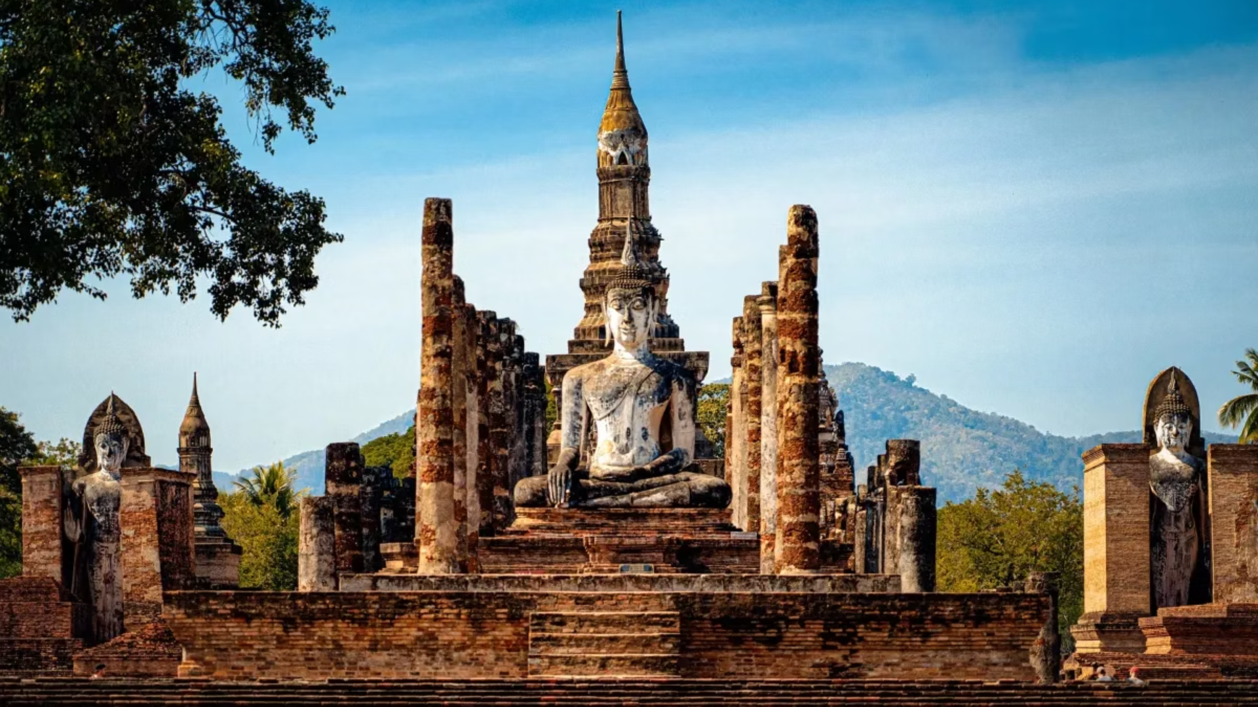
1. Sukhothai Period
The Sukhothai Period (1238–1351: 113 years) is marked by the rise of the Sukhothai Kingdom, considered by many to be one of the first Thai states.
Theravada Buddhism
Cultural Achievements
Enduring Legacy
Through its adoption of Theravada Buddhism as the state religion, Sukhothai established a spiritual foundation that continues to shape Thai identity.
The creation of the Thai script was a monumental achievement, laying the groundwork for the modern Thai language. The period's art, particularly its graceful Buddha images and distinctive architecture, remains iconic and influences Thai aesthetics to this day.
Sukhothai's legacy endures through its emphasis on Thai cultural unity, spiritual values, and artistic refinement.
Photo credit: Sawasdee Thailand

Slide 6
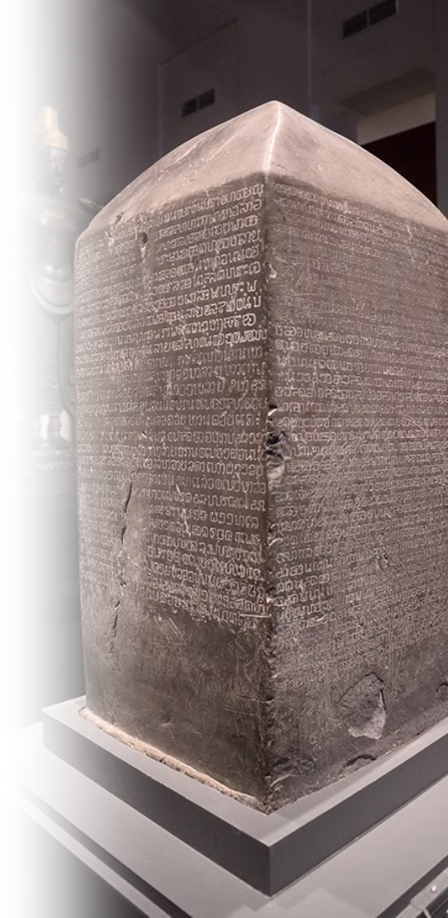
Important Events During the Sukhothai Period
1
Reign of King Ram Kamhaeng the Great (1279 – 1298)
Theravada Buddhism from Sri Lanka flourishes in Sukhothai
Missions sent to Yuan China
Early evidence of Thai Script
2
What's happening elsewhere in the world
1271: Kublai Khan established Yuan Dynasty
1272–1307: Reign of King Edward I "Longshanks" of England
14th century: Early beginning of the Renaissance
Pictured: King Ram Kamhaeng Inscription, an evidence of early Thai Script Photo credit: National Archives Of Thailand

Slide 7
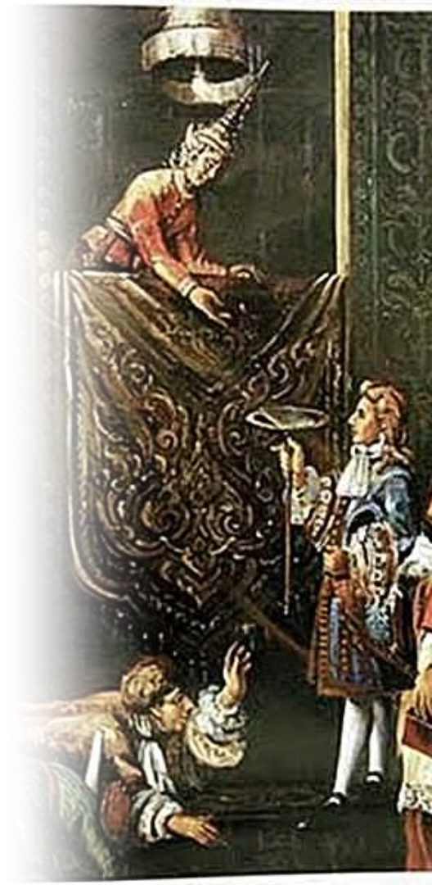
2. Ayutthaya Period
The Ayutthaya Period (1351–1767: 416 years) saw Thailand (then known as Siam) becoming a powerful and cosmopolitan state that shaped the course of Thai history.
Political and Economic Power
International Relations
Ayutthaya attracted merchants and diplomats from across Asia, Europe, and the Middle East. Foreign communities established permanent settlements in the Siam. Many foreigners also rose to important political roles.
Known for its political might and flourishing trade, Ayutthaya became a hub of cultural and economic exchange. Important exports from Ayutthaya included rice, teak, and animal parts, among others.
Pictured: King Narai the Great of Ayutthaya receiving the French Ambassador, Alexandre Chevalier de Chaumont (Photo credit: MGR Online)

Slide 8
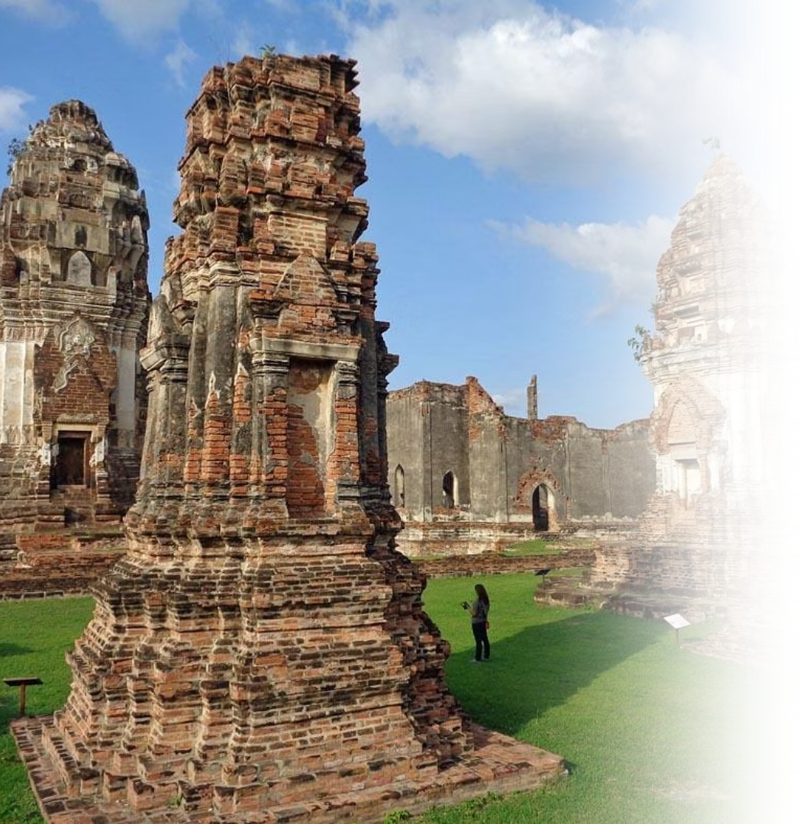
Cultural Influence
Ayutthaya's multicultural nature fostered a unique blend of traditions, seen in art, architecture, and cuisine, which laid the foundation for much of the Thai culture as seen today.
Pictured: Phra Narai Ratchaniwet, the royal palace of King Narai the Great in Lopburi, the former second capital of the Ayutthaya Kingdom.
Photo credit: tripadvisor

Slide 9
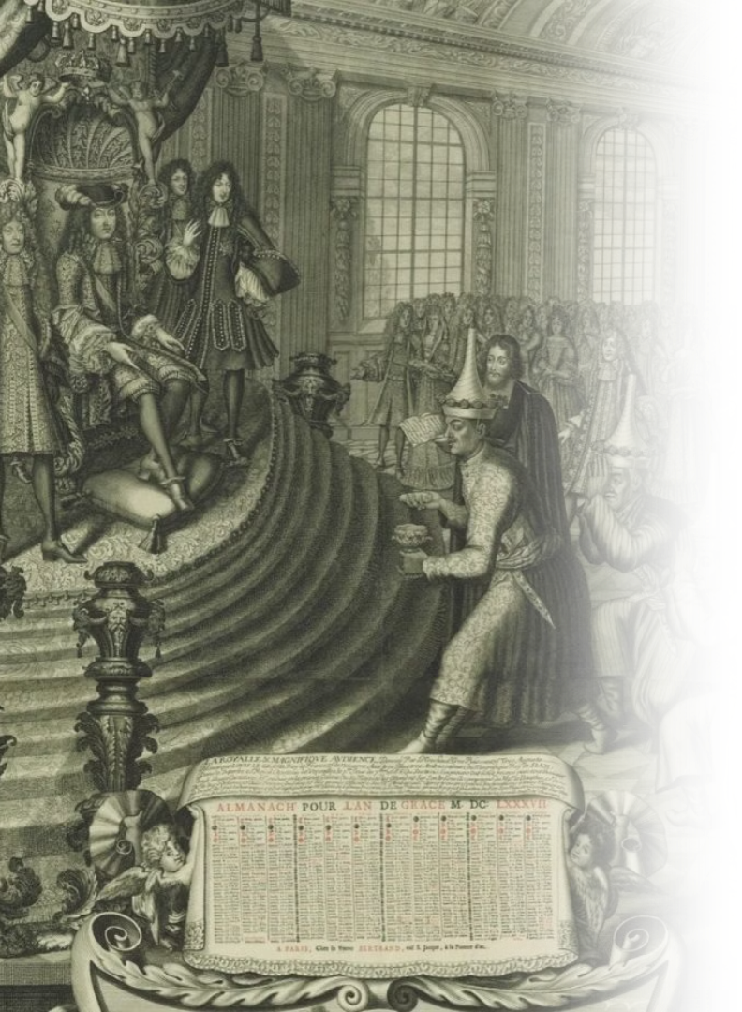
Important events during the Ayutthaya Period
1511: Portugal made contact with Ayutthaya
1602: The Persian merchant Sheikh Ahmad became Chula Ratchamontri (a high-ranking government position), reflecting Ayutthaya’s ties to the Islamic world
1685: French mission headed by Alexandre Chevalier de Chaumont visited Ayutthaya
1686 Kosa Pan led Ayutthaya mission to France
1753: Ayutthaya sent the monk Upali Thera to revive Buddhism in Sri Lanka, reflecting Ayutthaya’s influence in the international Buddhist community
1767: Burmese conquest, fall of Ayutthaya
Pictured: King Louis XIV of France receiving the Siamese Ambassador, Kosa Pan Photo credit: Silpa-Mag
See more…

Slide 10
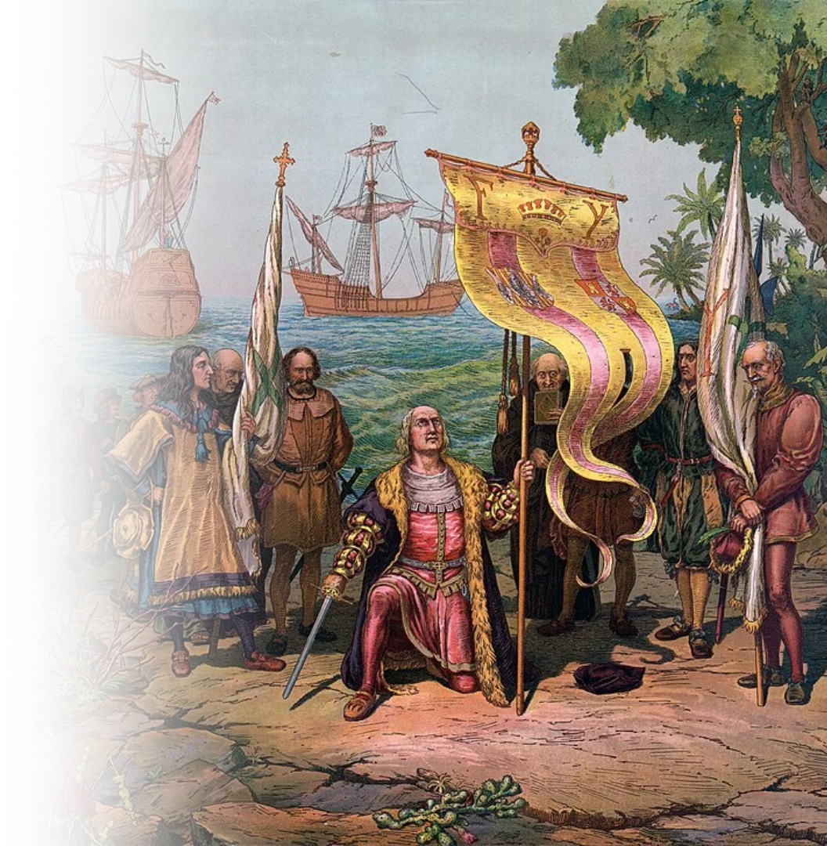
What's happening elsewhere in the world?
1368: Ming Dynasty established
1405-1433: Voyages of Zheng He
1492: Columbus set sails
1603: Tokugawa Ieyasu becomes Shōgun
1644: Manchu conquest of China
Pictured: Columbus taking possession of the new country Photo credit: The Prang Educational Co.

Slide 11
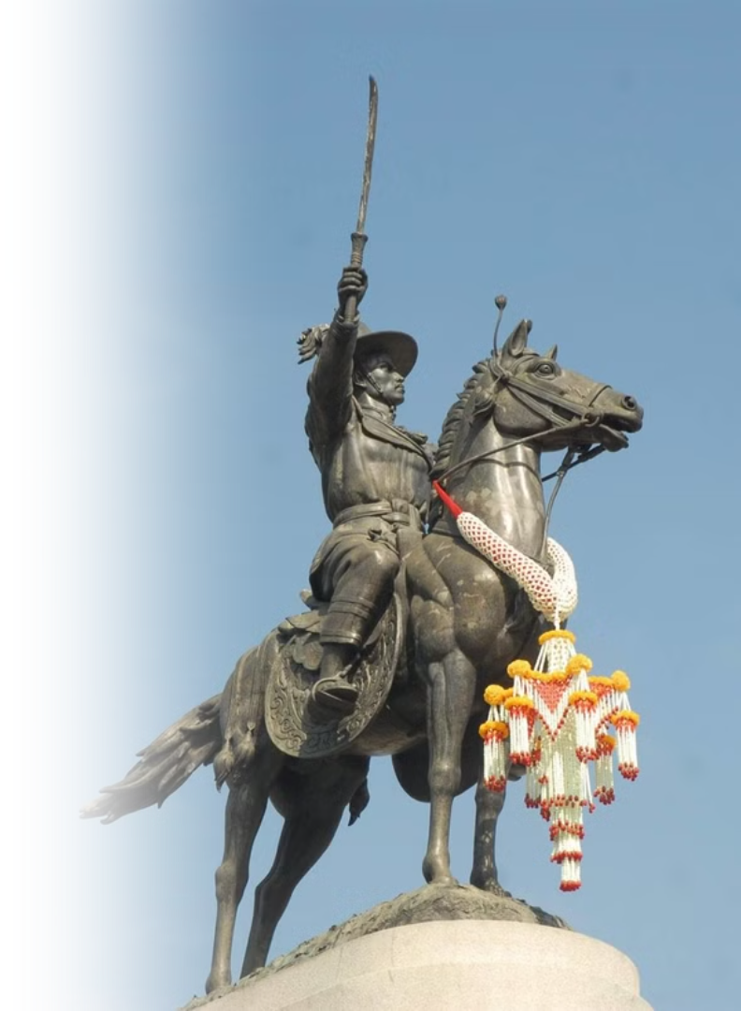
3. Thonburi Period
The Thonburi Kingdom (1767–1782: 15 years) was a short yet pivotal period in Thai history, marking the nation's recovery from the fall of Ayutthaya.
Leadership
Rebuilding
Trade Hub
Under the leadership of King Taksin the Great, the period was characterized by efforts to reunify the fragmented territories of Siam.
King Taksin focused on rebuilding the cultural and economic foundations of the kingdom after the destruction of Ayutthaya.
Thonburi's strategic location near the Chao Phraya River allowed it to thrive as a trading hub, maintaining connections with regional powers.
Pictured: Monument of King Taksin the Great (Photo credit: Matichon Weekly)

Slide 12
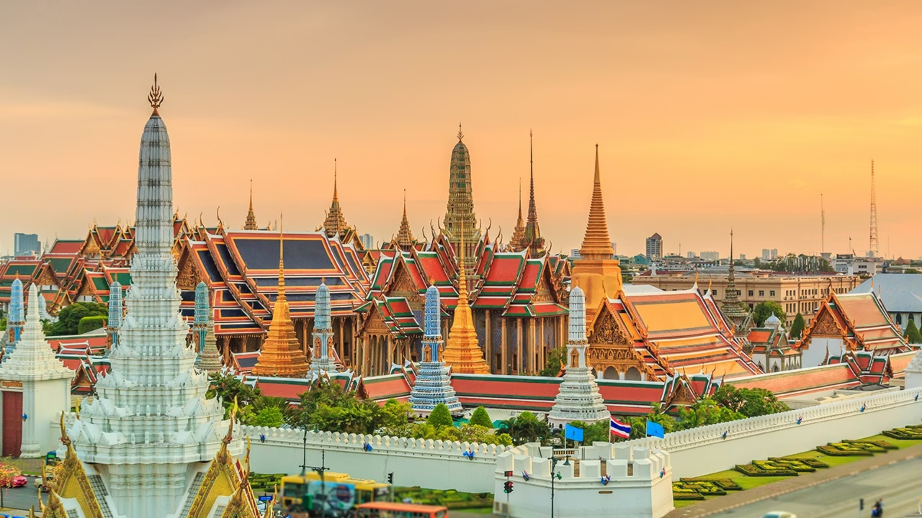
4. Rattanakosin Period (1782–present)
Establishment
Cultural Flourishing
Modernization
The Rattanakosin Period (1782–present) began with the establishment of Bangkok as the capital by King Rama I, marking the start of the Chakri dynasty.
This era saw the flourishing of Thai art, literature, and architecture, with landmarks such as the Grand Palace and Wat Phra Kaew being built.
It also witnessed Thailand's modernization, diplomatic engagements with Western powers, and reformed in governance, education, and infrastructure under later monarchs, especially King Rama V.
Photo credit: Thairath

Slide 13
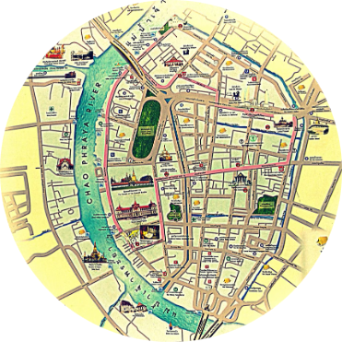
4.1 Early Rattanakosin (1782–1851)
Founding of Bangkok
Restoration
The early Rattanakosin period, spanning the reigns of Kings Rama I, II, and III, began with the founding of Bangkok as the new capital by King Rama I, strategically located along the Chao Phraya River to ensure defense and facilitate trade.
Some hallmarks of this period include cultural restoration, the strengthening of Theravada Buddhism, and Siam's engagement in international trade.
Photo credit: Bangkok Sightseeing, Royal Grand Palace, Chaophraya Tourist Boat, Pantip.com: Teo

Slide 14
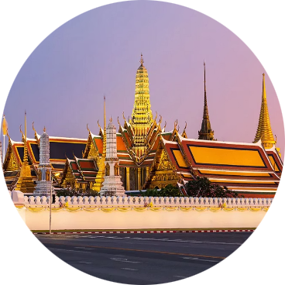
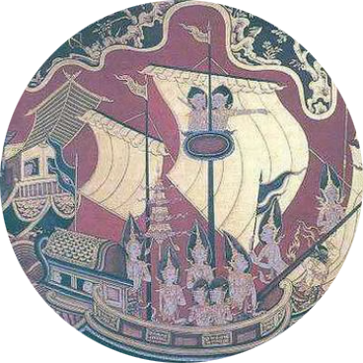
Key Developments
Global Context
Some key developments include the rewriting of Thai legal codes, the flourishing of literature and arts under King Rama II, and King Rama III's emphasis on economic expansion and diplomatic relations with China. The construction of grand temples within The Grand Palace Complex reflected the era's artistic and religious vibrancy.
Globally, this period coincided with significant changes, including the rise of the British Empire in Asia, the Industrial Revolution in Europe, and the expansion of Western colonialism.
Photo credit: Chaophraya Tourist Boat, Pantip.com: Teo

Slide 15
4.2 Modernization Period (1851-1925)
The modernization period of Thailand, spanning the reigns of King Rama IV (Mongkut), King Rama V (Chulalongkorn), and King Rama VI (Vajiravudh), marked a transformative era in which Siam embraced reform to safeguard its sovereignty in the face of Western colonial expansion.
Pictured: King Rama V with Tsar Nicholas II of Russia (Photo credit: Thai369)

Slide 16
Sovereignty
Reform
Leadership
Preserving independence amid colonial threats not colonized
Embracing modernization to strengthen the nation
Visionary kings guiding transformation
Pictured: Ceiling painting depicting King Rama V's Abolition of Slavery at the Ananta Samakhom Throne Hall (Photo credit: Matichon)

Slide 17
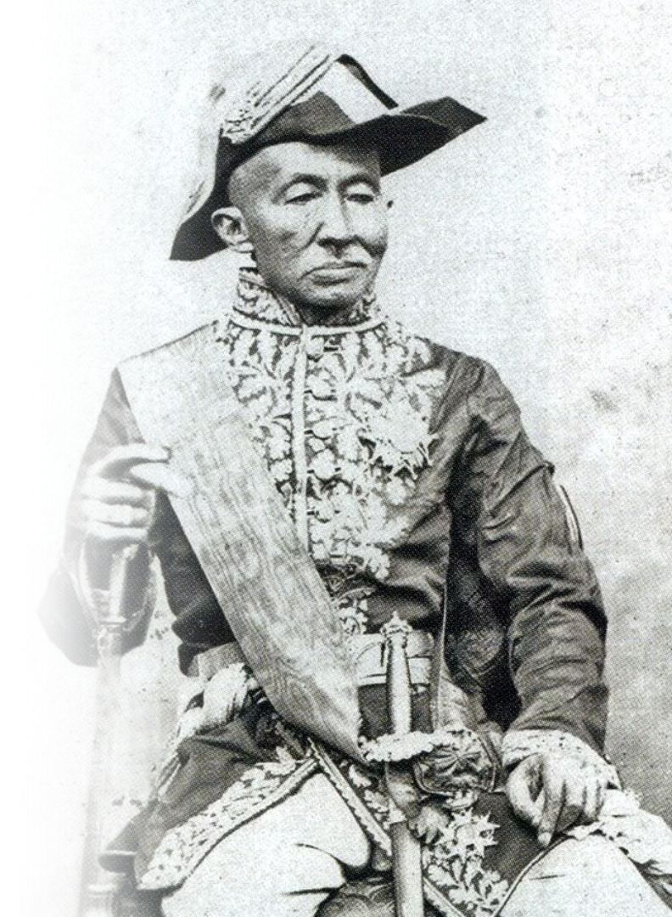
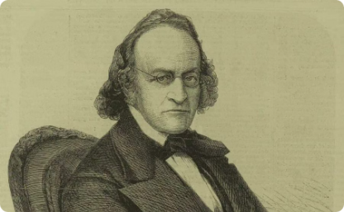
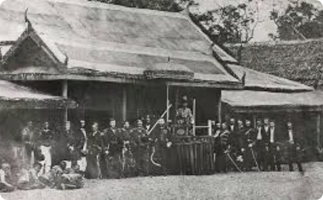
King Rama IV's Reforms (1851-1868)
Sir John Bowring, who negotiated the British trading treaty with Siam
King Rama IV led an expedition to observe a solar eclipse
King Rama IV (King Mongkut) conducted diplomatic relations with Western powers, signing treaties like the Bowring Treaty of 1855, which opened Siam to international trade and modern ideas. He also championed scientific knowledge, modern education, and infrastructure improvements, setting the stage for a more progressive nation.
Pictured: King Rama IV Photo credit: The Gale Review, The Standard, Matichon

Slide 18
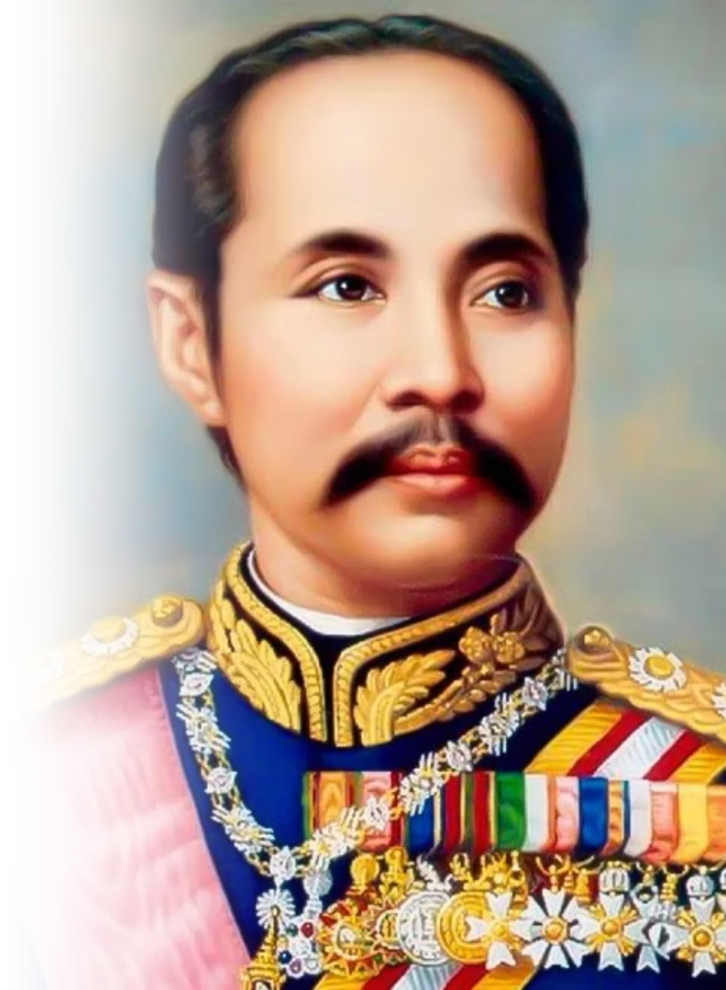
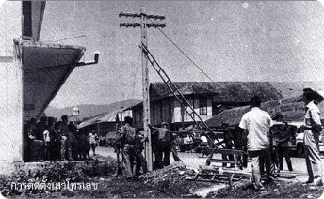
King Rama V's Modernization (1868-1910)
The First telecommunication line in Siam
Train in Siam
King Rama V (King Chulalongkorn the Great) built upon the reforms with sweeping modernization, including the abolition of slavery, administrative and legal reforms, the establishment of a centralized government, and the expansion of railways and telecommunication systems. His diplomatic skills preserved Siam's independence while neighboring countries fell under colonial rule.
Photo credit: Pantip, Silpa-Mag, nongchogcity.go.th

Slide 19
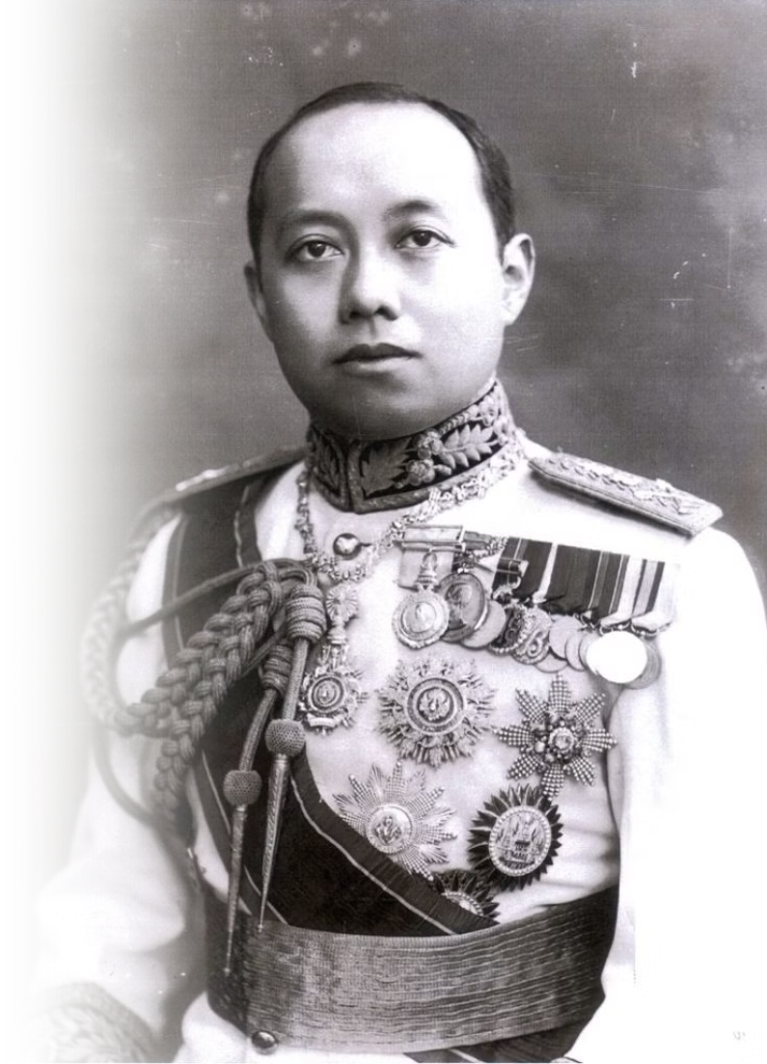
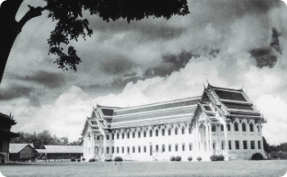
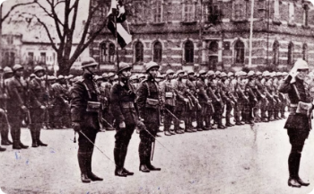
King Rama VI's Nation Building (1910-1925)
Vajiravudh College, one of the schools established by King Rama VI
Siamese soldiers participating in WWI
King Rama VI (King Vajiravudh) furthered his predecessors' works with nation-building efforts, by fostering a unified Thai identity through the promotion of nationalism and cultural reforms. He actively encouraged the adoption of Western-style education, emphasizing civic duty and loyalty to the nation, and played a key role in modernizing the military by introducing Western military training methods and establishing military academies. Additionally, he used literature, theater, and music to instill a sense of patriotism and national pride among the people.
Photo credit: The Cloud, Silpa-Mag

Slide 20
4.3 Age of Democracy (1932 – Present)
Thailand's democratic era began in 1932, when the country transitioned from an absolute monarchy to a constitutional monarchy. This pivotal moment marked the introduction of the first constitution, granting the Thai people a greater voice in governance while preserving the revered monarchy as a unifying national symbol. The first general election was held in 1933, laying the foundation for a parliamentary system and democratic governance.
Photo credit: Thairath

Slide 21
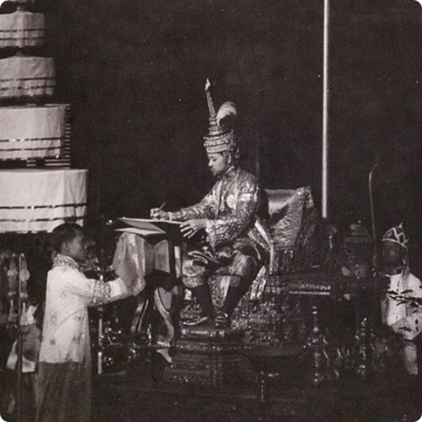
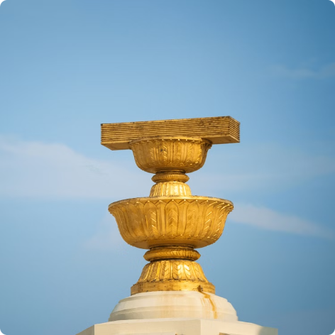
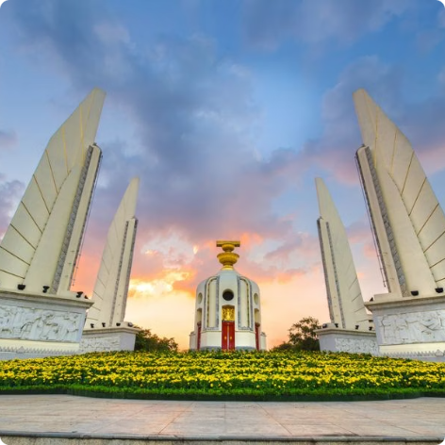
Constitutional
Constitution
Administrative Powers (Executive, Legislative, and Judicial)
Monarchy
The Democracy Monument, depicting the Constitution of Thailand
King Rama VII signs the First Constitution of Thailand
Over the decades, Thailand has continued to develop its democratic institutions, including the establishment of a bicameral legislature, constitutional courts, and local administrative bodies to empower communities.
Photo credit: Around Online, Move Forward Party, BangkokBiz

Slide 22
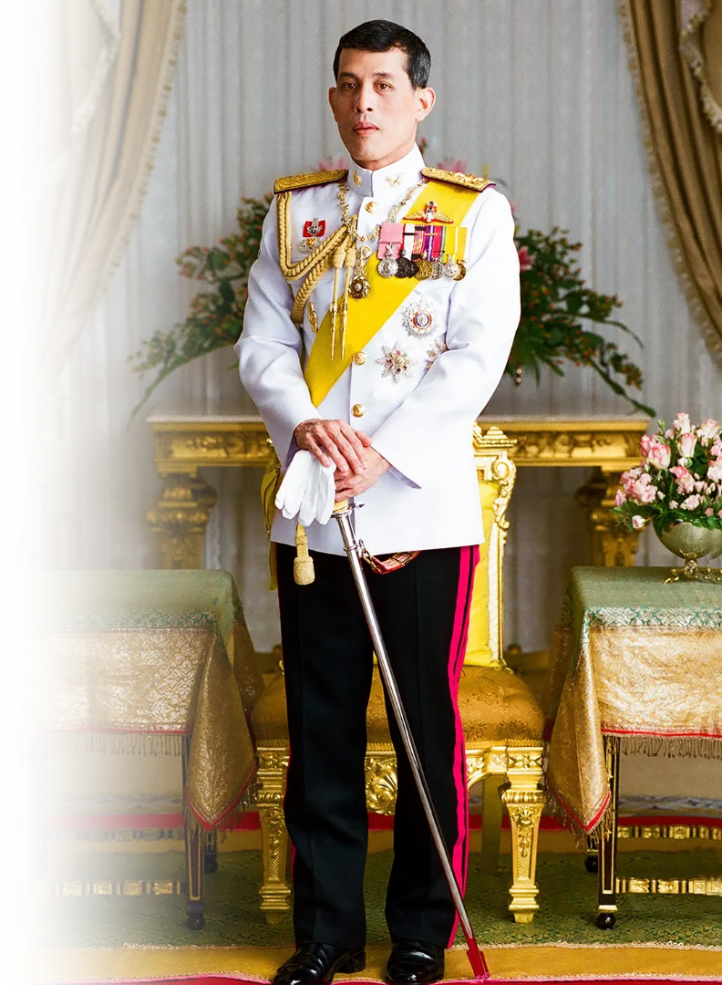
King Maha Vajiralongkorn (Rama X)
Current King of Thailand (2016 - present)
Son of King Rama IX (King Bhumibol Adulyadej the Great) and grandson of King Rama V (King Chulalongkorn the Great)
Photo credit: Phralan.in.th/coronation

