Slide 1
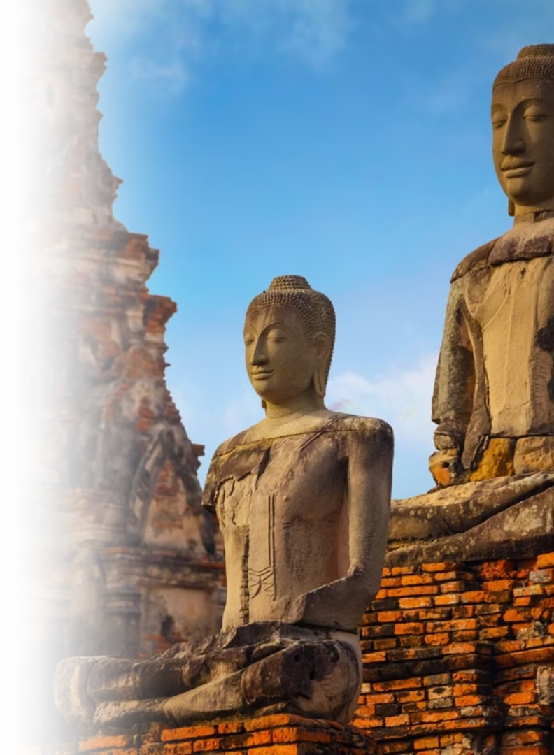

Thailand's History
Photo credit: Thailand Insider
Notes:
1

Slide 2
Thailand in Brief
"Thailand in Brief " has been prepared by the Thailand Foundation to support students, scholars, and the general public who wish to give presentations about Thailand to their audiences—for example, exchange program students and international participants.
The work presents some basic information about Thailand in 11 areas: 1) Geography, 2) History, 3) Politics and Government, 4) Economics, 5) Demographics, 6) Culture, 7) Values, 8) Thai People and Other Popularity That You May Know, 9) Misconceptions about Thailand, 10) Thailand's Role on the Global Stage, and 11) Rankings Related to Thailand.
"Thailand in Brief" is produced in both PDF file (.pdf) and Powerpoint Presentation (.pptx) formats, consisting of 399 slides. Users may download and select the topics they wish to present, and may rearrange the sequence of the slides as appropriate. However, the content of this document cannot be edited. Reproduction or use for commercial purposes without permission from the Thailand Foundation is not allowed.
"Thailand in Brief" will be updated every third quarter each year. For inquiries or further suggestions, please contact the Thailand Foundation at info@thailandfoundation.or.th.
July 2026
Notes:
2

Slide 3
Thailand in Brief
"Thailand in Brief " จัดทำขึ้นโดยมูลนิธิไทย (Thailand Foundation) เพื่ออำนวยความสะดวกแก่ นักเรียน นักศึกษา และผู้สนใจทั่วไป นำไปใช้ประโยชน์ อาทิ ในการบรรยาย หรือให้ความรู้เกี่ยวกับประเทศไทยในด้านต่าง ๆ แก่ชาวต่างประเทศ เช่น กรณีนักศึกษาแลกเปลี่ยนที่ไปเรียนในต่างประเทศที่ต้องนำเสนอเรื่องราวเกี่ยวกับประเทศไทยในสถาบันที่ไปศึกษาอยู่ เป็นต้น
งานชิ้นนี้เสนอข้อมูลเกี่ยวกับประเทศไทยโดยสังเขป 11 ด้าน ได้แก่ 1) ภูมิศาสตร์ (Geography) 2) ประวัติศาสตร์ (History) 3) การเมืองการปกครอง (Politics and Government) 4) เศรษฐกิจ (Economics) 5) ประชากร (Demographics) 6) วัฒนธรรม (Culture) 7) ค่านิยม (Values)
8) คนไทยและสื่อที่คุณอาจรู้จัก (Thai people and other popularity that you may know) 9) ความเข้าใจผิดเกี่ยวกับประเทศไทย (Misconceptions) 10) บทบาทของไทยในเวทีโลก (Thailand’s role on the Global Stage) และ 11) การจัดอันดับที่เกี่ยวกับประเทศไทย
(Rankings related to Thailand)
"Thailand in Brief " นี้จัดทำเป็นสไลด์ จำนวน 399 สไลด์ ในรูปแบบ .pdf และ .pptx สามารถดาวน์โหลดและเลือกใช้หัวข้อที่นำเสนอ และสลับลำดับการนำเสนอได้ตามความเหมาะสม อย่างไรก็ดี ผู้ใช้งานไม่สามารถดัดแปลงเนื้อหาในเอกสารได้ และห้ามผลิตซ้ำ หรือนำไปใช้เพื่อผลประโยชน์เชิงพาณิชย์โดยไม่ได้รับอนุญาตจากมูลนิธิไทย
"Thailand in Brief " จะได้รับการปรับปรุงให้ทันสมัยในทุกไตรมาสที่ 3 ของปี หากมีข้อสงสัยและข้อเสนอแนะเพิ่มเติม กรุณาติดต่อมูลนิธิไทย
อีเมล info@thailandfoundation.or.th
กรกฎาคม 2569
Notes:
3

Slide 4
Thai History Overview
Thailand's rich history spans centuries, shaped by powerful kingdoms and cultural adaptations. Exploring different eras of Thai history provides insight into Thailand's dynamic journey.
Early Periods
Sukhothai Period
Ayutthaya Period
Thonburi Period
Rattanakosin Period
The Early Periods consisted of several influential periods shaping the region’s political, religious, and cultural development.
The Sukhothai Period (1238–1351) is known as the birth period of Thai art, language, and Theravāda Buddhism.
The Ayutthaya Period (1351–1767), saw Thailand (then called Siam) becoming a prosperous and powerful international trade hub. Thai art, culture, religion, and military strength flourished.
The Thonburi Period (1767–1782) was a brief but pivotal period in Thai history, during which King Taksin reunified the country after the fall
of Ayutthaya and established Thonburi as the capital.
The Rattanakosin Period (1782–present) ushered in modern Thailand, with Bangkok as its capital and significant political, social, and cultural advancements.
Notes:
4

Slide 5
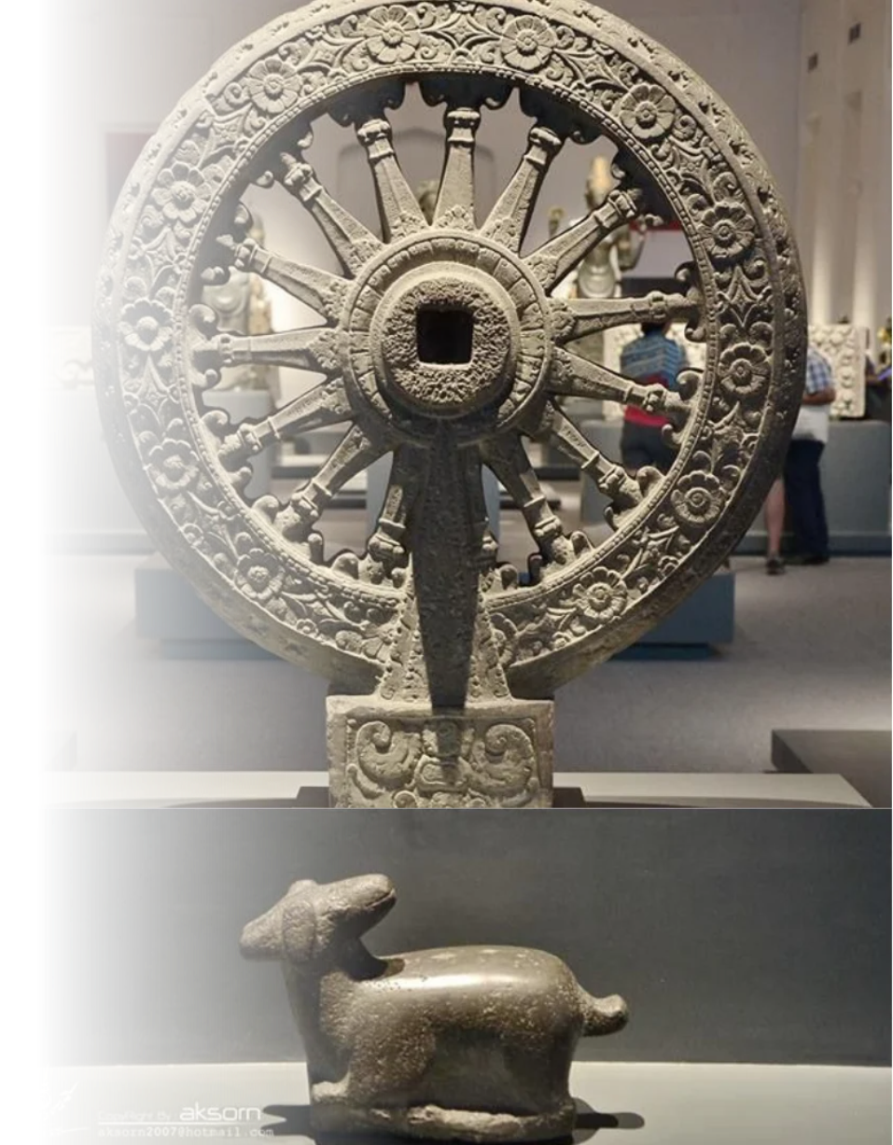
1. Early Periods
1.1 Dvaravati Period
(6th - 11th Century)
  A major center for the spread of Buddhism and cultural exchange in mainland Southeast Asia.
  Located in present-day Central Thailand, particularly the Chao Phraya River Basin.
  The capital is believed to have been either Nakhon Pathom or Suphan Buri, though no consensus has been reached.
  Distinctive artistic remains include Stone Wheel of Law (Dharmachakra) and crouching deer, and Buddha votive tablets.
Pictured: Wheel of Law (Dharmachakra) and crouching deer, National Museum Bangkok (Phranakorn)
Photo credit: Aksorn Publishing
Notes:
4

Slide 6
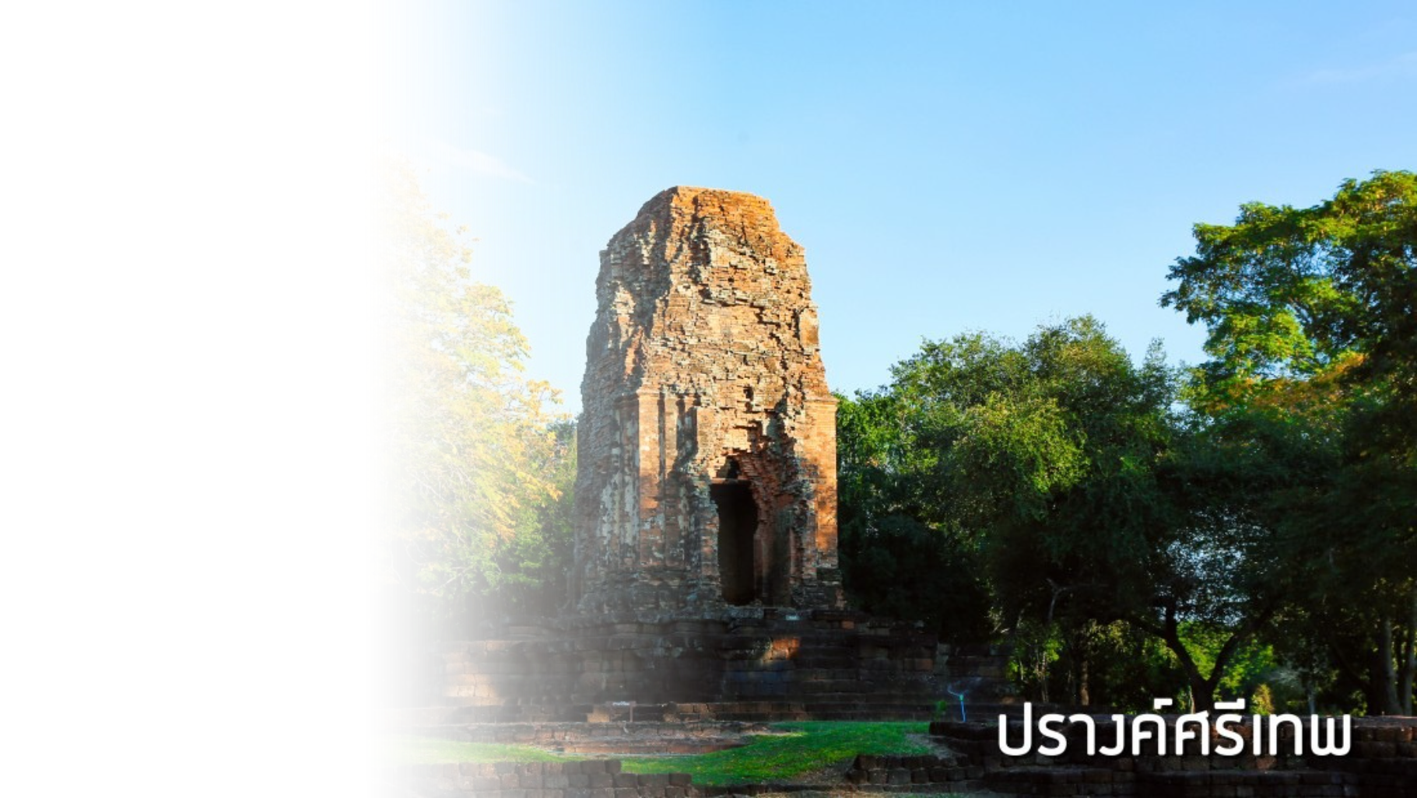
Important Dvaravati-Related Sites
1. Si Thep Historical Park
(Phetchabun)
  An important hub in early Southeast Asian trade and cultural networks.
  Demonstrates the integration of Theravada Buddhism, Mahayana Buddhism, and Hinduism.
  Inscribed as a UNESCO World Heritage Site in 2023.
Pictured: Prang Si Thep, Si Thep Historical Park, Phetchabun
Photo credit: Fine Arts Department
Notes:
4

Slide 7
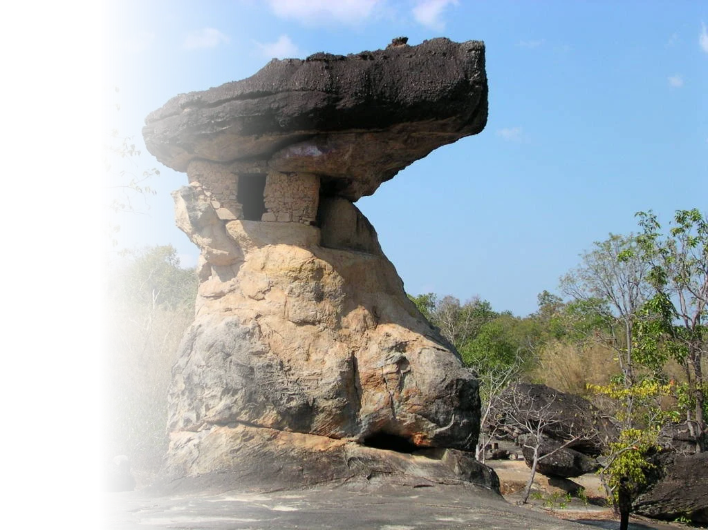
Important Dvaravati-Related Sites
2. Phu Phra Bat Historical Park
(Udon Thani)
  Evidence of sacred Buddhist landscapes.
  Features stone carvings and sema stones surrounding natural rock shelters used as religious sites.
  Inscribed as a UNESCO World Heritage Site in 2024.
Pictured: Hor Nang Usa, Phu Phra Bat Historical Park, Udon Thani
Photo credit: Fine Arts Department
Notes:
4

Slide 8
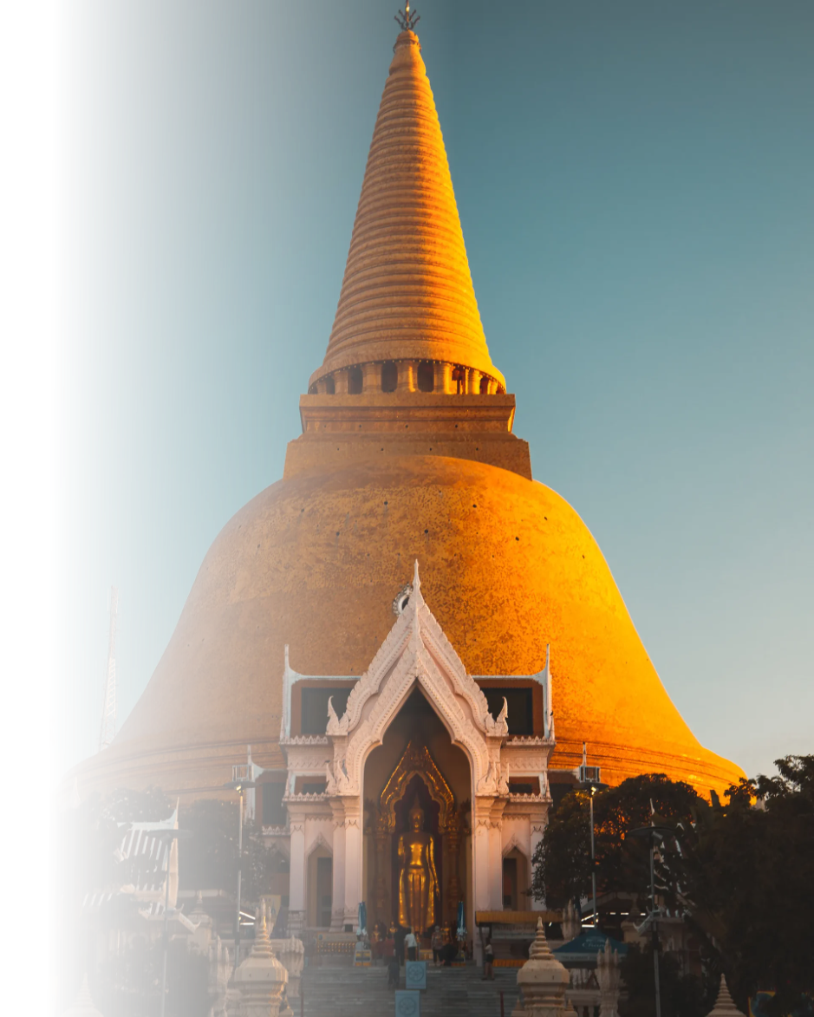
Important Dvaravati-Related Sites
3. Nakhon Pathom
  One of Thailand’s oldest ancient cities.
  Served as a major Dvaravati center between the 6th and 11th centuries.
  Home to important archaeological remains, including Phra Pathom Chedi, and Phra Prathon Chedi.
Pictured: Phra Pathom Chedi, Nakhon Pathom
Photo credit: worldpitou, rexby.com
Notes:
4

Slide 9
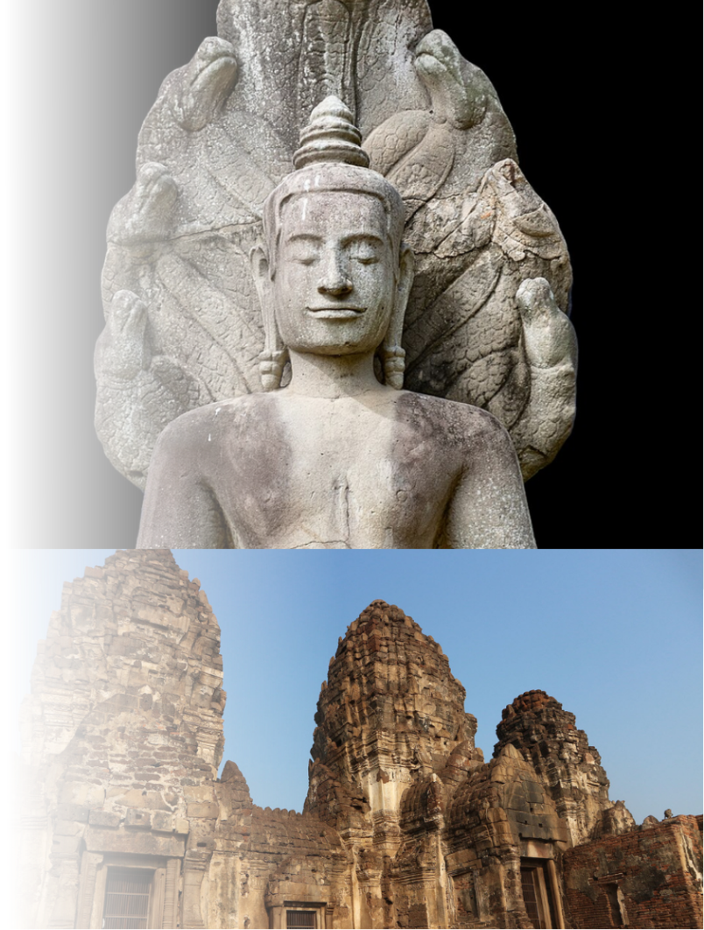
1.2 Lavo (Lopburi) Period
(7th - 13th Century)
  Centered in present-day Lopburi Province.
  One of the major political and cultural centers influenced by the Angkorian Civilization.
  Important artistic remains include the Buddha Sheltered by Naga Hood and Phra Prang Sam Yot.
The Buddha Sheltered by Naga Hood
  Major regional centers included Lavo (Lopburi) and Phimai (Nakhon Ratchasima).
Pictured: The Buddha Sheltered by Naga Hood (Top), Phra Prang Sam Yot (Bottom)
Photo credit: Mastertongapollo (Top), Human Excellence (Bottom)
Phra Prang Sam Yot
Notes:
4

Slide 10
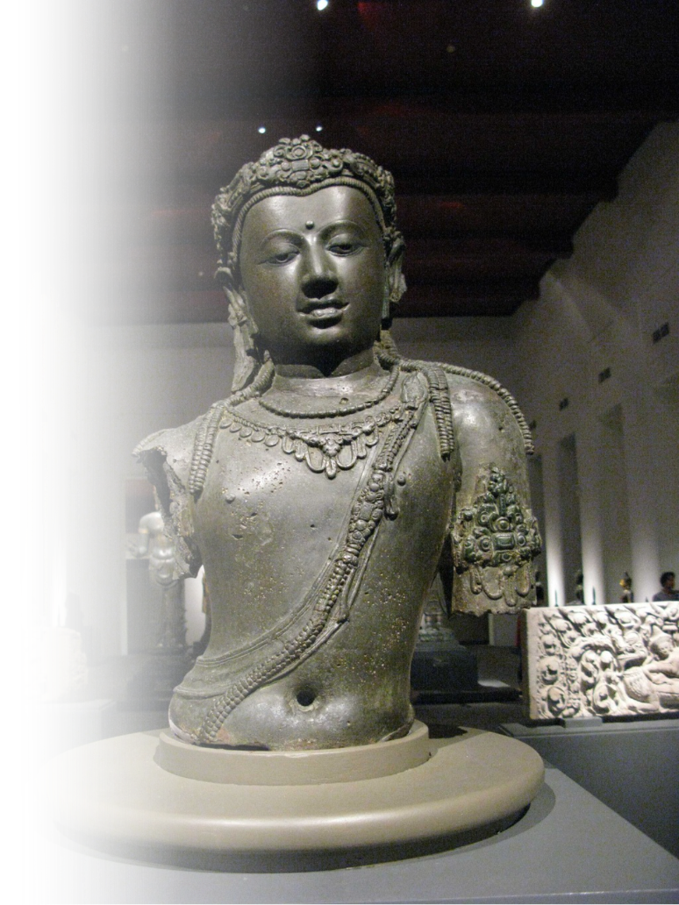
1.3 Srivijaya Period
(7th - 13th Century)
  A powerful maritime kingdom that dominated trade across the Malay Peninsula and the Indonesian Archipelago.
  Controlled important sea routes linking India, Southeast Asia, and China.
  A major center of Mahayana Buddhism in Southeast Asia.
  In present-day, Chaiya (Surat Thani) was an important center of Srivijaya and served as a regional capital.
  Notable artistic remains include Bodhisattva Avalokiteśvara statues, Phra Borommathat Chaiya.
Pictured: Bodhisattva Avalokiteśvara, National Museum Bangkok (Phranakorn)
Photo credit: Princess Maha Chakri Sirindhorn Anthropology Centre (Public Organisation)
Notes:
4

Slide 11
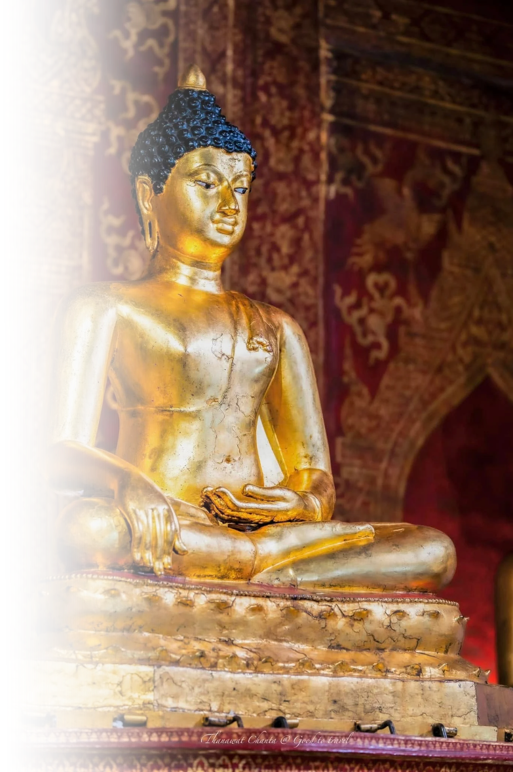
1.4 Lanna Period
(13th - 18th Century)
  Founded by King Mangrai in 753 CE after unifying Yonok, Haripunjaya, and other Northern regions.
  Centered in Chiang Mai, which became the capital of the kingdom.
  A major center of Theravada Buddhism and Northern Thai culture.
  Reached its cultural and religious peak during the 14th–15th centuries.
  Wat Phra Singh exemplifies the artistic and architectural traditions of the Lanna period.
Pictured: Phra Phutthasihing, Wat Phra Sing, Chiang Mai
Photo credit: Good to Travel
Notes:
4

Slide 12
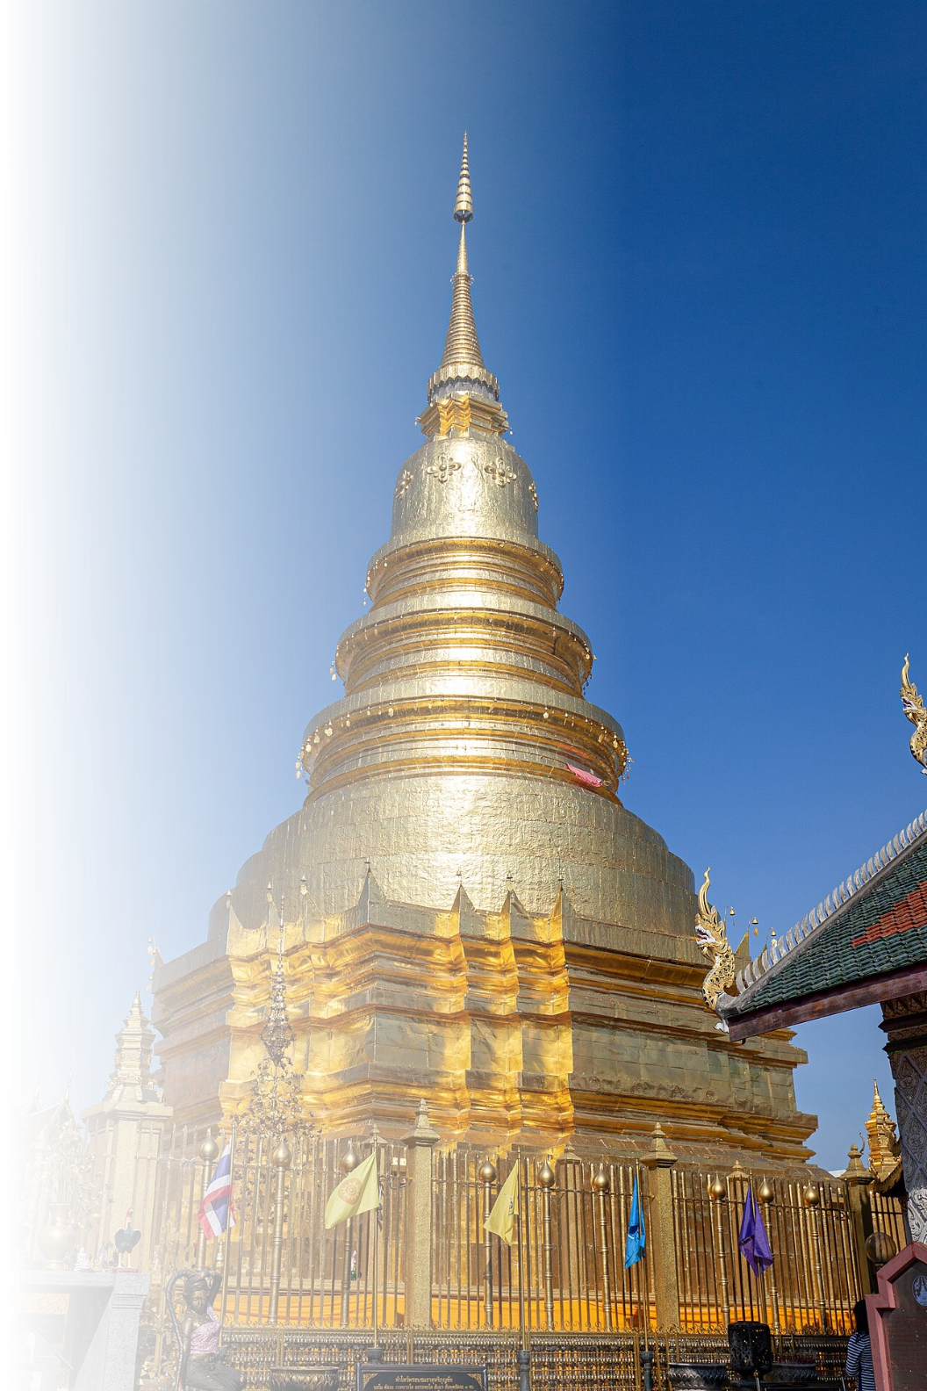
Important Lanna-Related Kingdoms
1. Haripunjaya Kingdom
(Lamphun)
  A Mon kingdom centered in present-day Lamphun.
  According to legend, Queen Chamadevi from Lavo was invited to rule the kingdom.
  Flourished as an important center of Buddhism and culture in Northern Thailand.
  Later incorporated into the Lanna Kingdom by King Mangrai in 13th Century
Pictured: The stupa of Wat Phra That Hariphunchai
Photo credit: Mastertongapollo
Notes:
21

Slide 13
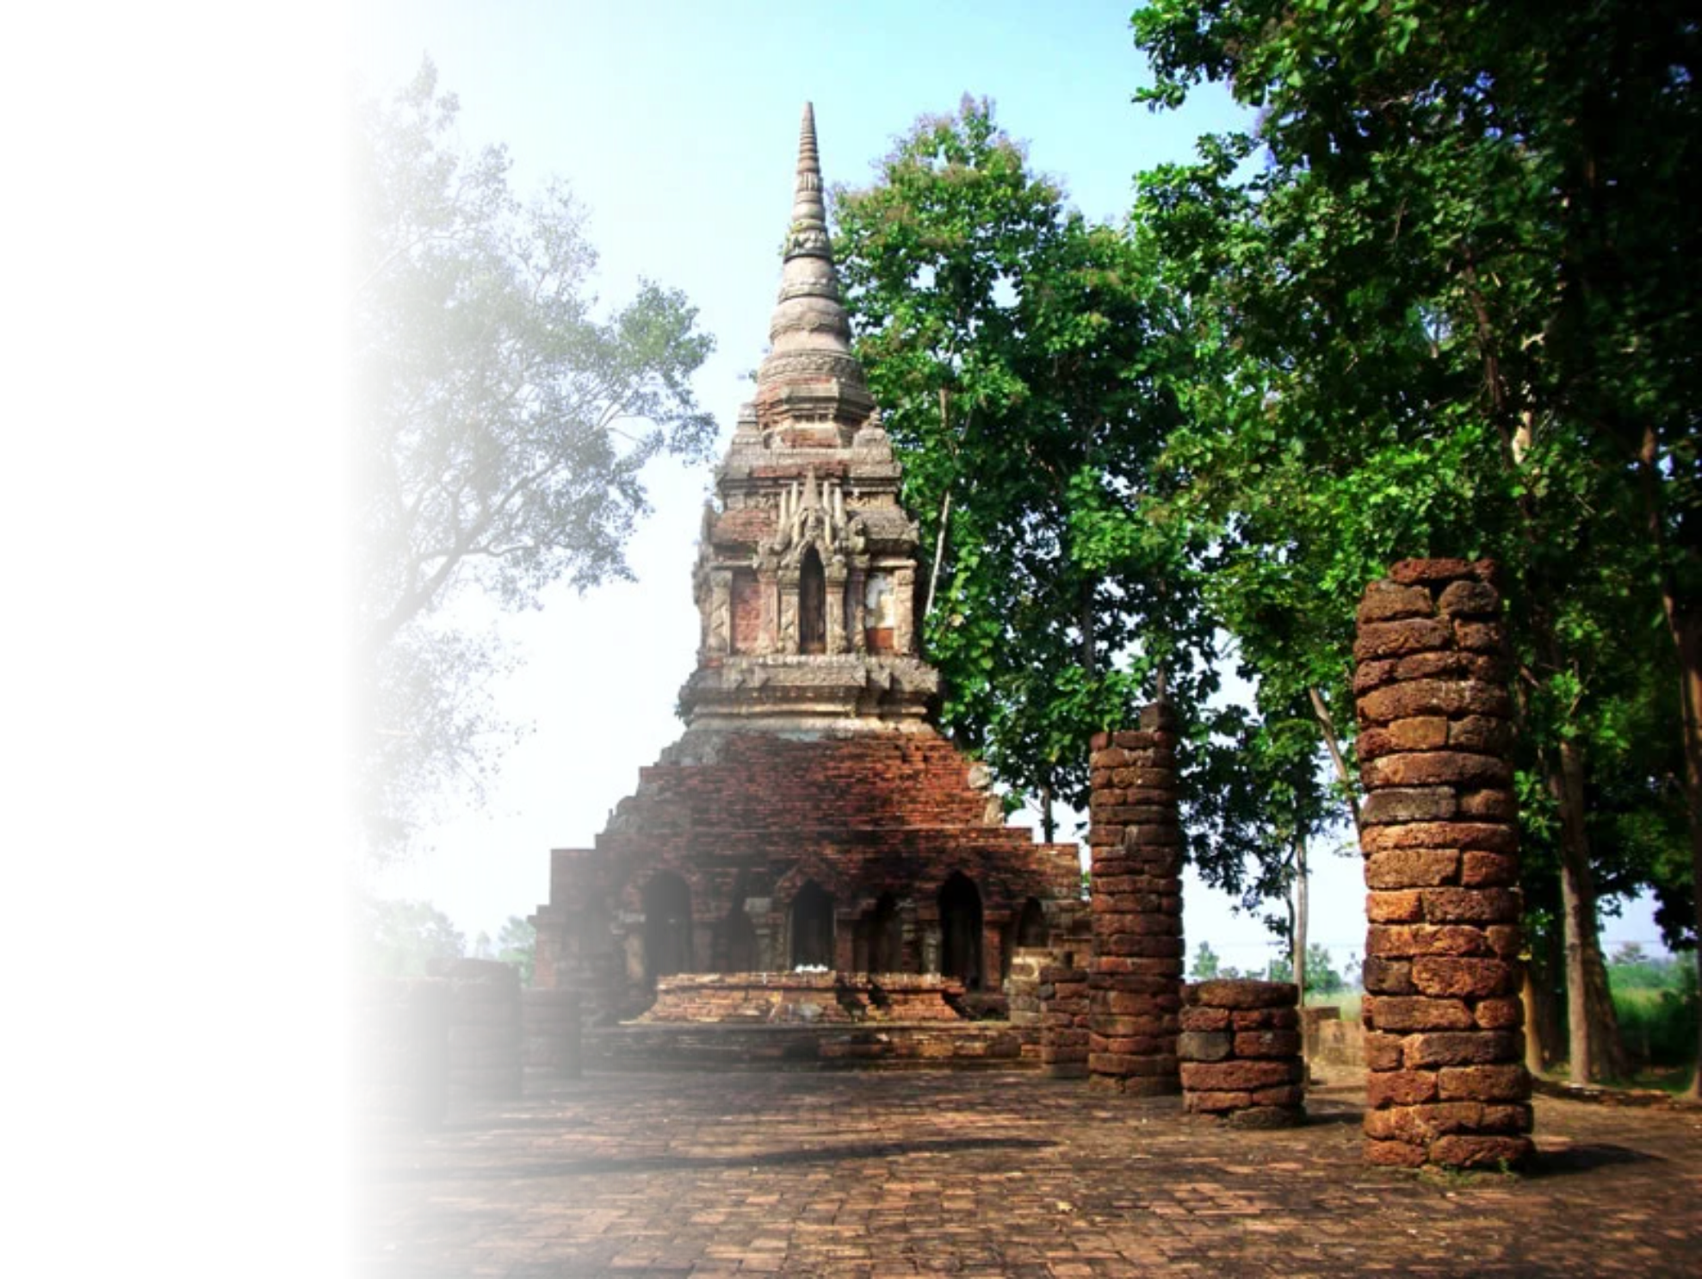

Important Lanna-Related Kingdoms
2. Yonok (Chiang Saen)
(Chiang Rai)
  Early northern polity in present-day Chiang Rai.
  Associated with Chiang Saen and regional trade networks.
  Considered an important precursor to the Lanna Kingdom.
Pictured: Wat Pa Sak, Chiang Rai
Photo credit: Historydo
Scan the QR code to access the digital PDF of Archaeology and History of Thailand (Early Periods). Please note that the publication is available in Thai only. Interested readers may use translation tools to explore the content in English.
Notes:
21

Slide 14
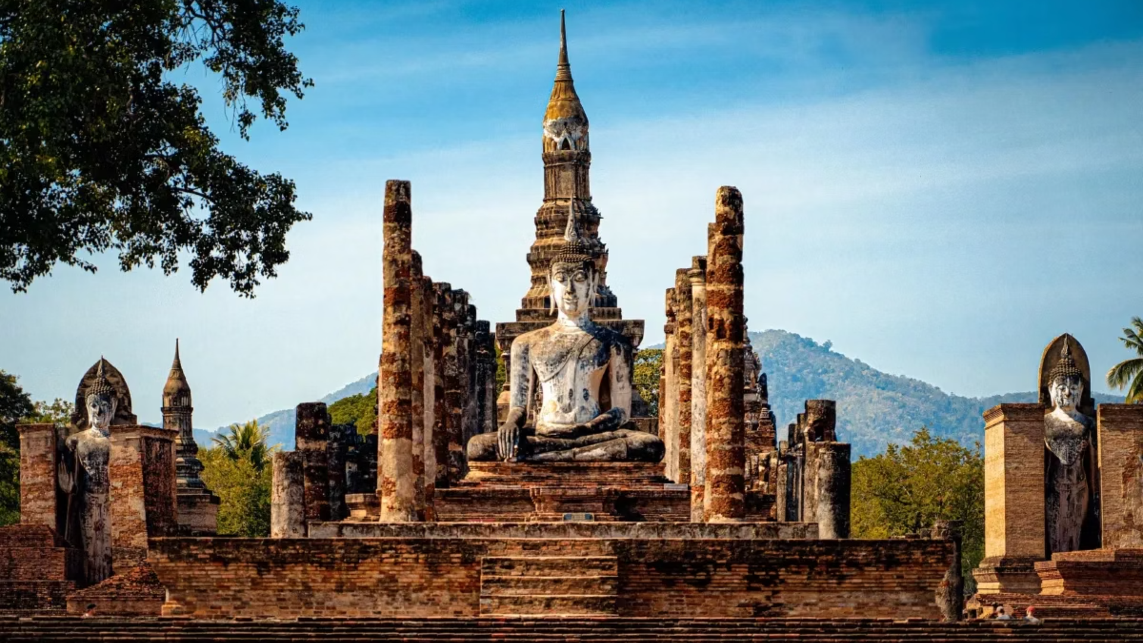
2. Sukhothai Period
The Sukhothai Period (1238–1351: 113 years) is marked by the rise of the Sukhothai Kingdom, considered by many to be one of the first Thai states.
Theravada Buddhism
Cultural Achievements
Enduring Legacy
Through its adoption of Theravada Buddhism as the state religion, Sukhothai established a spiritual foundation that continues to shape Thai identity.
The creation of the Thai script was a monumental achievement, laying the groundwork for the modern Thai language. The period's art, particularly its graceful Buddha images and distinctive architecture, remains iconic and influences Thai aesthetics to this day.
Sukhothai's legacy endures through its emphasis on Thai cultural unity, spiritual values, and artistic refinement.
Photo credit: Sawasdee Thailand
Notes:
5

Slide 15
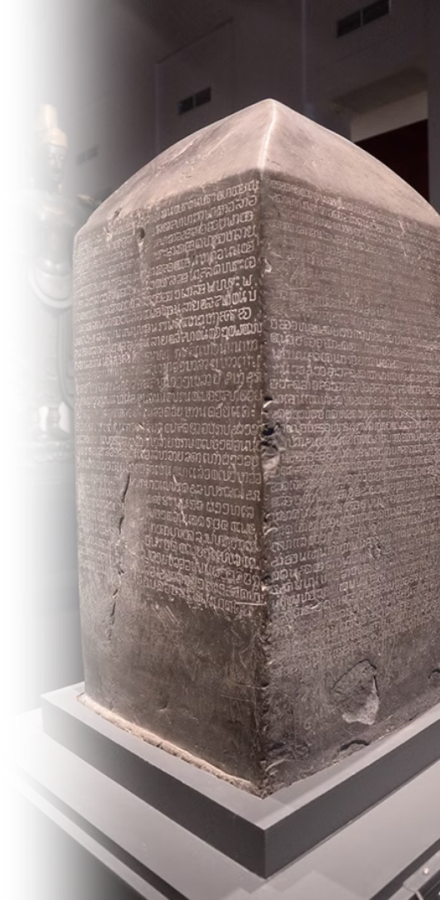
Important Events During the Sukhothai Period
Reign of King Sri Inthrathit (1238 – 1270)
  Pho Khun Bang Klang Hao (King Sri Inthratit), together with Pho Khun Pha Muang, successfully rebelled against the Khmer Empire, founding Sukhothai as the first independent Thai state in 1238
  Established the Phra Ruang Dynasty
Reign of King Ram Kamhaeng the Great (1279 – 1298)
  Theravada Buddhism from Sri Lanka flourishes in Sukhothai
  Missions sent to Yuan China
  Early evidence of Thai Script
Reign of King Maha Thammaracha I (1347 – 1368)
  Traibhumikatha (The Story of the Three Planes of Existence) around 1345
Pictured: King Ram Kamhaeng Inscription, an evidence of early Thai Script
Photo credit: National Archives of Thailand
Notes:
6

Slide 16
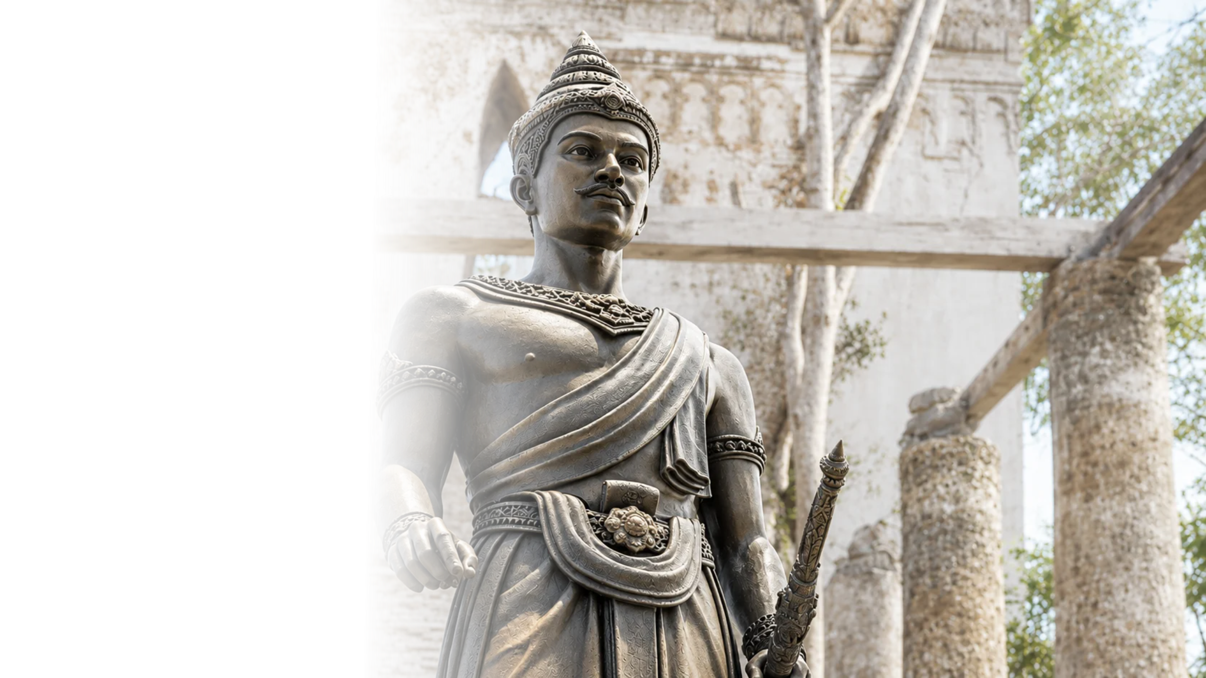
Phra Ruang Dynasty
  Founded and ruled the Sukhothai Kingdom, regarded as the first major Thai kingdom.
  Governed under the Paternal Autocracy, emphasizing a close relationship between the king and the people.
  Traditionally credited with the development of the Thai script during the reign of King Ramkhamhaeng.
  Promoted Theravada Buddhism, particularly during the reign of King Maha Thammaracha I.
  Developed the distinctive Sukhothai artistic style, known for graceful Buddha images and lotus-bud-shaped chedis.
Pictured: King Si Inthrathit
Photo credit: Silpa-mag
Notes:
4

Slide 17
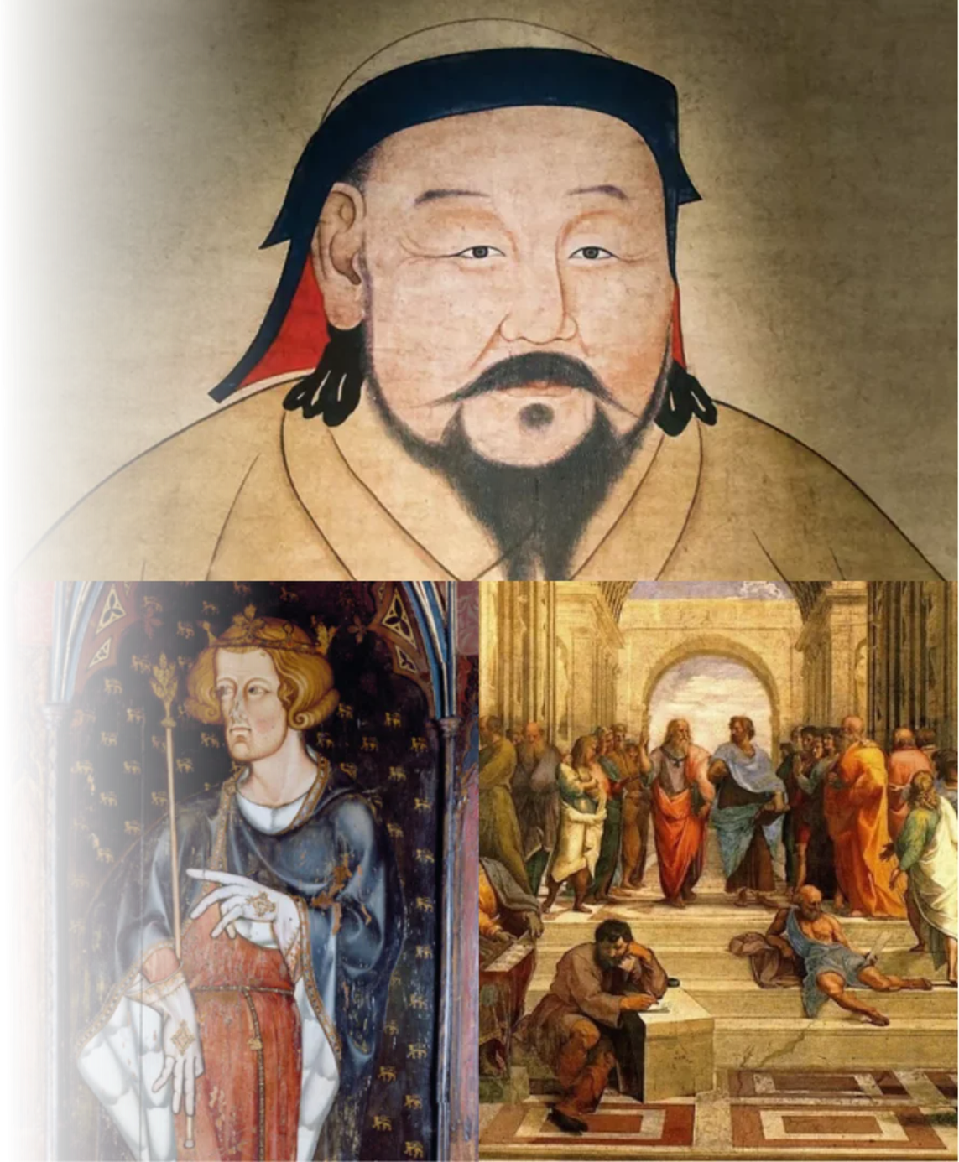
What's happening elsewhere
in the world?
  1271: Kublai Khan established Yuan Dynasty
Kublai Khan
  1272 - 1307: Reign of King Edward I "Longshanks" of England
  14th century: Early beginning of the Renaissance
Pictured: Kublai Khan (Top), King Edward I (Bottom Left), Renaissance Era (Bottom Right)
Photo credit: Keren Su/Getty Images (Top), Angelo Hornak / Alamy (Bottom Left), Public domain (Bottom Right)
King Edward I
The Renaissance Era
Notes:
10

Slide 18
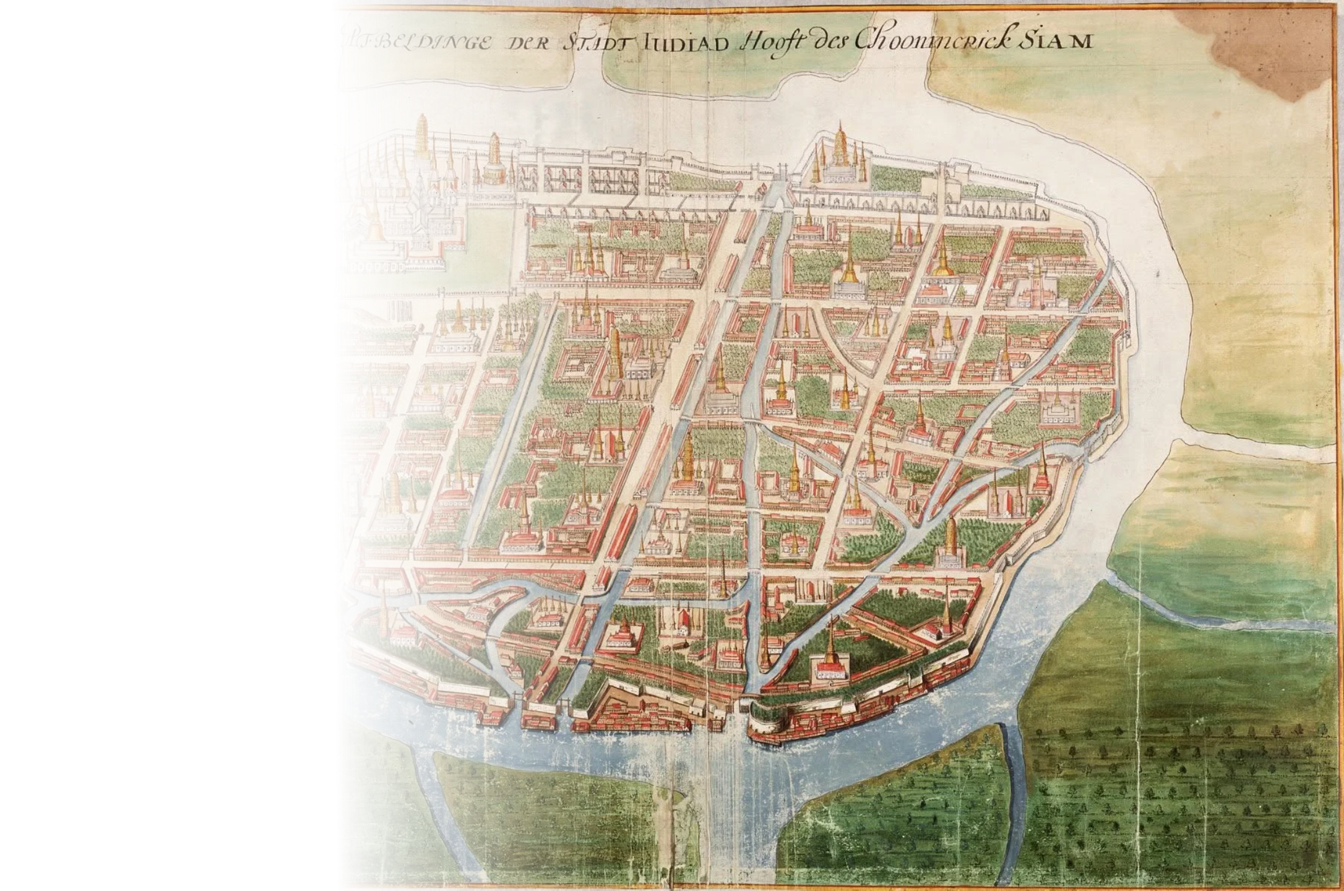

3. Ayutthaya Period
The Ayutthaya Period (1351–1767: 416 years) saw Thailand (then known as Siam) becoming a powerful and cosmopolitan state that shaped the course of Thai history.
Political and Economic Power
  Known for its political might and flourishing trade, Ayutthaya became a hub of cultural and economic exchange.
  Important exports from Ayutthaya included rice, teak, and animal parts, among others.
Pictured: Afbeldinge der Stadt Iudiad Hooft des Choonincrick Siam (View of the City of Ayutthaya, Capital of the Kingdom of Siam)
Photo credit: Nationaal Archief, The Hague, the Netherlands.
Notes:
7

Slide 19
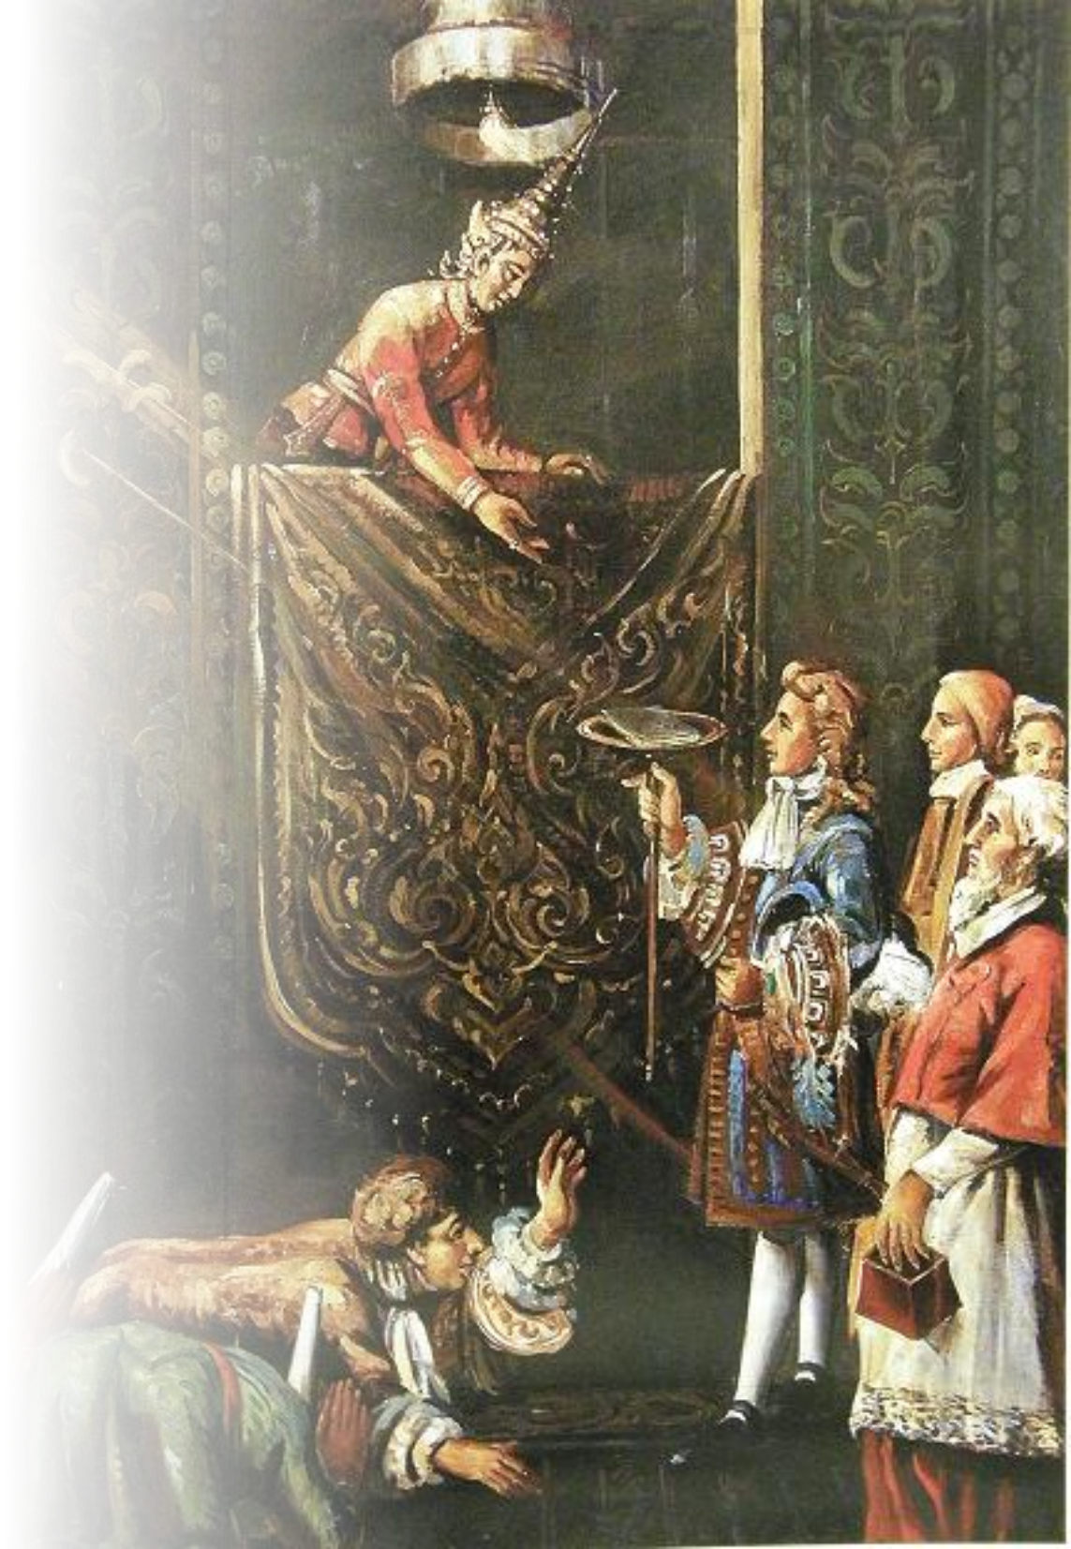

International Relations
  Ayutthaya attracted merchants and diplomats from across Asia, Europe, and the Middle East.
  Foreign communities established permanent settlements in the Siam. Many foreigners also rose to important political roles.
Pictured: King Narai the Great of Ayutthaya receiving the French Ambassador, Alexandre Chevalier de Chaumont
Photo credit: King Narai National Museum
Notes:
7

Slide 20
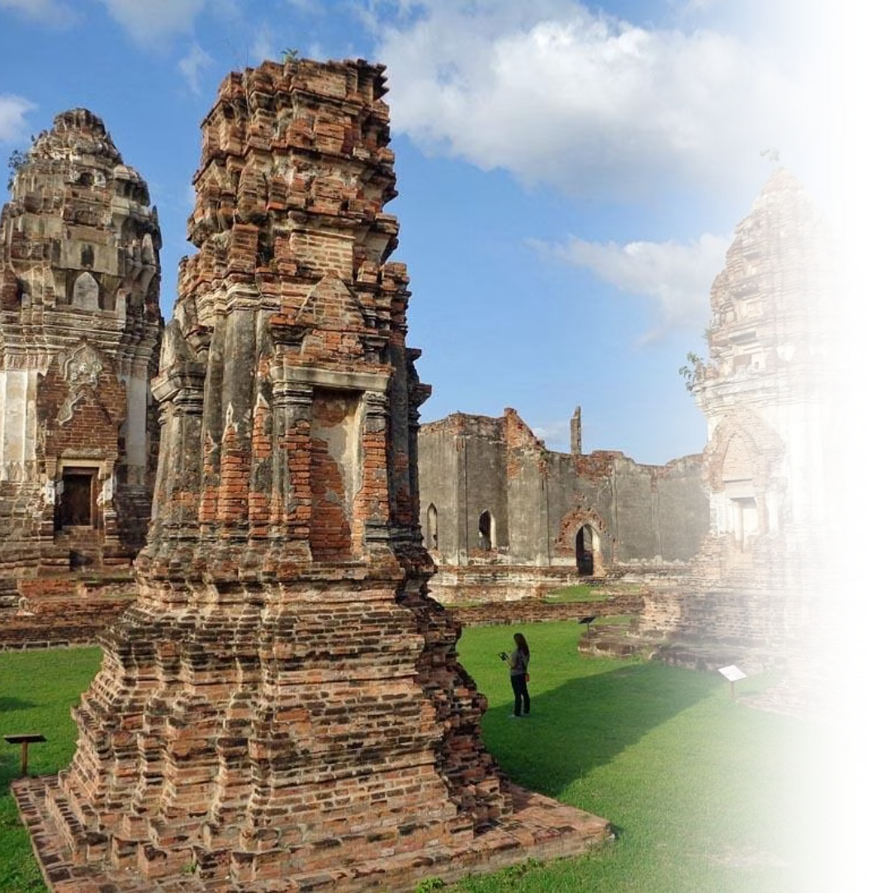
Cultural Influence
Ayutthaya's multicultural nature fostered a unique blend of traditions, seen in art, architecture, and cuisine, which laid the foundation for much of the Thai culture as seen today.
Pictured: Phra Narai Ratchaniwet, the royal palace of King Narai the Great in Lopburi, the former second capital of the Ayutthaya Kingdom.
Photo credit: tripadvisor
Notes:
8

Slide 21
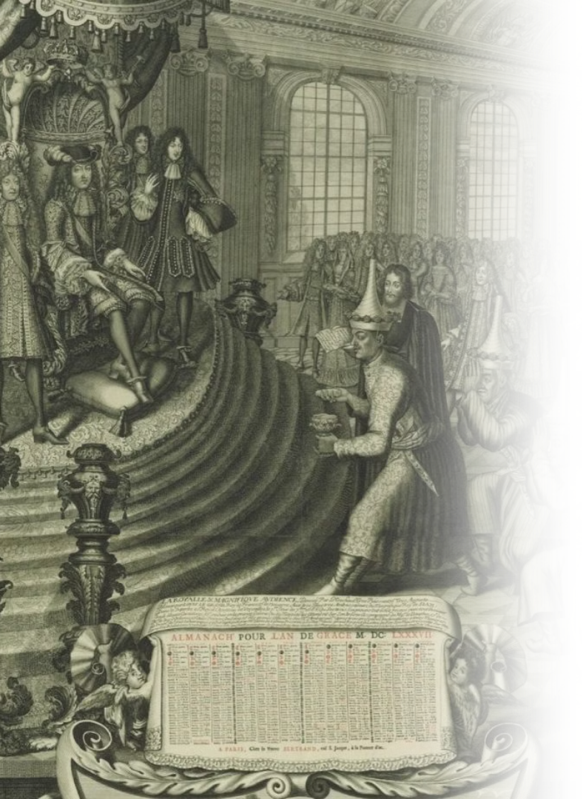
Important events during the Ayutthaya Period
  1511: Portugal made contact with Ayutthaya
  1602: The Persian merchant Sheikh Ahmad became Chula Ratchamontri (a high-ranking government position), reflecting Ayutthaya’s ties to the Islamic world
  1685: French mission headed by Alexandre Chevalier de Chaumont visited Ayutthaya
  1686 Kosa Pan led Ayutthaya mission to France
  1753: Ayutthaya sent the monk Upali Thera to revive Buddhism in Sri Lanka, reflecting Ayutthaya’s influence in the international Buddhist community
  1767: Burmese conquest, fall of Ayutthaya
Pictured: King Louis XIV of France receiving the Siamese Ambassador, Kosa Pan
Photo credit: Silpa-Mag
Notes:
9

Slide 22
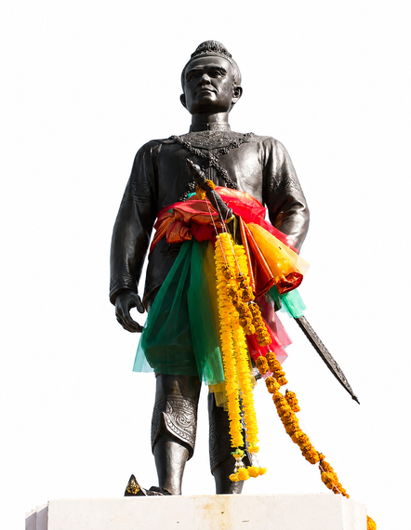
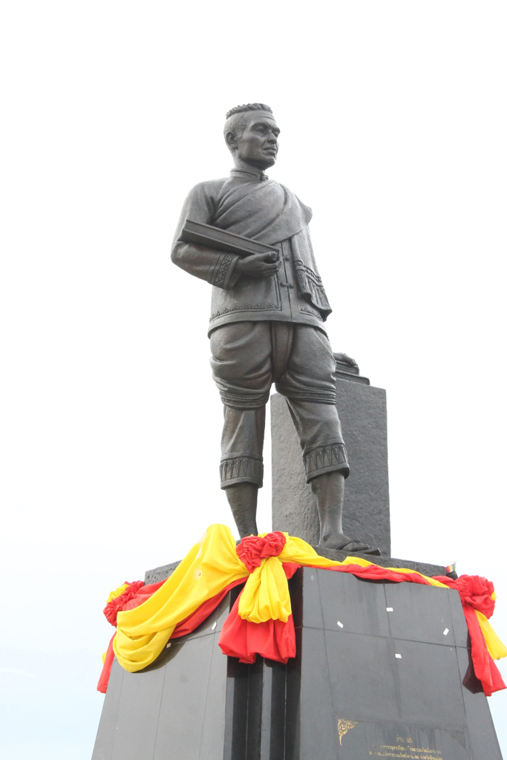
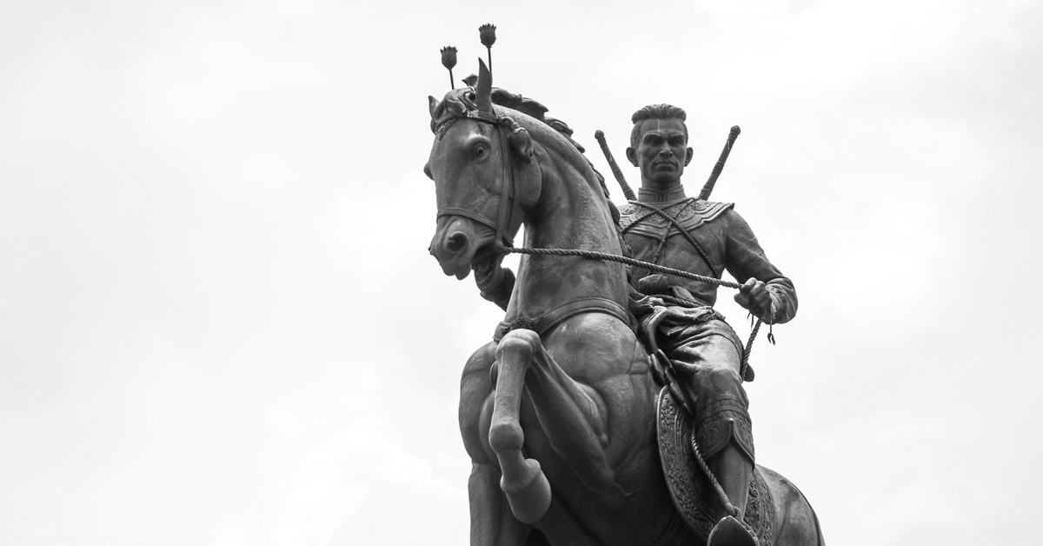
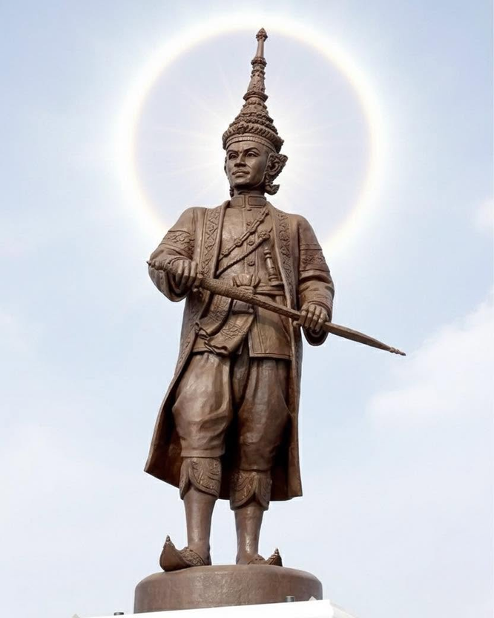
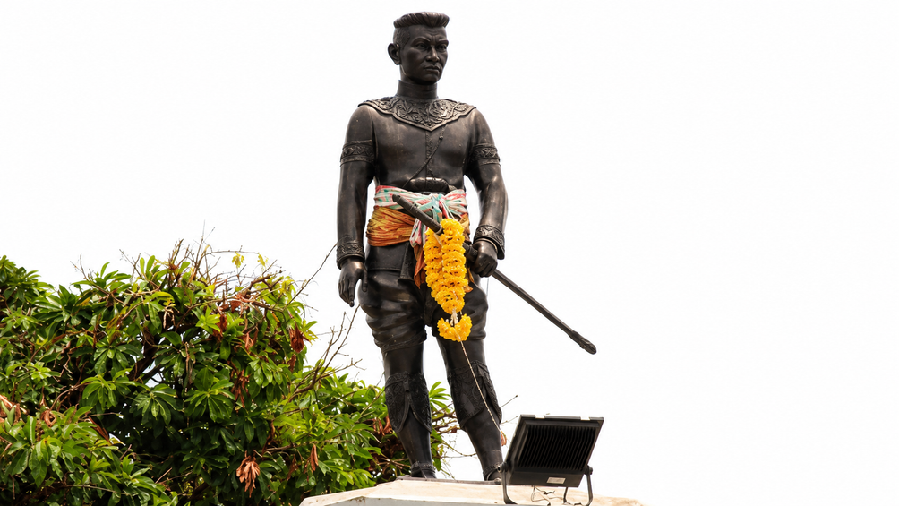
Dynasties in the Ayutthaya period
Uthong Dynasty
Suphannaphum Dynasty
Sukhothai Dynasty
Prasat Thong Dynasty
Ban Phlu Luang Dynasty
(1350 – 1370)
(1388 - 1409)
(1370 – 1388)
(1409 - 1569)
(1569 – 1629)
(1629 – 1688)
(1688 – 1767)
7 Kings
4 Kings
6 Kings
3 Kings
13 Kings
  Founded the Ayutthaya Kingdom and established its political foundations.
  Introduced the Chatusadom administrative system (City (Wiang), Palace (Wang), Treasury (Khlang), and Agriculture (Na)).
  Notable King: Ramathibodi I
  Expanded Ayutthaya's territory and incorporated Sukhothai into the kingdom.
  Reformed the administrative system under King Borommatrailokkanat.
  Notable King: Borommatrailokkanat
  Descended from the royal house of Sukhothai.
  Marked by the restoration of Ayutthaya's independence from Pegu and military expansion.
  Notable King: Naresuan the Great
  Oversaw Ayutthaya's golden age of international trade and diplomacy.
  Expanded relations with European powers, particularly France.
  Notable King: Narai the Great
  The final dynasty of Ayutthaya.
  Known for achievements in literature, arts, and Buddhism before the kingdom's fall in 1767.
  Notable Kings: Phetracha and Borommakot
Photo credit: Fine Arts Department, Silpa-mag
Notes:
21

Slide 23
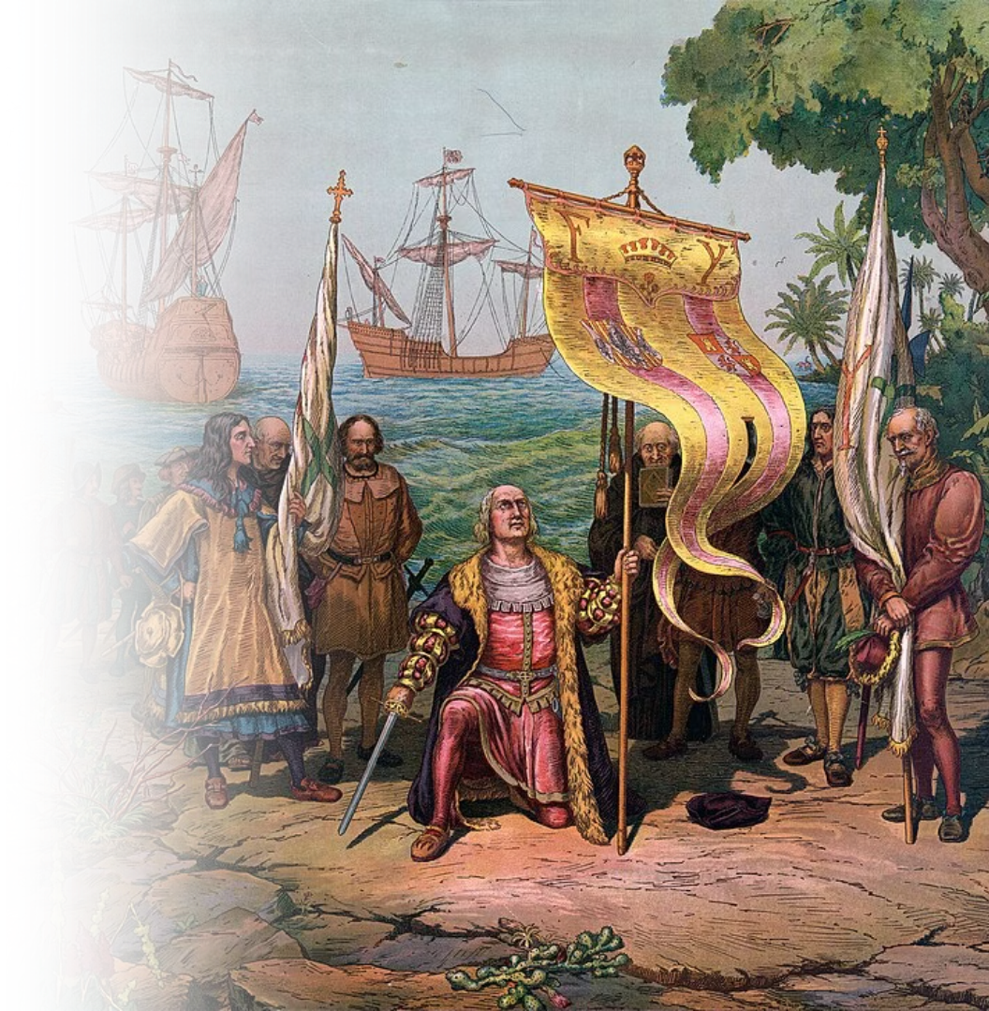
What's happening elsewhere
in the world?
  1368: Ming Dynasty established
  1405-1433: Voyages of Zheng He
  1492: Columbus set sails
  1603: Tokugawa Ieyasu becomes Shōgun
  1644: Manchu conquest of China
Pictured: Columbus taking possession of the new country
Photo credit: The Prang Educational Co.
Notes:
10

Slide 24
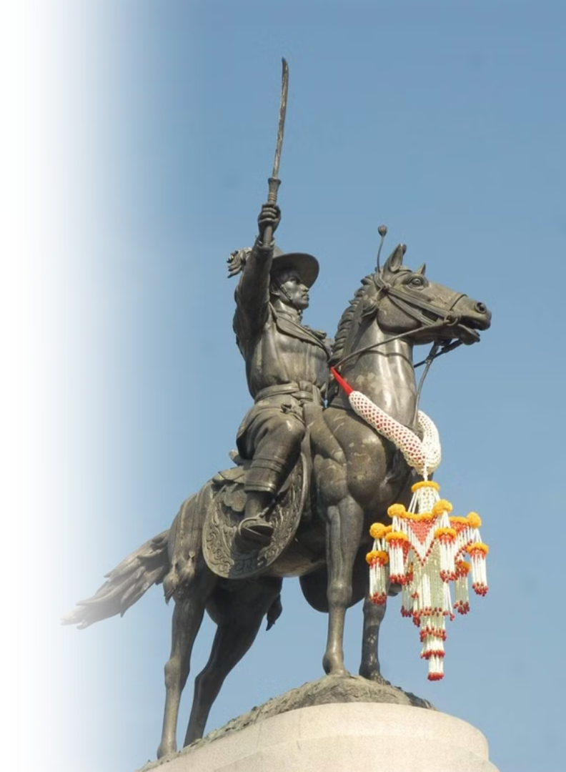



4. Thonburi Period
The Thonburi Kingdom (1767–1782: 15 years) was a short yet pivotal period in Thai history, marking the nation's recovery from the fall of Ayutthaya.
Leadership
Rebuilding
Trade Hub
Under the leadership of King Taksin the Great, the period was characterized by efforts to reunify the fragmented territories of Siam.
King Taksin focused on rebuilding the cultural and economic foundations of the kingdom after the destruction of Ayutthaya.
Thonburi's strategic location near the Chao Phraya River allowed it to thrive as a trading hub, maintaining connections with regional powers.
Pictured: Monument of King Taksin the Great (Photo credit: Matichon Weekly)
Notes:
11

Slide 25
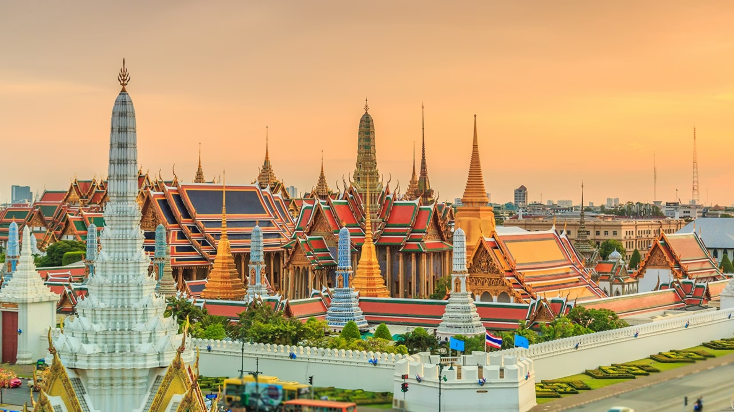
5. Rattanakosin Period (1782–present)
Establishment
Cultural Flourishing
Modernization
The Rattanakosin Period (1782–present) began with the establishment of Bangkok as the capital by King Rama I, marking the start of the Chakri dynasty.
This era saw the flourishing of Thai art, literature, and architecture, with landmarks such as the Grand Palace and Wat Phra Kaew being built.
It also witnessed Thailand's modernization, diplomatic engagements with Western powers, and reformed in governance, education, and infrastructure under later monarchs, especially King Rama V.
Photo credit: Thairath
Notes:
12

Slide 26
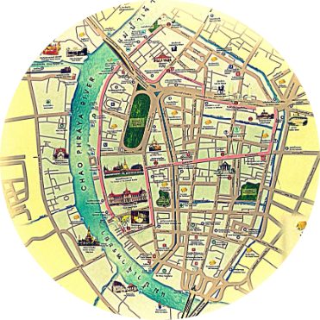

5.1 Early Rattanakosin (1782–1851)
Founding of Bangkok
Restoration
The early Rattanakosin period, spanning the reigns of Kings Rama I, II, and III, began with the founding of Bangkok as the new capital by King Rama I, strategically located along the Chao Phraya River to ensure defense and facilitate trade.
Some hallmarks of this period include cultural restoration, the strengthening of Theravada Buddhism, and Siam's engagement in international trade.
Photo credit: Bangkok Sightseeing, Royal Grand Palace, Chaophraya Tourist Boat, Pantip.com: Teo
Notes:
13

Slide 27
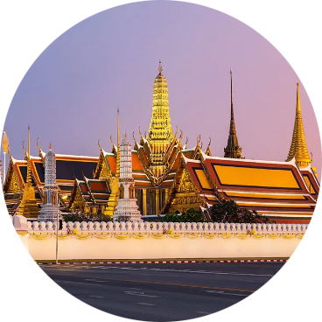
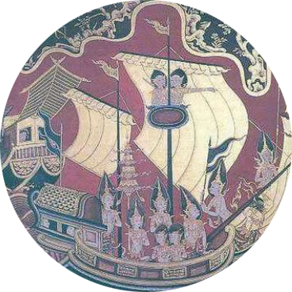
Key Developments
Global Context
Some key developments include the rewriting of Thai legal codes, the flourishing of literature and arts under King Rama II, and King Rama III's emphasis on economic expansion and diplomatic relations with China. The construction of grand temples within The Grand Palace Complex reflected the era's artistic and religious vibrancy.
Globally, this period coincided with significant changes, including the rise of the British Empire in Asia, the Industrial Revolution in Europe, and the expansion of Western colonialism.
Photo credit: Chaophraya Tourist Boat, Pantip.com: Teo
Notes:
14

Slide 28
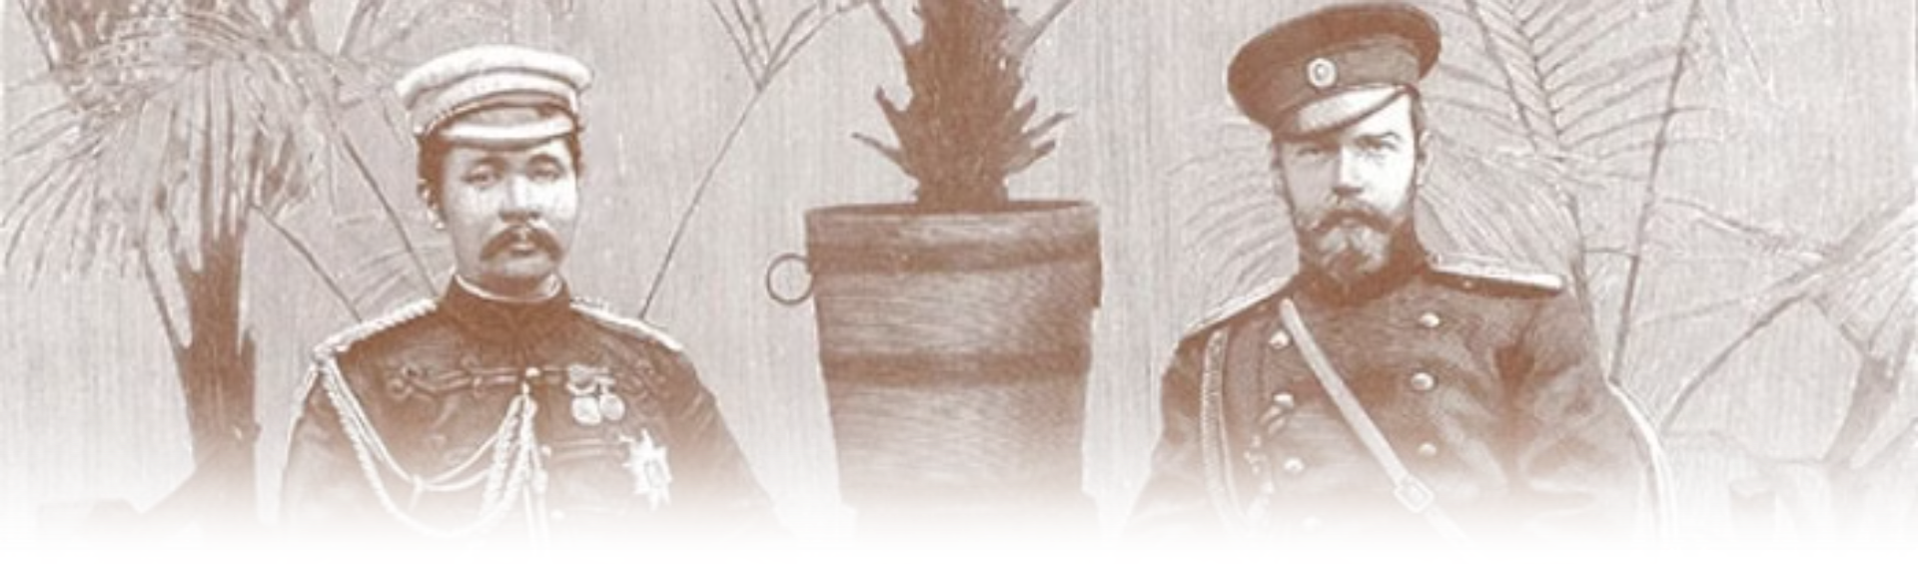
5.2 Modernization Period
(1851-1925)
The modernization period of Thailand, spanning the reigns of King Rama IV (Mongkut), King Rama V (Chulalongkorn), and King Rama VI (Vajiravudh), marked a transformative era in which Siam embraced reform to safeguard its sovereignty in the face of Western colonial expansion.
Pictured: King Rama V with Tsar Nicholas II of Russia (Photo credit: Thai369)
Notes:
15

Slide 29




Sovereignty
Reform
Leadership
Preserving independence amid colonial threats not colonized
Embracing modernization to strengthen the nation
Visionary kings guiding transformation
Pictured: Ceiling painting depicting King Rama V's Abolition of Slavery at the Ananta Samakhom Throne Hall (Photo credit: Matichon)
Notes:
16

Slide 30
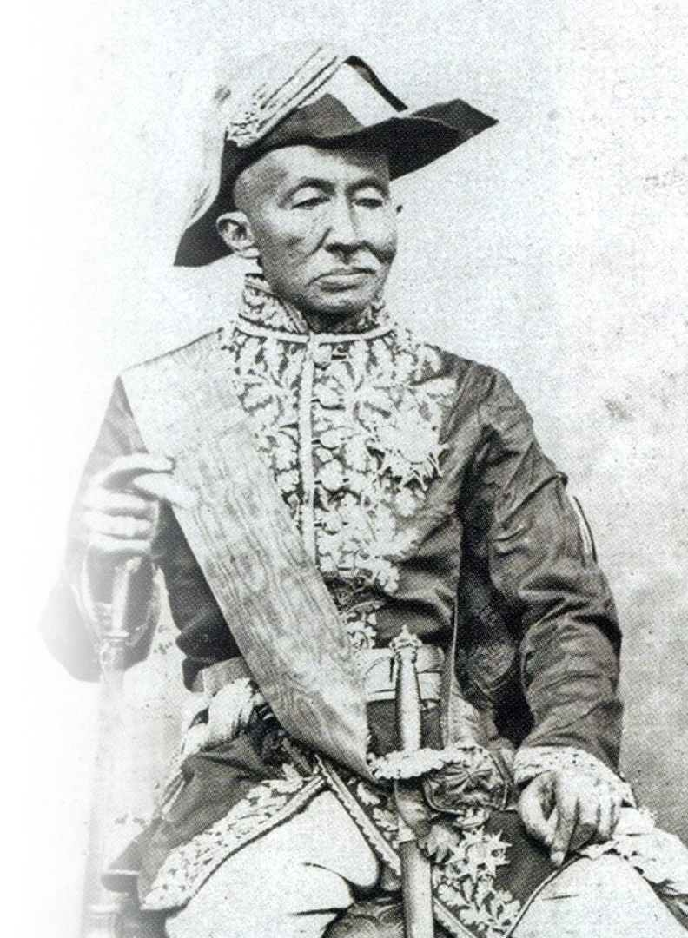
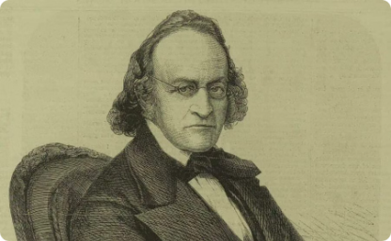
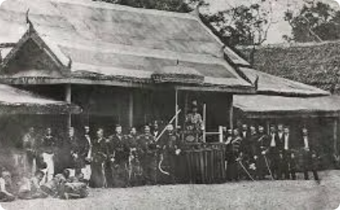
King Rama IV's Reforms (1851-1868)
Sir John Bowring, who negotiated the British trading treaty with Siam
King Rama IV led an expedition to observe a solar eclipse
King Rama IV (King Mongkut) conducted diplomatic relations with Western powers, signing treaties like the Bowring Treaty of 1855, which opened Siam to international trade and modern ideas. He also championed scientific knowledge, modern education, and infrastructure improvements, setting the stage for a more progressive nation.
Pictured: King Rama IV
Photo credit: The Gale Review, The Standard, Matichon
Notes:
17

Slide 31
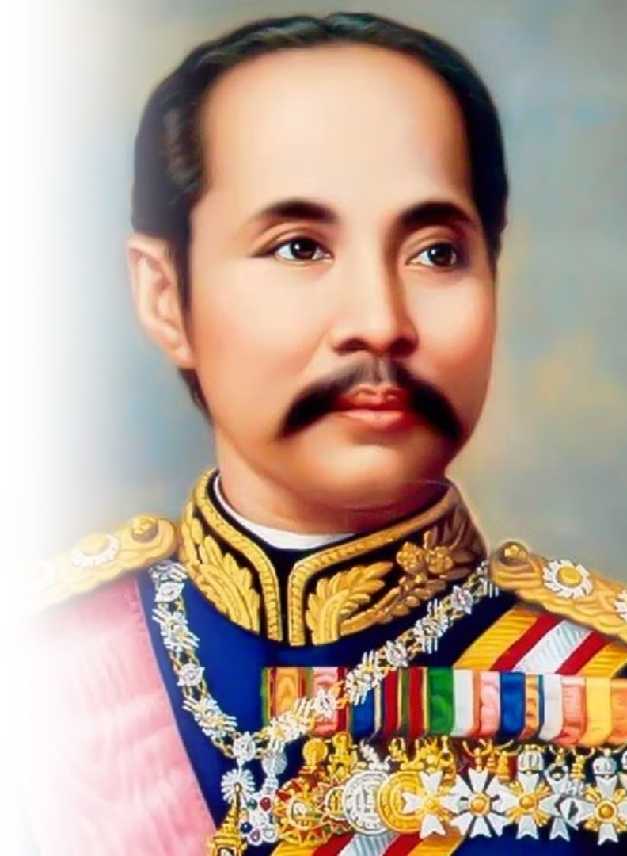
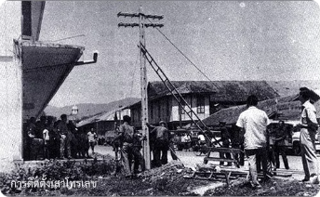

King Rama V's Modernization (1868-1910)
The First telecommunication line in Siam
Train in Siam
King Rama V (King Chulalongkorn the Great) built upon the reforms with sweeping modernization, including the abolition of slavery, administrative and legal reforms, the establishment of a centralized government, and the expansion of railways and telecommunication systems. His diplomatic skills preserved Siam's independence while neighboring countries fell under colonial rule.
Photo credit: Pantip, Silpa-Mag, nongchogcity.go.th
Notes:
18

Slide 32
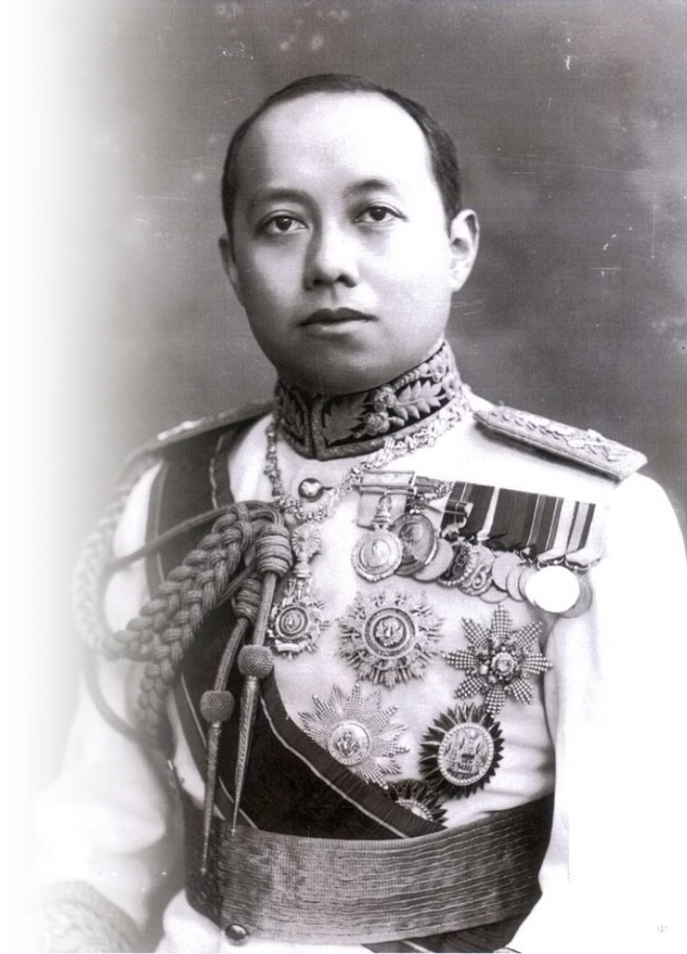
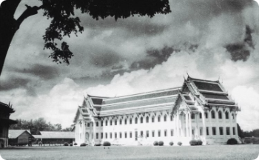
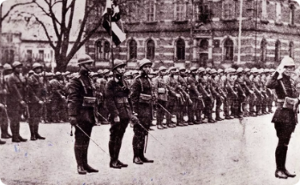
King Rama VI's Nation Building (1910-1925)
Vajiravudh College, one of the schools established by King Rama VI
Siamese soldiers participating in WWI
King Rama VI (King Vajiravudh) furthered his predecessors' works with nation-building efforts, by fostering a unified Thai identity through the promotion of nationalism and cultural reforms. He actively encouraged the adoption of Western-style education, emphasizing civic duty and loyalty to the nation, and played a key role in modernizing the military by introducing Western military training methods and establishing military academies. Additionally, he used literature, theater, and music to instill a sense of patriotism and national pride among the people.
Photo credit: The Cloud, Silpa-Mag
Notes:
19

Slide 33
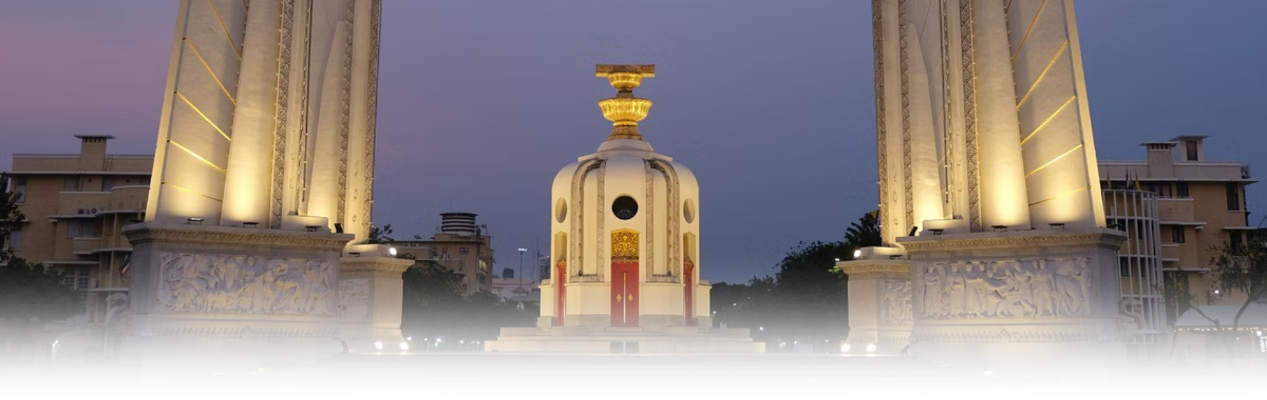
5.3 Age of Democracy (1932 – Present)
Thailand's democratic era began in 1932, when the country transitioned from an absolute monarchy to a constitutional monarchy. This pivotal moment marked the introduction of the first constitution, granting the Thai people a greater voice in governance while preserving the revered monarchy as a unifying national symbol. The first general election was held in 1933, laying the foundation for a parliamentary system and democratic governance.
Photo credit: Thairath
Notes:
20

Slide 34
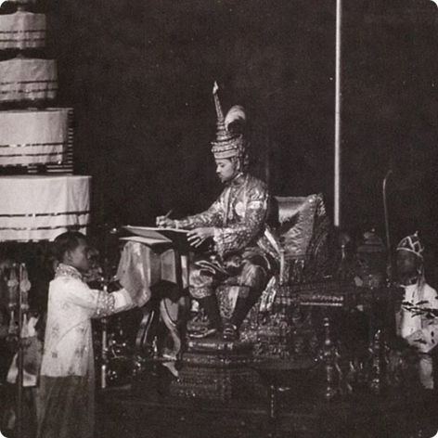
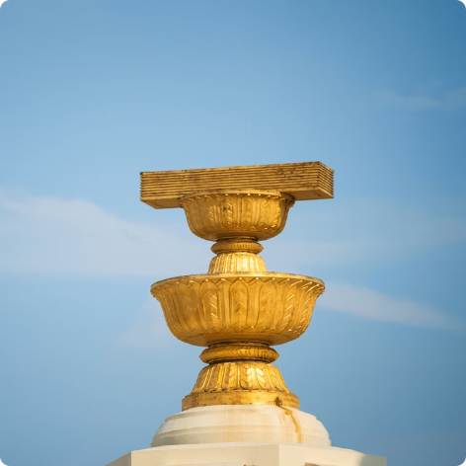
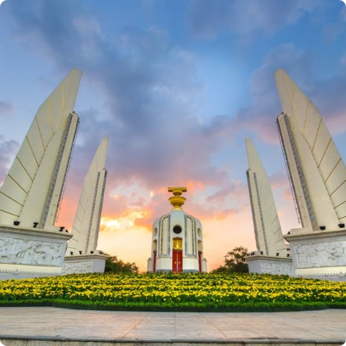
Constitutional
Constitution
Administrative Powers (Executive, Legislative, and Judicial)
Monarchy
The Democracy Monument, depicting the Constitution of Thailand
King Rama VII signs the First Constitution of Thailand
Over the decades, Thailand has continued to develop its democratic institutions, including the establishment of a bicameral legislature, constitutional courts, and local administrative bodies to empower communities.
Photo credit: Around Online, Move Forward Party, BangkokBiz
Notes:
21

Slide 35
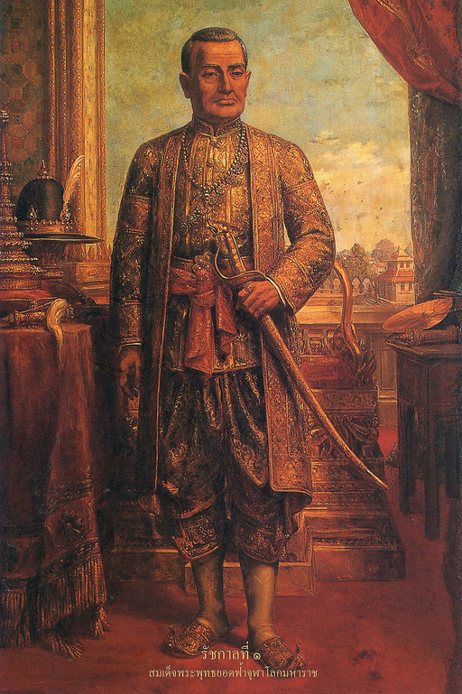
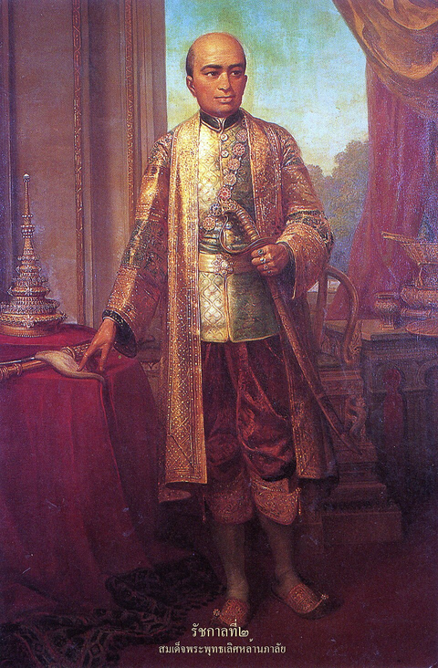
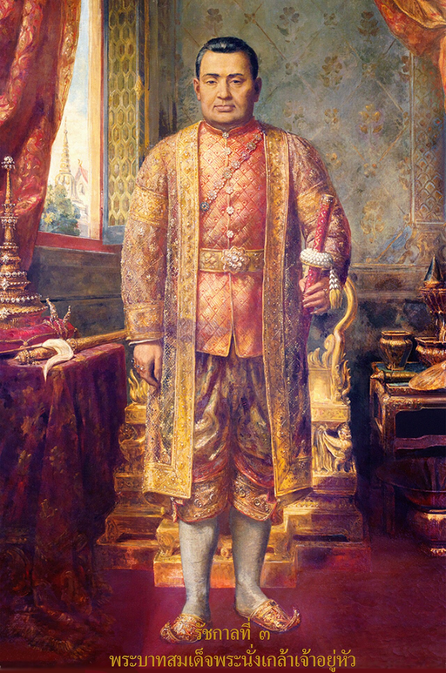
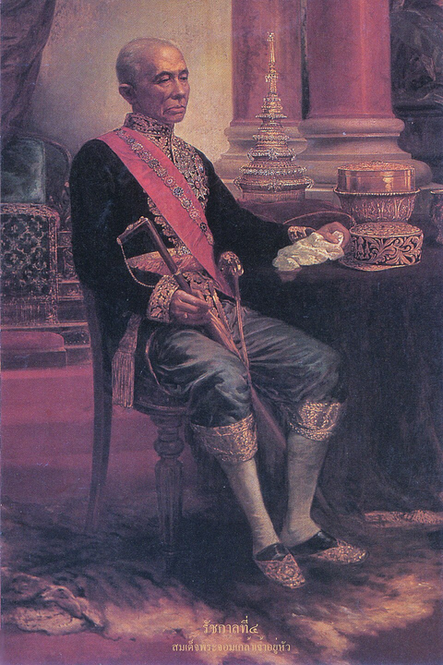
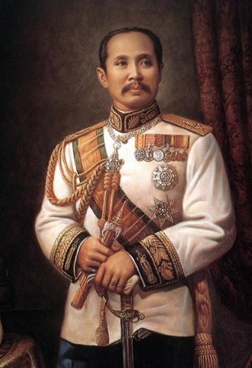
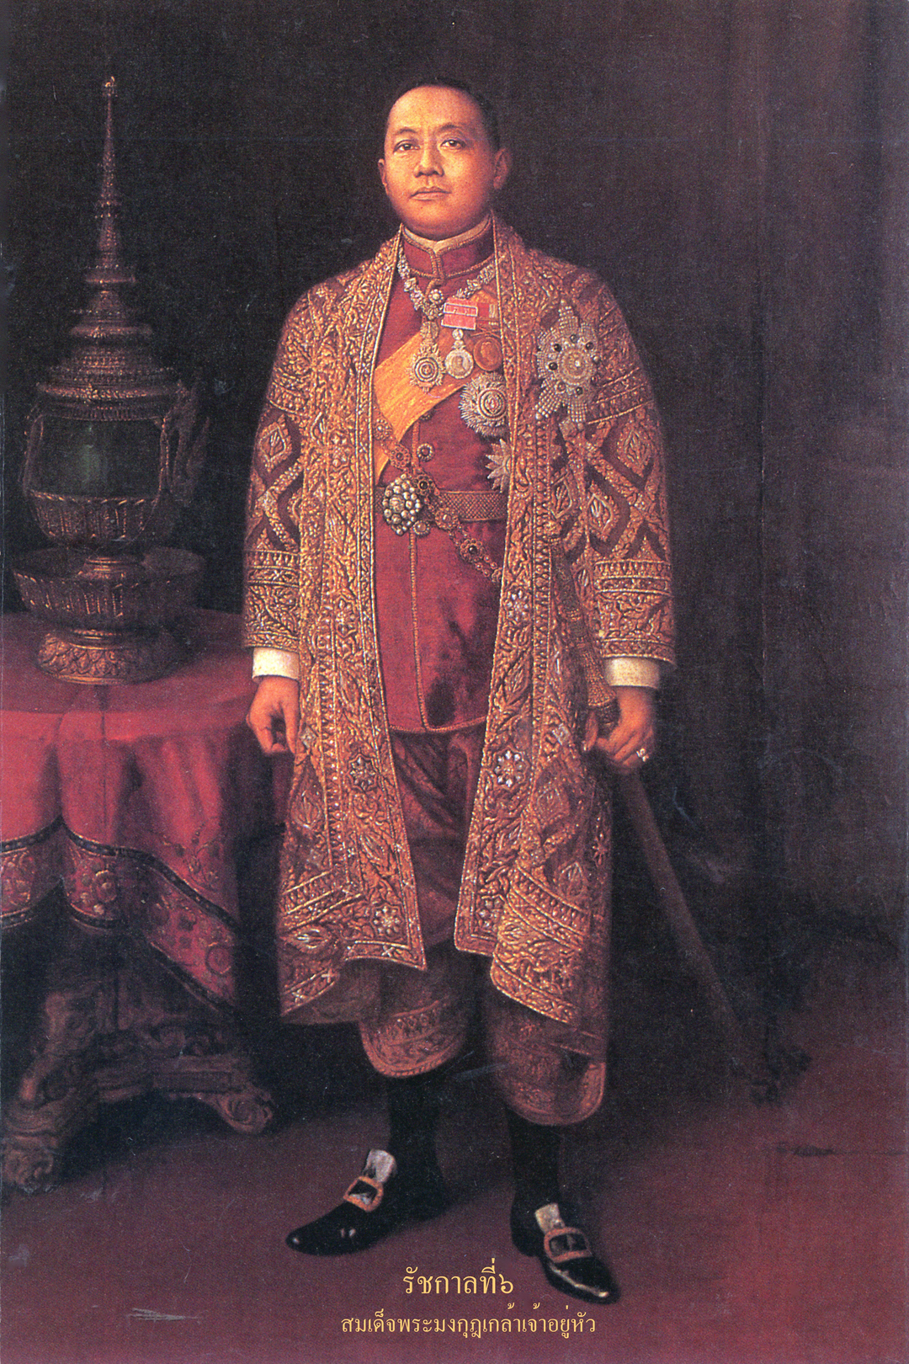
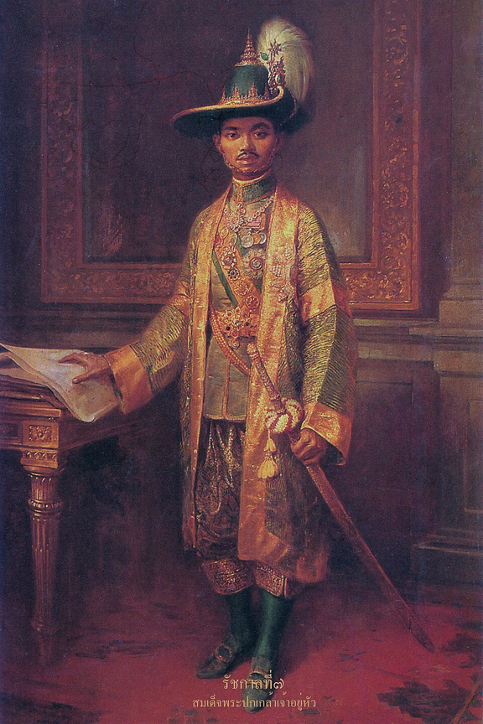
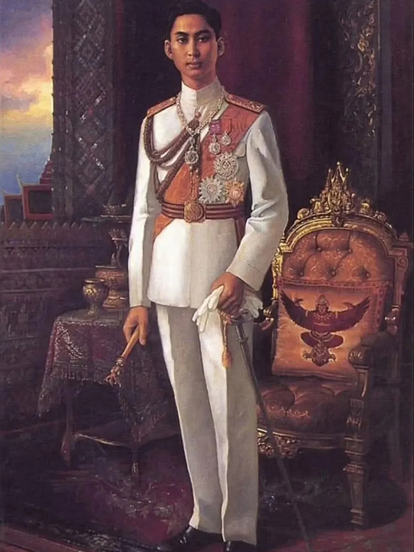

Monarchs of the Chakri dynasty
King Phutthayotfa Chulalok
(King Rama I)
King Phutthaloetla Naphalai
(King Rama II)
King Nangklao
(King Rama III)
King Mongkut
(King Rama IV)
King Chulalongkorn
(King Rama V)
King Vajiravudh
(King Rama VI)
King Prajadhipok
(King Rama VII)
King Ananda Mahidol
(King Rama VIII)
King Bhumibol Adulyadej
(King Rama IX)
Photo credit: Chakri Maha Prasat Throne Hall, Grand Palace, Bangkok
Notes:
21

Slide 36

King Maha Vajiralongkorn
(Rama X)
  Current King of Thailand (2016 - present)
  Son of King Rama IX (King Bhumibol Adulyadej the Great) and grandson of King Rama V (King Chulalongkorn the Great)
Photo credit: Phralan.in.th/coronation
Notes:
22

