Slide 1
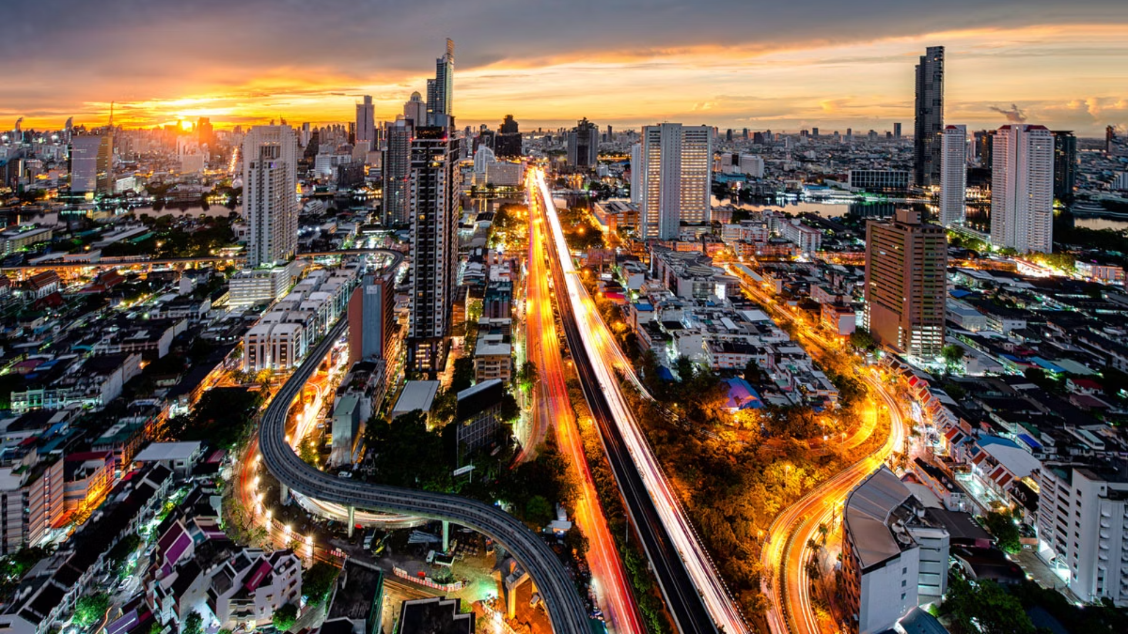
Thailand in International Rankings 2023-2025
Photo credit: William Russell

Slide 2
Thailand in Brief
"Thailand in Brief " has been prepared by the Thailand Foundation to support students, scholars, and the general public who wish to give presentations about Thailand to their audiences—for example, exchange program students and international participants.
The work presents some basic information about Thailand in 11 areas: 1) Geography, 2) History, 3) Politics and Government, 4) Economics, 5) Demographics, 6) Culture, 7) Values, 8) Thai People and Other Popularity That You May Know, 9) Misconceptions about Thailand, 10) Thailand's Role on the Global Stage, and 11) Rankings Related to Thailand.
"Thailand in Brief" is produced in both PDF file (.pdf) and Powerpoint Presentation (.pptx) formats, consisting of xx slides. Users may download and select the topics they wish to present, and may rearrange the sequence of the slides as appropriate. However, the content of this document cannot be edited. Reproduction or use for commercial purposes without permission from the Thailand Foundation is not allowed.
"Thailand in Brief" will be updated every third quarter each year. For inquiries or further suggestions, please contact the Thailand Foundation at info@thailandfoundation.or.th.
27 May 2025

Slide 3
Thailand in Brief
"Thailand in Brief " จัดทำขึ้นโดยมูลนิธิไทย (Thailand Foundation) เพื่ออำนวยความสะดวกแก่ นักเรียน นักศึกษา และผู้สนใจทั่วไป นำไปใช้ประโยชน์ อาทิ ในการบรรยาย หรือให้ความรู้เกี่ยวกับประเทศไทยในด้านต่าง ๆ แก่ชาวต่างประเทศ เช่น กรณีนักศึกษาแลกเปลี่ยนที่ไปเรียนในต่างประเทศที่ต้องนำเสนอเรื่องราวเกี่ยวกับประเทศไทยในสถาบันที่ไปศึกษาอยู่ เป็นต้น
งานชิ้นนี้เสนอข้อมูลเกี่ยวกับประเทศไทยโดยสังเขป 11 ด้าน ได้แก่ 1) ภูมิศาสตร์ (Geography) 2) ประวัติศาสตร์ (History) 3) การเมืองการปกครอง (Politics and Government) 4) เศรษฐกิจ (Economics) 5) ประชากร (Demographics) 6) วัฒนธรรม (Culture) 7) ค่านิยม (Values) 8) คนไทยและสื่อที่คุณอาจรู้จัก (Thai people and other popularity that you may know) 9) ความเข้าใจผิดเกี่ยวกับประเทศไทย (Misconceptions) 10) บทบาทของไทยในเวทีโลก (Thailand’s role on the Global Stage) และ 11) การจัดอันดับที่เกี่ยวกับประเทศไทย (Rankings related to Thailand)
"Thailand in Brief " นี้จัดทำเป็นสไลด์ จำนวน xx สไลด์ ในรูปแบบ .pdf และ .pptx สามารถดาวน์โหลดและเลือกใช้หัวข้อที่นำเสนอ และสลับลำดับการนำเสนอได้ตามความเหมาะสม อย่างไรก็ดี ผู้ใช้งานไม่สามารถดัดแปลงเนื้อหาในเอกสารได้ และห้ามผลิตซ้ำ หรือนำไปใช้เพื่อผลประโยชน์เชิงพาณิชย์โดยไม่ได้รับอนุญาตจากมูลนิธิไทย
"Thailand in Brief " จะได้รับการปรับปรุงให้ทันสมัยในทุกไตรมาสที่ 3 ของปี หากมีข้อสงสัยและข้อเสนอแนะเพิ่มเติม กรุณาติดต่อมูลนิธิไทย อีเมล info@thailandfoundation.or.th
27 พฤษภาคม 2568

Slide 4
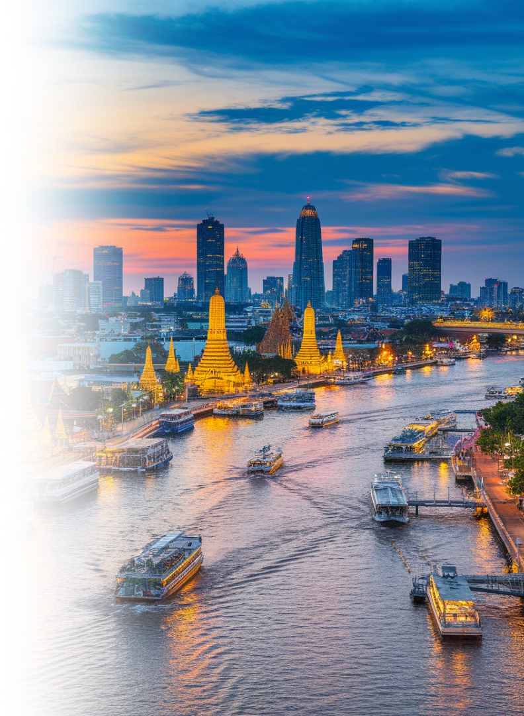
Bangkok: The Best City in Asia 2025
DestinAsian magazine readers crowned Bangkok as Asia's premier destination in their 2025 survey.
"A city where centuries-old temples stand alongside glittering skyscrapers, and street food is just as revered as fine dining."
Sources: DestinAsian

Slide 5
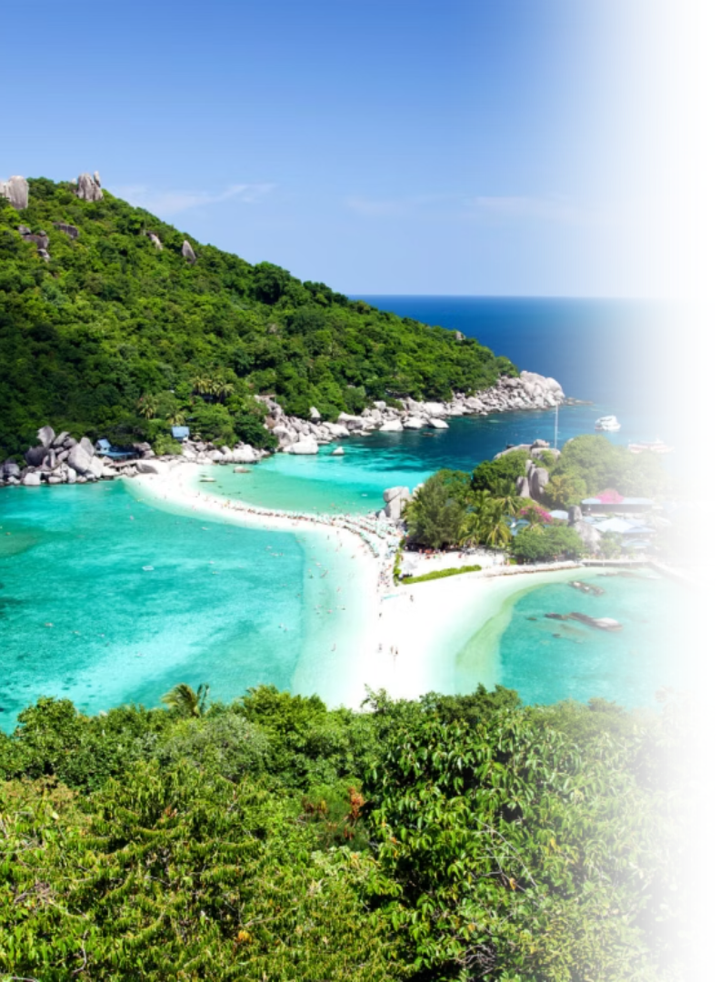
Koh Samui: The Best Island in Asia Pacific 2024
Koh Samui Reigns as The Best Asia-Pacific Island Destination in Travel + Leisure Luxury Awards 2024.
As for Koh Samui, “Samui is now one of Thailand’s most visited destinations―and the filming location of the White Lotus. But the island retains numerous pockets of back-to-nature bliss. Visits can be made to local villages and waterfalls in its interior."
Source: The Government Public Relations Department of Thailand Photo credit: The Luxury Signature

Slide 6
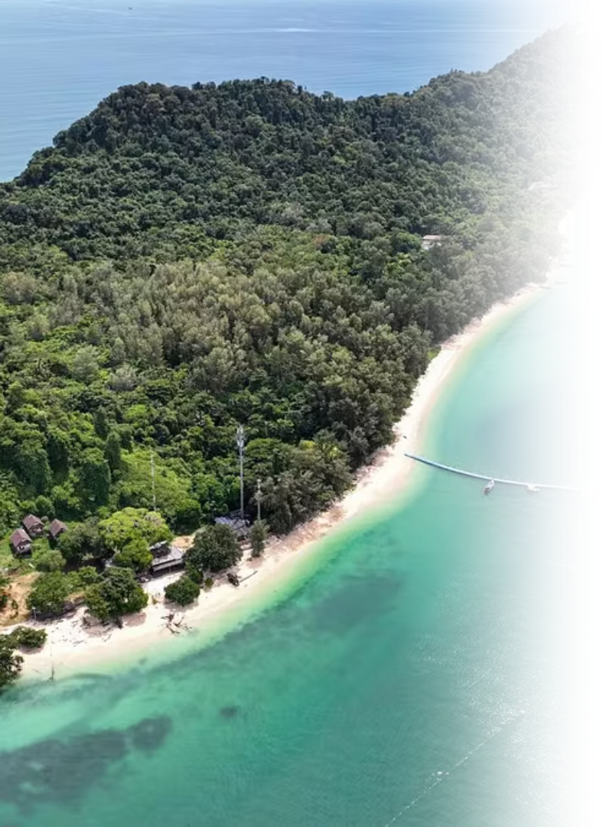
Koh Kradan: World's Most Beautiful Beach 2023
Thailand's pristine paradise of Trang province in Thailand ranked the #1 spot among the "Top 100 Beaches on Earth 2023" by UK's World Beach Guide.
"The world’s most beautiful beach is more than one, and they are all on Trang province’s Koh Kradan, a pristine island gem known for its translucent sea, and white-sand beaches fringed with palm trees," according to the "Top 100 beaches on Earth 2023" ranking by the World Beach Guide.
"Despite only being a couple of hours south of Phuket and even closer to Koh Phi Phi, Koh Kradan is a world apart, sharing all the natural beauty but without the crowds and noise," World Beach Guide also said.
Source: The Nation Photo credit: Kapook ​

Slide 7
Suvarnabhumi Airport’s SAT-1 Terminal: World's Most Beautiful Airport 2024
Suvarnabhumi International Airport’s Midfield Satellite Terminal 1 (SAT-1) won the Prix Versailles “Special award for an Exterior” in the “World’s most beautiful airport 2024” competition, sponsored by the United Nations Educational, Scientific, and Cultural Organization (UNESCO), for its exceptional exterior architecture and design.
Source: The Government Public Relations Department of Thailand Photo credit: Travel News

Slide 8
Numbers of Foreign Film Productions in Thailand (2024)
from
491
42
Film Productions
Countries
Source: Thailand Film Office Photo credit: World Travel Magazine

Slide 9
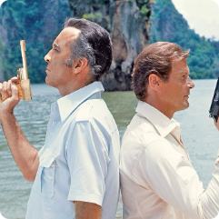
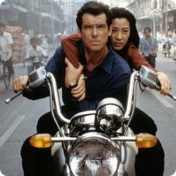
Examples of Famous Movies/Series Filmed in Thailand
James Bond: The Man with the Golden Gun (1974)
James Bond: Tomorrow Never Dies (1997)
The Beach (2000)
This film featured scenes in Bangkok, the Klongs (canals), and most notably, the dramatic backdrop of Phang Nga Bay. The iconic Khao Phing Kan island, later renamed "James Bond Island," became a major tourist attraction thanks to its appearance in the movie.
Bangkok and Phang Nga Bay were again featured, with scenes like a thrilling motorbike chase in the narrow streets of Bangkok and a boat chase in the bays.
The movie The Beach, starring Leonardo DiCaprio, was primarily filmed at Maya Bay on Koh Phi Phi Leh Island. Additional scenes were shot in Krabi Province, Bangkok, and Khao Yai National Park.
Photo credit: James Bond 007 Museum, The Gentleman's Journal, Pinterest

Slide 10
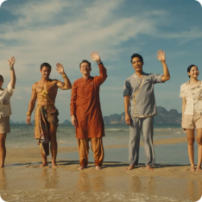
Examples of Famous Movies/Series Filmed in Thailand
Fast & Furious 9 (2019)
King the Land (2024)
The White Lotus (Season 3, 2025)
The Jurassic World 4
The 340-million-baht production for the Hollywood action film Fast and Furious 9 was set across the southern provinces of Krabi, Phang Nga, Phuket, and Surat Thani.
The K-drama King the Land ranks as the most watched on the streaming platform Netflix in 2023. The filming locations in Thailand portrayed in the series are Wat Arun, Ong Ang Walking Street, ICONSIAM, etc.
Thailand has been selected as a filming location for Universal Pictures' Jurassic World 4, with production set in Krabi and Trang provinces. The team is also considering locations in Bangkok, Phang Nga, Phuket, and Chiang Mai.
The third season of the Emmy-winning HBO show, the White Lotus, was filmed in various locations in Thailand, including Koh Samui, Phuket, and Bangkok.
Photo credit: Sanook, Khaosod English, Elle, Bangkokbiznews

Slide 11
8 Michelin's Three Key Hotels in Thailand
Mandarin Oriental Bangkok
The Siam, Bangkok
Four Season Resort Chiangmai
Soneva Kiri, Trat
Samujana Villas, Koh Samui, Surat Thani
Photo credit: Forbes Thailand, Michelin Guide

Slide 12
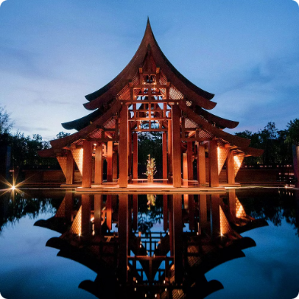
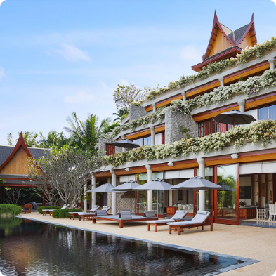
8 Michelin's Three Key Hotels in Thailand
Phula Bay, A Ritz-Carlton Reserve, Krabi
Amanpuri, Phuket
Keemala, Phuket
Photo credit: Forbes Thailand, Michelin Guide

Slide 13
Source: Department of Tourism Ministry of Tourism and Sports

Slide 14
Source: Department of Tourism Ministry of Tourism and Sports

Slide 15
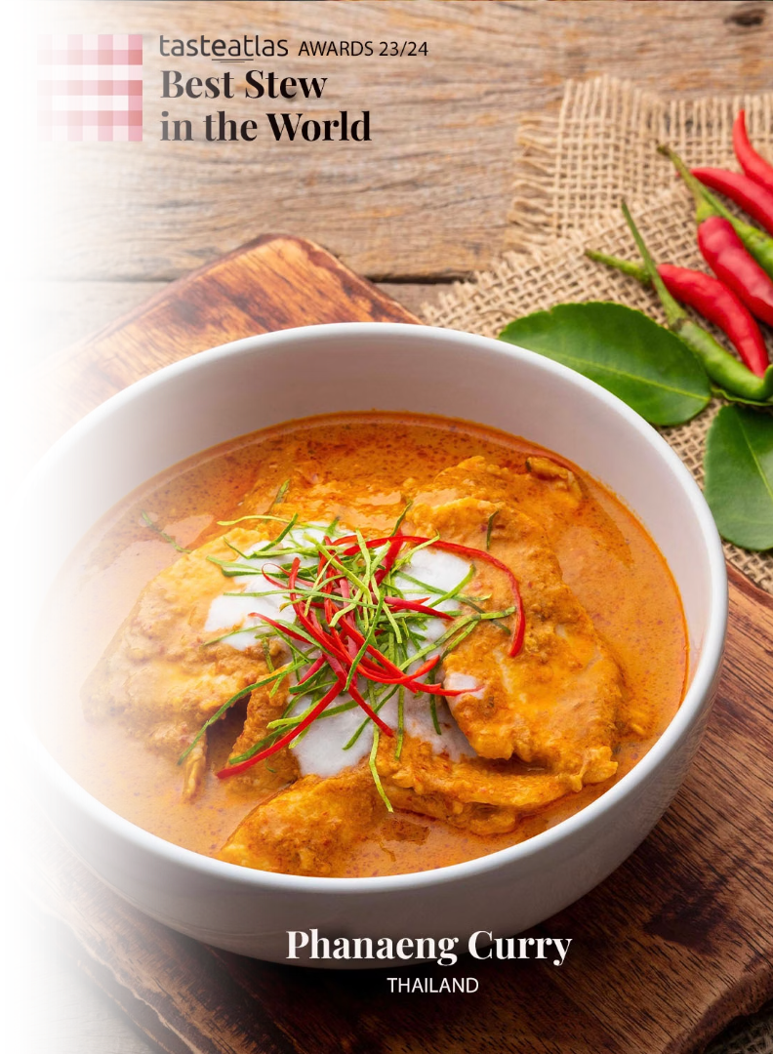
Phanaeng Curry: World's Best Stew 2023
Phanaeng Curry, a rich and flavorful Thai dish, earned Thailand's 1st place among the 10 Best Rated Stews in the world by TasteAtlas.
Phanaeng curry is a variety of Thai curry that is characterized by a thick texture and salty-sweet peanut flavor. It consists of meat that is stewed with coconut milk, panang curry paste, makrut lime leaves, fish sauce, and palm sugar.
Source: TasteAtlas Photo credit: TasteAtlas

Slide 16
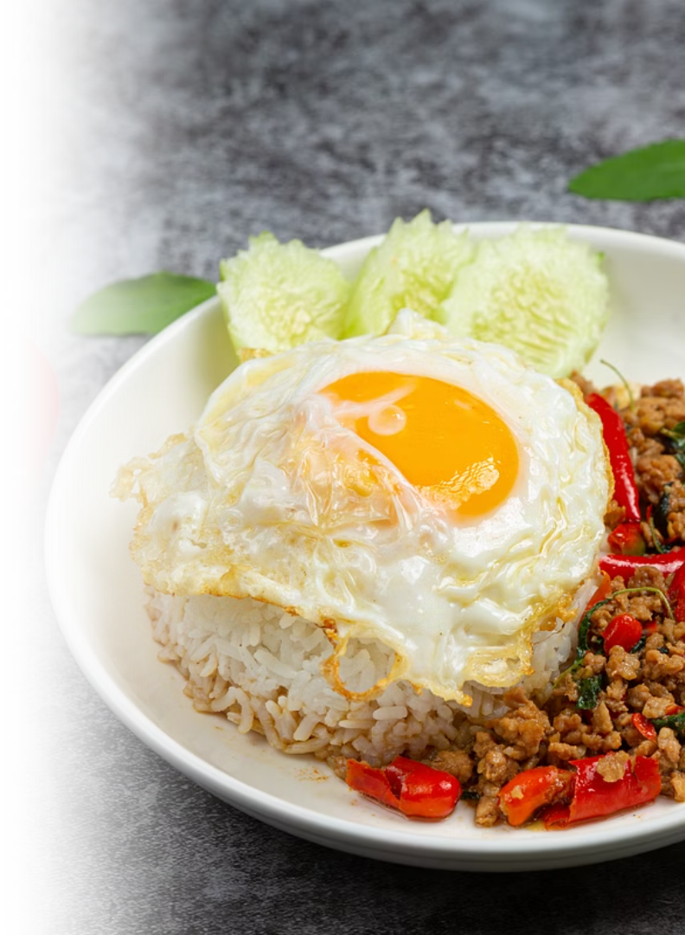
Pad Kaprao: World's Best Stir-fried Dish 2023
Pad Kaprao, a fiery and aromatic Thai stir-fry, earned the top spot in the Best Stir-Fried Dishes in the World, according to TasteAtlas.
Pad Kaprao is made with minced meat stir-fried with garlic, chili, and fragrant holy basil, often served over rice and topped with a crispy fried egg. Its bold, spicy flavor and irresistible aroma make it a staple of everyday Thai cuisine.
Source: Bangkok Post ​ Photo credit: Workpoint Today

Slide 17
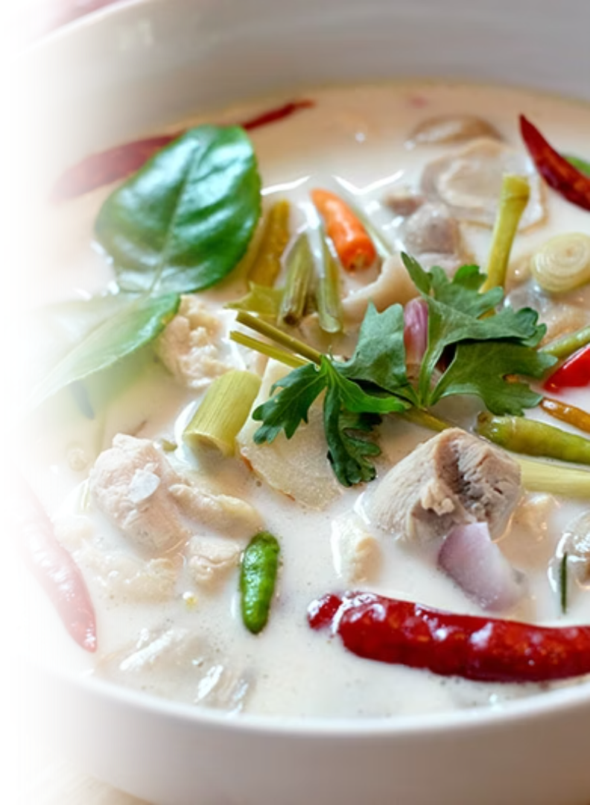
Tom Kha Gai: World's Best Chicken Soup 2023
Tom Kha Gai , a delicious national dish of Thailand, is ranked No. 1 in the world's best chicken soup in 2023, by TasteAtlas.
Tom Kha Gai consists of coconut milk, small pieces of chicken, galangal, lemongrass, garlic, chili, kaffir lime leaves, fish sauce and mushrooms, resulting in a spicy, pungent and slightly sour taste. It also has high nutritional value and has good medicinal properties, such as helping relieve the gastrointestinal tract.
Source: Bangkok Post ​ Photo credit: Kapook

Slide 18
Thailand ranks 7th in World Happiness Index 2025
Thailand continues to rank high in global happiness, according to the Ipsos Happiness Index 2025, a 30-country Global Advisor survey. With 78% of Thais reporting being happy, the nation secures 6th place globally, significantly surpassing the global average of 71%.
Source: Ipsos ​ Photo credit: Michael Breitung​

