Slide 1
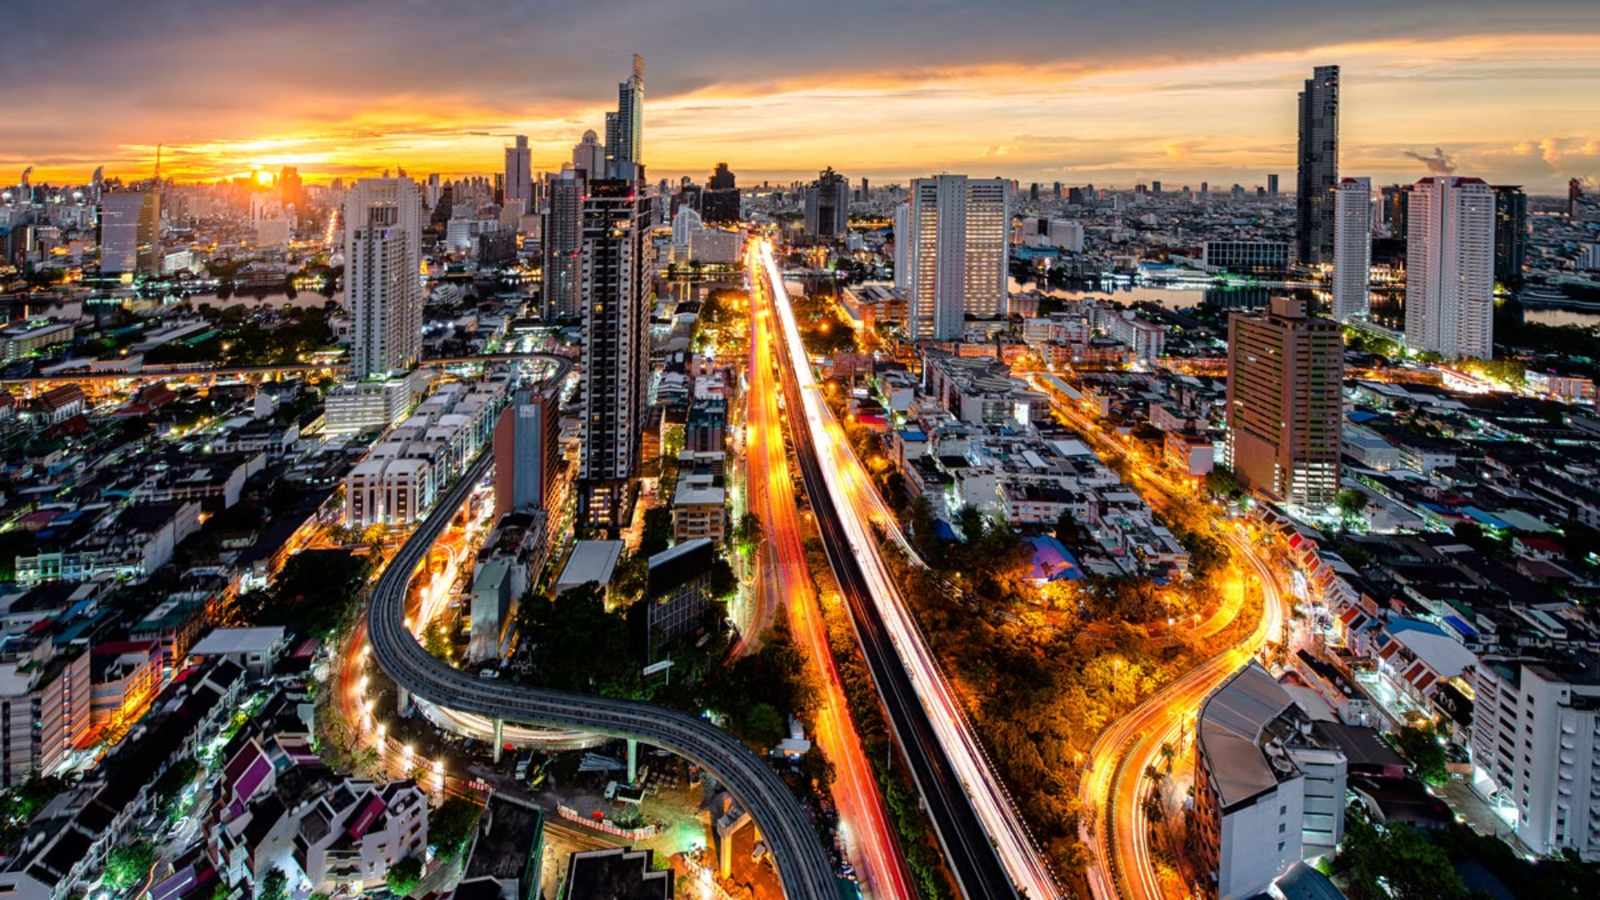

Thailand in International Rankings
2024-2026
Photo credit: William Russell
Notes:
1

Slide 2
Thailand in Brief
"Thailand in Brief " has been prepared by the Thailand Foundation to support students, scholars, and the general public who wish to give presentations about Thailand to their audiences—for example, exchange program students and international participants.
The work presents some basic information about Thailand in 11 areas: 1) Geography, 2) History, 3) Politics and Government, 4) Economics, 5) Demographics, 6) Culture, 7) Values, 8) Thai People and Other Popularity That You May Know,
9) Misconceptions about Thailand, 10) Thailand's Role on the Global Stage, and 11) Rankings Related to Thailand.
"Thailand in Brief" is produced in both PDF file (.pdf) and Powerpoint Presentation (.pptx) formats, consisting of 400 slides. Users may download and select the topics they wish to present, and may rearrange the sequence of the slides as appropriate. However, the content of this document cannot be edited. Reproduction or use for commercial purposes without permission from the Thailand Foundation is not allowed.
"Thailand in Brief" will be updated every third quarter each year. For inquiries or further suggestions, please contact the Thailand Foundation at info@thailandfoundation.or.th.
July 2026
Notes:
2

Slide 3
Thailand in Brief
"Thailand in Brief " จัดทำขึ้นโดยมูลนิธิไทย (Thailand Foundation) เพื่ออำนวยความสะดวกแก่ นักเรียน นักศึกษา และผู้สนใจทั่วไป นำไปใช้ประโยชน์ อาทิ ในการบรรยาย หรือให้ความรู้เกี่ยวกับประเทศไทยในด้านต่าง ๆ แก่ชาวต่างประเทศ เช่น กรณีนักศึกษาแลกเปลี่ยนที่ไปเรียนในต่างประเทศที่ต้องนำเสนอเรื่องราวเกี่ยวกับประเทศไทยในสถาบันที่ไปศึกษาอยู่ เป็นต้น
งานชิ้นนี้เสนอข้อมูลเกี่ยวกับประเทศไทยโดยสังเขป 11 ด้าน ได้แก่ 1) ภูมิศาสตร์ (Geography) 2) ประวัติศาสตร์ (History) 3) การเมืองการปกครอง (Politics and Government) 4) เศรษฐกิจ (Economics) 5) ประชากร (Demographics) 6) วัฒนธรรม (Culture) 7) ค่านิยม (Values) 8) คนไทยและสื่อที่คุณอาจรู้จัก (Thai people and other popularity that you may know) 9) ความเข้าใจผิดเกี่ยวกับประเทศไทย (Misconceptions)
10) บทบาทของไทยในเวทีโลก (Thailand’s role on the Global Stage) และ 11) การจัดอันดับที่เกี่ยวกับประเทศไทย (Rankings related to Thailand)
"Thailand in Brief " นี้จัดทำเป็นสไลด์ จำนวน 400 สไลด์ ในรูปแบบ .pdf และ .pptx สามารถดาวน์โหลดและเลือกใช้หัวข้อที่นำเสนอ และสลับลำดับการนำเสนอได้ตามความเหมาะสม อย่างไรก็ดี ผู้ใช้งานไม่สามารถดัดแปลงเนื้อหาในเอกสารได้ และห้ามผลิตซ้ำ หรือนำไปใช้เพื่อผลประโยชน์เชิงพาณิชย์โดยไม่ได้รับอนุญาตจากมูลนิธิไทย
"Thailand in Brief " จะได้รับการปรับปรุงให้ทันสมัยในทุกไตรมาสที่ 3 ของปี หากมีข้อสงสัยและข้อเสนอแนะเพิ่มเติม กรุณาติดต่อมูลนิธิไทย
อีเมล info@thailandfoundation.or.th
กรกฎาคม 2569
Notes:
3

Slide 4

Suvarnabhumi Airport’s SAT-1 Terminal:
the World's Most Beautiful Airport in 2024
Suvarnabhumi International Airport’s Midfield Satellite Terminal 1 (SAT-1) won the Prix Versailles
“Special award for an Exterior” in the “World’s Most Beautiful Airport 2024” competition, sponsored by
the United Nations Educational, Scientific, and Cultural Organization (UNESCO),
for its exceptional exterior architecture and design.
Source: The Government Public Relations Department of Thailand
Photo credit: Travel News
Notes:
7

Slide 5

Bangkok:
the World's Best City for Gen Z in 2025
The Thai capital has topped Time Out’s first-ever global ranking of the best cities
for the next generation, thanks to its unbeatable combination of happiness, affordability and community.
Source: Time Out
Photo credit: YAS Blog ​

Slide 6

Thailand ranks 7th
in World Happiness Index in 2025
Thailand continues to rank high in global happiness, according to the Ipsos Happiness Index 2025,
a 30-country Global Advisor survey. With 78% of Thais reporting being happy, the nation secures 6th place globally, significantly surpassing the global average of 71%.
Source: Ipsos ​
Photo credit: Thaiger​
Notes:
18

Slide 7
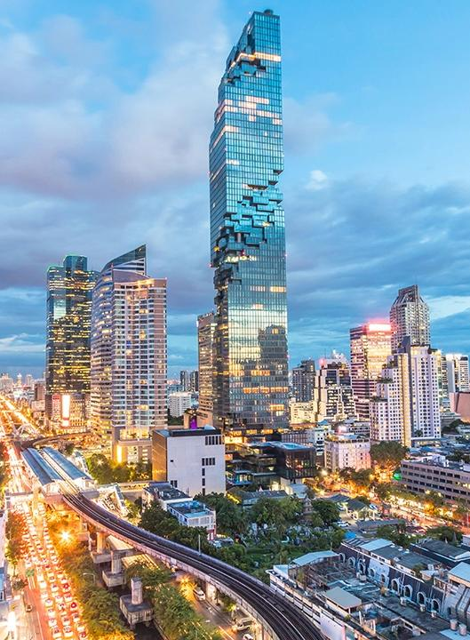
Bangkok:
the Best City in Asia in 2026
Bangkok has been crowned the Best City in the Asia-Pacific
at the DestinAsian Readers' Choice Awards 2026 for
the third consecutive year by DestinAsian magazine.
DestinAsian cited the Thai capital as a vibrant metropolis where centuries-old temples stand beside gleaming skyscrapers, riverboats cruise along the Chao Phraya, and the BTS Skytrain glides above
lively streets. From heritage landmarks and world-class shopping to legendary street food and fine dining, Bangkok truly has it all.
Sources: PR Thai Government, DestinAsian
Photo credit: Thairath
Notes:
4

Slide 8
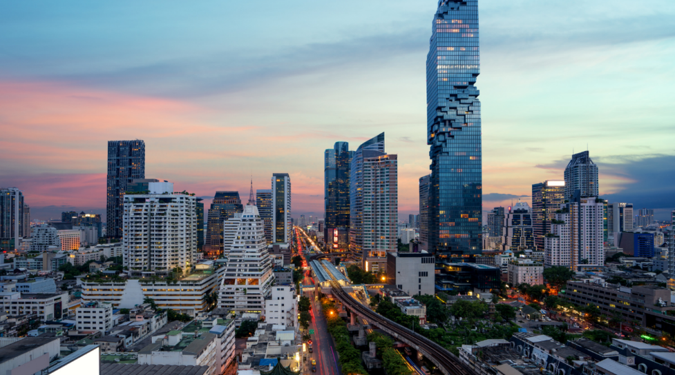
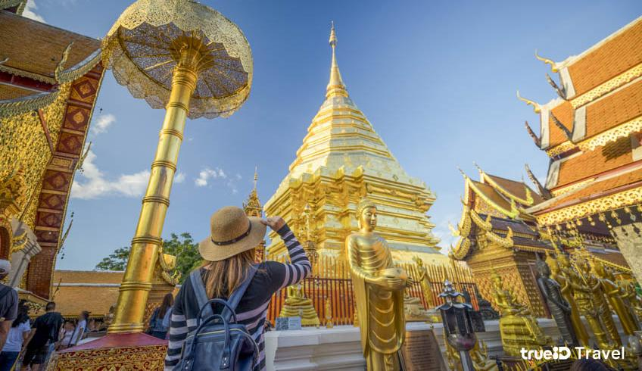
Bangkok
Chiangmai
Bangkok and Chiangmai
top the World’s Most Popular for Digital Nomads in 2026
Bangkok and Chiang Mai rank as the top two most popular cities for digital nomads in 2026 by Time Out,
underscoring their growing reputations as a global hub for remote workers and location-independent professionals.
Source: Time Out, Khaosod English
Photo credit: SC Asset, True ID Travel​

Slide 9
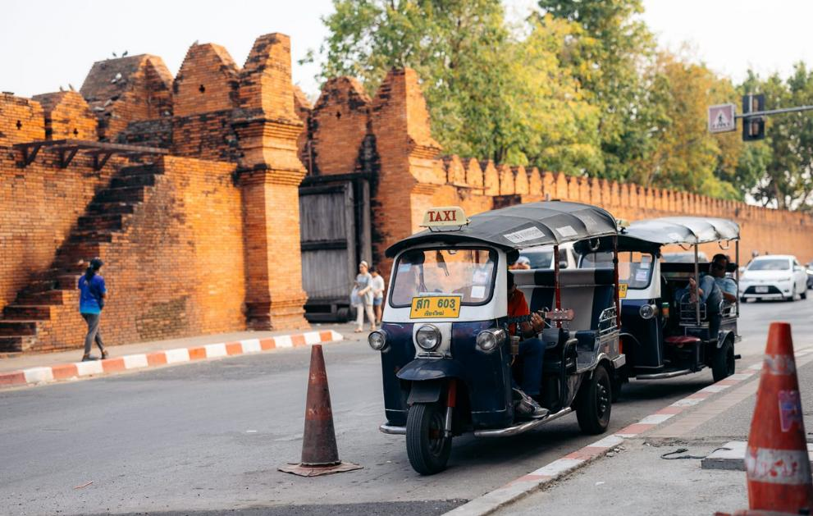
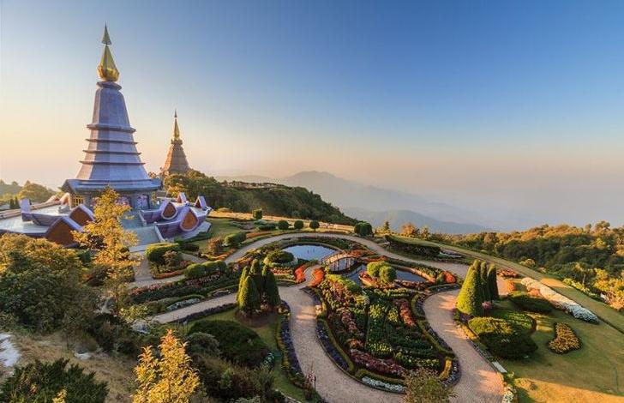
Chiangmai ranks
the 3rd World’s Best City in Asia in 2026
Chiang Mai has been named the third-best city in the world in the Travel + Leisure World's Best Awards 2026.
The northern Thai city earned global recognition for its rich Lanna heritage, historic temples, outstanding cuisine, natural beauty and warm hospitality.
Source: Travel + Leisure, Khaosod English
Photo credit: We Seek Travel, Sanook​

Slide 10
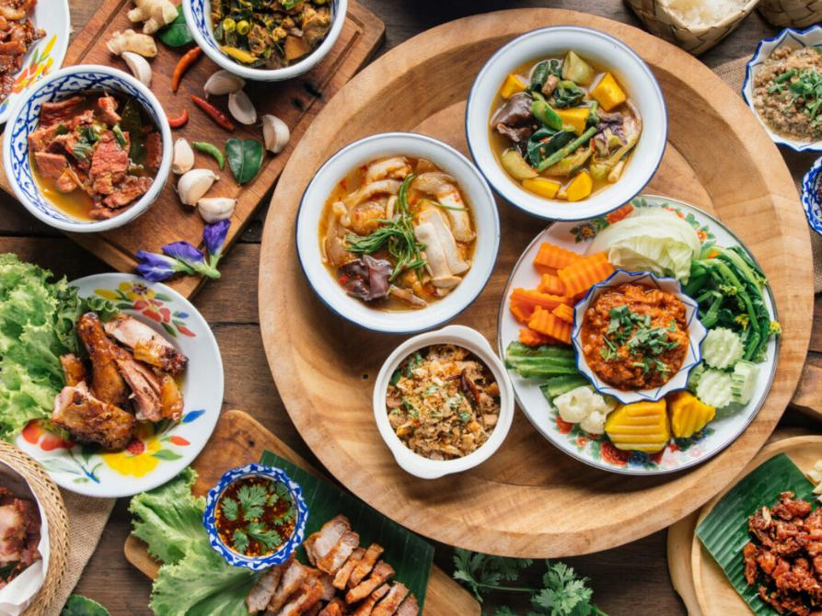
Bangkok ranks the 2nd
in the World’s Best cities
for food in 2026
Bangkok has been ranked the world’s second-best food city
in Time Out’s 2026 list, with the Thai capital praised
for its street food, fine dining and fast-growing food districts.
Source: Time Out​
Photo credit: Thai Airways ​
Notes:
27

Slide 11
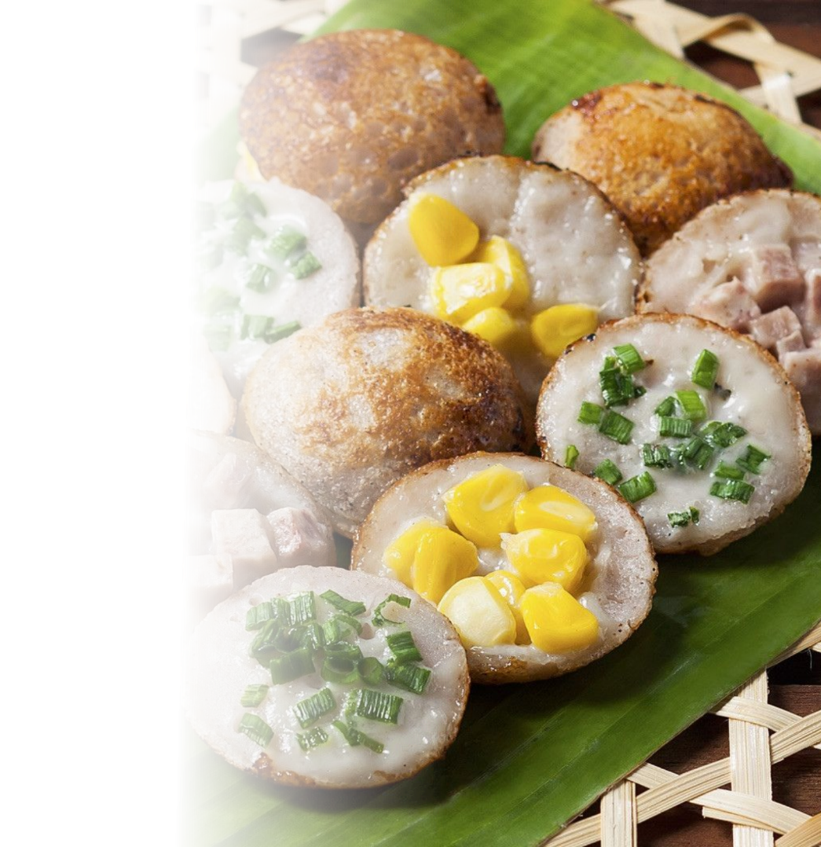
Khanom Khrok:
Thailand’s Best Dessert in 2026
Khanom Krok, or coconut rice pancakes, has been ranked Thailand’s No.1 dessert of 2026 by TasteAtlas.
Khanom Khrok is a staple street food in Thailand, standing out
for its distinctive qualities — the rich aroma of coconut milk,
a crisp exterior with a soft centre, and its meticulous preparation process — all of which embody Thai culinary wisdom passed down through generations.
Source: TasteAtlas, Bangkok Post ​
Photo credit: Krua.co
Notes:
16

Slide 12
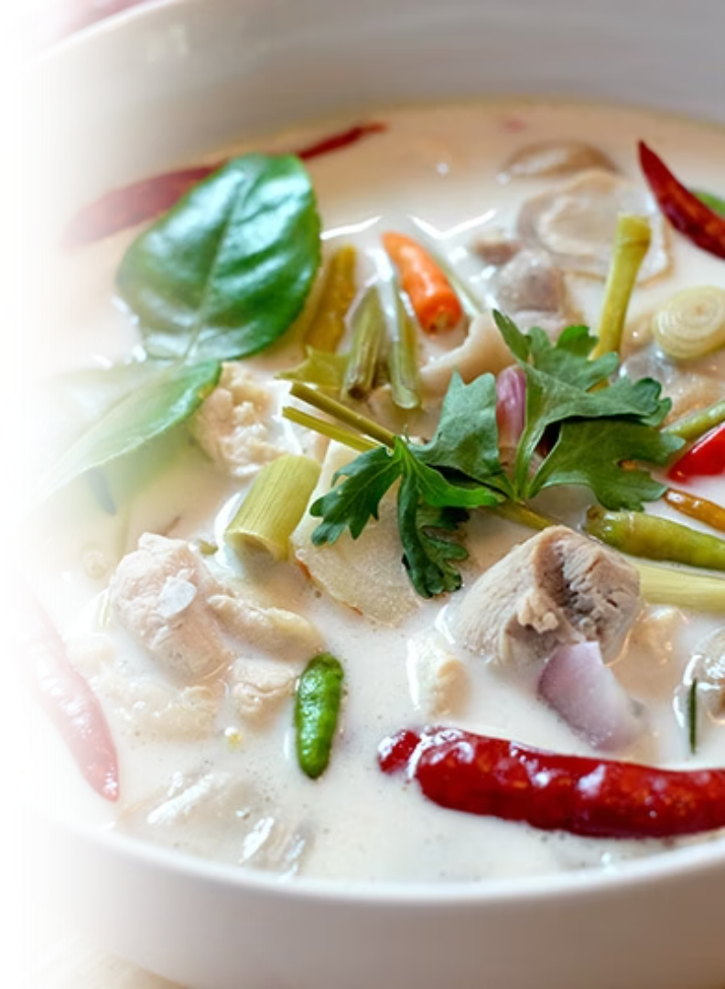
Tom Kha Gai:
the World's Best Chicken Soup in 2025
Tom Kha Gai , a delicious national dish of Thailand, is ranked No. 1
in the world's best chicken soup in 2025, by TasteAtlas.
Tom Kha Gai consists of coconut milk, small pieces of chicken, galangal, lemongrass, garlic, chili, kaffir lime leaves, fish sauce and mushrooms, resulting in a spicy, pungent and slightly sour taste.
It also has high nutritional value and has good medicinal properties, such as helping relieve the gastrointestinal tract.
Source: Seasia.stats
Photo credit: Kapook
Notes:
17

Slide 13
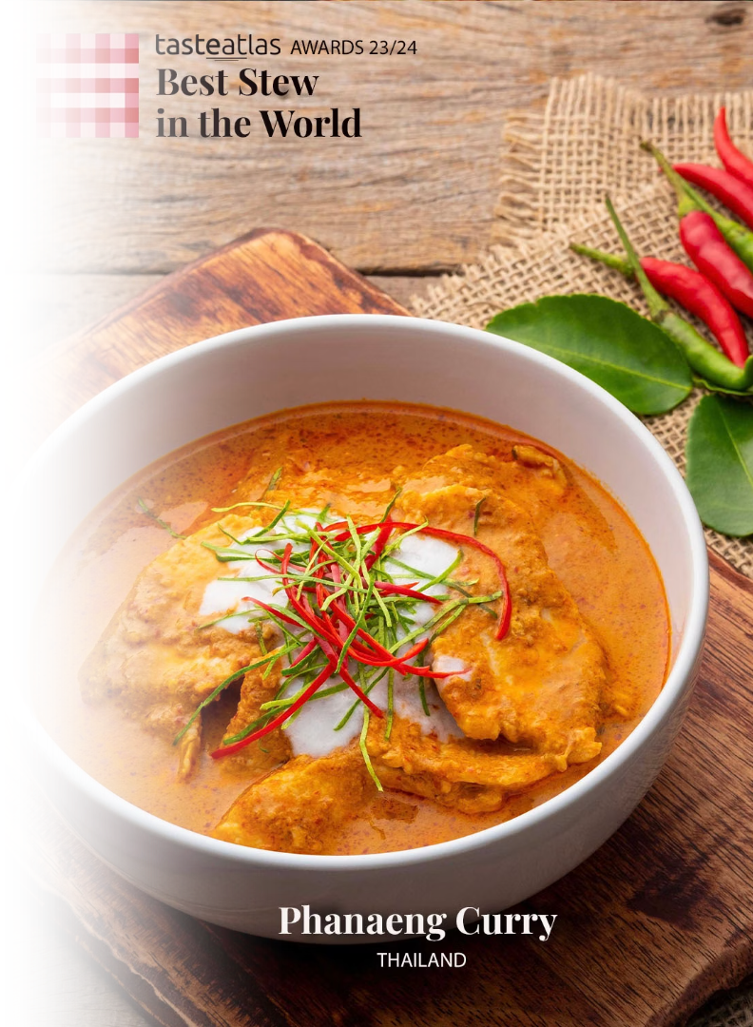
Phanaeng Curry:
the World's Best Stew in 2025
Phanaeng Curry, a rich and flavorful Thai dish, earned Thailand's
1st place among the 10 Best Rated Stews in the world by TasteAtlas.
Phanaeng curry is a variety of Thai curry that is characterized by
a thick texture and salty-sweet peanut flavor. It consists of meat that is stewed with coconut milk, panang curry paste, makrut lime leaves, fish sauce, and palm sugar.
Source: TasteAtlas
Photo credit: TasteAtlas
Notes:
15

Slide 14
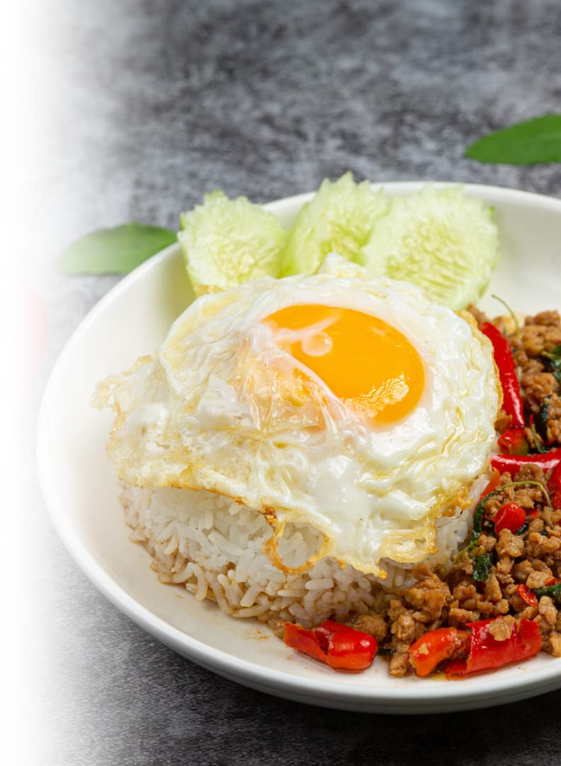
Pad Kaprao:
World's 3rd Best Stir-fried Dish in 2025
Pad Kaprao, a fiery and aromatic Thai stir-fry, earned the 3rd top spot in the Best Stir-Fried Dishes in the World, according to TasteAtlas.
Pad Kaprao is made with minced meat stir-fried with garlic, chili, and fragrant holy basil, often served over rice and topped with a crispy fried egg. Its bold, spicy flavor and irresistible aroma make it a staple of everyday Thai cuisine.
Source: Bangkok Post ​
Photo credit: Workpoint Today
Notes:
16

Slide 15
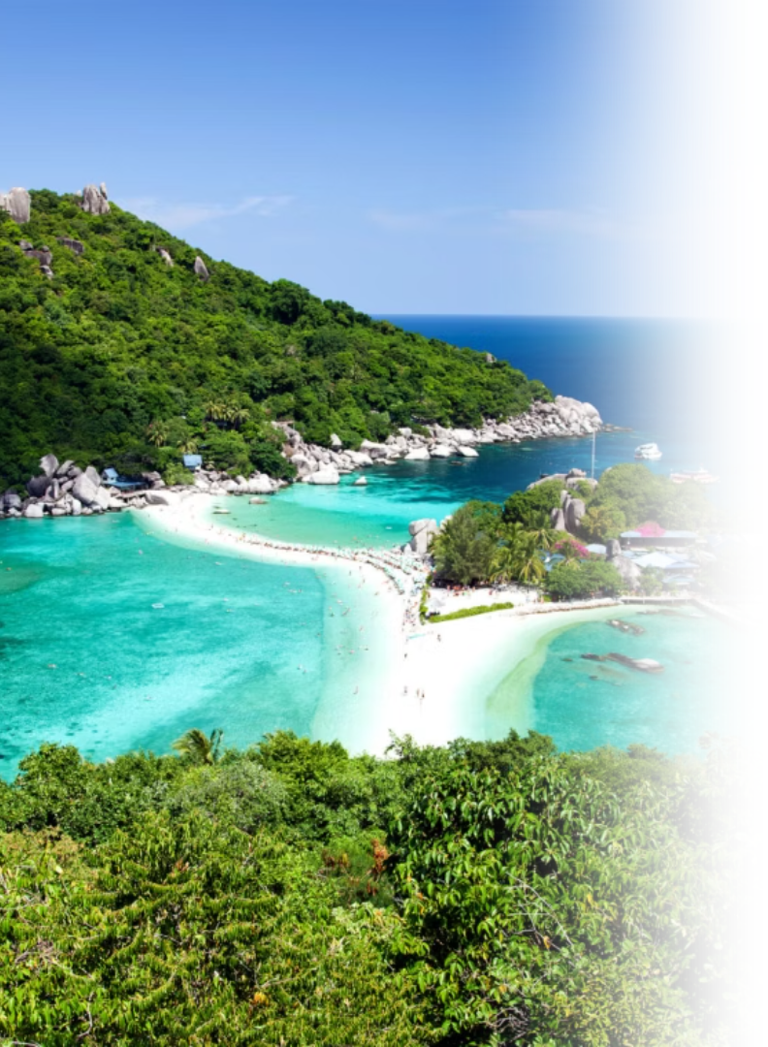
Koh Samui: the Best Island
in Asia-Pacific in 2026
Travel + Leisure Asia, Asia’s leading tourism and lifestyle magazine, has announced its Luxury Awards 2026 Best Islands rankings, naming Koh Samui in Surat Thani Province, southern Thailand,
the best island in Asia-Pacific in 2026.
The magazine said in its citation, “How do you develop one of the world’s most famous island destinations without sacrificing its soul? Koh Samui manages it better than most. Riding high following its starring role in The White Lotus season 3, the island is now synonymous with sleek resorts, sophisticated dining and polished beachside luxury.”
Source: Travel + Leisure Asia
Photo credit: The Luxury Signature
Notes:
5

Slide 16

Numbers of Foreign Film Productions in Thailand
(2025)
Numbers of Foreign Film Productions in Thailand
(January - June 2026)
540
302
Film Productions
Film Productions
Source: Thailand Film Office
Photo credit: Bangkok Post
Notes:
8

Slide 17
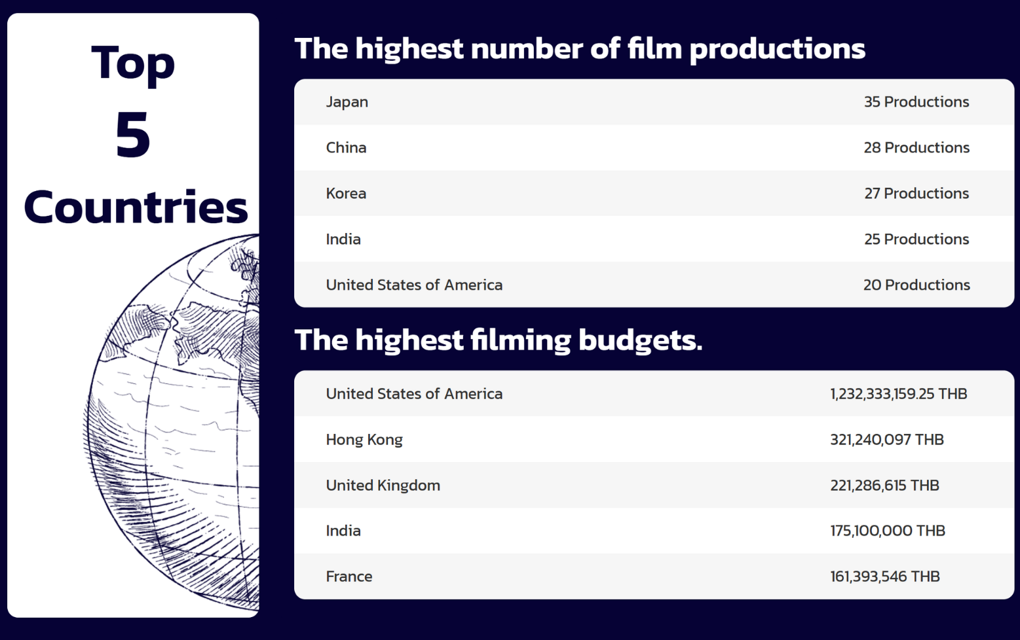
in 2025
Source: Thailand Film Office
Photo credit: World Travel Magazine

Slide 18

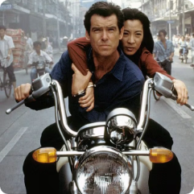
Examples of Famous Movies/Series Filmed in Thailand
James Bond: The Man with the Golden Gun (1974)
James Bond: Tomorrow Never Dies (1997)
This film featured scenes in Bangkok, the Klongs (canals),
and most notably, the dramatic backdrop of Phang Nga Bay.
The iconic Khao Phing Kan island, later renamed
"James Bond Island," becamea major tourist attraction thanks to its appearance in the movie.
Bangkok and Phang Nga Bay were again featured, with scenes like a thrilling motorbike chase in the narrow streets of Bangkok and a boat chase in the bays.
Photo credit: James Bond 007 Museum, The Gentleman's Journal
Notes:
9

Slide 19


Examples of Famous Movies/Series Filmed in Thailand
The Beach (2000)
Fast & Furious 9 (2019)
The movie The Beach, starring Leonardo DiCaprio, was primarily filmed at Maya Bay on Koh Phi Phi Leh Island. Additional scenes were shot in Krabi Province, Bangkok, and Khao Yai National Park.
The 340-million-baht production for the Hollywood action film Fast and Furious 9 was set across the southern provinces of Krabi, Phang Nga, Phuket, and Surat Thani.
Photo credit: James Bond 007 Museum, The Gentleman's Journal
Notes:
9

Slide 20

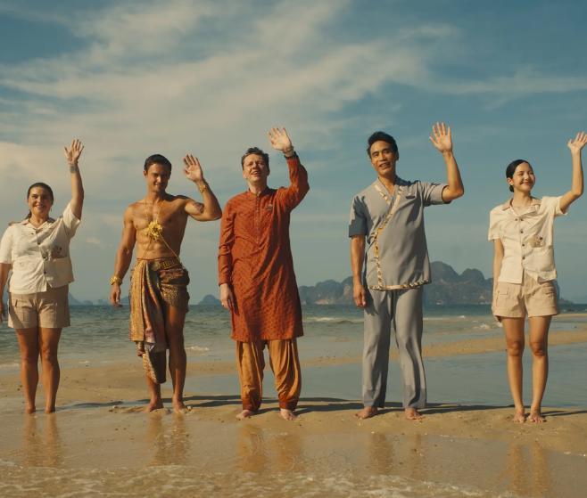
Examples of Famous Movies/Series Filmed in Thailand
King the Land (2024)
The White Lotus (Season 3, 2025)
The K-drama King the Land ranks as the most watched
on the streaming platform Netflix in 2023.
The filming locations in Thailand portrayed in the series are
Wat Arun, Ong Ang Walking Street, ICONSIAM, etc.
The third season of the Emmy-winning HBO show,
the White Lotus, was filmed in various locations
in Thailand, including Koh Samui, Phuket, and Bangkok.
Photo credit: Thai Rath, Vogue
Notes:
10

Slide 21

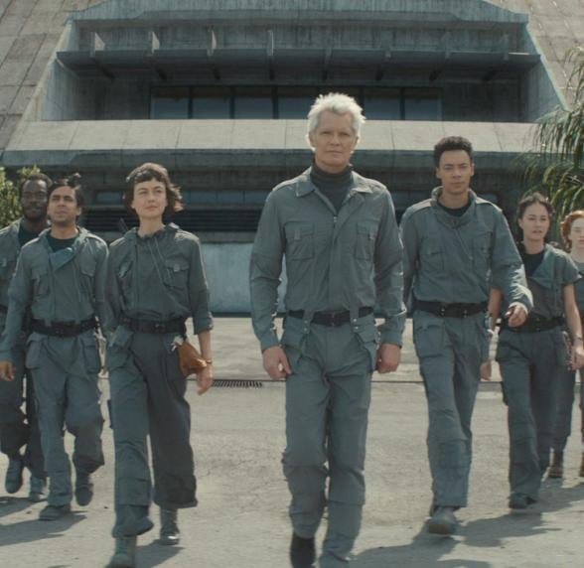
Examples of Famous Movies/Series Filmed in Thailand
Alien: Earth
The Jurassic World 4: Rebirth
American science fiction horror television series on the Disney+ channel marks the highest investment in the history of foreign film production in Thailand, with various locations in Bangkok,
Surat Thani, Samut Prakan, Krabi, and Phang Nga.
Thailand has been selected as a filming location for
Universal Pictures' Jurassic World 4, with production set
in Krabi, Trang, and Phang Nga provinces.
Photo credit: Sanook, Khaosod English, Elle, Bangkokbiznews
Notes:
10

Slide 22



Examples of Famous Music Videos in Thailand
Rihanna – "What Now"
(2013)
Duke Dumont – "I GOT U"
(2014)
Girls' Generation (SNSD)
– "Party" (2015)
Global pop icon Rihanna filmed the music video for her hit single "What Now"
in Phuket in 2013, featuring locations such as a customized warehouse soundstage out in the countryside.
British DJ Duke Dumont filmed
the immersive music video for the single
"I Got U" across Thailand in 2014, featuring locations like in Phuket, the Phi Phi Islands, and the vibrant streets of Bangkok.
Legendary K-pop group Girls' Generation filmed the music video for their hit summer single "Party"
across Koh Samui in 2015
Photo credit: BK Magazine, UMoon Production, Sanook
Notes:
10

Slide 23


Examples of Famous Music Videos in Thailand
Troy Sivan - “Got Me Started” (2023)
LISA (Blackpink) – "Rockstar" (2024)
Australian pop star Troye Sivan filmed the music video for his hit single "Got Me Started" across Bangkok in 2023 —including the Chong Nonsi Skywalk and Yaowarat Road (Bangkok’s Chinatown).
Global K-pop star and Thailand native LISA filmed the music video for her hit comeback single "Rockstar" in 2024, at Yaowarat Road (Bangkok’s Chinatown)
Photo credit: LLOUD official YT, Sanook, Time Out
Notes:
10

Slide 24


Examples of Famous Music Videos in Thailand
BamBam – "WONDERING” (2025)
BamBam – "Dancing by Myself” (2025)
Thai K-pop star and GOT7 member BamBam filmed the romantic music video for his hit single "WONDERING" across Thailand’s scenic beaches and urban streets in 2025.
Thai K-pop star and GOT7 member BamBam filmed the dynamic music video for his single "Dancing by Myself" across Bangkok's luxury sky lounge and bar,
showcasing the city's vibrant nightlife in 2025.
Photo credit: Time Out, Neon Music
Notes:
10

Slide 25

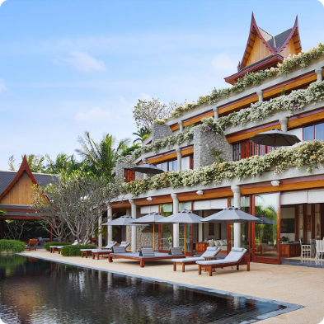

8 Michelin's Three Key Hotels in Thailand
Phula Bay,
A Ritz-Carlton Reserve, Krabi
Amanpuri, Phuket
Keemala, Phuket
Source: Michelin Guide
Photo credit: Forbes Thailand, Michelin Guide
Notes:
12

Slide 26


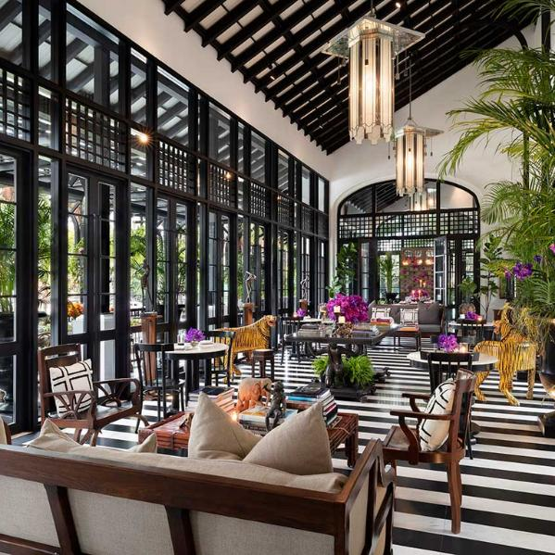
8 Michelin's Three Key Hotels in Thailand
Mandarin Oriental Bangkok
The Siam, Bangkok
Four Season Resort Chiangmai
Source: Michelin Guide
Photo credit: Forbes Thailand, Michelin Guide
Notes:
12

Slide 27
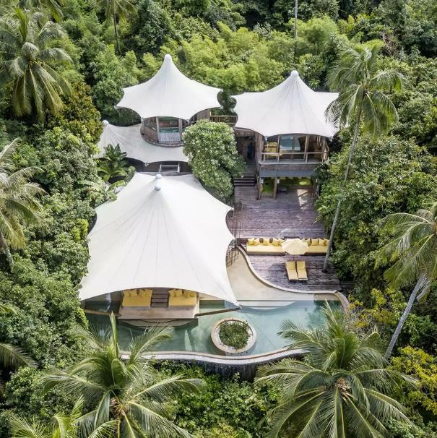

8 Michelin's Three Key Hotels in Thailand
Soneva Kiri, Trat
Samujana Villas, Koh Samui, Surat Thani
Source: Michelin Guide
Photo credit: Forbes Thailand, Michelin Guide
Notes:
12

Slide 28
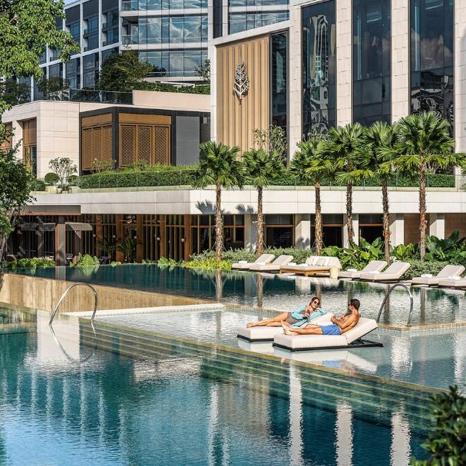




3 Thailand’s Hotels rank in
“The World’s Best Hotels 2026” by 50Best
2nd - Four Seasons Hotel Bangkok
at Chao Phraya River
3rd - Capella Bangkok
7th - Mandarin Oriental Bangkok
2nd - Four Seasons Hotel Bangkok
at Chao Phraya River
3rd - Capella Bangkok
Source: 50Best
Photo credit: Four Season Hotel, Capella Bangkok, Mandarin Oriental Bangkok
Photo credit: Forbes Thailand, Michelin Guide
Notes:
12

Slide 29
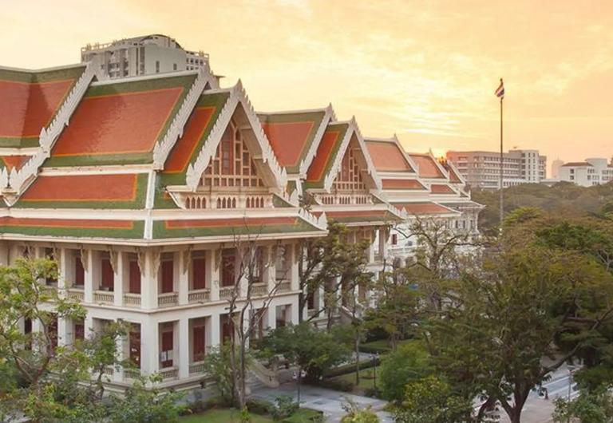

Thai Universities rank
in the Times Higher Education’s Global Top 100
Chulalongkorn University
secured the number one university in Thailand
in the Times Higher Education World University Rankings 2026,
for the third consecutive year (2024–2026). The university also ranks 19th for overall score globally.
Source: Times Higher Education, Chulalongkorn Univerrsity Website, Amarin TV
Photo credit: Chulalongkorn University Website
Notes:
12

Slide 30
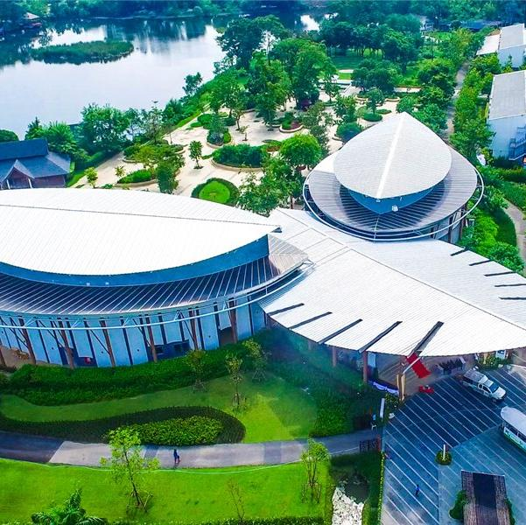
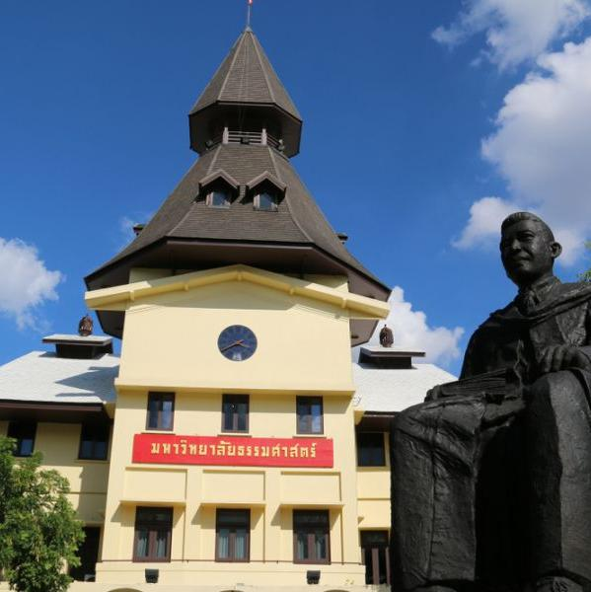
Thai Universities rank
in the Times Higher Education’s Global Top 100
Mahidol University
No.1 for SDG 3
(Good Health and Well-being),
Thammasat University
No. 1 for SDG 16
(Peace, Justice and Strong Institutions)
Source: Amarin TV
Photo credit: Mahidol University, Thammasat University, Chulalongkorn University Website
Notes:
12

Slide 31

Thailand ranks the 1st country in Asia
and 9th as a retirement destination
in the Global Retirement Index 2026
Thailand was ranked 1st in Asia and 9th worldwide by International Living, a leading US media outlet specializing in overseas living and retirement, receiving an overall score of 80.0 points.
The results reflect Thailand’s potential as a global retirement destination, citing its quality of life, healthcare system and welcoming living environment.
Source: Khaosod English
Photo credit: Canvas
​

Slide 32
4 Provinces of Thailand
Top Forbes’ 2025 Retirement Destinations
The cities making the list are Chiang Mai, Hua Hin (Prachuap Khiri Khan),
Koh Samui, (Surat Thani), and Phuket, reinforcing Thailand’s image as a
“dream destination” for those seeking a comfortable retirement.
Forbes evaluated each location based on a variety of factors, including cost of living, healthcare standards, safety, amenities, climate, and the friendliness of locals.
Source: Forbes, PR Thai Government​

Slide 33
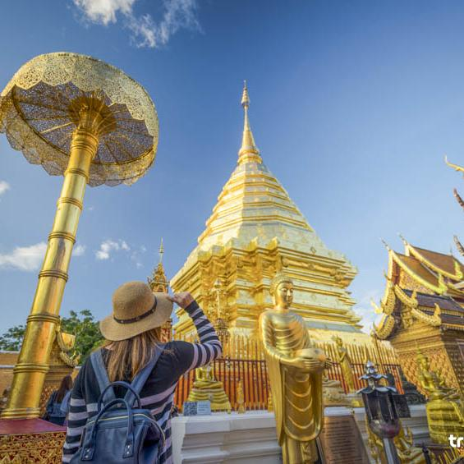
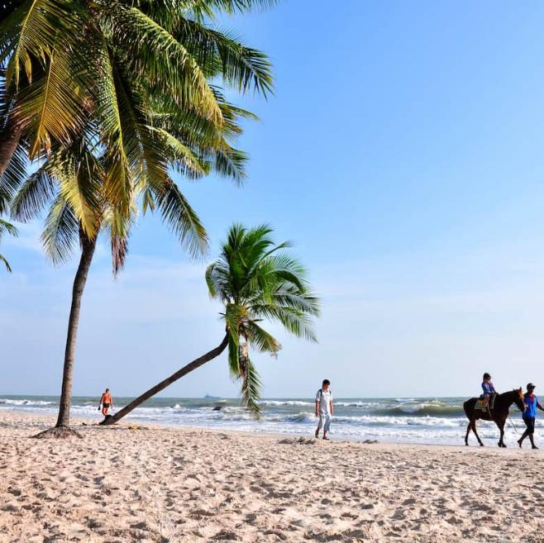
4 Provinces of Thailand
Top Forbes’ 2025 Retirement Destinations
Chiangmai
Hua Hin (Prachuap Khiri Khan )
Source: Forbes, PR Thai Government​
Photo credit: True ID, Movenpick Huahin
Notes:
12

Slide 34
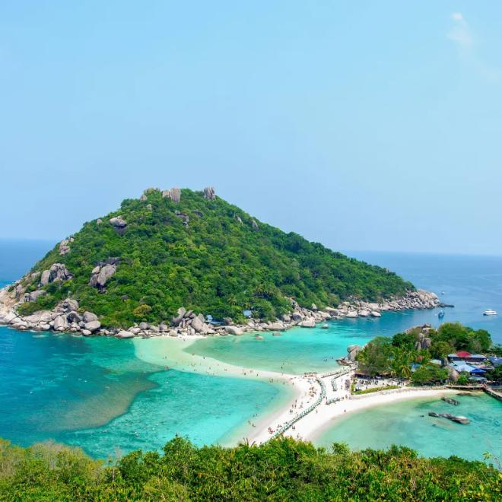
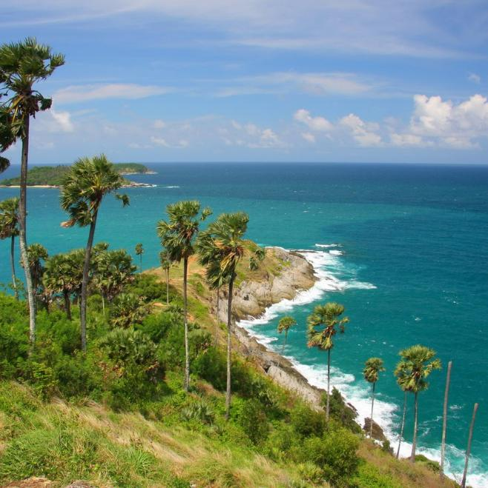
4 Provinces of Thailand
Top Forbes’ 2025 Retirement Destinations
Koh Samui (Surat Thani)
Phuket
Source: Forbes, PR Thai Government​
Photo credit: Sawasdee Thailand, Thailand Tourism Directory
Notes:
12

Slide 35
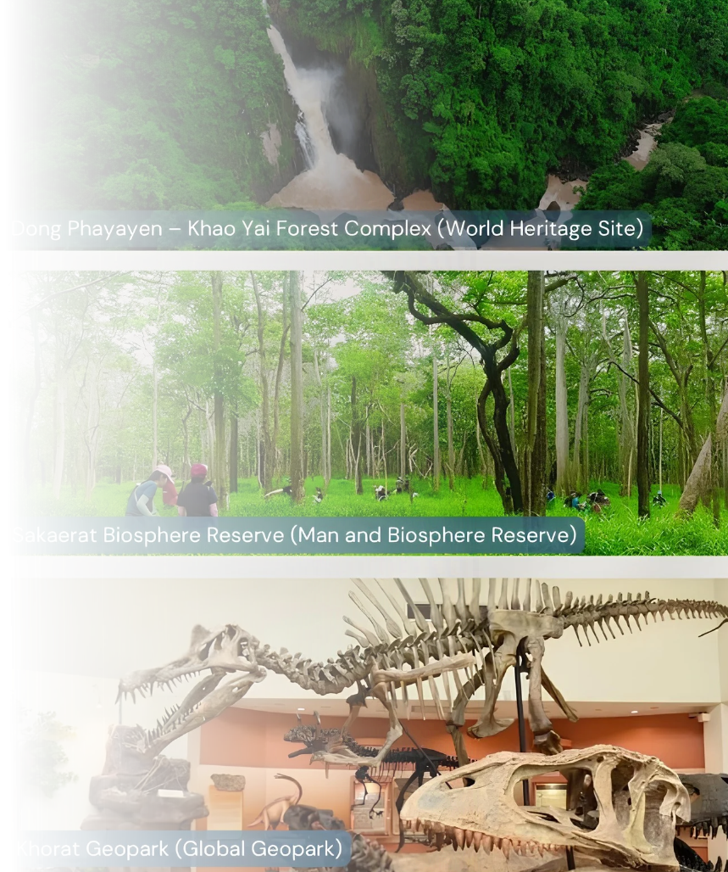
Nakhon Ratchasima:
the World's 4th city "Triple Crown" by UNESCO
The UNESCO Triple Crown in Nakhon Ratchasima includes:
  World Heritage Site: Khao Yai National Park (part of the Dong Phayayen-Khao Yai Forest Complex), famous for its biodiversity and lush tropical forests.
  Biosphere Reserve: Sakaerat Biosphere Reserve located in the Pak Thong Chai District, a hub for ecological research and forest conservation.
  Global Geopark: Khorat Geopark, recognized for its ancient fossils (such as ancient elephants) and unique geological landscapes spanning across five districts.
Photo credit: The Goverment Public Relations Department
Notes:
11

Slide 36
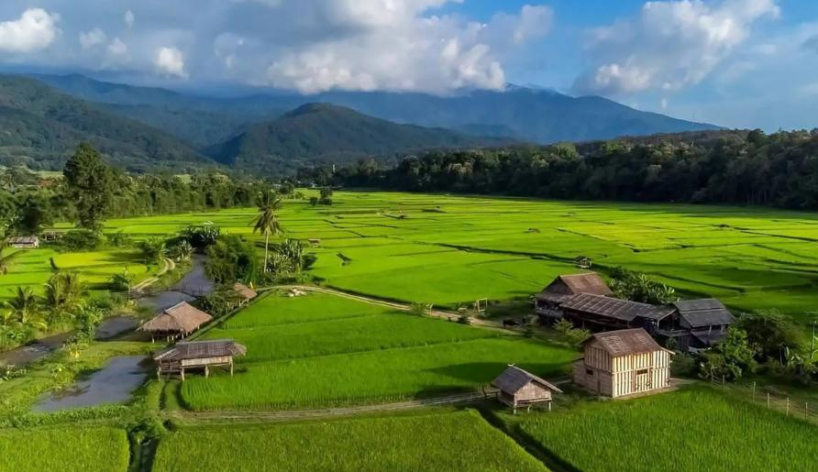

Five Thai destinations in
TIME's World's Greatest Places 2026
Five Thai destinations were featured in TIME's World's Greatest Places 2026, highlighting Thailand's strengths in community-based tourism, heritage hospitality, cultural travel, and contemporary art.
DaiDib DaiDee in Nan, Thailand
Community-Based Tourism
Mandarin Oriental Bangkok
Heritage Hospitality
Source: TIME Magazine, 2026
Photo credit: DaiDib DaiDee, Mandarin Oriental Bangkok
Notes:
27

Slide 37
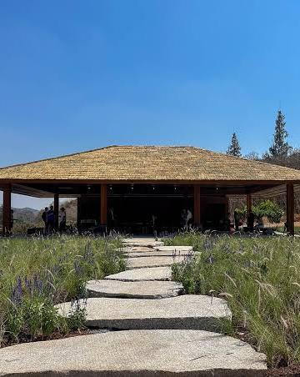



Five Thai destinations in
TIME's World's Greatest Places 2026
Khao Yai Art Forest
Nature and Contemporary Art Space
Dib Bangkok
Contemporary Creative Space
Source: TIME Magazine, 2026
Photo credit: The Standard, Bangkok, Dib Bangkok
Notes:
27

Slide 38



Five Thai destinations in
TIME's World's Greatest Places 2026
Dib Bangkok
Contemporary creative space
Blue Jasmine Train
Luxury Cultural Rail Travel
Source: TIME Magazine, 2026
Photo credit: The Blue Jasmin Train, How E Magazine
Notes:
27

Slide 39

Thailand ranks 1st in ASEAN
and 8th in the World’s Best Health Care System
in 2026
Thailand is ranked 8th worldwide and 1st in the ASEAN region. Thailand achieved a Health Care Index score of 77.5
out of 100, climbing up one spot from its 2025 ranking, according to the 2026 Health Care Index by Country reported by the Numbeo website, which ranks healthcare systems across 100 countries globally.
Source: ASEAN Association - Thailand
Photo credit: Alorica​

Slide 40


Thailand ranks 2nd
in the World's Top Medical Tourism Destinations
in 2026
Thailand has secured second place in Travel And Tour World’s Top 50 Medical Tourism Destinations for 2026.
The ranking weighs the things that matter most to patients travelling abroad for treatment: trusted care,
specialist expertise, modern medical technology, competitive pricing, shorter waiting times and somewhere appealing to recover afterwards. On those counts, Thailand clearly makes a strong case.
Source: Time Out, Travel and Tour World
Photo credit: Sawassdee Thailand, TTG Asia​

Slide 41
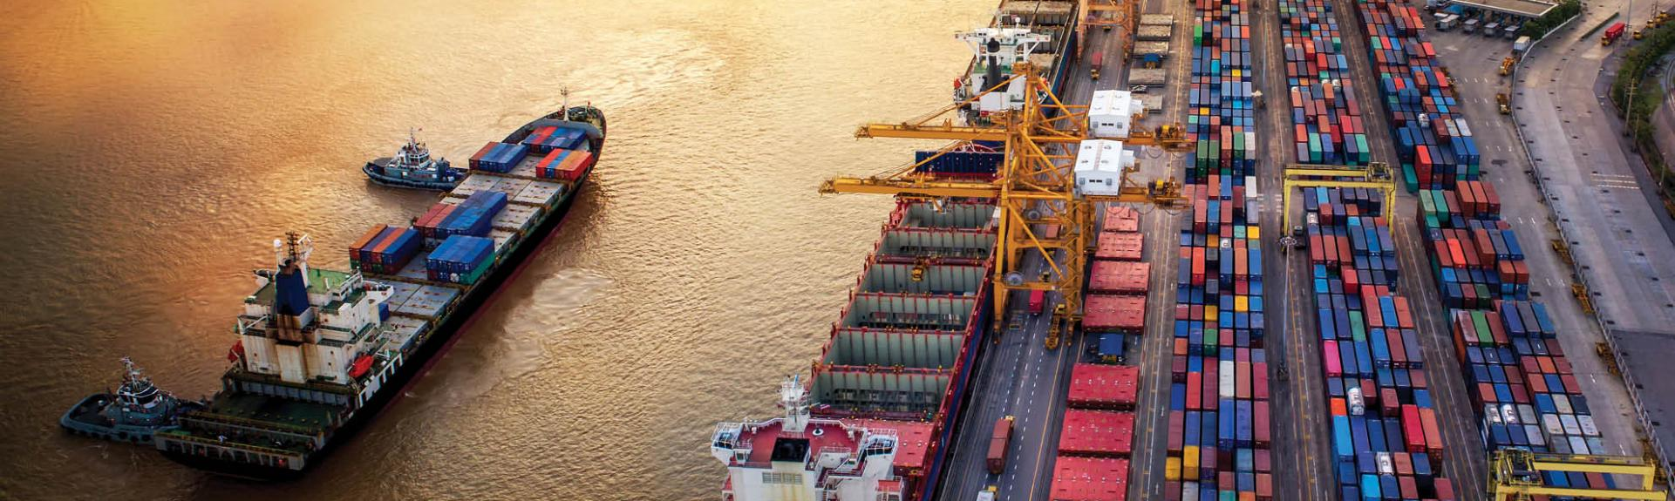
Thailand ranked Top 25
of the World in the 2026 FDI Index
The 2026 Foreign Direct Investment (FDICI) index survey by Kearney
indicates that Thailand has returned to the top 25 in the world.
It reflects a recovery in confidence among senior executives worldwide amidst structural changes in global supply chains.
Source: Kearney, Money & Banking Online
Photo credit: We are CP​

Slide 42

Thailand ranks
among the World’s Four Largest Exporters
of AI-related hardware
Thailand has been ranked among the world’s four largest exporters of AI-related hardware by
the International Monetary Fund (IMF), underscoring the Kingdom’s growing role in global technology supply chains,
as it pushes to transform itself into a regional hub for AI and semiconductor manufacturing.
Source: Thailand Now, PR Thai Government
Photo credit: Citi Group​

