Slide 1
Thailand's Role on the Global Stage

Slide 2
Thailand in Brief
"Thailand in Brief " has been prepared by the Thailand Foundation to support students, scholars, and the general public who wish to give presentations about Thailand to their audiences—for example, exchange program students and international participants.
The work presents some basic information about Thailand in 11 areas: 1) Geography, 2) History, 3) Politics and Government, 4) Economics, 5) Demographics, 6) Culture, 7) Values, 8) Thai People and Other Popularity That You May Know, 9) Misconceptions about Thailand, 10) Thailand's Role on the Global Stage, and 11) Rankings Related to Thailand.
"Thailand in Brief" is produced in both PDF file (.pdf) and Powerpoint Presentation (.pptx) formats, consisting of xx slides. Users may download and select the topics they wish to present, and may rearrange the sequence of the slides as appropriate. However, the content of this document cannot be edited. Reproduction or use for commercial purposes without permission from the Thailand Foundation is not allowed.
"Thailand in Brief" will be updated every third quarter each year. For inquiries or further suggestions, please contact the Thailand Foundation at info@thailandfoundation.or.th.
27 May 2025

Slide 3
Thailand in Brief
"Thailand in Brief " จัดทำขึ้นโดยมูลนิธิไทย (Thailand Foundation) เพื่ออำนวยความสะดวกแก่ นักเรียน นักศึกษา และผู้สนใจทั่วไป นำไปใช้ประโยชน์ อาทิ ในการบรรยาย หรือให้ความรู้เกี่ยวกับประเทศไทยในด้านต่าง ๆ แก่ชาวต่างประเทศ เช่น กรณีนักศึกษาแลกเปลี่ยนที่ไปเรียนในต่างประเทศที่ต้องนำเสนอเรื่องราวเกี่ยวกับประเทศไทยในสถาบันที่ไปศึกษาอยู่ เป็นต้น
งานชิ้นนี้เสนอข้อมูลเกี่ยวกับประเทศไทยโดยสังเขป 11 ด้าน ได้แก่ 1) ภูมิศาสตร์ (Geography) 2) ประวัติศาสตร์ (History) 3) การเมืองการปกครอง (Politics and Government) 4) เศรษฐกิจ (Economics) 5) ประชากร (Demographics) 6) วัฒนธรรม (Culture) 7) ค่านิยม (Values) 8) คนไทยและสื่อที่คุณอาจรู้จัก (Thai people and other popularity that you may know) 9) ความเข้าใจผิดเกี่ยวกับประเทศไทย (Misconceptions) 10) บทบาทของไทยในเวทีโลก (Thailand’s role on the Global Stage) และ 11) การจัดอันดับที่เกี่ยวกับประเทศไทย (Rankings related to Thailand)
"Thailand in Brief " นี้จัดทำเป็นสไลด์ จำนวน xx สไลด์ ในรูปแบบ .pdf และ .pptx สามารถดาวน์โหลดและเลือกใช้หัวข้อที่นำเสนอ และสลับลำดับการนำเสนอได้ตามความเหมาะสม อย่างไรก็ดี ผู้ใช้งานไม่สามารถดัดแปลงเนื้อหาในเอกสารได้ และห้ามผลิตซ้ำ หรือนำไปใช้เพื่อผลประโยชน์เชิงพาณิชย์โดยไม่ได้รับอนุญาตจากมูลนิธิไทย
"Thailand in Brief " จะได้รับการปรับปรุงให้ทันสมัยในทุกไตรมาสที่ 3 ของปี หากมีข้อสงสัยและข้อเสนอแนะเพิ่มเติม กรุณาติดต่อมูลนิธิไทย อีเมล info@thailandfoundation.or.th
27 พฤษภาคม 2568

Slide 4
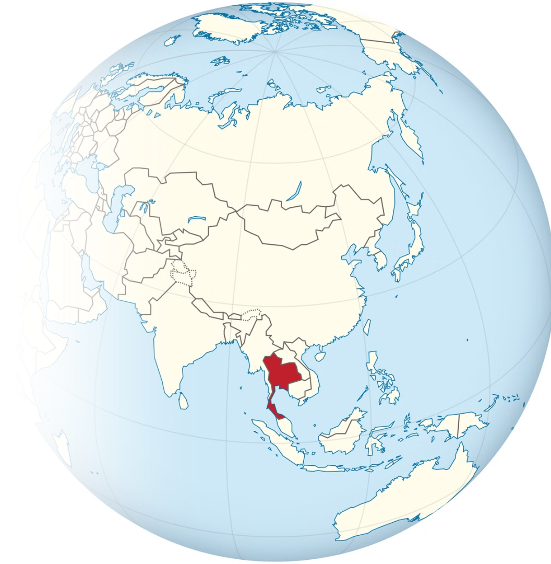
Thailand has emerged as a significant player in international relations by actively participating in various multilateral organizations and initiatives. This presentation explores Thailand's contributions to global cooperation, focusing on its role as an initiator and key member of several important regional and international bodies.
Photo credit: Wikibook

Slide 5
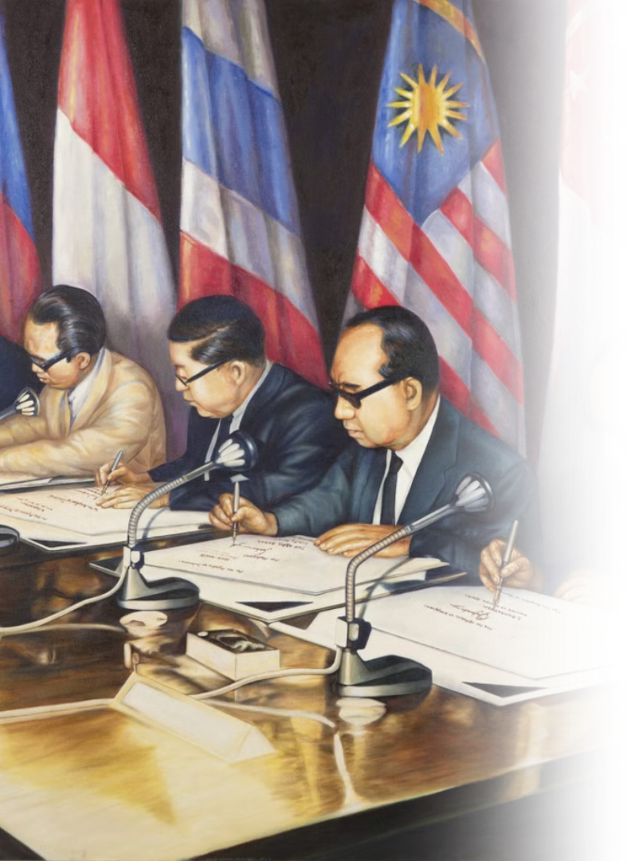
Thailand in ASEAN
ASEAN Member Countries: Brunei Darussalam, Cambodia, Indonesia, Laos, Malaysia, Myanmar, Philippines, Singapore, Thailand, and Vietnam.
Founding Member
Key Contributor
Thailand is one of the five founding members of ASEAN, established in 1967 through the Bangkok Declaration.
Thailand has been a key contributor to ASEAN's evolution from political cooperation to economic and sustainable development.
Economic Importance
ASEAN is Thailand's largest export market, and the bloc remains a pillar of Thai foreign policy.
Photo credit: ASEAN

Slide 6
Thailand's Role in ASEAN Cooperation
Political and Security Cooperation
Economic Integration
Socio-Cultural Cooperation
Thailand advocates for regional economic integration, supporting AFTA and RCEP to enhance ASEAN's competitiveness and contribute to global economic growth.
Supports a people-centered ASEAN Community.
Active in peace-building through mechanisms like TAC, ADMM, ARF, and preventive diplomacy.
Initiated engagement with ASEAN Inter-Parliamentary Assembly (AIPA), civil society organizations (CSOs), and youth to promote involvement in community-building.
Promoted the establishment of the ASEAN Intergovernmental Commission on Human Rights (AICHR) in 2009.
Proposed enhanced ASEAN connectivity, covering physical, institutional, and people-to-people aspects.
Photo Credit: ASEAN

Slide 7
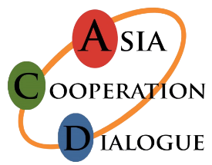
Thailand in BIMSTEC and ACD
BIMSTEC
ACD
Thailand initiated BIST-EC in 1997, later renamed BIMSTEC. This forum connects 1.5 billion people across South and Southeast Asia.
Thailand founded the Asia Cooperation Dialogue in 2002, creating the first pan-Asian forum.
Member countries such as China, Japan, India, South Korea and Indonesia
Member includes Thailand, Bangladesh, Bhutan, India, Myanmar, Nepal and Sri Lanka
Thailand leads the Inclusive and Sustainable Development pillar
Thailand leads in 14 cooperation sectors including trade and tourism
Photo credit: Observer Research Foundation and ACD

Slide 8
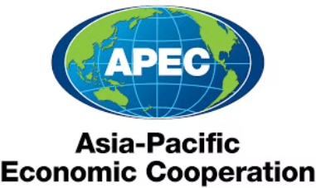
ACMECS and APEC
ACMECS
APEC
Thailand co-founded ACMECS in 2003 with Cambodia, Laos, Myanmar, and Vietnam.\
Thailand is a founding member of the Asia-Pacific Economic Cooperation (APEC), established in 1989.
Strengthens cooperation with Cambodia, Laos, Myanmar, and Vietnam.
Members economies such as United States, China, Russia, Japan and Australia
Focuses on economic development and regional stability.
Introduced the Bangkok Goals on Bio-Circular-Green (BCG) Economy in 2022, emphasizing sustainable growth and environmental resilience.
Photo Credit: ACMECS, APEC

Slide 9
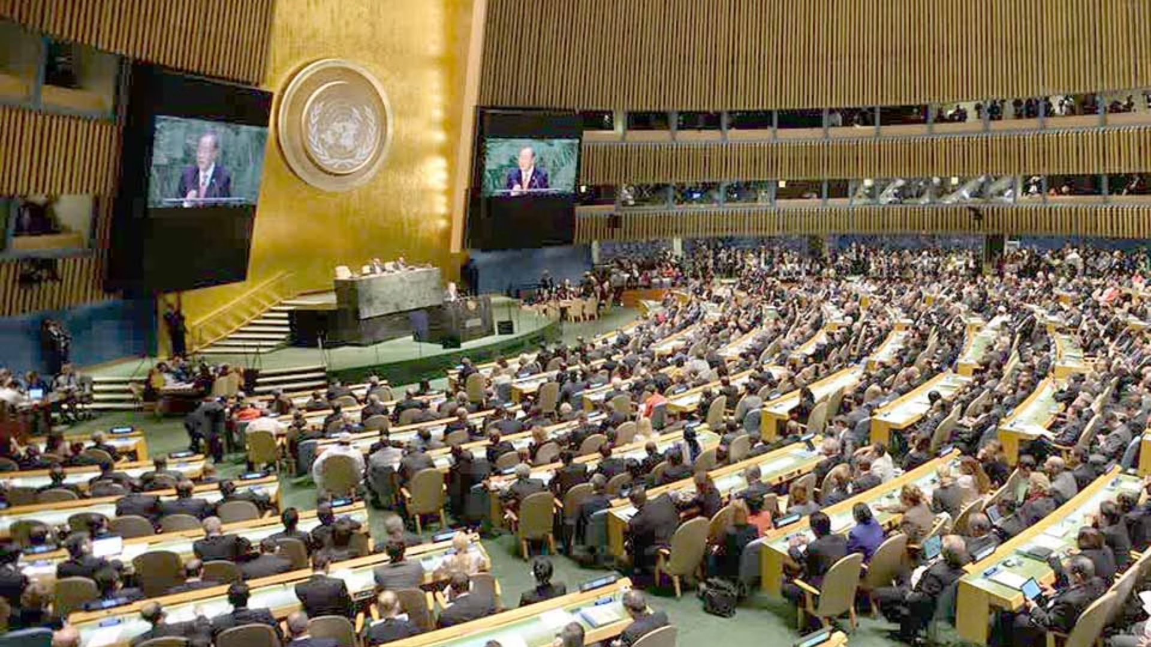
Thailand and the United Nations
1
Joining the UN
Thailand joined in 1946, shortly after the UN's founding in 1945.
2
Cultural Diplomacy and Education
Promotes cultural preservation and education through UNESCO.
Several Thai landmarks, such as Ayutthaya and Sukhothai, are UNESCO World Heritage Sites.
3
Peacekeeping Missions
Contributed personnel to UN peacekeeping operations in South Sudan, Timor-Leste and more.
Thai peacekeepers are recognized for their professionalism and dedication to maintaining global peace.
Photo Credit: Pattaya Mail

Slide 10
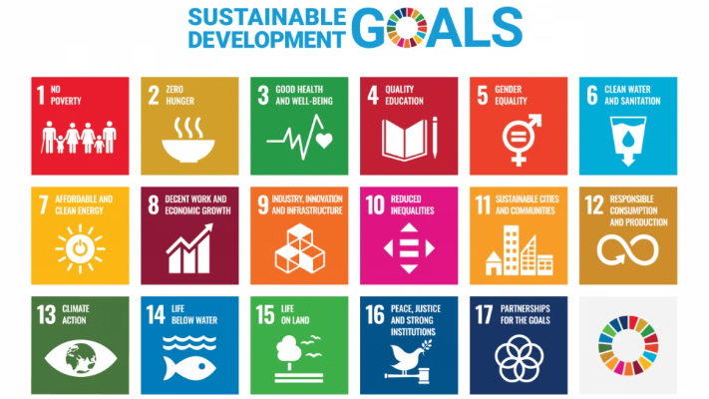
Thailand's Integration of Sustainable Development Goals (SDGs)
Thailand and UN Country Team signed the Sustainable Development Cooperation Framework 2022-2026.
National Integration: SDGs are embedded within Thailand's 20-year National Strategy and 5-year Economic Plans.
Priority Areas: Focus on poverty reduction, quality education, gender equality, and environmental sustainability.
Photo credit: SDG Move

Slide 11
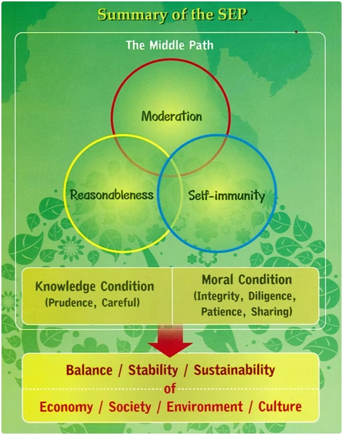
SEP with SDGs
Thailand's Sufficiency Economy Philosophy complements the UN's Sustainable Development Goals perfectly.
Both frameworks balance social, economic, and environmental dimensions for sustainable growth.
SEP adds cultural values and practical implementation principles
Knowledge, morality, reasonableness, and moderation guide actions
Development starts locally, building community resilience
Photo credit: UNDP and MFA Thailand

Slide 12
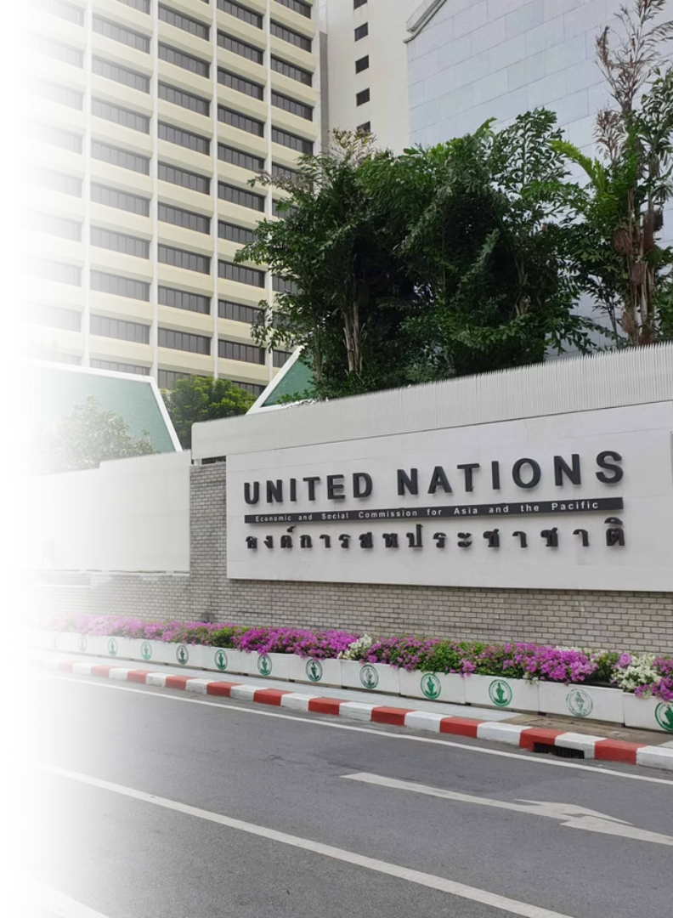
Thailand as the "Geneva of Asia"
Home to Numerous UN and International Organizations
UN Agencies
International Organizations
Hosts several UN agencies, including the Economic and Social Commission for Asia and the Pacific (ESCAP) in Bangkok.
Over 30 international organizations, such as FAO, ICAO, UNAIDS, UNDP, UNESCO, UNHCR, UNICEF, and UNODC, operate in Thailand.

