Slide 1


Thailand's Role on the Global Stage
Notes:
1

Slide 2
Thailand in Brief
"Thailand in Brief " has been prepared by the Thailand Foundation to support students, scholars, and the general public who wish to give presentations about Thailand to their audiences—for example, exchange program students and international participants.
The work presents some basic information about Thailand in 11 areas: 1) Geography, 2) History, 3) Politics and Government, 4) Economics, 5) Demographics, 6) Culture, 7) Values, 8) Thai People and Other Popularity That You May Know,
9) Misconceptions about Thailand, 10) Thailand's Role on the Global Stage, and 11) Rankings Related to Thailand.
"Thailand in Brief" is produced in both PDF file (.pdf) and Powerpoint Presentation (.pptx) formats, consisting of 400 slides. Users may download and select the topics they wish to present, and may rearrange the sequence of the slides as appropriate. However, the content of this document cannot be edited. Reproduction or use for commercial purposes without permission from the Thailand Foundation is not allowed.
"Thailand in Brief" will be updated every third quarter each year. For inquiries or further suggestions, please contact the Thailand Foundation at info@thailandfoundation.or.th.
July 2026
Notes:
2

Slide 3
Thailand in Brief
"Thailand in Brief " จัดทำขึ้นโดยมูลนิธิไทย (Thailand Foundation) เพื่ออำนวยความสะดวกแก่ นักเรียน นักศึกษา และผู้สนใจทั่วไป นำไปใช้ประโยชน์ อาทิ ในการบรรยาย หรือให้ความรู้เกี่ยวกับประเทศไทยในด้านต่าง ๆ แก่ชาวต่างประเทศ เช่น กรณีนักศึกษาแลกเปลี่ยนที่ไปเรียนในต่างประเทศที่ต้องนำเสนอเรื่องราวเกี่ยวกับประเทศไทยในสถาบันที่ไปศึกษาอยู่ เป็นต้น
งานชิ้นนี้เสนอข้อมูลเกี่ยวกับประเทศไทยโดยสังเขป 11 ด้าน ได้แก่ 1) ภูมิศาสตร์ (Geography) 2) ประวัติศาสตร์ (History) 3) การเมืองการปกครอง (Politics and Government) 4) เศรษฐกิจ (Economics) 5) ประชากร (Demographics) 6) วัฒนธรรม (Culture) 7) ค่านิยม (Values) 8) คนไทยและสื่อที่คุณอาจรู้จัก (Thai people and other popularity that you may know) 9) ความเข้าใจผิดเกี่ยวกับประเทศไทย (Misconceptions)
10) บทบาทของไทยในเวทีโลก (Thailand’s role on the Global Stage) และ 11) การจัดอันดับที่เกี่ยวกับประเทศไทย (Rankings related to Thailand)
"Thailand in Brief " นี้จัดทำเป็นสไลด์ จำนวน 400 สไลด์ ในรูปแบบ .pdf และ .pptx สามารถดาวน์โหลดและเลือกใช้หัวข้อที่นำเสนอ และสลับลำดับการนำเสนอได้ตามความเหมาะสม อย่างไรก็ดี ผู้ใช้งานไม่สามารถดัดแปลงเนื้อหาในเอกสารได้ และห้ามผลิตซ้ำ หรือนำไปใช้เพื่อผลประโยชน์เชิงพาณิชย์โดยไม่ได้รับอนุญาตจากมูลนิธิไทย
"Thailand in Brief " จะได้รับการปรับปรุงให้ทันสมัยในทุกไตรมาสที่ 3 ของปี หากมีข้อสงสัยและข้อเสนอแนะเพิ่มเติม กรุณาติดต่อมูลนิธิไทย
อีเมล info@thailandfoundation.or.th
กรกฎาคม 2569
Notes:
3

Slide 4
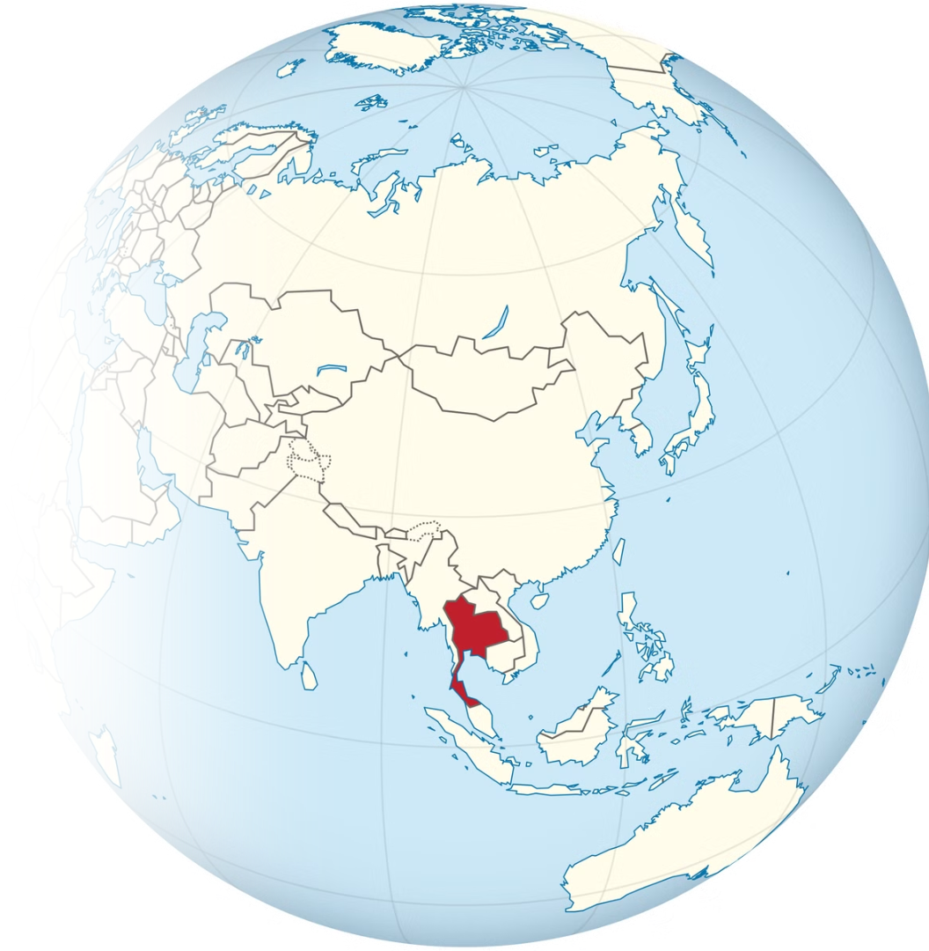
Thailand has emerged as a significant player in international relations by actively participating in various multilateral organizations and initiatives.
This presentation explores Thailand's contributions to global cooperation, focusing on its role as an initiator and key member of several important regional and international bodies.
Photo credit: Wikibook
Notes:
4

Slide 5
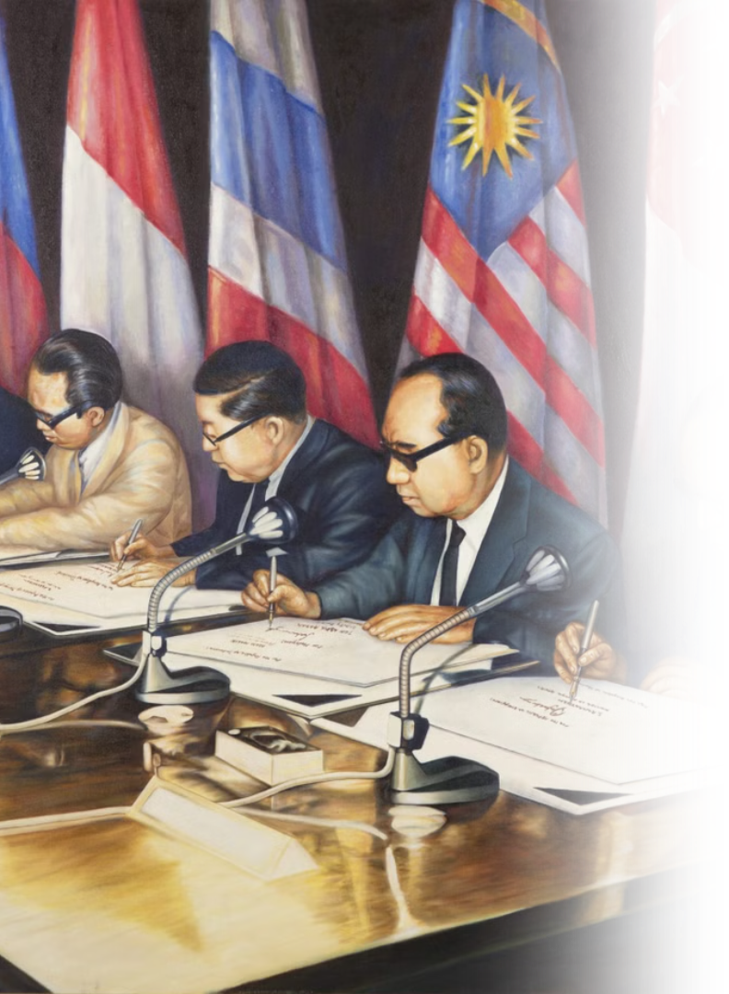



Thailand in ASEAN
ASEAN Member Countries: Brunei Darussalam, Cambodia, Indonesia, Laos, Malaysia, Myanmar, Philippines, Singapore, Thailand,
Timor-Leste (2025) and Vietnam.
Founding Member
Key Contributor
Thailand is one of the five founding members of ASEAN, established in 1967 through the Bangkok Declaration.
Thailand has been a key contributor to ASEAN's evolution from political cooperation to economic and sustainable development.
Economic Importance
ASEAN is Thailand's largest export market, and the bloc remains a pillar of Thai foreign policy.
Photo credit: ASEAN
Notes:
5

Slide 6

Thailand's Role in ASEAN Cooperation
Political and Security Cooperation
  Active in peace-building through mechanisms like TAC, ADMM, ARF, and preventive diplomacy.
  Promoted the establishment of the ASEAN Intergovernmental Commission on Human Rights (AICHR) in 2009.
Economic Integration
  Thailand advocates for regional economic integration, supporting AFTA and RCEP to enhance ASEAN's competitiveness and contribute to global economic growth.
  Proposed enhanced ASEAN connectivity, covering physical, institutional, and people-to-people aspects.
Socio-Cultural Cooperation
  Supports a people-centered ASEAN Community.
  Initiated engagement with ASEAN Inter-Parliamentary Assembly (AIPA), civil society organizations (CSOs), and youth to promote involvement in community-building.
Photo Credit: ASEAN Flag (Photo Credit: asean.org)
Notes:
6

Slide 7

Thailand’s ASEAN Chairmanship
1
1995
  The Southeast Asian Nuclear-Weapon-Free Zone Treaty (SEANWFZ)
  The formal admission of Vietnam as ASEAN's member.
2
2009
  ASEAN Intergovernmental Commission on Human Rights (AICHR)
  Cha-am Hua Hin Declaration on Strengthening Cooperation on Education to Achieve an ASEAN Caring and Sharing Community
3
2019
  ASEAN Outlook on the Indo-Pacific (AOIP)
  Advanced negotiations for the Regional Comprehensive Economic Partnership (RCEP)
4
2028
  Stands ready to serve as a bridge between ASEAN and Global South
  Advances social cooperation and environmental management
  Strengthens regional peace, stability, and security through hosting security
and defense cooperation meetings
Photo Credit: MFA
Notes:
9

Slide 8

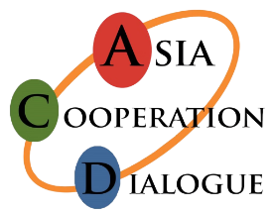
Thailand in BIMSTEC and ACD
BIMSTEC
ACD
Thailand initiated BIST-EC in 1997, later renamed BIMSTEC. This forum connects 1.5 billion people across South and Southeast Asia.
Thailand founded the Asia Cooperation Dialogue
in 2002, creating the first pan-Asian forum.
  Member countries such as China, Japan, India,
South Korea and Indonesia and others.
  Members include Thailand, Bangladesh, Bhutan, India, Myanmar, Nepal and Sri Lanka.
  Thailand leads the Inclusive and Sustainable Development pillar
  Thailand leads in 14 cooperation sectors including trade and tourism.
  Thailand has served as the host on two occasions, specifically the 1st Summit in 2004 and the 6th Summit in 2025.
Photo credit: Observer Research Foundation and ACD
Notes:
7

Slide 9


ACMECS and APEC
ACMECS
APEC
  Thailand co-founded ACMECS in 2003 with Cambodia, Laos, Myanmar, and Vietnam.
  Thailand is a founding member of the Asia-Pacific Economic Cooperation (APEC), established in 1989.
  Strengthens cooperation with Cambodia, Laos, Myanmar, and Vietnam.
  Members economies such as United States, China, Russia, Japan and Australia
  Focuses on economic development and regional stability.
  Introduced the Bangkok Goals on Bio-Circular-Green (BCG) Economy in 2022, emphasizing sustainable growth and environmental resilience.
Photo Credit: ACMECS, APEC
Notes:
8

Slide 10
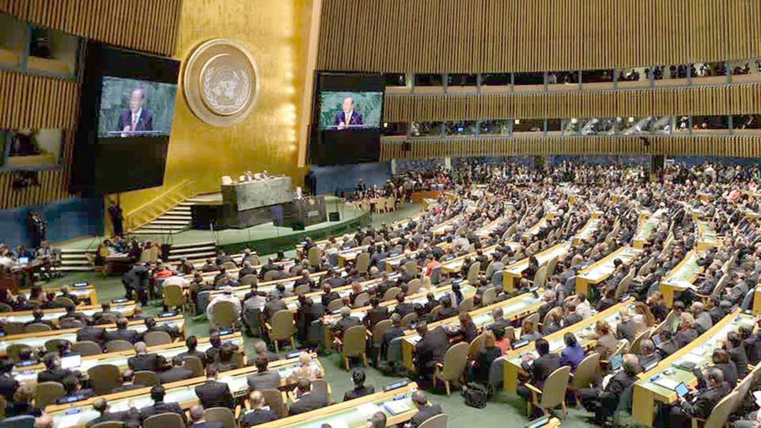
Thailand and the United Nations
1
Joining the UN
Thailand joined in 1946, shortly after the UN's founding in 1945.
2
Cultural Diplomacy and Education
Promotes cultural preservation and education through UNESCO.
Several Thai landmarks, such as Ayutthaya and Sukhothai, are UNESCO World Heritage Sites.
3
Peacekeeping Missions
Contributed personnel to UN peacekeeping operations in South Sudan, Timor-Leste and more.
Thai peacekeepers are recognized for their professionalism and dedication to maintaining global peace.
Pictured: United Nations General Assembly (UNGA)
Photo Credit: Pattaya Mail
Notes:
9

Slide 11
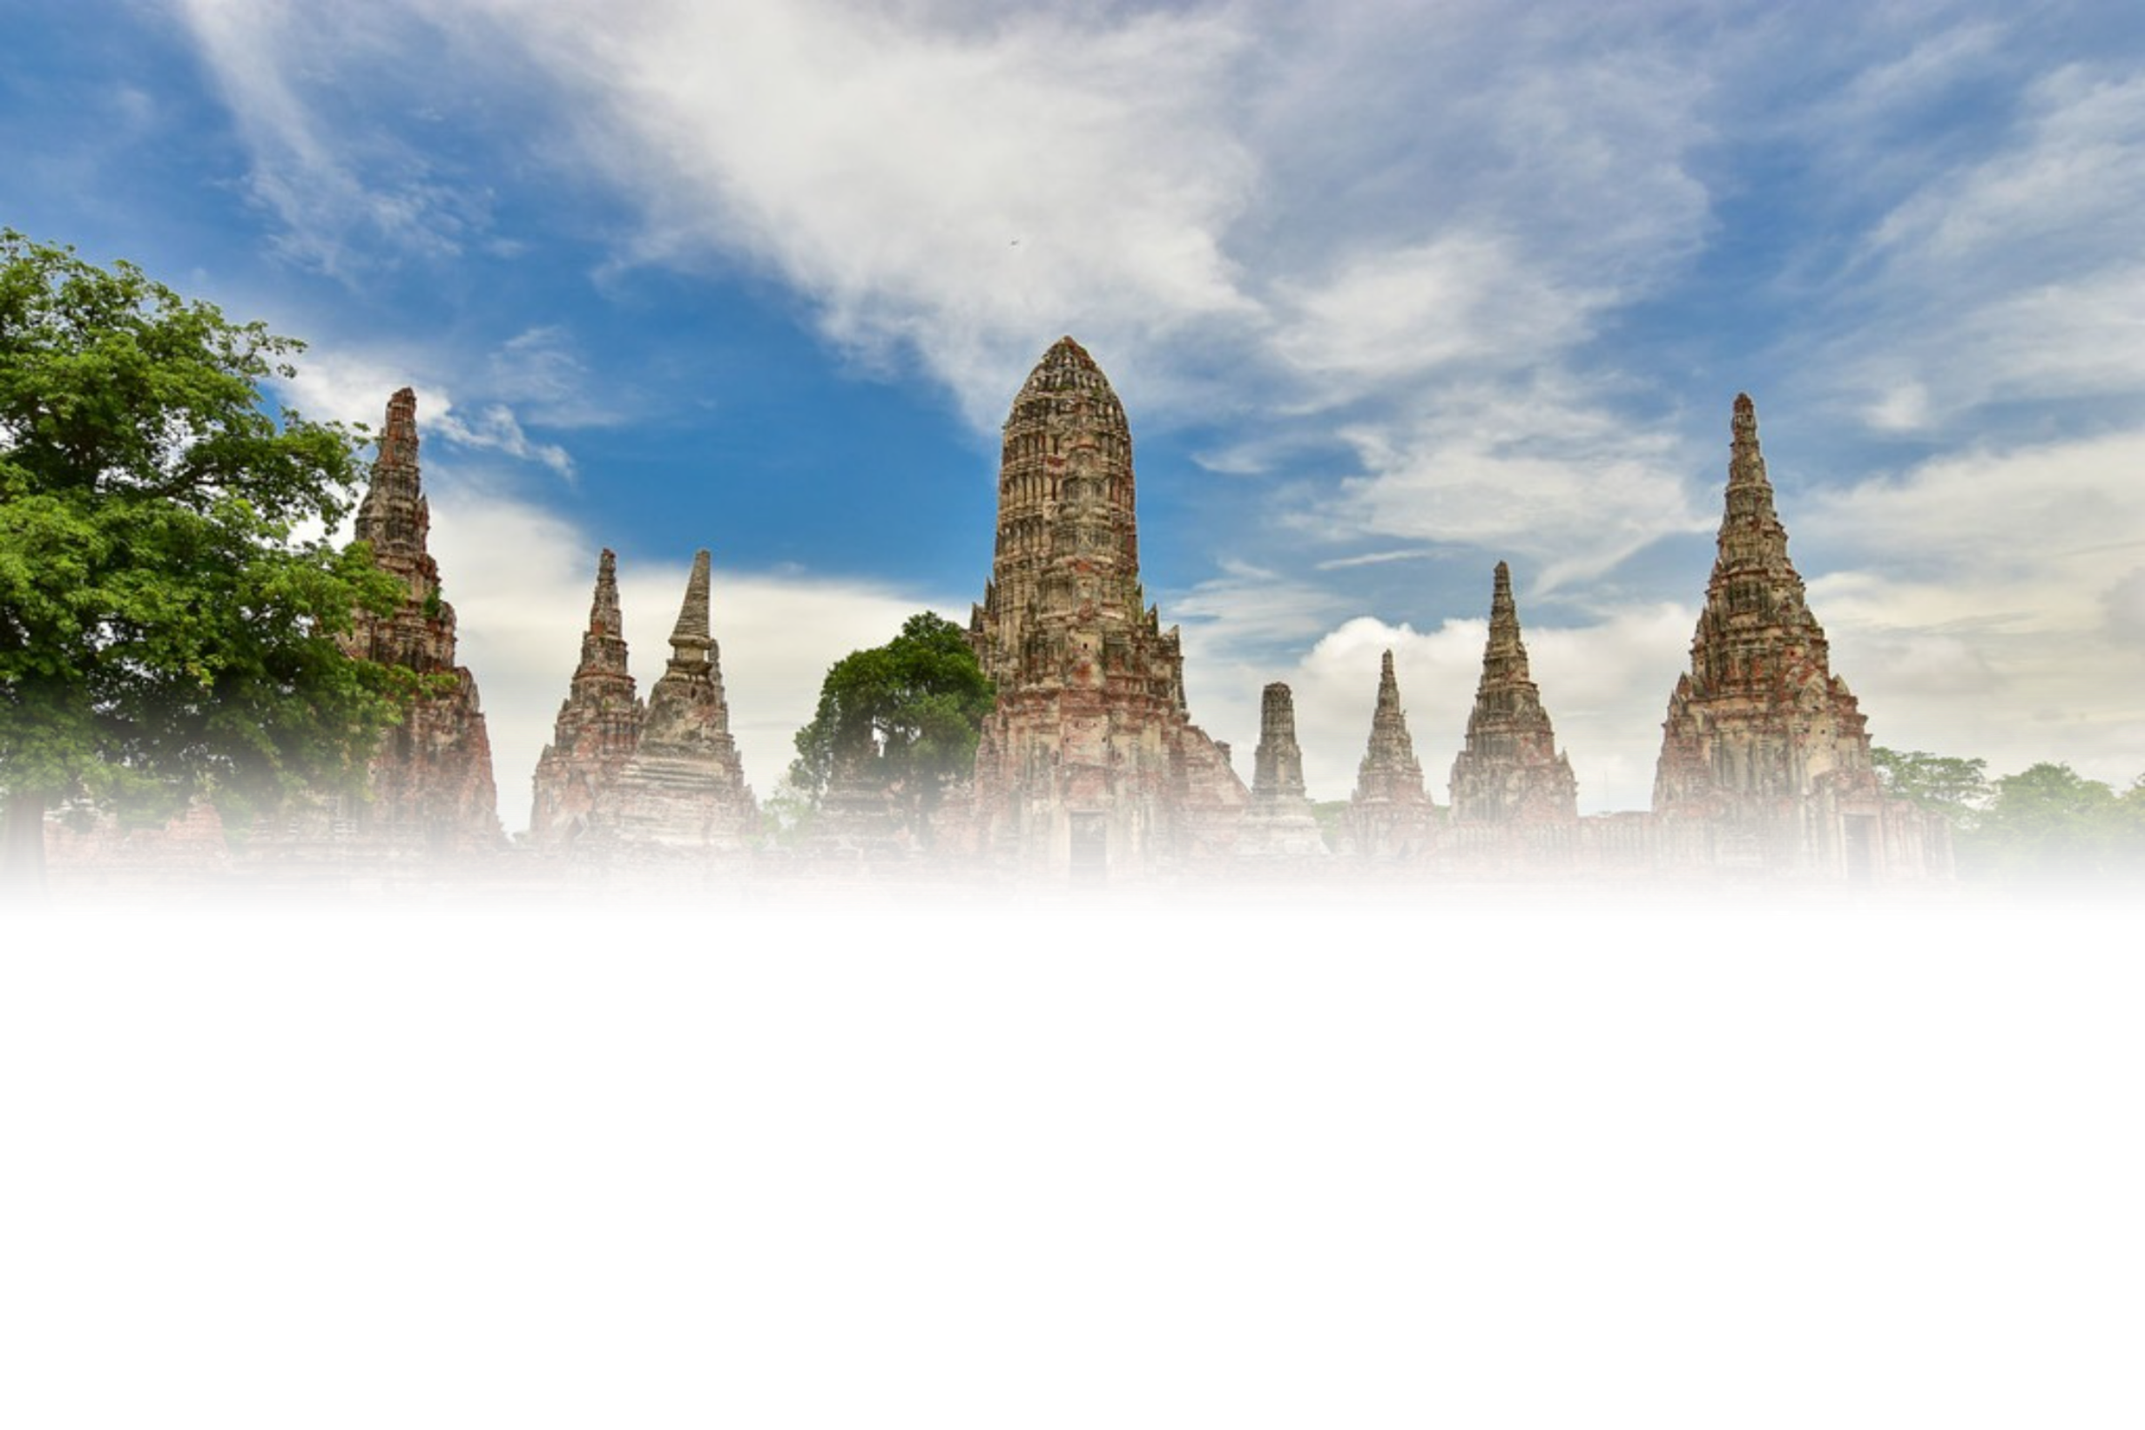
UNESCO
Thailand’s Properties
inscribed on the World Heritage List
Thailand has nine properties officially inscribed on the UNESCO World Heritage List. This includes six cultural sites and three natural sites, showcasing the country's rich historical legacy and unique ecological diversity.
Pictured: Wat Chaiwatthanaram, Historic City of Ayutthaya - Photo Credit: fanclubthailand
Notes:
12

Slide 12
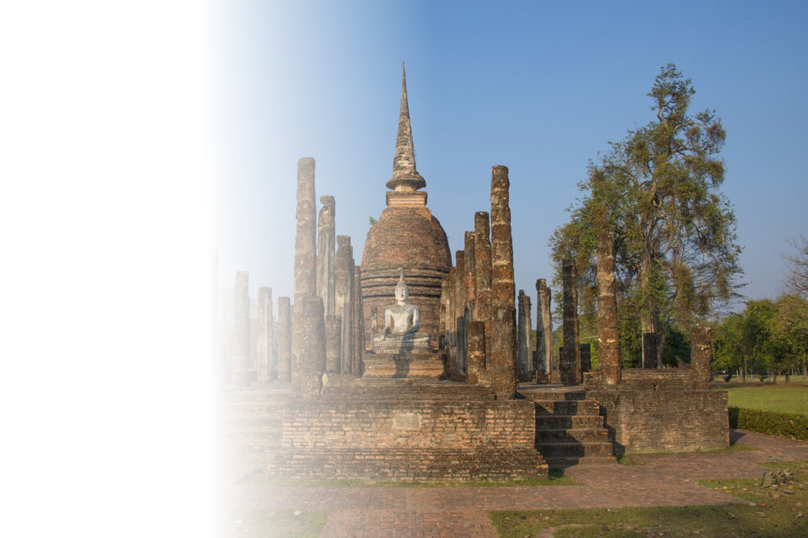
Cultural Sites
1. Historic Town of Sukhothai
and Associated Historic Towns
  The capital of the first Kingdom of Siam in the 13th and 14th centuries.
  It has a number of fine monuments, illustrating the beginnings of Thai architecture.
  Inscribed as a UNESCO World
Heritage Site in 1991.
Pictured: Historic Town of Sukhothai and Associated Historic Towns
Photo Credit: UNESCO
Notes:
12

Slide 13
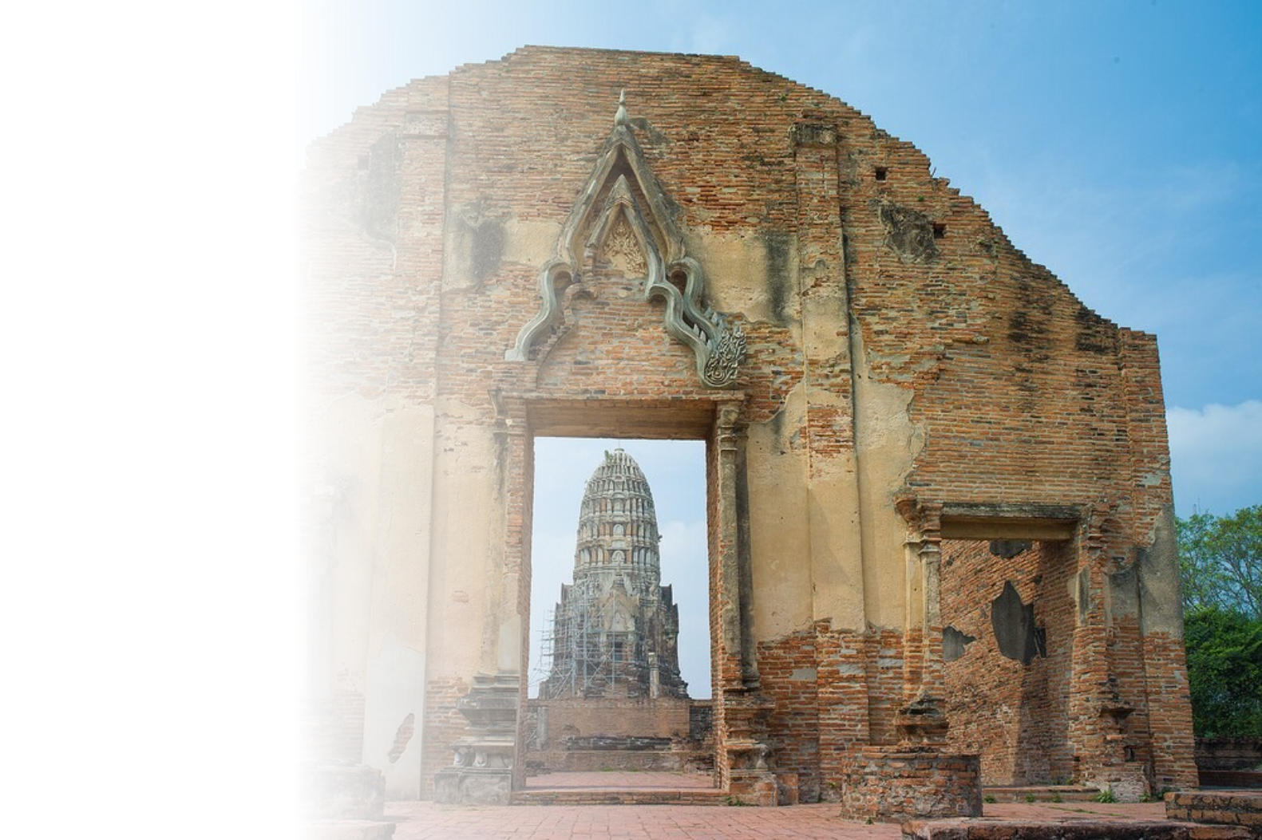
Cultural Sites
2. Historic City of Ayutthaya
  Became the second Siamese capital after Sukhothai.
  Its remains, characterized by the prang (reliquary towers) and gigantic monasteries, give an idea of its past splendour.
  Inscribed as a UNESCO World
Heritage Site in 1991.
Pictured: Historic City of Ayutthaya
Photo Credit: UNESCO
Notes:
12

Slide 14

Cultural Sites
3. Ban Chiang Archaeological Site
(Udon Thani)
  The most important prehistoric settlement discovered in South-East Asia.
  Presents the earliest evidence of farming in the region and of the manufacture and use of metals.
  Inscribed as a UNESCO World
Heritage Site in 1992.
Pictured: Ban Chiang Archaeological Site
Photo Credit: Kiwiodysee
Notes:
12

Slide 15

Cultural Sites
4. Si Thep Historical Park (Phetchabun)
  The most important prehistoric settlement discovered in South-East Asia.
  Presents the earliest evidence of farming in the region and of the manufacture and use of metals.
  Inscribed as a UNESCO World
Heritage Site in 2023.
Pictured: Prang Si Thep, Si Thep Historical Park, Phetchabun
Photo Credit: Fine Arts Department
Notes:
12

Slide 16
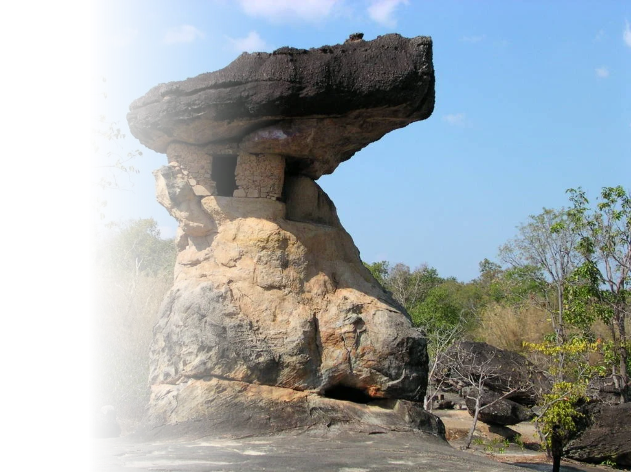
Cultural Sites
5. Phu Phra Bat (Udon Thani)
  The most important prehistoric settlement discovered in South-East Asia.
  Presents the earliest evidence of farming in the region and of the manufacture and use of metals.
  Inscribed as a UNESCO World
Heritage Site in 2024.
Pictured: Hor Nang Usa, Phu Phra Bat Historical Park, Udon Thani
Photo Credit: Fine Arts Department
Notes:
12

Slide 17
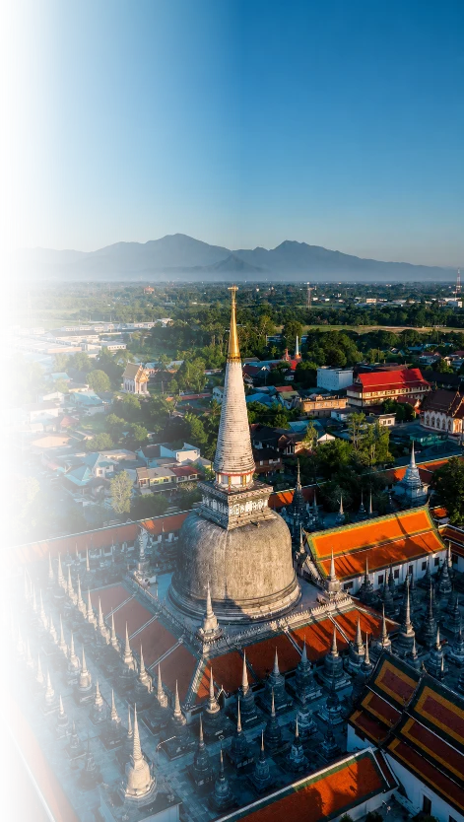
Cultural Sites
6. Wat Phra Mahathat Woramahawihan (Nakhon Si Thammarat)
  Founded in the 8th century, Wat Phra Mahathat Woramahawihan has been a major Buddhist centre in southern Thailand for over 1,500 years.
  Its architecture and traditions blend influences from India, Java, Sri Lanka and the Mon region.
  The monastery preserves important traditions, including the annual cloth-wrapping ceremony, and Nora dance drama.
  Inscribed as a UNESCO World
Heritage Site in 2026.
Pictured: Wat Phra Mahathat Woramahawihan
Photo Credit: Tourism Authority of Thailand (TAT)
Notes:
12

Slide 18

Natural Sites
1. Thungyai-Huai Kha Khaeng Wildlife Sanctuaries
  Contain examples of almost all the forest types of continental South-East Asia.
  Home to a diverse array of animals, 77% of the large mammals, 50% of the large birds and 33% of the land vertebrates
  Inscribed as a UNESCO World
Heritage Site in 1991.
Pictured: Thungyai-Huai Kha Khaeng Wildlife Sanctuaries
Photo Credit: UNESCO
Notes:
12

Slide 19
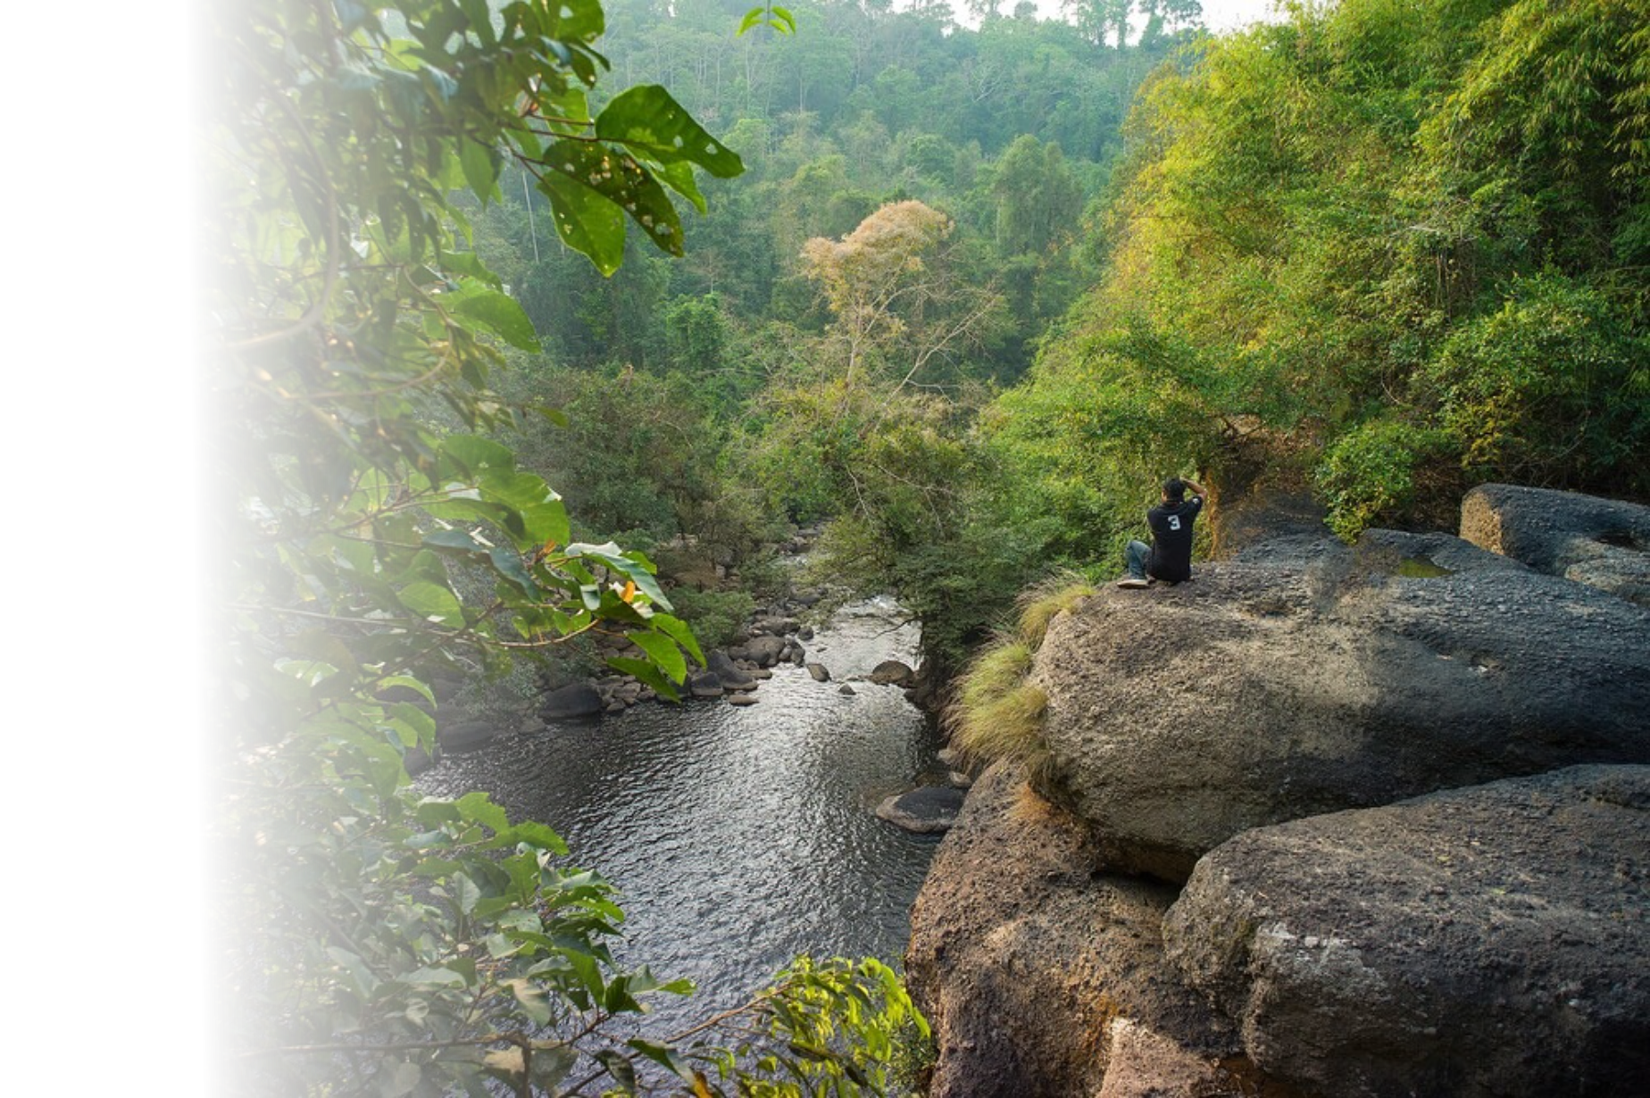
Natural Sites
2. Dong Phayayen-Khao Yai
Forest Complex
  Home to more than 800 species of fauna, including 112 mammal species (among them two species of gibbon), 392 bird species and 200 reptile and amphibian species.
  Inscribed as a UNESCO World
Heritage Site in 2005.
Pictured: Dong Phayayen-Khao Yai Forest Complex
Photo Credit: UNESCO
Notes:
12

Slide 20

Natural Sites
3. Kaeng Krachan Forest Complex
  Home to rich diversity.
  Dominated by semi-evergreen/dry evergreen and moist evergreen forest with some mixed deciduous forest, montane forest, and deciduous dipterocarp forest.
  Inscribed as a UNESCO World
Heritage Site in 2021.
Pictured: Kaeng Krachan Forest Complex
Photo Credit: UNESCO
Notes:
12

Slide 21
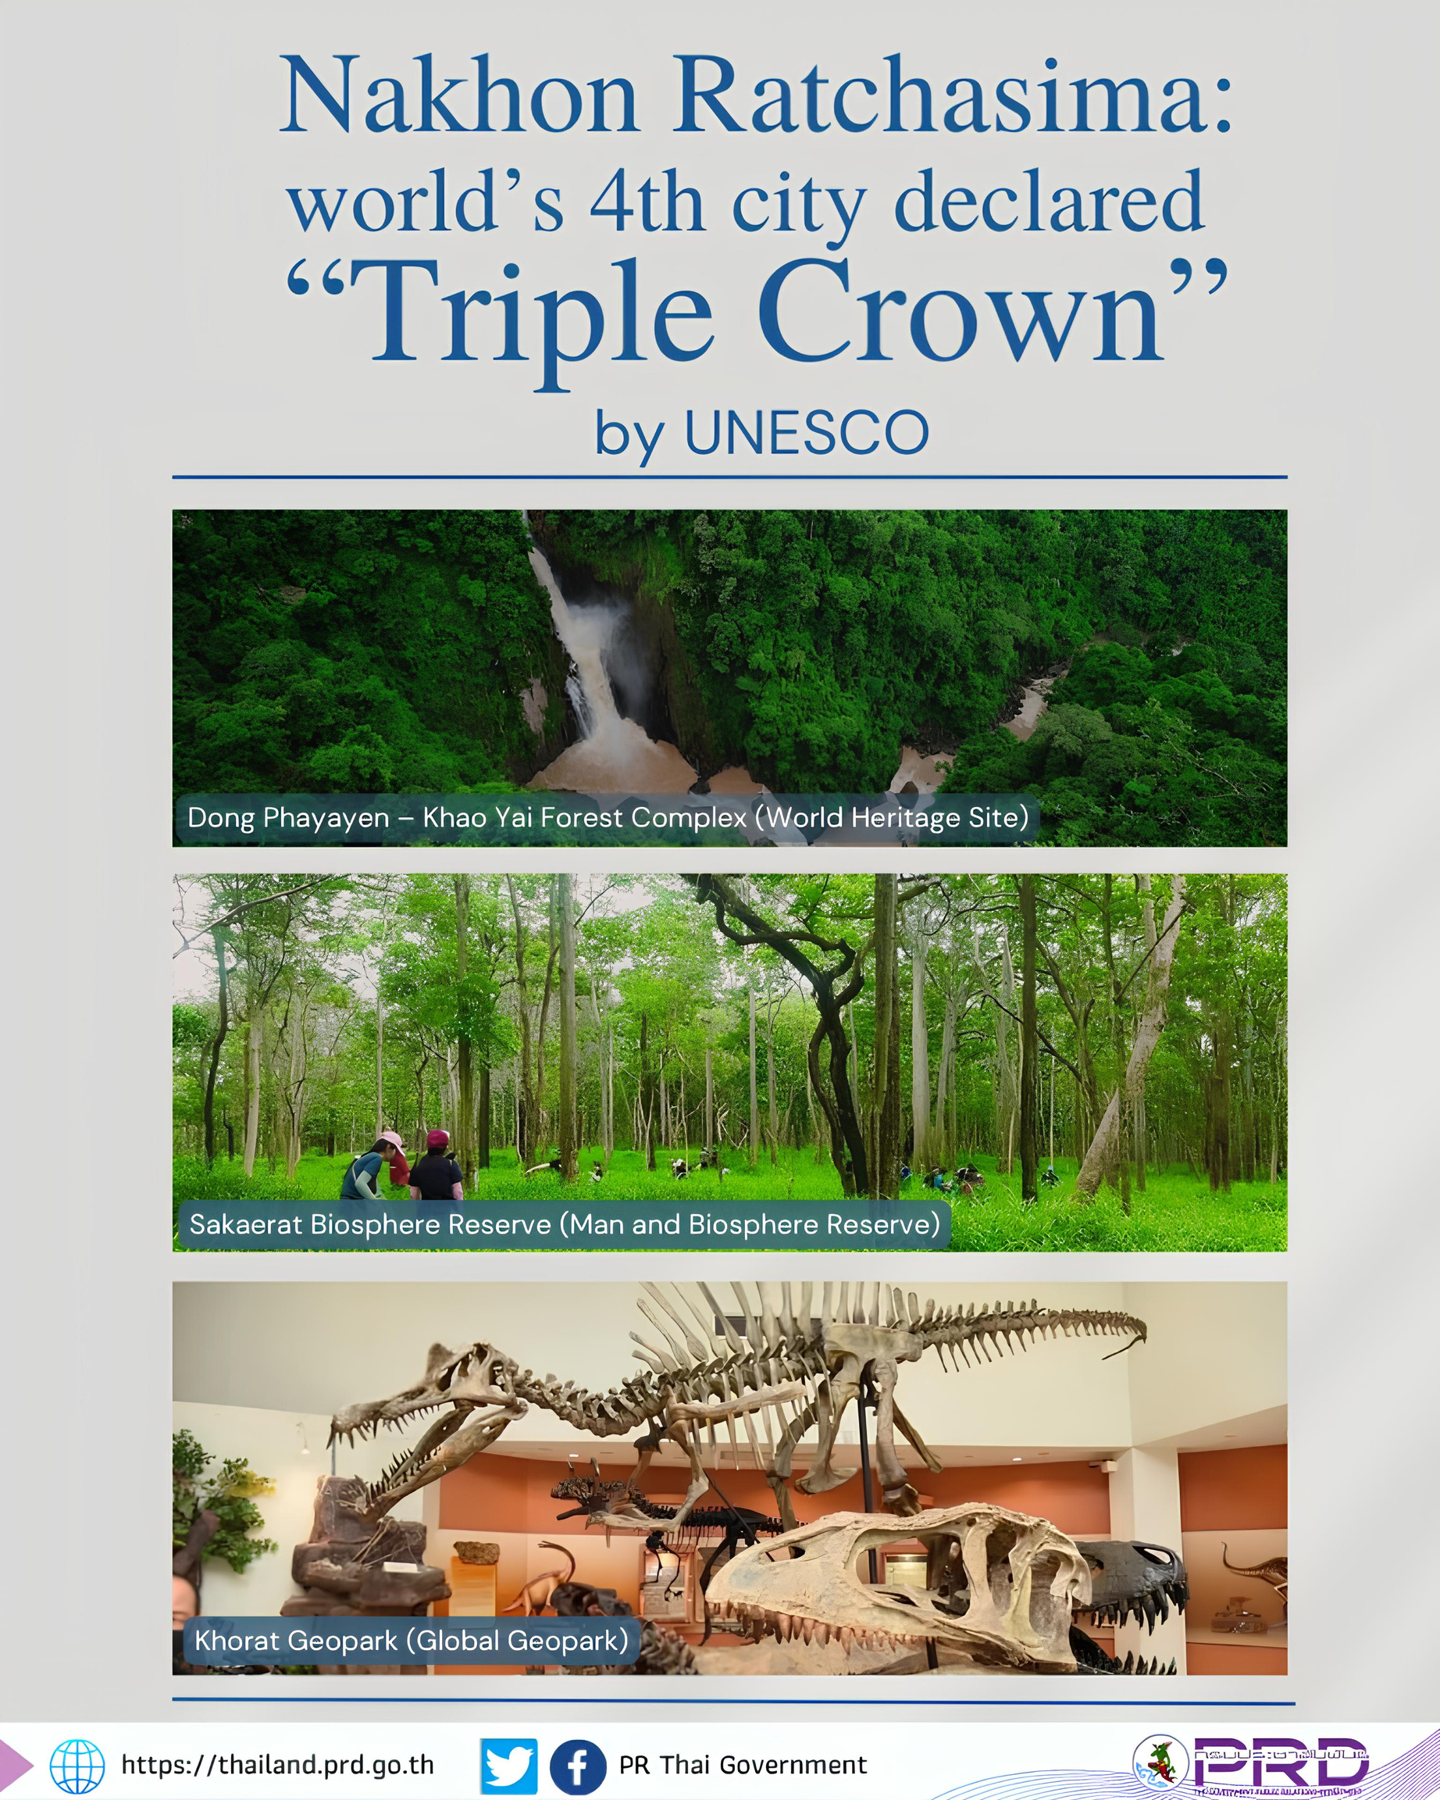
Nakhon Ratchasima
world's 4th city declared "Triple Crown" by UNESCO
The UNESCO Triple Crown in Nakhon Ratchasima includes:
  World Heritage Site: Khao Yai National Park (part of the Dong Phayayen-Khao Yai Forest Complex), famous for its biodiversity and lush tropical forests.
  Biosphere Reserve: Sakaerat Biosphere Reserve located in the Pak Thong Chai District, a hub for ecological research and forest conservation.
  Global Geopark: Khorat Geopark, recognized for its ancient fossils (such as ancient elephants) and unique geological landscapes spanning across five districts.
Photo credit: The Goverment Public Relations Department
Notes:
11

Slide 22
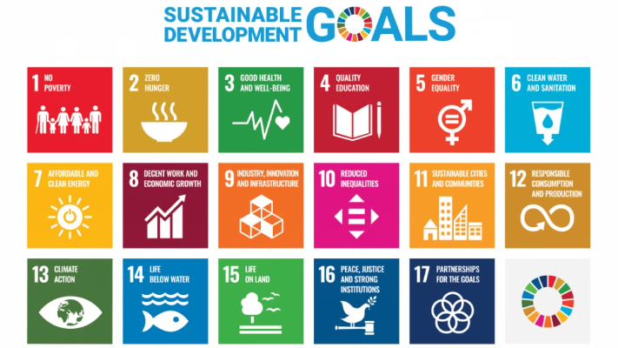
Thailand's Integration of Sustainable Development Goals (SDGs)
Thailand and UN Country Team signed the Sustainable Development Cooperation Framework 2022-2026.
  National Integration: SDGs are embedded within Thailand's 20-year National Strategy and 5-year Economic Plans.
  Priority Areas: Focus on poverty reduction, quality education, gender equality, and environmental sustainability.
Photo credit: SDG Move
Notes:
10

Slide 23
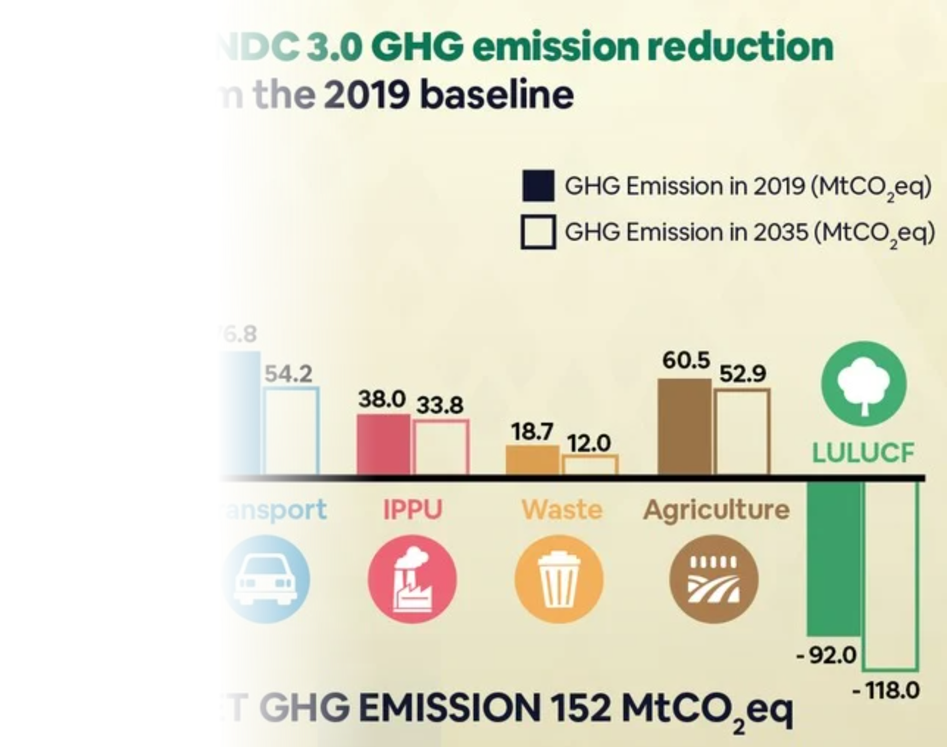
Thailand's Climate
Commitments
Thailand officially announced its commitment to achieving net-zero greenhouse gas emissions by 2050 at COP30 on 19 November 2025.
Thailand also pledged to reduce its greenhouse gas emissions
by 47% by 2035.
Thailand also remains committed to its goal of achieving
carbon neutrality by 2050.
Photo credit: Department of Climate Change and Environment
Notes:
11

Slide 24

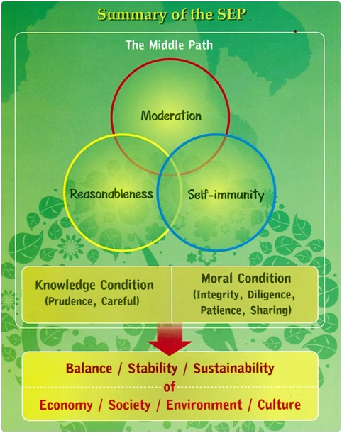
SEP with SDGs
Thailand's Sufficiency Economy Philosophy (SEP) complements the UN's Sustainable Development Goals (SDGs) perfectly.
Both frameworks balance social, economic, and environmental dimensions for sustainable growth.
  SEP adds cultural values and practical implementation principles
  Knowledge, morality, reasonableness, and moderation guide actions
  Development starts locally, building community resilience
Photo credit: UNDP and MFA Thailand
Notes:
11

Slide 25
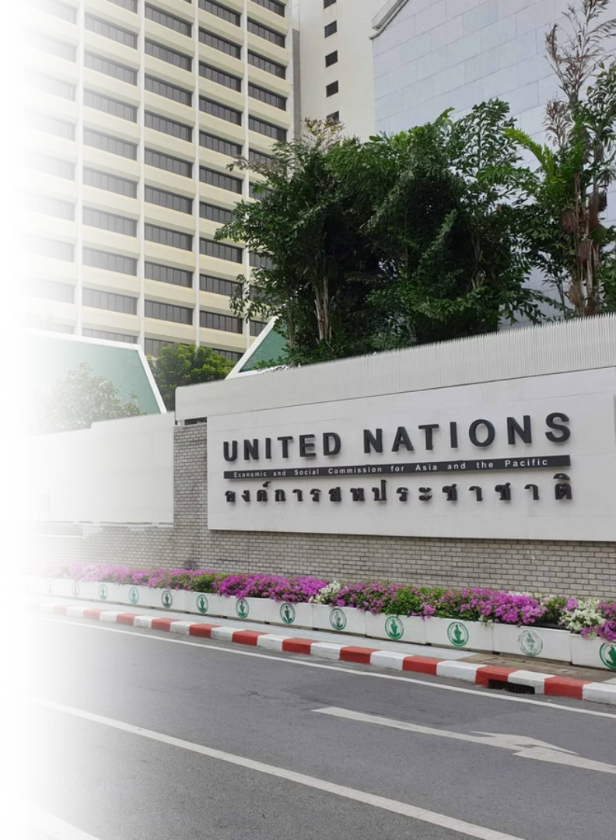


Thailand as the
"Geneva of Asia"
Home to Numerous UN and International Organizations
UN Agencies
International Organizations
Hosts several UN agencies, including the Economic and Social Commission for Asia and the Pacific (ESCAP) in Bangkok.
Over 30 international organizations, such as FAO, ICAO, UNAIDS, UNDP, UNESCO, UNHCR, UNICEF, and UNODC, operate in Thailand.
Notes:
12

Slide 26


Thailand as Host of
the 2026 Annual Meetings
Thailand is honored to host the 2026 IMF–World Bank Annual Meetings, reaffirming its commitment to multilateral cooperation and sustainable development.
The Meetings will take place from 12–18 October 2026 and mark Thailand’s second time hosting, following its first hosting in 1991.
The official logo
As a leading economy in Southeast Asia, Thailand provides a strategic platform for dialogue on global economic and financial issues.
Designed by Thai designer Paitoon Patisonticharoen, the logo is inspired by the Phoduang (ancient Thai bullet coin). The logo also symbolizes endless financial growth, global economic cooperation, and Thailand’s welcoming hospitality.
Photo Credit: www.am2026thailand.go.th
The official landmark located at Benjakitti Park
Notes:
12

Slide 27

International Campaigns /
Events in Thailand
1. Bangkok Music City 2026
  24–25 January 2026, Bangkok
  Thailand’s leading music conference and showcase festival, connecting Asian artists with global music industry opportunities in Bangkok’s Charoenkrung Creative District.
Photo Credit: Bangkok Music City
Notes:
12

Slide 28

International Campaigns /
Events in Thailand
2. Thailand International
Choral Festival 2026
  3–7 August 2026, Bangkok
  An international choir festival bringing together choirs from around the world through competitions, performances, masterclasses, and cultural exchange
Photo Credit: KMUTT
Notes:
12

Slide 29

International Campaigns /
Events in Thailand
3. International Horticultural
Expo 2026
  1 November 2026–14 March 2027, Udon Thani
  A major international expo under the theme “Diversity of Life,” highlighting nature, sustainability, local identity, and Thailand’s connection with the Mekong region.
Photo Credit: Udon Thani Expo
Notes:
12

Slide 30

International Campaigns /
Events in Thailand
4. Global Wellness Summit 2026
  10–13 November 2026, Angsana Laguna, Phuket, marking the summit’s 20th anniversary.
  Under the theme “The Science, Art and Soul of Wellness,” discussions will cover longevity and precision medicine, women’s health, wellness travel, neuroaesthetics, creativity, and spirituality.
  Highlights Thailand’s potential to combine traditional healing wisdom with preventive medicine and future health innovations.
Photo Credit: Global Wellness Summit
Notes:
12

Slide 31

International Campaigns /
Events in Thailand
5. Wonderfruit 2026
  3–7 December 2026, Chonburi
  A Thai-born international festival celebrating music, art, food, wellness, sustainability, and creative culture, with its first overseas chapter in Kyoto.
Photo Credit: The Standard
Notes:
12

Slide 32

International Campaigns /
Events in Thailand
6. Tomorrowland Thailand 2026
  11–13 December 2026, Chonburi
  The first full-scale Tomorrowland festival in Asia, highlighting Thailand as a global hub for music, creative tourism, and international events.
Photo Credit: Tourism Thailand
Notes:
12

Slide 33

International Campaigns /
Events in Thailand
7. Road to WorldPride 2030
  Thailand is launching a nationwide campaign to support its bid for WorldPride 2030, bringing together Pride events, local communities, and partners across the country.
  Through this campaign, Thailand showcases its openness, creativity, LGBTQIA+ inclusion, and readiness to welcome the world.
Photo Credit: Pride City Network Thailand
Notes:
12

