Slide 1
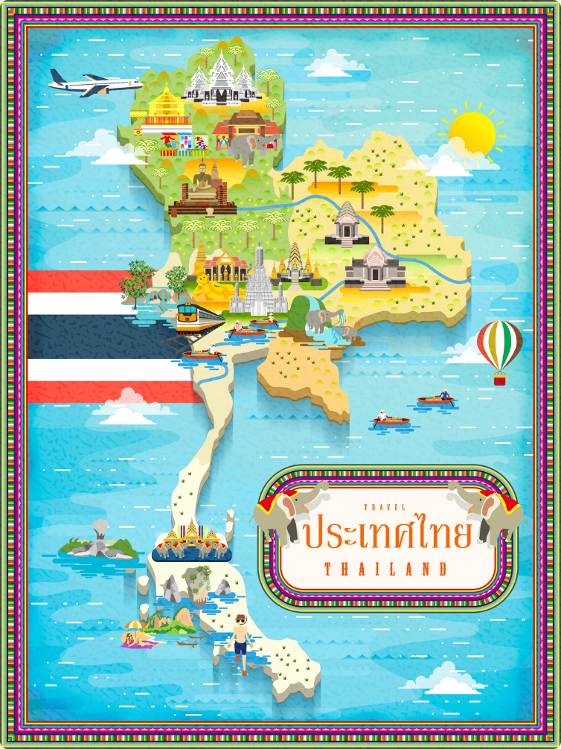
Geography of Thailand
Thailand, a country rich in natural beauty and cultural heritage, is located in the heart of Southeast Asia. This presentation will explore the geography, regions, connectivity, and major cities of Thailand, providing insights into its unique characteristics and global significance.

Slide 2
Thailand in Brief
"Thailand in Brief " has been prepared by the Thailand Foundation to support students, scholars, and the general public who wish to give presentations about Thailand to their audiences—for example, exchange program students and international participants.
The work presents some basic information about Thailand in 11 areas: 1) Geography, 2) History, 3) Politics and Government, 4) Economics, 5) Demographics, 6) Culture, 7) Values, 8) Thai People and Other Popularity That You May Know, 9) Misconceptions about Thailand, 10) Thailand's Role on the Global Stage, and 11) Rankings Related to Thailand.
"Thailand in Brief" is produced in both PDF file (.pdf) and Powerpoint Presentation (.pptx) formats, consisting of xx slides. Users may download and select the topics they wish to present, and may rearrange the sequence of the slides as appropriate. However, the content of this document cannot be edited. Reproduction or use for commercial purposes without permission from the Thailand Foundation is not allowed.
"Thailand in Brief" will be updated every third quarter each year. For inquiries or further suggestions, please contact the Thailand Foundation at info@thailandfoundation.or.th.
27 May 2025

Slide 3
Thailand in Brief
"Thailand in Brief " จัดทำขึ้นโดยมูลนิธิไทย (Thailand Foundation) เพื่ออำนวยความสะดวกแก่ นักเรียน นักศึกษา และผู้สนใจทั่วไป นำไปใช้ประโยชน์ อาทิ ในการบรรยาย หรือให้ความรู้เกี่ยวกับประเทศไทยในด้านต่าง ๆ แก่ชาวต่างประเทศ เช่น กรณีนักศึกษาแลกเปลี่ยนที่ไปเรียนในต่างประเทศที่ต้องนำเสนอเรื่องราวเกี่ยวกับประเทศไทยในสถาบันที่ไปศึกษาอยู่ เป็นต้น
งานชิ้นนี้เสนอข้อมูลเกี่ยวกับประเทศไทยโดยสังเขป 11 ด้าน ได้แก่ 1) ภูมิศาสตร์ (Geography) 2) ประวัติศาสตร์ (History) 3) การเมืองการปกครอง (Politics and Government) 4) เศรษฐกิจ (Economics) 5) ประชากร (Demographics) 6) วัฒนธรรม (Culture) 7) ค่านิยม (Values) 8) คนไทยและสื่อที่คุณอาจรู้จัก (Thai people and other popularity that you may know) 9) ความเข้าใจผิดเกี่ยวกับประเทศไทย (Misconceptions) 10) บทบาทของไทยในเวทีโลก (Thailand’s role on the Global Stage) และ 11) การจัดอันดับที่เกี่ยวกับประเทศไทย (Rankings related to Thailand)
"Thailand in Brief " นี้จัดทำเป็นสไลด์ จำนวน xx สไลด์ ในรูปแบบ .pdf และ .pptx สามารถดาวน์โหลดและเลือกใช้หัวข้อที่นำเสนอ และสลับลำดับการนำเสนอได้ตามความเหมาะสม อย่างไรก็ดี ผู้ใช้งานไม่สามารถดัดแปลงเนื้อหาในเอกสารได้ และห้ามผลิตซ้ำ หรือนำไปใช้เพื่อผลประโยชน์เชิงพาณิชย์โดยไม่ได้รับอนุญาตจากมูลนิธิไทย
"Thailand in Brief " จะได้รับการปรับปรุงให้ทันสมัยในทุกไตรมาสที่ 3 ของปี หากมีข้อสงสัยและข้อเสนอแนะเพิ่มเติม กรุณาติดต่อมูลนิธิไทย อีเมล info@thailandfoundation.or.th
27 พฤษภาคม 2568

Slide 4
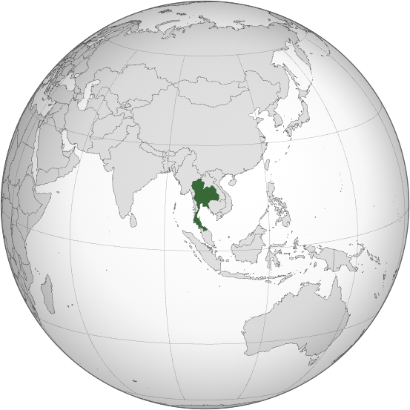
Where is Thailand in the World?
Photo credit: Zuanzuanfuwa

Slide 5
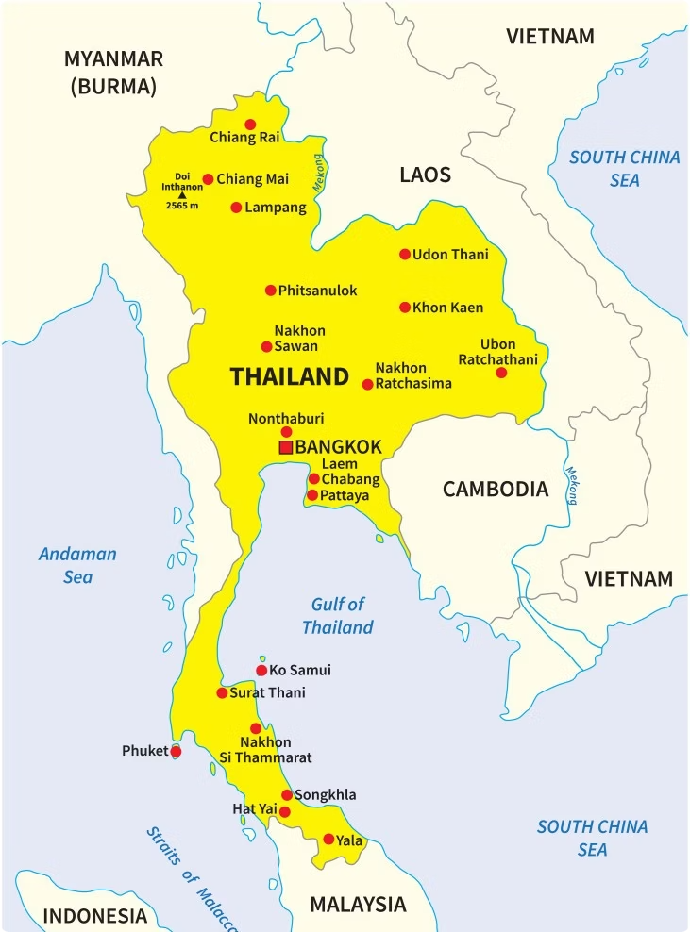
Where is Thailand? Who are Thailand's Neighbors?
Thailand is located in the middle of mainland Southeast Asia.
Bordering Countries
It is bordered by 4 countries: Myanmar to the northwest, Laos to the northeast, Cambodia to the southeast, and Malaysia to the south.
Coastal Access
The country has coastlines along the Andaman Sea to the west and the Gulf of Thailand to the east, providing access to significant maritime routes.
Photo credit: VectorStock

Slide 6
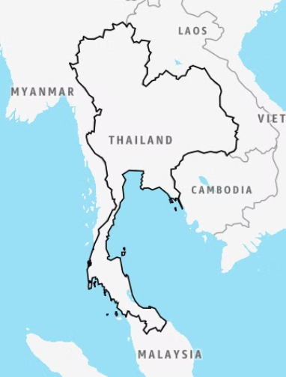
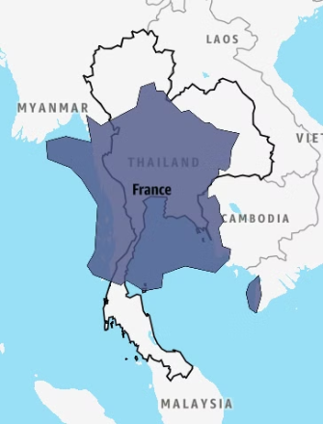
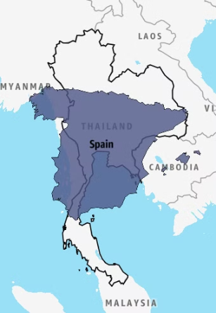
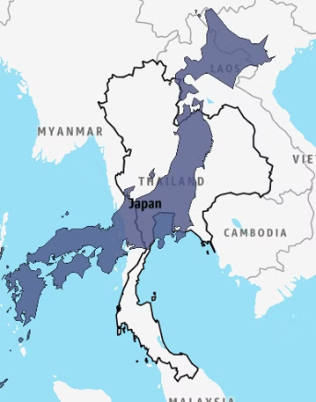
Thailand's Size Comparison
France
Spain
Japan
With 513,120 km²
543,940 km²
505,990 km²
377,975 km²
Thailand is the 53rd largest country in the world by total area.
Photo credit: Mylifeelsewhere

Slide 7
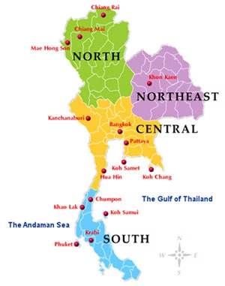
Four Regions of Thailand
Thailand is commonly divided into four regions*:
The North
The Northeast (Isan)
The Central
The South
*Using for administrative and statistical contexts
Photo credit: Thai Language Hut

Slide 8
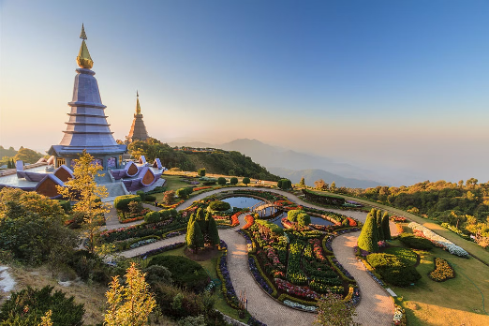
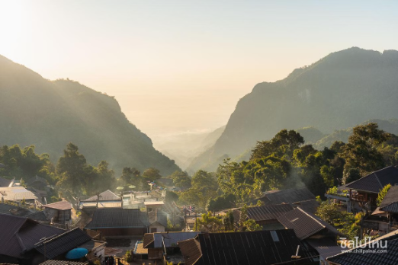
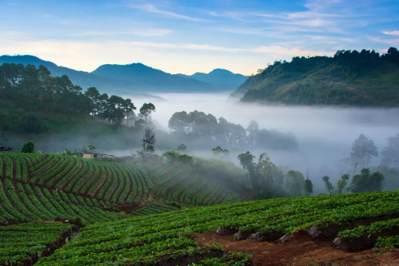
The North
Characterized by forested mountains and cooler climate
Doi Inthanon, Chiang Mai
Doi Pha Hee, Chiang Rai
Doi Ang Khang, Chiang Mai
Photo credit: Khun Kay, Chillpainai, Thai Rath

Slide 9
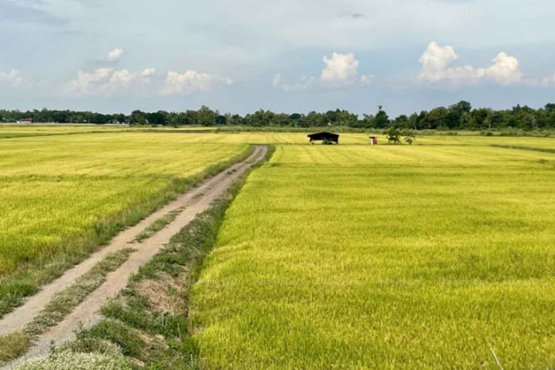
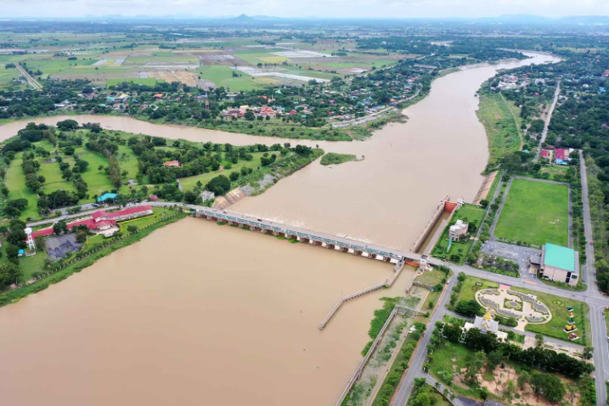
The Central
Known as the "Rice Bowl of Thailand," it features agricultural fields, rivers, and flood plains.
Rice fields in Ayutthaya
Chao Phraya Dam, Chai Nat
Photo credit: Bangkokpost

Slide 10
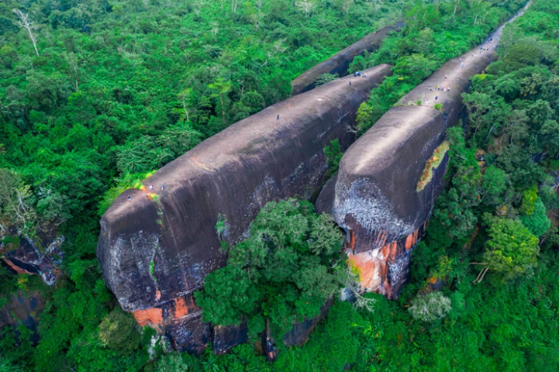
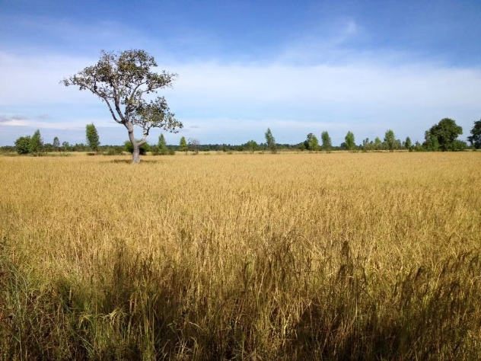
The Northeast
Also known as Isan, the Thai Northeast is a plateau with drier climate
Hin Sam Wan (Three Whale Rock), Bueng Kan
Thung Kula Ronghai, Roi Et
Photo credit: Kapook Travel, Silpa-mag

Slide 11
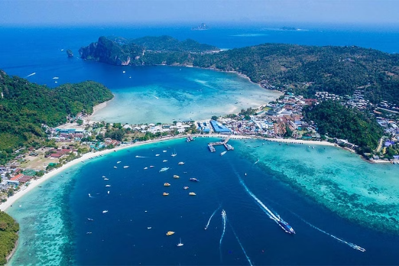
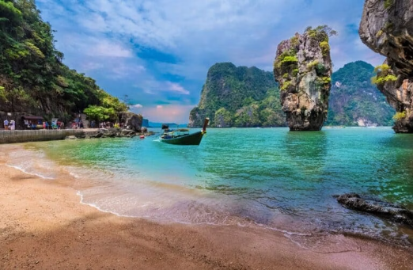
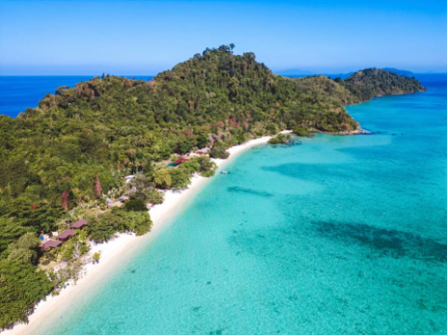
The South
Boasts tropical weather, beaches, islands, and coastlines
Koh Phi Phi, Krabi
Koh Ta Pu, Phang Nga
Koh Kradan, Trang
Photo credit: Asia King Travel, Thailand Tours, Krungthep Turakij

Slide 12
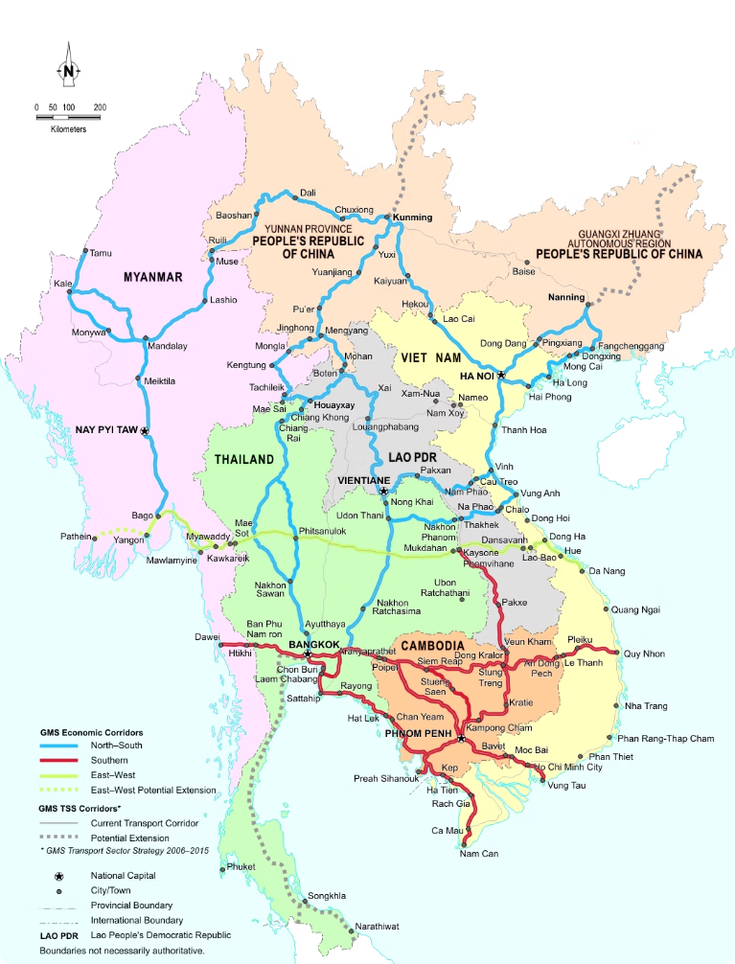
Thailand's Connectivity
Thailand's strategic location, combined with a robust transportation network, has established the country as a vital hub for regional and international connectivity.
Primary Highways
Through several major highways, Thailand is connected to its neighbors and regions beyond such as India and China.
Photo credit: greatermekong.org

Slide 13
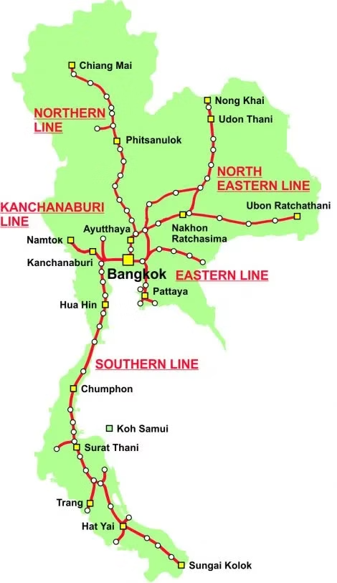
Railways
Thailand’s railway system spans over 4,800 km passing through a total of 47 of 76 provinces.
Its major railways link the country with international transportation routes, extending far and wide.
Photo credit: Thailand Trains

Slide 14
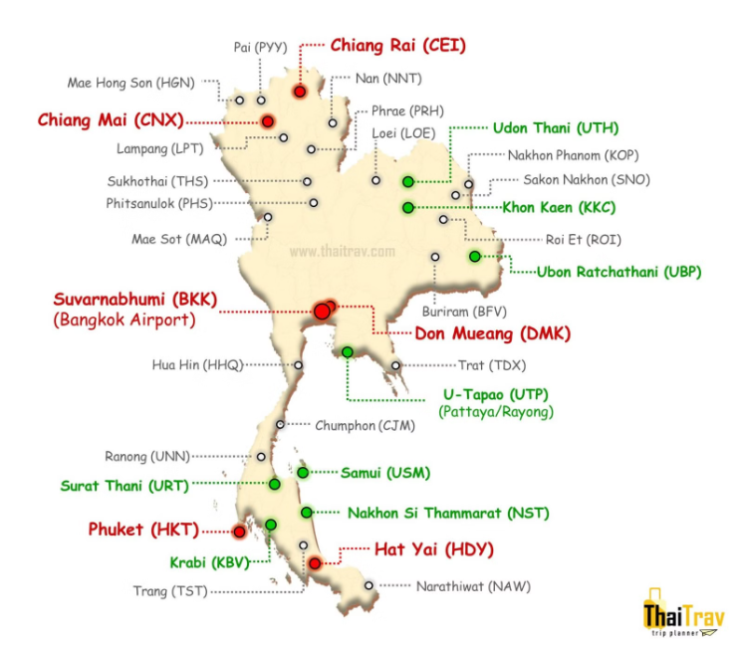
Airports in Thailand
There are approximately 33 airports all over the country.
Photo credit: ThaiTrav

Slide 15
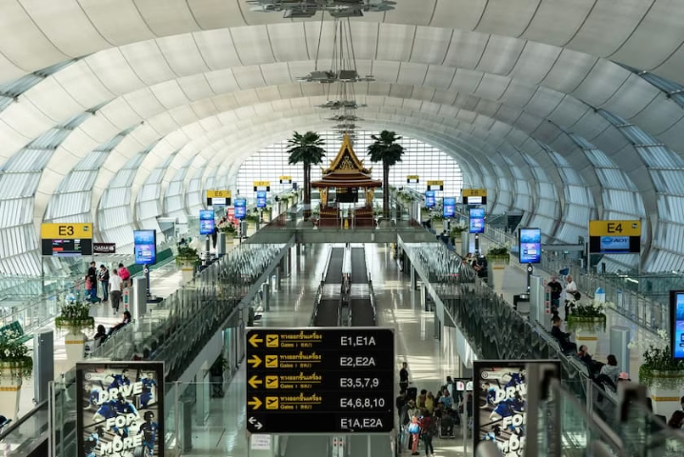
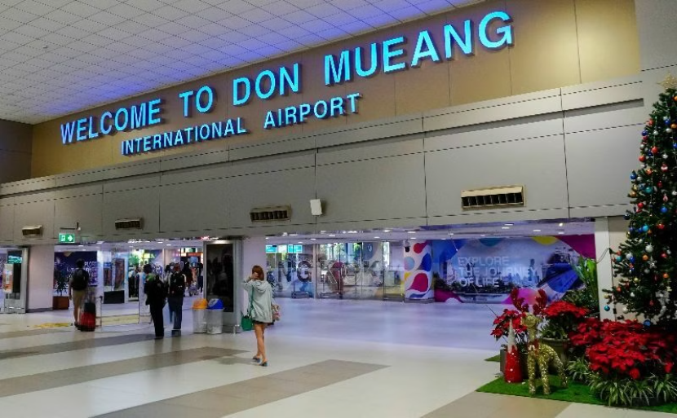
Major Airports in Thailand
Suvarnabhumi Airport (BKK)
Don Mueang Airport (DMK)
One of Southeast Asia's busiest aviation hubs, offering international flights to Europe, Asia, the Middle East, and beyond.
Caters to low-cost carriers and domestic flights.
Photo credit: Akyra Hotels, Thailand Awaits

Slide 16
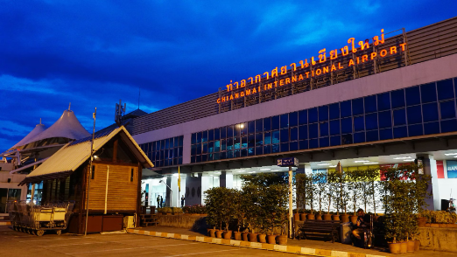
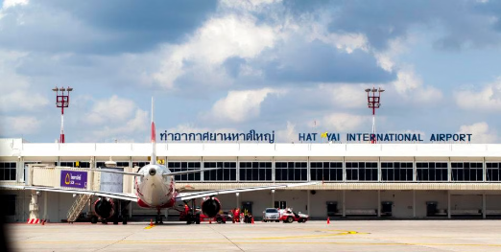
Secondary Airports in Thailand
and other airports include…
Chiang Rai International Airport (CEI)
Udon Thani International Airport (UTH)
Hat Yai International Airport (HDY)
Chiang Mai International Airport (CNX)
Phuket International Airport (HKT)
U-Tapao International Airport (UTP)
Photo credit: Airportthai, Sailing Click

Slide 17
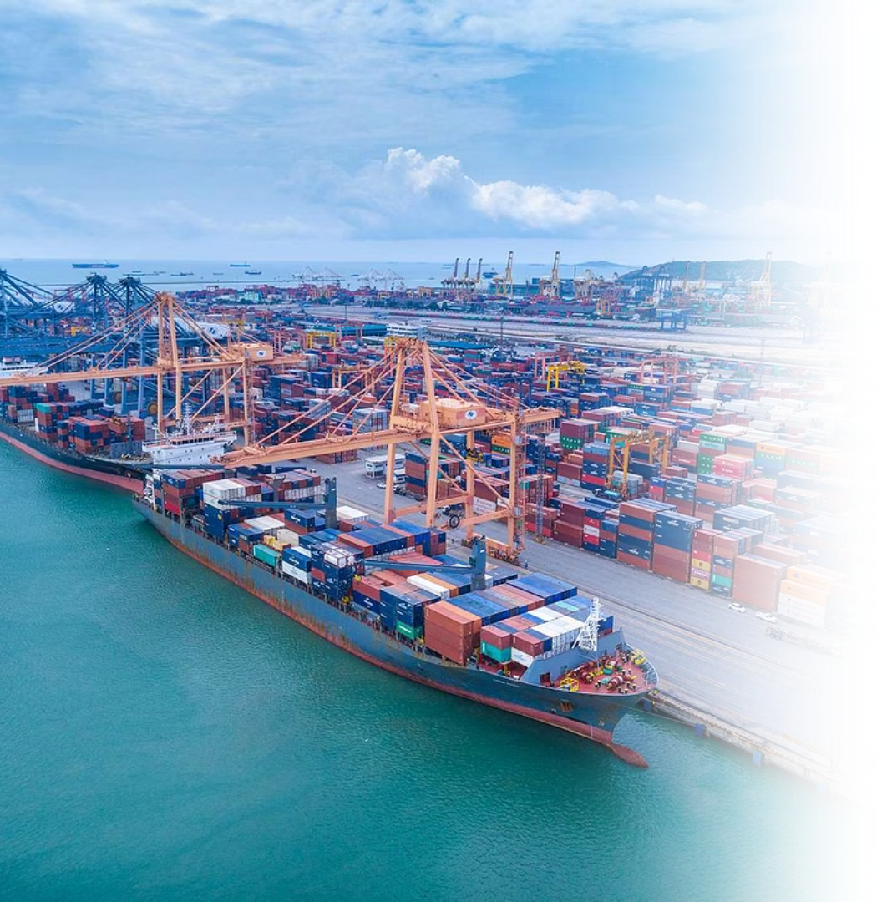
Seaports
Laem Chabang Port in Chonburi, is Thailand’s largest deep-sea port.
Map Ta Phut Industrial Port in Rayong, together with Laem Chabang Port, is part of the Eastern Economic Corridor (EEC).
Bangkok Port further supports the nation’s logistics and industrial sectors.
Pictured: Laem Chabang Port Photo credit: Hutchison Ports Thailand

Slide 18
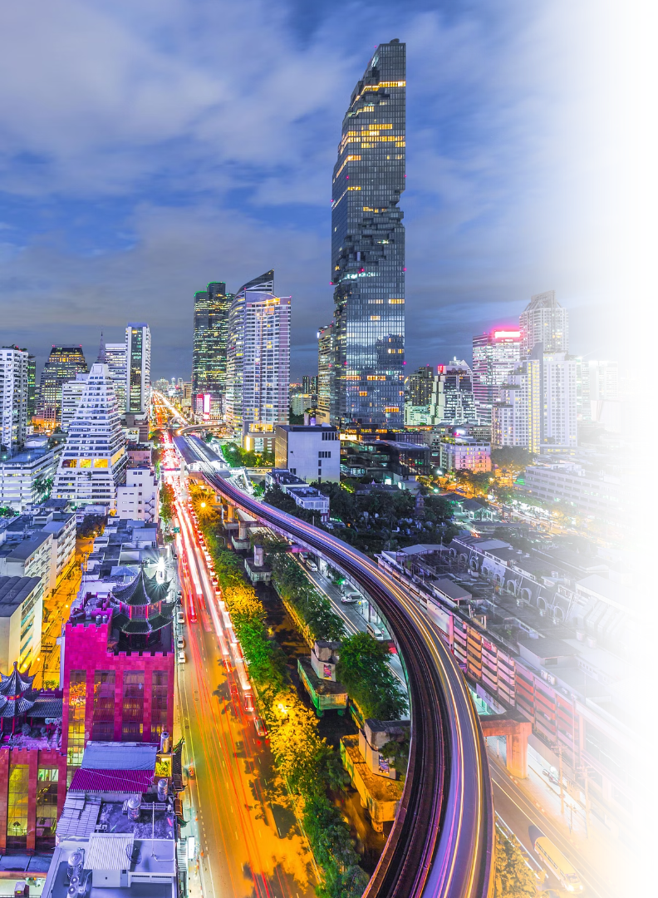
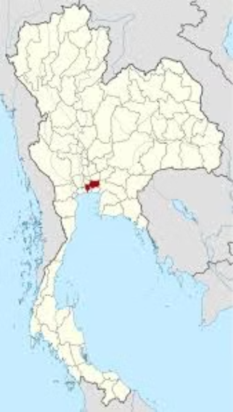
Thailand's Major Cities
Bangkok: The Capital City
Where is Bangkok?
Size and Population
1,568.737 km² in total area. Bangkok is the most populous city in Thailand with over 9 million total residents.
Photo credit: NordNordWest

Slide 19
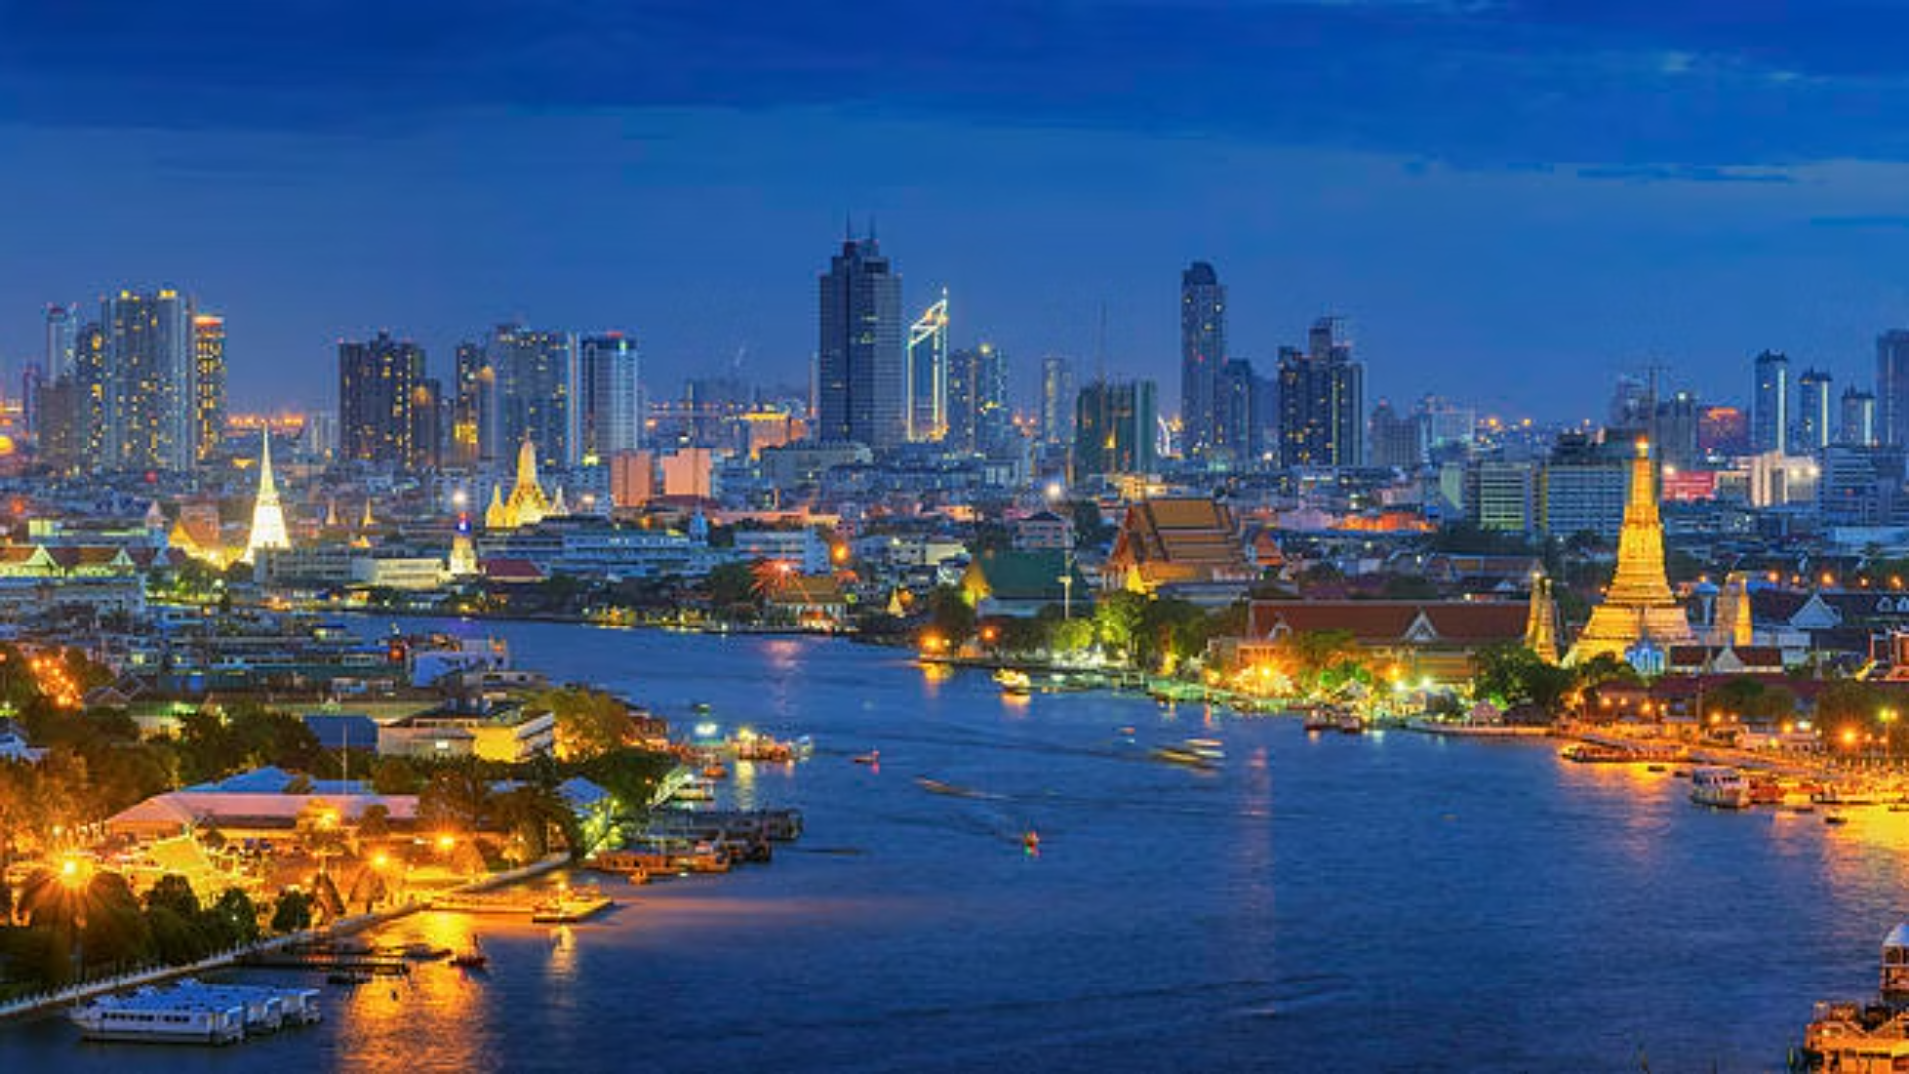
Bangkok: The Capital City
World's Longest City Name
Meaning
Krungthepmahanakhon Amonrattanakosin Mahintharayutthaya Mahadilokphop Noppharatratchathaniburirom Udomratchaniwetmahasathan Amonphimanawatansathit Sakkathattiyawitsanukamprasit
City of angels, great city of immortals, magnificent city of the nine gems, seat of the king, city of royal palaces, home of gods incarnate, erected by Vishvakarman at Indra's behest
Photo credit: Pixels

Slide 20
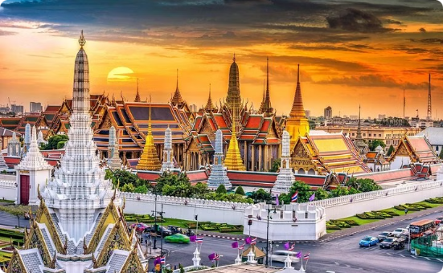
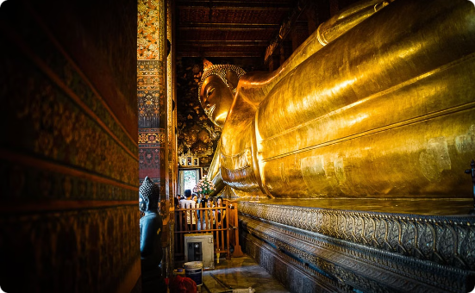
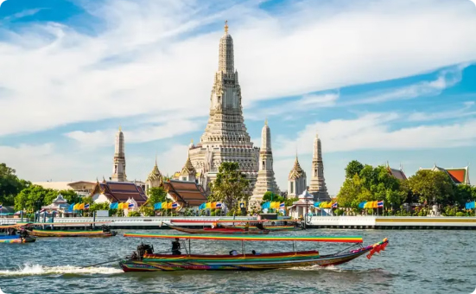
Bangkok's Historic Places
The Grand Palace Complex
Wat Pho
Wat Arun
The Grand Palace sits at the heart of Bangkok and has been the official residence of the monarchy since 1782. Located in the Grand Palace, Wat Phra Kaew is Thailand’s most sacred site housing the revered Emerald Buddha statue.
One of Bangkok’s oldest temples, Wat Pho is home to the massive Reclining Buddha statue and a center of traditional Thai massage.
Wat Arun, or the Temple of Dawn, stands as a stunning monument on the bank of Chao Phraya river serving as the first sign to travelers sailing from the Gulf of Thailand that they have arrived in Bangkok.
Photo credit: Sun Leisure World, Roasn, Tourism Authority of Thailand

Slide 21
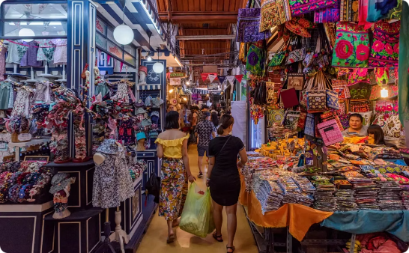
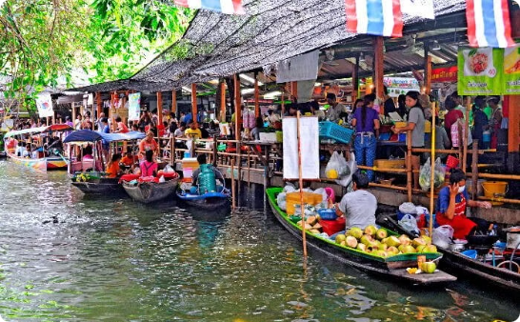
Bangkok's Shopping Destinations
Siam Shopping District
Chatuchak Market
Khlong Lat Mayom Floating Market
One of the top shopping destinations in the world, featuring Siam Paragon, Siam Center, Siam Discovery, Siam Square One, MBK Center, Central World, etc.
Thailand's biggest market with over 200,000 visitors every weekend. It offers diverse goods, selling anything from antiques, furniture, cosmetics, clothing to pets and plants.
A traditional Thai floating market experience in Bangkok, offering local foods and goods.
Photo credit: Siampiwat, Thairath, The Unusual Trip

Slide 22
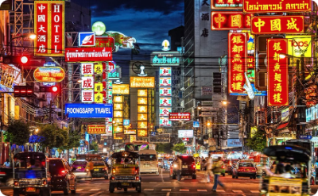
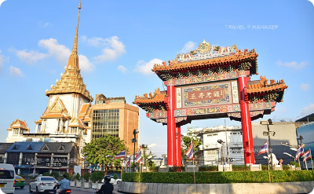
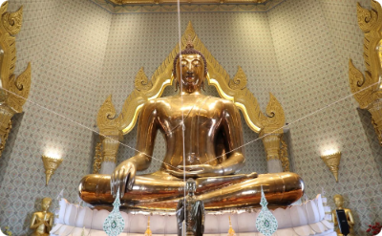
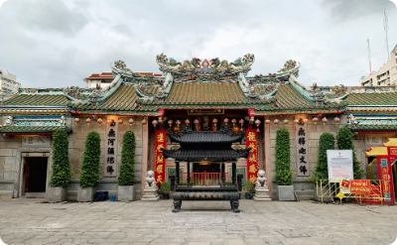
Chinatown (Yaowarat)
Yaowarat Road
Dragon Gate
The Golden Buddha at Wat Traimitr
Wat Leng Noei Yi
Photo credit: Bangkok Tuk Tuk Tour, HLP VirtualTour, Thaipost, Shutterstock

Slide 23
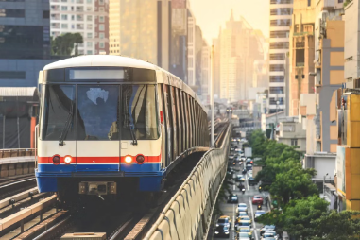
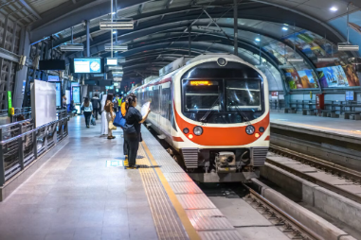
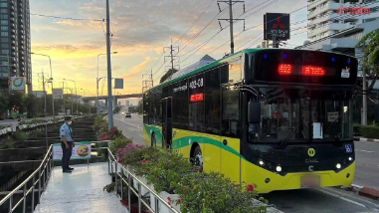
Bangkok's Mass Transit System
Buses and BRT
BTS Skytrain
MRT
Airport Rail Link (ARL)
Operated by the Bangkok Mass Transit Authority (BMTA) and private companies. BRT (Bus Rapid Transit) is a dedicated bus service operating along specific lanes to provide faster travel compared to regular buses.
An elevated rail system with two main lines—the Sukhumvit Line and the Silom Line—providing a convenient way to navigate the city's central areas.
The metro system that connects key districts and suburban areas.
An elevated rail connecting Suvarnabhumi Airport to the city center.
Photo credit: Sawasdee Thailand, TAT Newsroom, Atmind Group, Khaosod

Slide 24
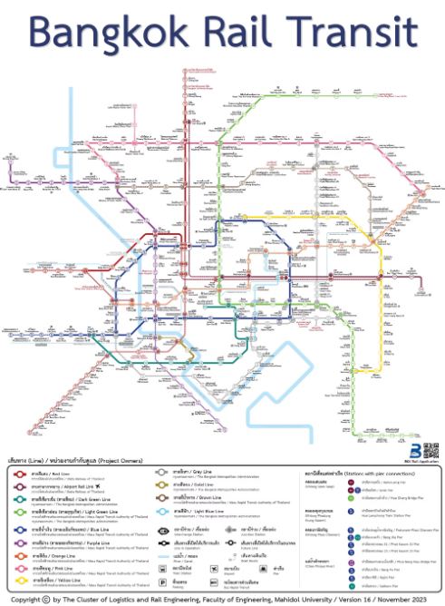
Bangkok's Mass Transit System
As of 2025, Bangkok’s rapid mass transportation network (BTS, MRT, ARL, BRT) covers a combined distance of nearly 250 kilometers, with ongoing expansions to accommodate the city's growing population and ease congestion.
Photo credit: Faculty of Engineering, Mahidol University

Slide 25
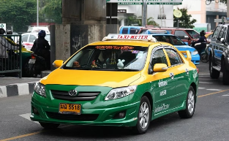
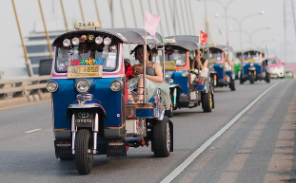
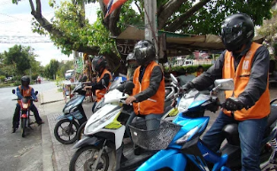
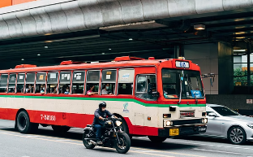
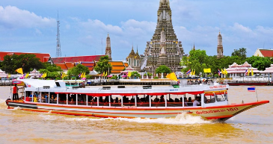
Bangkok's Mass Transit System
Other Transport
Taxis, Tuk-Tuks, Motorbike Taxis, Buses, and Boats and Ferries traversing the Chao Phraya River and canals within the city.
Photo credit: Bangkok Tuk Tuk Tour, Techsauce, Consumerthai, Thairath, Siamnews

Slide 26
Bangkok's Global Rankings
1st
1st
Ranked as the Top Tourism City in 2024 with around 32.4 million visitors. (Euromonitor International)
Ranked 1st globally for 'easy to get a visa'. (Brand Finance Global City Index 2024)
2nd
4th
Ranked as the 2nd best place in the world for digital nomads in 2023. (ETHRWorld)
The 4th most ‘affordable city’ for housing, education, and overall cost of living. (Brand Finance Global City Index 2024)

Slide 27
Bangkok's Global Rankings
6th
9th
Ranked as the 6th best food city in the world in 2024. (Time Out magazine)
The 9th most diverse and multicultural city in the world. (Brand Finance Global City Index 2024)
11th
13th
Ranked 11th top city in the area of economic activity in 2024. (Global Cities Index)
The 13th most open and welcoming city in the world. (Brand Finance Global City Index 2024)

Slide 28
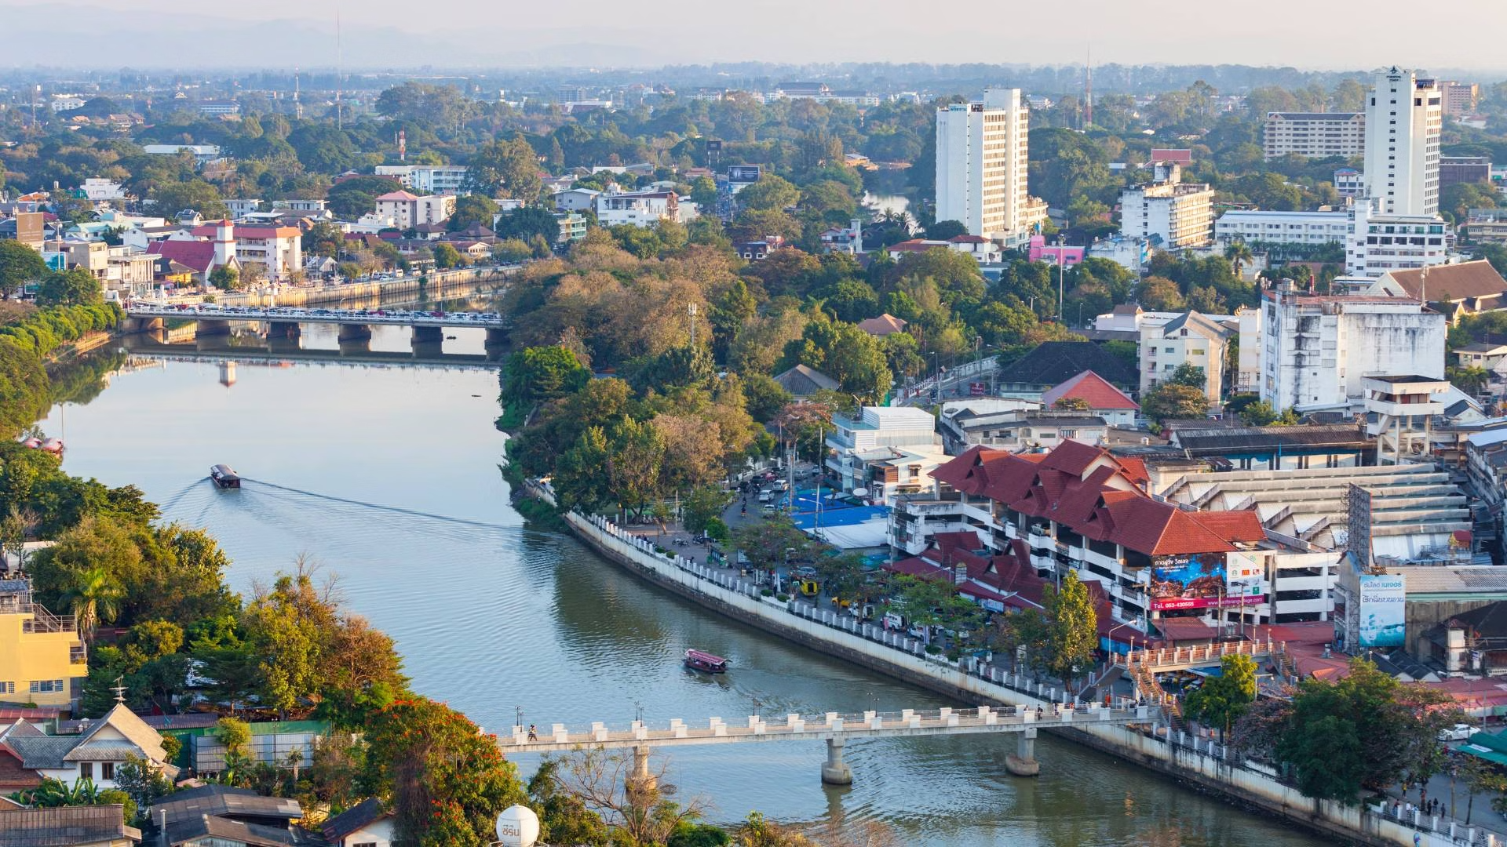
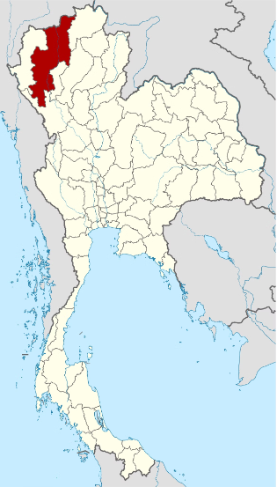
Chiang Mai
The second largest city in Thailand at 405 km², Chiang Mai has a population of over a million people.
Where is Chiang Mai province?
Located on Thai Highlands and surrounded by mountains and forests, making it a hub for outdoor activities.
It is home to Chiang Mai University, the leading academic institution of the Northern region.
Photo credit: Agoda, NordNordWest

Slide 29
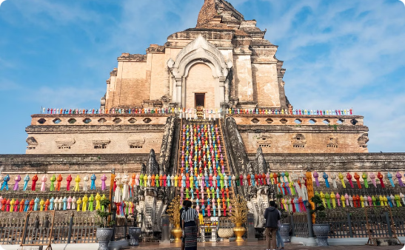
Landmarks in Chiang Mai
Wat Chedi Luang
Doi Suthep
Tha Phae Gate
A historic temple known for its massive Lanna-style chedi (pagoda), which once housed the revered Emerald Buddha.
A doi (mountain) overlooking Chiang Mai, it hosts a sacred temple with a golden pagoda and panoramic views of the city. The site is a major pilgrimage destination in Thailand.
A historic gateway to Chiang Mai’s Old City, it is a well-preserved remnant of the ancient city walls. The gate serves as a cultural hub, hosting festivals and a lively night market.
Photo credit: Flickr, Silpa-mag, ForeverVacation

Slide 30
Pattaya City
Pattaya is a vibrant coastal city located in the Chonburi province, famous for its lively beaches, nearby islands such as Koh Larn, entertainment, and nightlife. Once a small fishing village, Pattaya has grown into a major tourist destination.
Where is Chonburi province?
Size and Population
53.4 km² in area. With 120,000 population
Photo credit: Thailand Awaits, NordNordWest

Slide 31
Landmarks in Pattaya City
Beaches
Sanctuary of Truth
Nong Nooch Tropical Garden
Tiffany's Show
Pattaya beach, Jomtien beach
A intricately carved wooden temple
A famous transgender cabaret known for its spectacular costumes and choreography
The largest botanical garden in Southeast Asia
Photo credit: Withlocals, Atmind Group, Viator

Slide 32
Ayutthaya
Ayutthaya, a UNESCO World Heritage Site, was the former capital of the Kingdom of Siam and remains one of Thailand’s most historically significant cities.
Where is Ayutthaya province?
Founded in 1350, it flourished as a cosmopolitan trade and cultural hub. Today, the Ayutthaya Historical Park showcases the city's grandeur, which includes Wat Mahathat, famous for the Buddha head in tree roots, and Wat Phra Si Sanphet, the former royal temple.
With its rich history and well-preserved ruins, Ayutthaya offers a captivating journey into Thailand’s past.
Photo credit: NordNordWest

Slide 33
Landmarks in Ayutthaya
Wat Mahathat
Buddha Head in Tree Roots
Wat Phra Si Sanphet
Ayutthaya Floating Market
Photo credit: Quizlet, iStock, Tripadvisor

Slide 34
Nakhon Ratchasima
Nakhon Ratchasima, commonly known as Korat, is the third largest city in Thailand.
Where is Nakhon Ratchasima province?
It serves as a gateway to the Isan region and is known for its rich history, cultural landmarks, and modern urban development.
Photo credit: Asia King Travel, NordNordWest

Slide 35
Landmarks in Nakhon Ratchasima
Thao Suranaree Monument
Phimai Historical Park
Dedicated to the revered local heroine, Thao Suranaree (Ya Mo), who played a role in defending the city from invaders in the 19th century.
Home to Thailand’s largest sandstone temple complex. Built in the 11th century, the site features intricate Khmer architecture, reflecting Thailand's historical connections with ancient Khmer civilization.
Photo credit: Unseentourthailand, Virtual Historical Park

Slide 36
Khon Kaen
The Isan region's center for education and commerce, Khon Kaen is one of the 'Big Four' of Isan, which also includes Nakhon Ratchasima, Udon Thani, and Ubon Ratchathani.
Where is Khon Kaen province?
It is home to Khon Kaen University, the region’s leading academic institution. The province is known for its rich silk-weaving tradition and landmarks like Wat Nong Wang, with its towering pagoda overlooking Kaen Nakhon Lake. Nature lovers can explore Phu Pha Man National Park, famous for its limestone mountains, caves, and diverse wildlife.
Photo credit: Asia King Travel, NordNordWest

Slide 37
Landmarks in Khon Kaen
Khon Kaen University
Wat Nong Waeng
Phu Pha Man National Park
The leading academic institution of Isan, it is a hub for research, innovation, and higher education. Established in 1964, it plays a key role in regional development.
A revered temple featuring a 9-story pagoda that enshrines the Buddha’s holy relics. Each floor showcases intricate carvings while the top level offers a panoramic view of the city
A limestone mountain range, known for its cliff resembling a giant curtain. The park features evergreen forests, a cool climate year-round, caves, and waterfalls for nature lovers to explore.
Photo credit: Khon Kaen University, Thaipost, Roijang

Slide 38
Udon Thani
Udon Thani is known for its historical significance and natural beauty. It is home to Ban Chiang Archaeological Site, a UNESCO World Heritage site, and Talay Bua Daeng (Red Lotus Sea), a stunning seasonal lake covered in blooming pink water lilies.
Where is Udon Thani province?
Serving as a key economic and transportation hub, the province is easily accessible via Udon Thani International Airport, connecting it to major domestic and international destinations.
Photo credit: MGR Online, NordNordWest

Slide 39
Landmarks in Udon Thani
Ban Chiang National Museum
Phu Phra Bat Historical Park
Talay Bua Daeng
This UNESCO World Heritage Site is one of Southeast Asia’s oldest Bronze Age archaeological sites. Famous for pottery, ancient tools, and burial sites, it offers insight into early human settlements.
Home to the prehistoric archaeological site featuring ancient cave paintings, religious shrines, and rock formations shaped by nature over thousands of years.
The Red Lotus Sea is a seasonal lake in Udon Thani, famous for its breathtaking pink water lilies that bloom from December to February.
Photo credit: The Cloud, CBT Thailand, Agoda

Slide 40
Ubon Ratchathani
One of the major provinces in the Isan region, known for its Buddhist heritage, natural beauty, and cultural festivals.
Where is Ubon Ratchathani province?
Located near the Lao and Cambodian borders, the province is famous for its annual Candle Festival and features numerous beautiful and historically significant temples.
Photo credit: Nopparat Thnatawan, NordNordWest

Slide 41
Landmarks in Ubon Ratchathani
Candle Festival
Wat Nong Pa Phong
Urban Area
Featuring elaborate wax sculptures, the festival marks the start of Buddhist Lent in July.
A prominent forest monastery founded by the venerable Ajahn Chah. It is a center for meditation and monastic training, attracting practitioners from around the world.
Ubon Ratchathani city blends modern urban development with traditional Thai culture.
Photo credit: Thailand NOW, CBT Thailand, Ubon Ratchathani Municipality

Slide 42
Nong Khai
Nong Khai, a scenic province in northeastern Thailand, sits along the Mekong River, serving as a gateway to Laos via the Thai-Lao Friendship Bridge.
Where is Nong Khai province?
With its blend of history and Mekong River charm, Nong Khai offers a fascinating glimpse into Thailand’s north Isan culture.
Photo credit: Paikanmayang, NordNordWest

Slide 43
Landmarks in Nong Khai
Sala Kaew Ku
Thai-Lao Friendship Bridge
A unique sculpture park featuring large concrete statues inspired by Buddhism and Hinduism
An important landmark connecting Thailand and Laos across the Mekong River
Photo credit: Diwerent, Jim Holmes/AusAID

Slide 44
Phuket
Thailand’s largest island, Phuket is a world-renowned tourist destination. Surrounded by the Andaman Sea, it offers crystal-clear waters, numerous luxury resorts, and famous spots.
Where is Phuket province?
Photo credit: JFTB Real Estate Phuket, NordNordWest

Slide 45
Landmarks in Phuket
Beaches
Old Phuket Town
Luxury Tourism
Beaches such as Patong Beach and Karon Beach are famous for pristine white sand and clear waters.
Features Sino-Portuguese architecture and rich cultural heritage.
Home to high-end resorts and a popular destination for yachts.
Photo credit: Phuket Elephant Nature Reserve, Global Galivanting, World's Best Luxury Hotels

Slide 46
Krabi
Another province on the Andaman Sea coast, Krabi is well-known for its stunning limestone cliffs, clear turquoise waters, and magnificent beaches.
Where is Krabi province?
Photo credit: Magzter, NordNordWest

Slide 47
Krabi
Koh Phi Phi
Ao Nang
A group of islands known for their stunning beauty, clear waters, and limestone cliffs. Popular for snorkeling, diving, and beach activities.
A central beach town in Krabi, serving as a starting point for island tours and offering a variety of accommodations and restaurants.
Photo credit: Asia King Travel, Zonezi Properties

Slide 48
Songkhla
A coastal province on the Gulf of Thailand, it is a key southern cultural and economic hub with a unique blend of Thai, Chinese, and Malay influences.
Where is Songkhla province?
As a major port city, it plays a vital role in trade and tourism, offering a rich mix of history, culture, and scenic coastal landscapes.
Photo credit: Adobe Stock, Suphanut Arunprayote

Slide 49
Songkhla
Samila Beach
Hat Yai
A beautiful beach known for its mermaid statue and clear waters.
The largest city in the Thai South, known for its markets and diverse culture.
Photo credit: Traveloka, Suphanut Arunprayote

