Slide 1


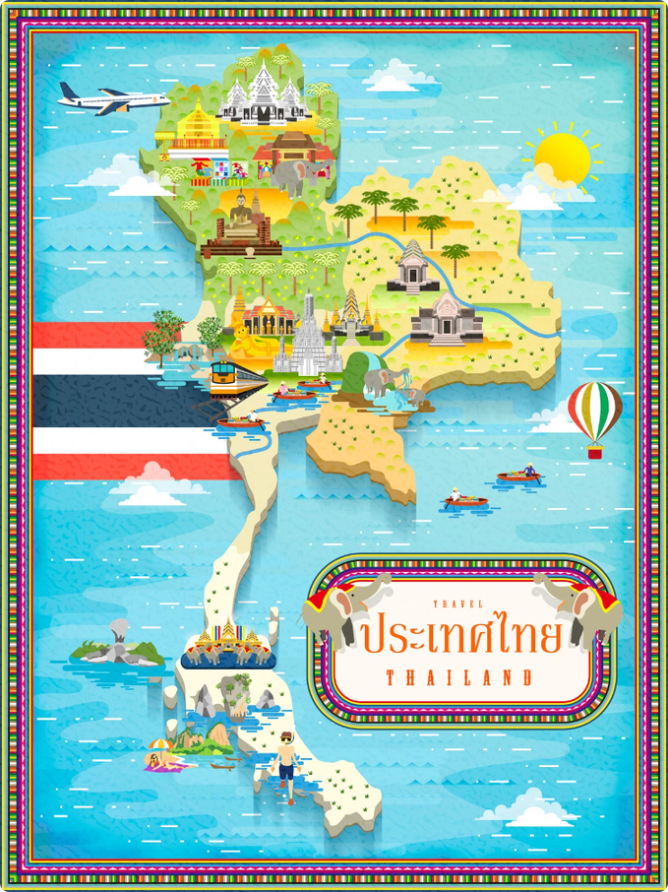
Geography of Thailand
Thailand, a country rich in natural beauty and cultural heritage, is located in the heart of Southeast Asia. This presentation will explore the geography, regions, connectivity, and major cities of Thailand, providing insights into its unique characteristics and global significance.
Notes:
1

Slide 2
Thailand in Brief
"Thailand in Brief " has been prepared by the Thailand Foundation to support students, scholars, and the general public who wish to give presentations about Thailand to their audiences—for example, exchange program students and international participants.
The work presents some basic information about Thailand in 11 areas: 1) Geography, 2) History, 3) Politics and Government,
4) Economics, 5) Demographics, 6) Culture, 7) Values, 8) Thai People and Other Popularity That You May Know,
9) Misconceptions about Thailand, 10) Thailand's Role on the Global Stage, and 11) Rankings Related to Thailand.
"Thailand in Brief" is produced in both PDF file (.pdf) and Powerpoint Presentation (.pptx) formats, consisting of 394 slides. Users may download and select the topics they wish to present, and may rearrange the sequence of the slides as appropriate. However, the content of this document cannot be edited. Reproduction or use for commercial purposes without permission from the Thailand Foundation is not allowed.
"Thailand in Brief" will be updated every third quarter each year. For inquiries or further suggestions, please contact the Thailand Foundation at info@thailandfoundation.or.th.
22 July 2026
Notes:
2

Slide 3
Thailand in Brief
"Thailand in Brief " จัดทำขึ้นโดยมูลนิธิไทย (Thailand Foundation) เพื่ออำนวยความสะดวกแก่ นักเรียน นักศึกษา และผู้สนใจทั่วไป นำไปใช้ประโยชน์ อาทิ ในการบรรยาย หรือให้ความรู้เกี่ยวกับประเทศไทยในด้านต่าง ๆ แก่ชาวต่างประเทศ เช่น กรณีนักศึกษาแลกเปลี่ยนที่ไปเรียนในต่างประเทศที่ต้องนำเสนอเรื่องราวเกี่ยวกับประเทศไทยในสถาบันที่ไปศึกษาอยู่ เป็นต้น
งานชิ้นนี้เสนอข้อมูลเกี่ยวกับประเทศไทยโดยสังเขป 11 ด้าน ได้แก่ 1) ภูมิศาสตร์ (Geography) 2) ประวัติศาสตร์ (History) 3) การเมืองการปกครอง (Politics and Government) 4) เศรษฐกิจ (Economics) 5) ประชากร (Demographics) 6) วัฒนธรรม (Culture) 7) ค่านิยม (Values) 8) คนไทยและสื่อที่คุณอาจรู้จัก (Thai people and other popularity that you may know) 9) ความเข้าใจผิดเกี่ยวกับประเทศไทย (Misconceptions) 10) บทบาทของไทยในเวทีโลก (Thailand’s role on the Global Stage) และ 11) การจัดอันดับที่เกี่ยวกับประเทศไทย (Rankings related to Thailand)
"Thailand in Brief " นี้จัดทำเป็นสไลด์ จำนวน 394 สไลด์ ในรูปแบบ .pdf และ .pptx สามารถดาวน์โหลดและเลือกใช้หัวข้อที่นำเสนอ และสลับลำดับ การนำเสนอได้ตามความเหมาะสม อย่างไรก็ดี ผู้ใช้งานไม่สามารถดัดแปลงเนื้อหาในเอกสารได้ และห้ามผลิตซ้ำ หรือนำไปใช้เพื่อผลประโยชน์เชิงพาณิชย์โดย ไม่ได้รับอนุญาตจากมูลนิธิไทย
"Thailand in Brief " จะได้รับการปรับปรุงให้ทันสมัยในทุกไตรมาสที่ 3 ของปี หากมีข้อสงสัยและข้อเสนอแนะเพิ่มเติม กรุณาติดต่อมูลนิธิไทย
อีเมล info@thailandfoundation.or.th
22 กรกฎาคม 2569
Notes:
3

Slide 4
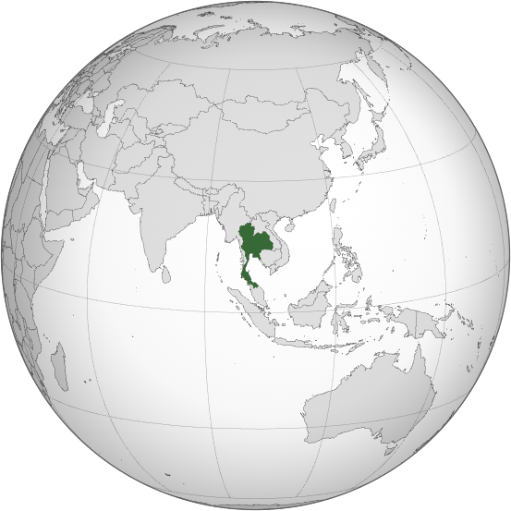
Where is Thailand in the World?
Photo credit: Zuanzuanfuwa
Notes:
4

Slide 5

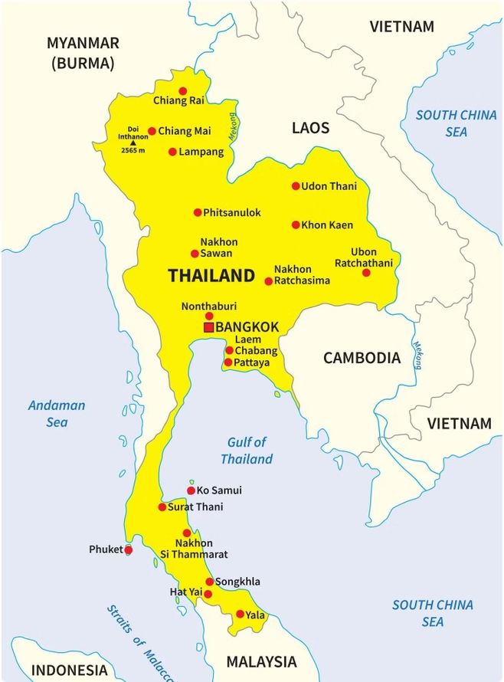
Where is Thailand? Who are Thailand's Neighbors?
Thailand is located in the middle of mainland Southeast Asia.
Bordering Countries
It is bordered by 4 countries: Myanmar to the northwest, Laos to the northeast, Cambodia to the southeast, and Malaysia to the south.
Coastal Access
The country has coastlines along the Andaman Sea to the west and the Gulf of Thailand to the east, providing access to significant maritime routes.
Photo credit: VectorStock
Notes:
5

Slide 6
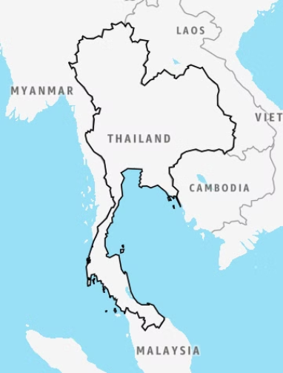
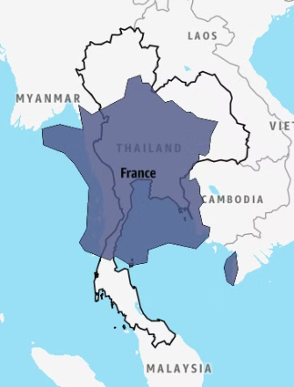
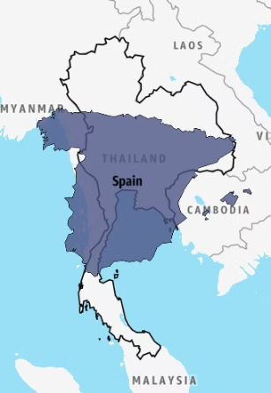
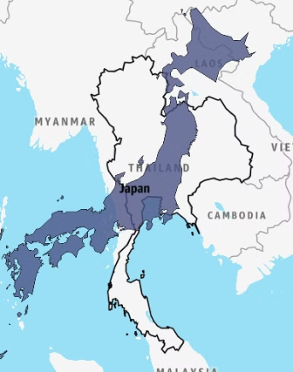
Thailand's Size Comparison
France
Spain
Japan
With 513,120 km²
543,940 km²
505,990 km²
377,975 km²
Thailand is the 50th largest country in the world by total area and
the 3rd largest country in Southeast Asia.
Photo credit: Mylifeelsewhere
Notes:
6

Slide 7

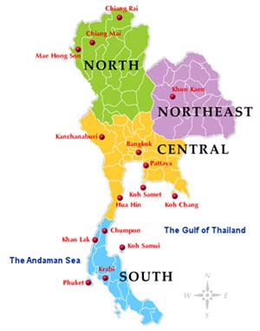
Four Regions of Thailand
Thailand is commonly divided into four regions*:
  The North
  The Northeast (Isan)
  The Central
  The South
*Using for administrative and statistical contexts
Photo credit: Thai Language Hut
Notes:
7

Slide 8
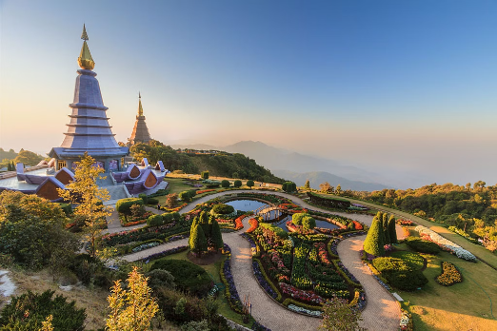
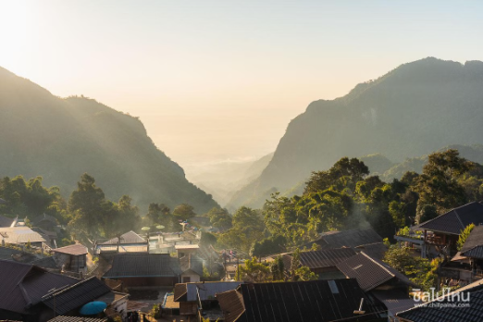
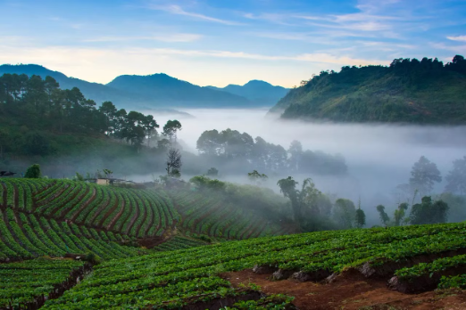
The North
Characterized by forested mountains and cooler climate
Doi Inthanon, Chiang Mai
Doi Pha Hee, Chiang Rai
Doi Ang Khang, Chiang Mai
Photo credit: Khun Kay, Chillpainai, Thai Rath
Notes:
8

Slide 9
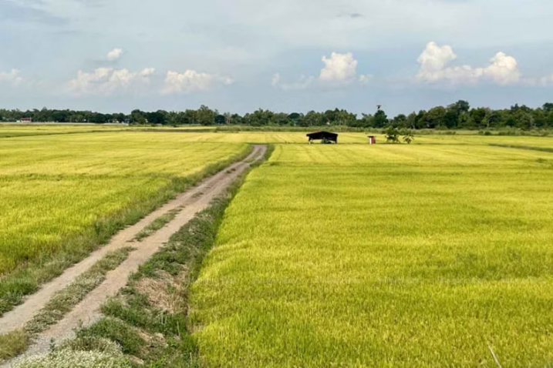
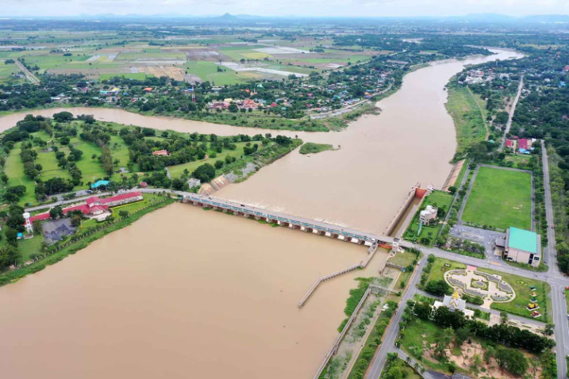
The Central
Known as the "Rice Bowl of Thailand," it features agricultural fields, rivers, and flood plains.
Rice fields in Ayutthaya
Chao Phraya Dam, Chai Nat
Photo credit: Bangkokpost
Notes:
9

Slide 10
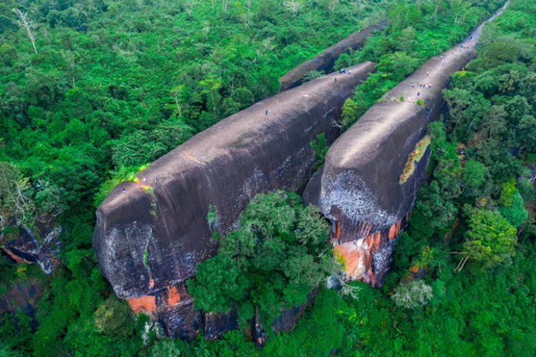
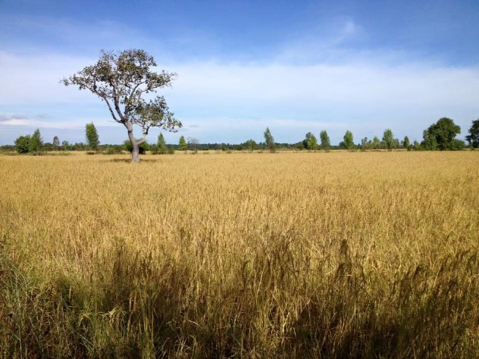
The Northeast
Also known as Isan, the Thai Northeast is a plateau with drier climate
Hin Sam Wan (Three Whale Rock), Bueng Kan
Thung Kula Ronghai, Roi Et
Photo credit: Kapook Travel, Silpa-mag
Notes:
10

Slide 11
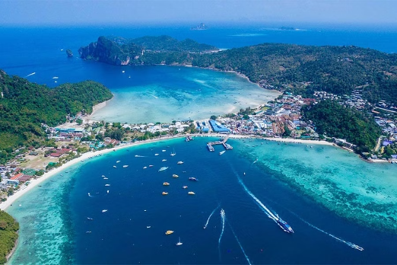
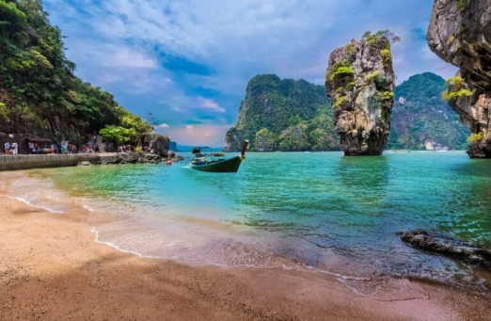
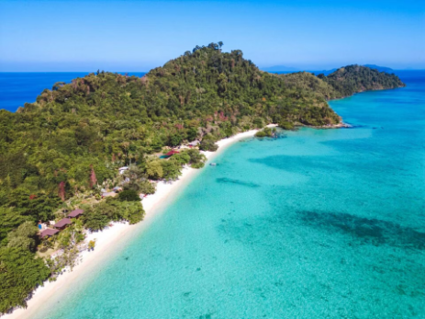
The South
Boasts tropical weather, beaches, islands, and coastlines
Koh Phi Phi, Krabi
Koh Ta Pu, Phang Nga
Koh Kradan, Trang
Photo credit: Asia King Travel, Thailand Tours, Krungthep Turakij
Notes:
11

Slide 12
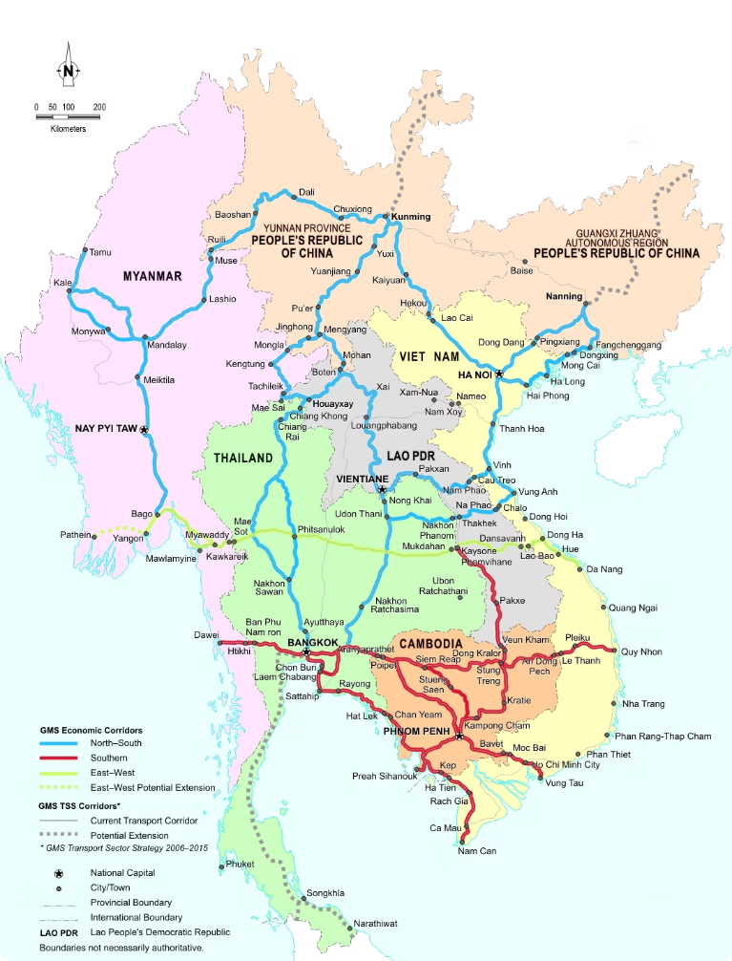
Thailand's Connectivity
Thailand's strategic location, combined with a robust transportation network, has established the country as a vital hub for regional and international connectivity.
Primary Highways
Through several major highways, Thailand is connected to its neighbors and regions beyond such as India and China.
Photo credit: greatermekong.org
Notes:
12

Slide 13

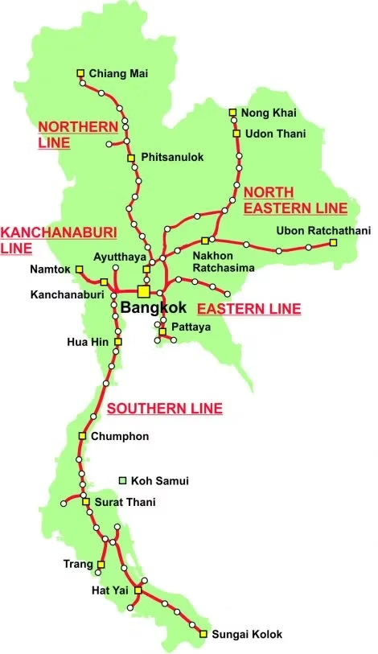
Railways
  Thailand’s railway system spans over 4,800 km passing through a total of 47 of 77 provinces.
  Its major railways link the country with international transportation routes, extending far and wide.
Photo credit: Thailand Trains
Notes:
13

Slide 14
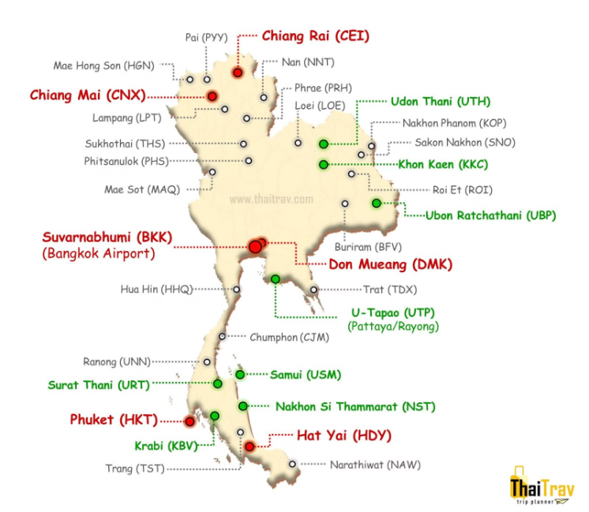
Airports in Thailand
There are approximately
33 airports all over the country.
Photo credit: ThaiTrav
Notes:
14

Slide 15
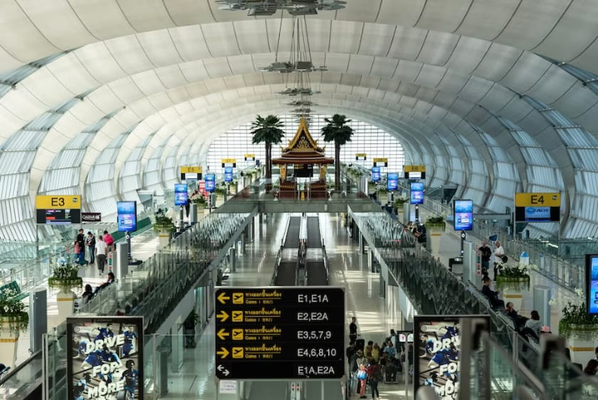
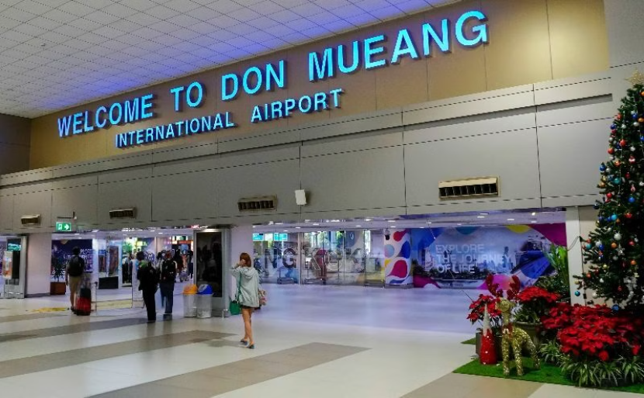
Major Airports in Thailand
Suvarnabhumi Airport (BKK)
Don Mueang Airport (DMK)
One of Southeast Asia's busiest aviation hubs, offering international flights to Europe, Asia, the Middle East,
and beyond.
Caters to low-cost carriers and domestic flights.
Photo credit: Akyra Hotels, Thailand Awaits
Notes:
15

Slide 16
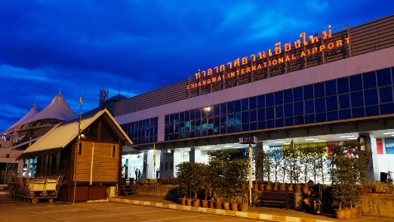
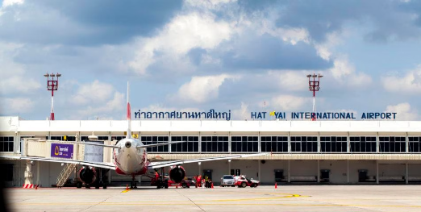
Secondary Airports in Thailand
and other airports include…
Chiang Rai International Airport (CEI)
Udon Thani International Airport (UTH)
Phuket International Airport (HKT)
Chiang Mai International Airport (CNX)
Hat Yai International Airport (HDY)
U-Tapao International Airport (UTP)
Photo credit: Airportthai, Sailing Click
Notes:
16

Slide 17
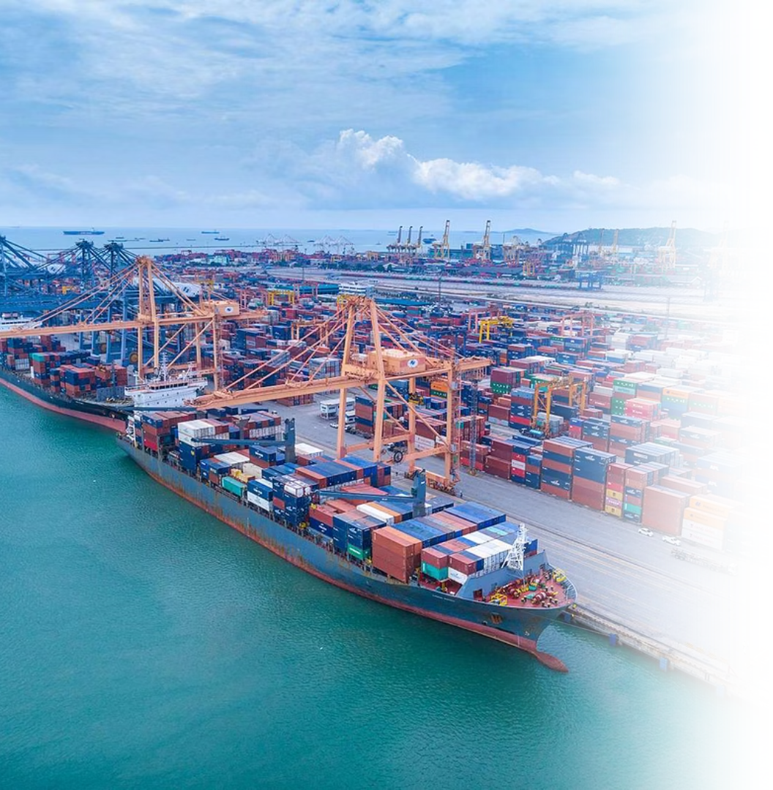
Seaports
  Laem Chabang Port in Chonburi, is Thailand’s largest deep-sea port.
  Map Ta Phut Industrial Port in Rayong, together with Laem Chabang Port, is part of the Eastern Economic Corridor (EEC).
  Bangkok Port further supports the nation’s logistics and industrial sectors.
Pictured: Laem Chabang Port
Photo credit: Hutchison Ports Thailand
Notes:
17

Slide 18
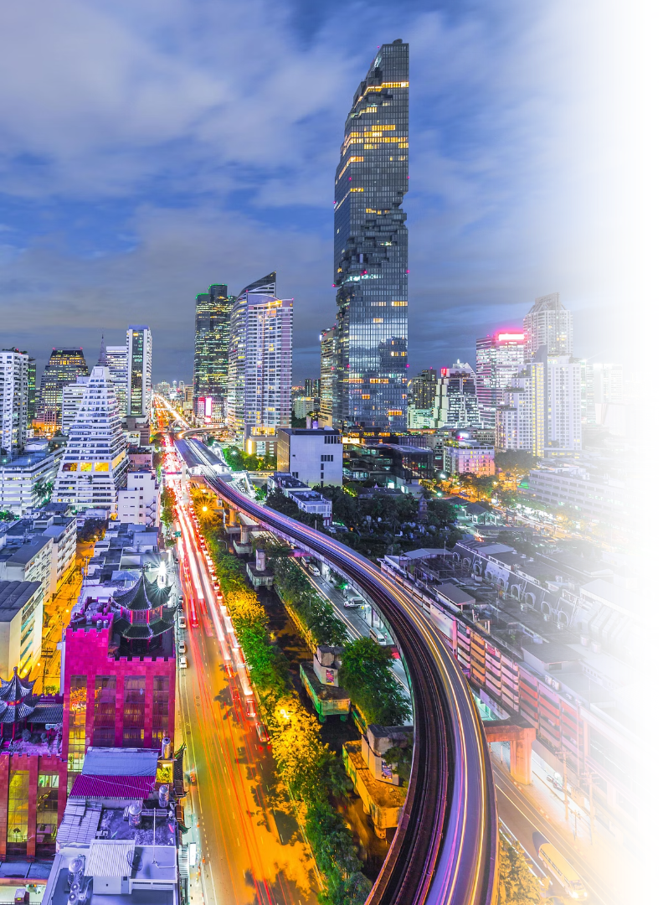
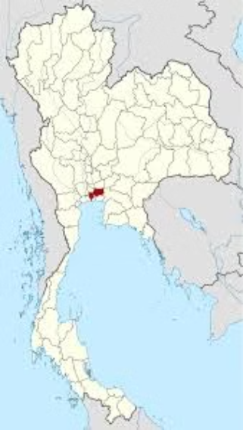
Thailand's Major Cities
Bangkok:
The Capital City
Where is Bangkok?
Size and Population
1,568.737 km² in total area. Bangkok is the most populous city in Thailand with over 5,422,568 total registered residents.
Photo credit: NordNordWest
Notes:
18

Slide 19
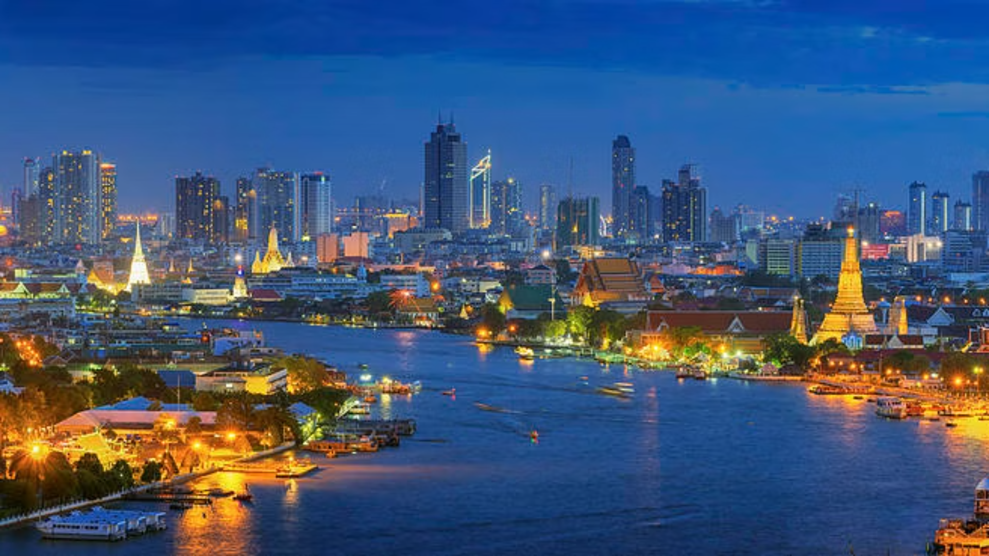
Bangkok: The Capital City
World's Longest City Name
Meaning
Krungthepmahanakhon Amonrattanakosin Mahintharayutthaya Mahadilokphop Noppharatratchathaniburirom Udomratchaniwetmahasathan Amonphimanawatansathit Sakkathattiyawitsanukamprasit
City of angels, great city of immortals, magnificent city of the nine gems, seat of the king, city of royal palaces, home of gods incarnate, erected by Vishvakarman at Indra's behest
Bangkok’s 244th anniversary
Bangkok marked its 244th anniversary on 21 April 2026, commemorating its establishment as Thailand’s capital in 1782.
Photo credit: Pixels
Notes:
19

Slide 20
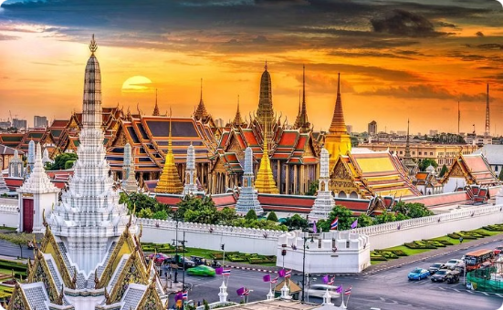
Bangkok's Historic Places
The Grand Palace Complex
The Grand Palace sits at the heart of Bangkok and has been the official residence of the monarchy since 1782. Located in the Grand Palace,
Wat Phra Kaew is Thailand’s
most sacred site housing the revered Emerald Buddha statue.
Photo credit: Sun Leisure World
Notes:
20

Slide 21
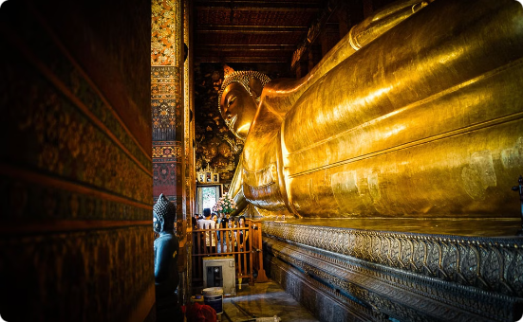
Bangkok's Historic Places
Wat Pho
One of Bangkok’s oldest temples, Wat Pho is home to the massive Reclining Buddha statue and a center of
traditional Thai massage.
Photo credit: Roasn
Notes:
20

Slide 22
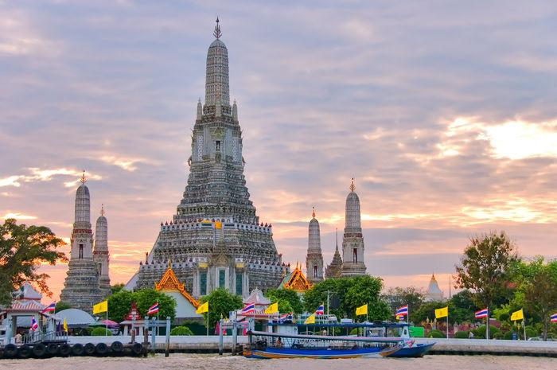
Bangkok's Historic Places
Wat Arun
Wat Arun, or the Temple of Dawn, stands as a stunning monument on the bank of Chao Phraya river serving as the first sign to travelers sailing from the Gulf of Thailand that they have arrived in Bangkok.
Photo credit: Into Asia
Notes:
20

Slide 23
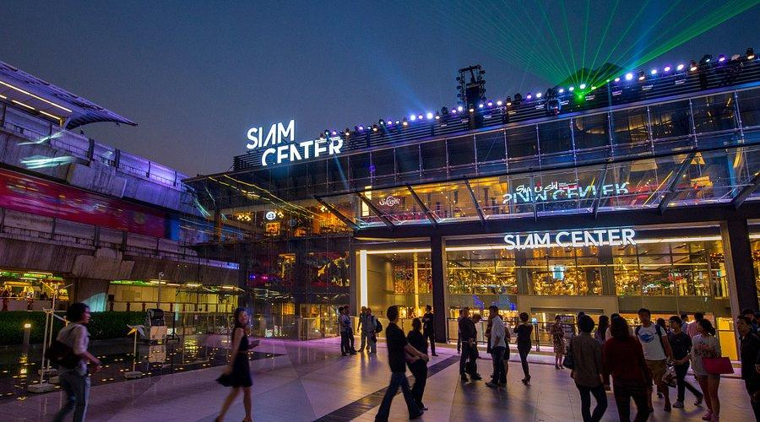
Bangkok's Shopping Destinations
Siam Shopping District
One of the top shopping destinations in the world, featuring Siam Paragon, Siam Center, Siam Discovery,
Siam Square One, MBK Center,
Central World, etc.
Photo credit: Tripadvisor
Notes:
21

Slide 24
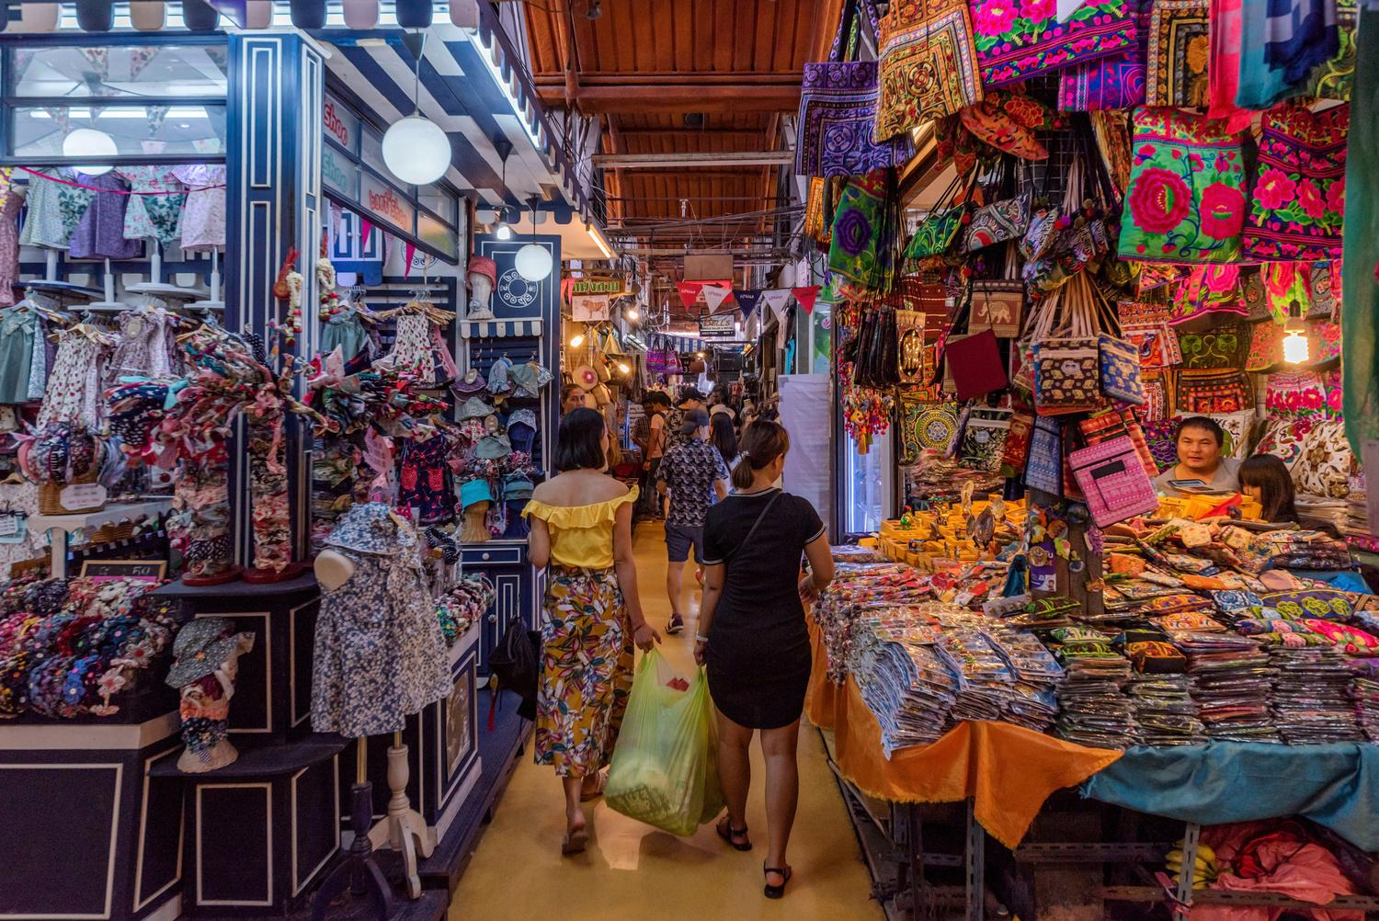
Bangkok's Shopping Destinations
Chatuchak Market
Thailand's biggest market with over 200,000 visitors every weekend. It offers diverse goods, selling anything from antiques, furniture, cosmetics, clothing to pets and plants.
Photo credit: Time Out
Notes:
21

Slide 25
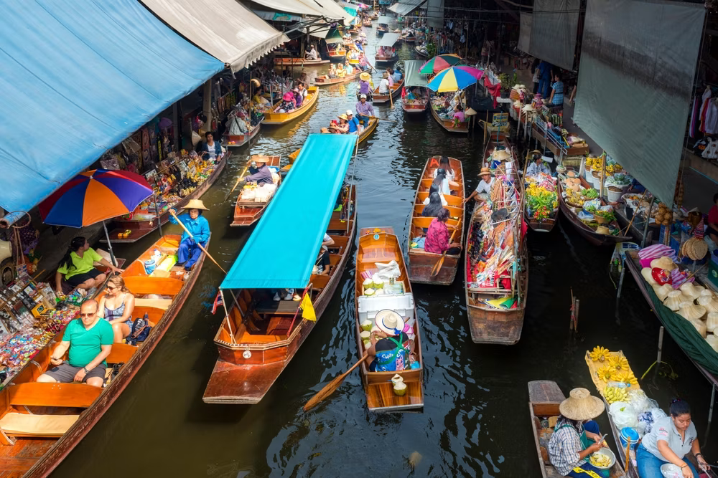
Bangkok's Shopping Destinations
Khlong Lat Mayom
Floating Market
A traditional Thai floating market experience in Bangkok,
offering local foods and goods.
Photo credit: Tiqets
Notes:
21

Slide 26
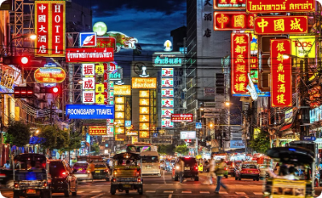
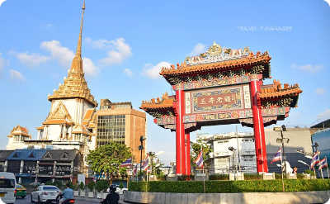
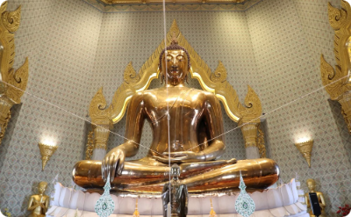
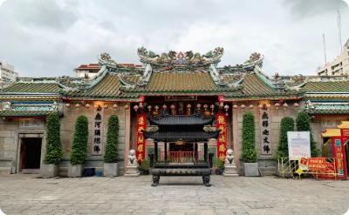
Chinatown (Yaowarat)
Yaowarat Road
Dragon Gate
The Golden Buddha at Wat Traimitr
Wat Leng Noei Yi
Photo credit: Bangkok Tuk Tuk Tour, HLP VirtualTour, Thaipost, Shutterstock
Notes:
22

Slide 27


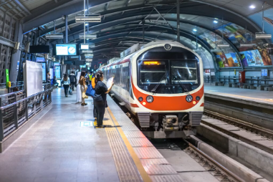
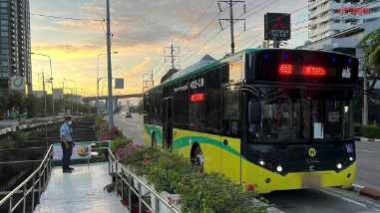
Bangkok's Mass Transit System
BTS Skytrain
MRT
Airport Rail Link (ARL)
Buses and BRT
An elevated rail system
with two main lines—the Sukhumvit Line and the Silom Line—providing a convenient way to navigate the city's central areas.
The metro system that connects key districts
and suburban areas.
Operated by the Bangkok Mass Transit Authority (BMTA) and private companies. BRT (Bus Rapid Transit) is a dedicated bus service operating along specific lanes to provide faster travel compared
to regular buses.
An elevated rail connecting Suvarnabhumi Airport
to the city center.
Photo credit: Sawasdee Thailand, TAT Newsroom, Atmind Group, Khaosod
Notes:
23

Slide 28
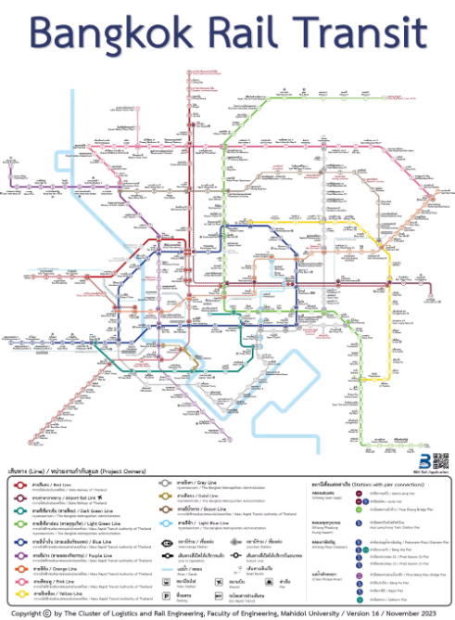
Bangkok's Mass Transit System
As of 2025, Bangkok’s rapid mass transportation network (BTS, MRT, ARL, BRT) covers a combined distance of nearly 250 kilometers, with ongoing expansions to accommodate the city's growing population and ease congestion.
Photo credit: Faculty of Engineering, Mahidol University
Notes:
24

Slide 29
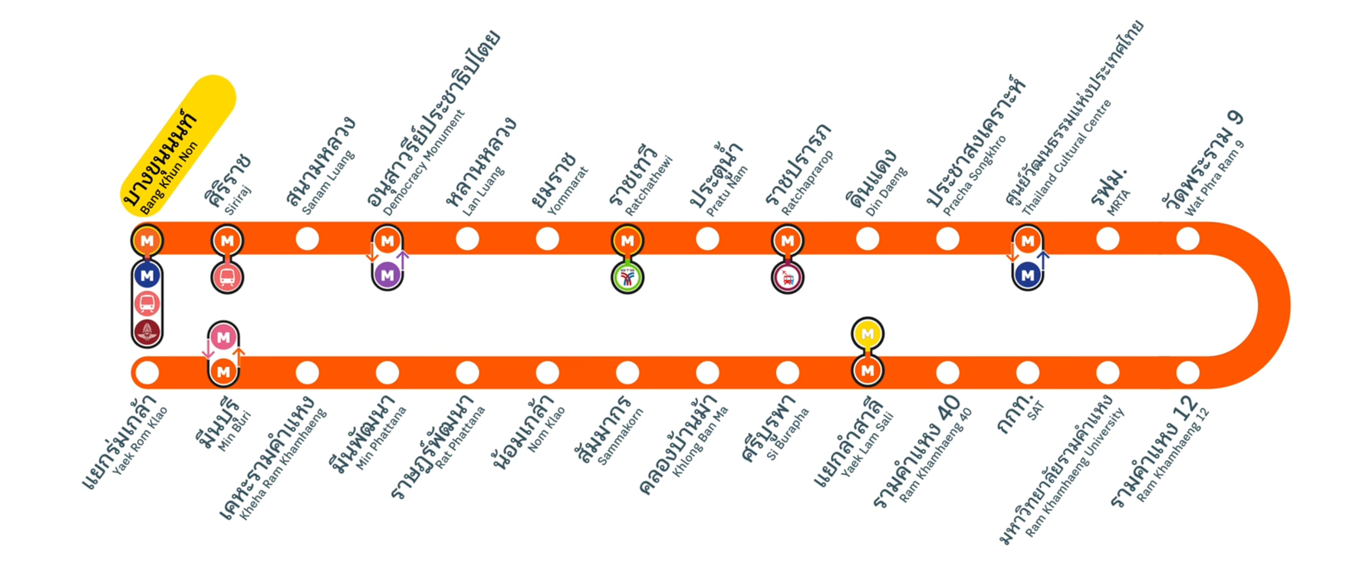
Bangkok’s MRT Orange Line
The MRT Orange Line is an under-construction rapid transit line designed to strengthen east-west connectivity across Bangkok. The eastern section is expected to open in late 2027, while the western section is planned to open around 2030.
When fully completed, it will link Bang Khun Non, Thailand Cultural Centre, and Yaek Rom Klao, serving 29 stations and connecting with several major rail systems.
Pictured: MRT Orange Line Future Interchange Announcement 2025
Photo credit: P_Railway on YouTube
Notes:
24

Slide 30
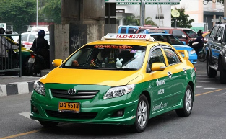
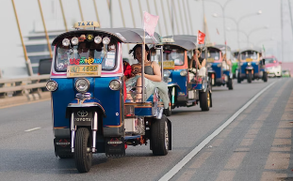
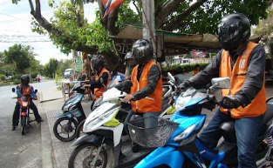
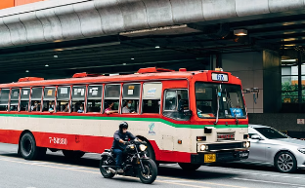
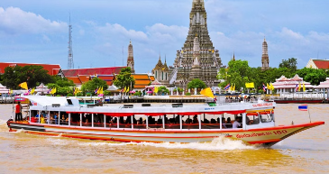
Bangkok's Mass Transit System
Other Urban Transport Options
Taxis, Tuk-Tuks, Motorbike Taxis, Buses, app-based ride-hailing services, and Boats and Ferries traversing the Chao Phraya River and the city’s canals.
Photo credit: Bangkok Tuk Tuk Tour, Techsauce, Consumerthai, Thairath, Siamnews
Notes:
25

Slide 31
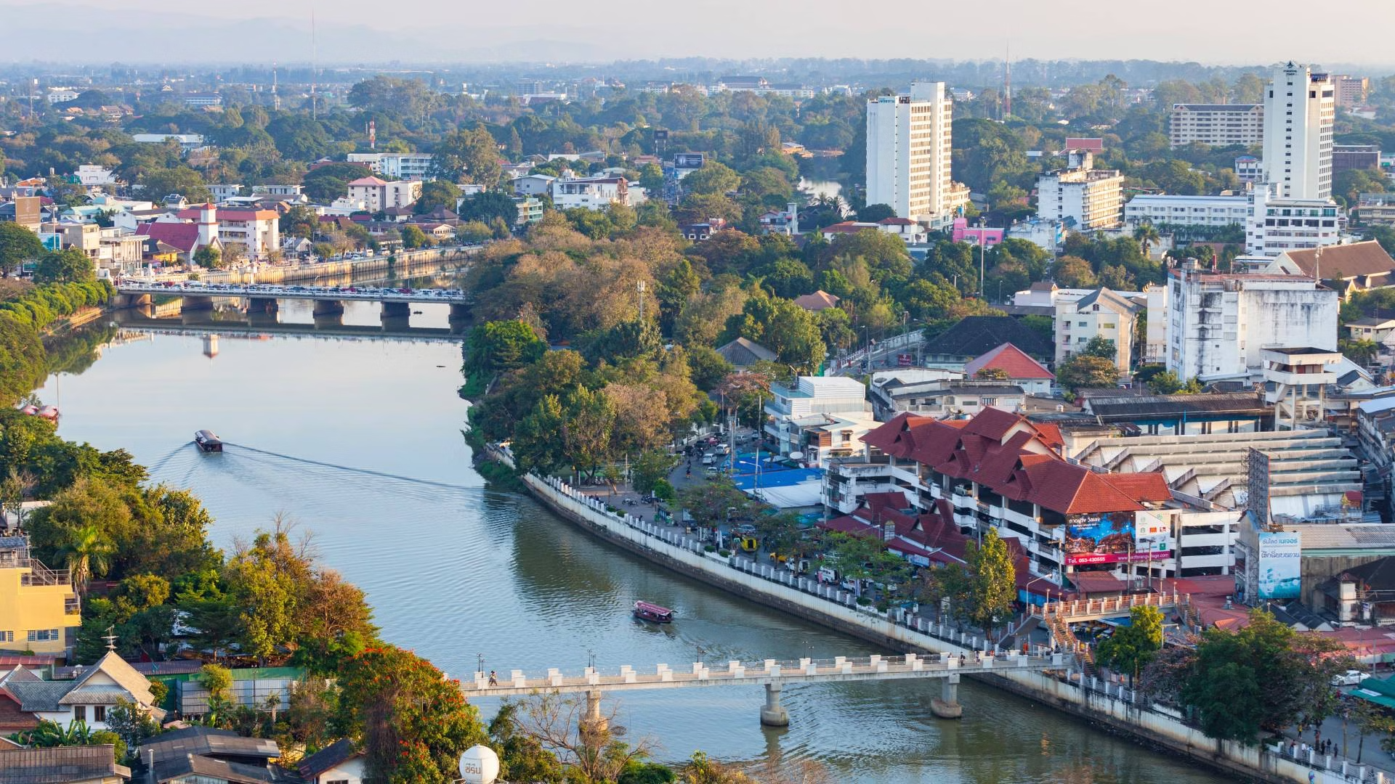
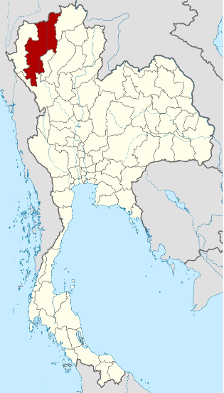
Chiang Mai
The second largest city in Thailand at 405 km², Chiang Mai has a population of over a million people.
Where is Chiang Mai province?
Located on Thai Highlands and surrounded by mountains and forests, making it a hub for outdoor activities.
It is home to Chiang Mai University, the leading academic institution of the Northern region.
International Recognition
Forbes named Chiang Mai one of the world’s eight leading destinations for digital nomads and creators, highlighting its co-working spaces, café culture, infrastructure, creative ecosystem, and growing role as a MICE city.
Travel + Leisure ranked Chiang Mai as the 3rd best city in the world in its World’s Best Awards 2026, based on reader votes evaluating landmarks, culture, food, friendliness, shopping, and overall value.
Source: Forbes, reported by Bangkok Post,
TravelandLeisure
Photo credit: Agoda, NordNordWest1
Notes:
28

Slide 32

Landmarks in Chiang Mai
Wat Chedi Luang
A historic temple known for its massive Lanna-style chedi (pagoda), which once housed the revered Emerald Buddha.
Photo credit: Flickr
Notes:
29

Slide 33

Landmarks in Chiang Mai
Doi Suthep
A doi (mountain) overlooking Chiang Mai, it hosts a sacred temple with a golden pagoda and panoramic views of the city. The site is a major pilgrimage destination in Thailand.
Photo credit: Wikipedia
Notes:
29

Slide 34

Landmarks in Chiang Mai
Tha Phae Gate
A historic gateway to Chiang Mai’s Old City, it is a well-preserved remnant of the ancient city walls. The gate serves as a cultural hub, hosting festivals
and a lively night market.
Photo credit: ForeverVacation
Notes:
29

Slide 35


Pattaya City
Where is Chonburi province?
Pattaya is a vibrant coastal city located in the Chonburi province, famous for its lively beaches, nearby islands such as Koh Larn, entertainment, and nightlife. Once a small fishing village, Pattaya has grown into a major tourist destination.
Size and Population
53.4 km² in area. With 120,000 population
Photo credit: Thailand Awaits, NordNordWest
Notes:
30

Slide 36




Landmarks in Pattaya City
Beaches
Sanctuary of Truth
Nong Nooch Tropical Garden
Tiffany's Show
Pattaya beach,
Jomtien beach
A intricately carved
wooden temple
A famous transgender cabaret known for its spectacular costumes
and choreography
The largest botanical garden in Southeast Asia
Photo credit: Withlocals, Atmind Group, Viator
Notes:
31

Slide 37


Ayutthaya
Where is Ayutthaya province?
Ayutthaya, a UNESCO World Heritage Site, was the former capital of the Kingdom of Siam and remains one of Thailand’s most historically significant cities.
Founded in 1350, it flourished as a cosmopolitan trade and cultural hub. Today, the Ayutthaya Historical Park showcases the city's grandeur, which includes Wat Mahathat, famous for the Buddha head in tree roots, and Wat Phra Si Sanphet, the former royal temple.
With its rich history and well-preserved ruins, Ayutthaya offers a captivating journey into Thailand’s past.
Photo credit: NordNordWest
Notes:
32

Slide 38




Landmarks in Ayutthaya
Wat Mahathat
Buddha Head
in Tree Roots
Wat Phra Si Sanphet
Ayutthaya
Floating Market
Photo credit: Quizlet, iStock, Tripadvisor
Notes:
33

Slide 39


Nakhon Ratchasima
Nakhon Ratchasima, commonly known as Korat, is the third largest city in Thailand.
Where is Nakhon Ratchasima province?
It serves as a gateway to the Isan region and is known for its rich history, cultural landmarks, and modern urban development.
Photo credit: Asia King Travel, NordNordWest
Notes:
34

Slide 40


Landmarks in Nakhon Ratchasima
Thao Suranaree Monument
Phimai Historical Park
Dedicated to the revered local heroine,
Thao Suranaree (Ya Mo), who played a role in
defending the city from invaders in the 19th century.
Home to Thailand’s largest sandstone temple complex.
Built in the 11th century, the site features intricate
Khmer architecture, reflecting Thailand's historical connections with ancient Angkorian civilization.
Photo credit: Unseentourthailand, Virtual Historical Park
Notes:
35

Slide 41


Khon Kaen
Where is Khon Kaen province?
The Isan region's center for education and commerce, Khon Kaen is one of the 'Big Four' of Isan, which also includes Nakhon Ratchasima, Udon Thani, and Ubon Ratchathani.
It is home to Khon Kaen University, the region’s leading academic institution. The province is known for its rich silk-weaving tradition and landmarks like Wat Nong Wang, with its towering pagoda overlooking Kaen Nakhon Lake. Nature lovers can explore Phu Pha Man National Park, famous for its limestone mountains, caves, and diverse wildlife.
Photo credit: Asia King Travel, NordNordWest
Notes:
36

Slide 42

Landmarks in Khon Kaen
Khon Kaen University
The leading academic institution of Isan, it is a hub for research, innovation, and higher education. Established in 1964, it plays a key role in regional development.
Photo credit: Khon Kaen University, Thaipost, Roijang
Notes:
37

Slide 43

Landmarks in Khon Kaen
Wat Nong Waeng
A revered temple featuring a 9-story pagoda that enshrines the Buddha’s holy relics. Each floor showcases intricate carvings while the top level offers a panoramic view of the city
Photo credit: Khon Kaen University, Thaipost, Roijang
Notes:
37

Slide 44

Landmarks in Khon Kaen
Phu Pha Man
National Park
A limestone mountain range, known for its cliff resembling a giant curtain. The park features evergreen forests, a cool climate year-round, caves, and waterfalls for
nature lovers to explore.
Photo credit: Khon Kaen University, Thaipost, Roijang
Notes:
37

Slide 45


Udon Thani
Where is Udon Thani province?
Udon Thani is known for its historical significance and natural beauty. It is home to Ban Chiang Archaeological Site, a UNESCO World Heritage site, and Talay Bua Daeng (Red Lotus Sea), a stunning seasonal lake covered in blooming pink water lilies.
Serving as a key economic and transportation hub, the province is easily accessible via Udon Thani International Airport, connecting it to major domestic and international destinations.
Photo credit: MGR Online, NordNordWest
Notes:
38

Slide 46

Landmarks in Udon Thani
Ban Chiang National
Museum
This UNESCO World Heritage Site is one of Southeast Asia’s oldest Bronze Age archaeological sites. Famous for pottery, ancient tools, and burial sites, it offers insight into
early human settlements.
Photo credit: The Cloud
Notes:
39

Slide 47

Landmarks in Udon Thani
Phu Phra Bat
Historical Park
This UNESCO World Heritage Site preserves the world’s largest collection of in situ Sīma stones from the Dvaravati period. It reflects the long-standing Buddhist heritage of the Khorat Plateau and the transformation of a natural landscape into a sacred religious site.
Photo credit: CBT Thailand
Notes:
39

Slide 48

Landmarks in Udon Thani
Talay Bua Daeng
The Red Lotus Sea is a seasonal lake
in Udon Thani, famous for its breathtaking pink water lilies that bloom from December to February.
Photo credit: Agoda
Notes:
39

Slide 49


Ubon Ratchathani
Where is Ubon Ratchathani province?
One of the major provinces in the Isan region, known for its Buddhist heritage, natural beauty, and cultural festivals.
Located near the Lao and Cambodian borders, the province is famous for its annual Candle Festival and features numerous beautiful and historically significant temples.
Photo credit: Nopparat Thnatawan, NordNordWest
Notes:
40

Slide 50



Landmarks in Ubon Ratchathani
Candle Festival
Wat Nong Pa Phong
Urban Area
Featuring elaborate wax sculptures, the festival marks the start of Buddhist Lent in July.
A prominent forest monastery founded by the venerable Ajahn Chah. It is a center for meditation and monastic training, attracting practitioners from around the world.
Ubon Ratchathani city blends modern urban development with
traditional Thai culture.
Photo credit: Thailand NOW, CBT Thailand, Ubon Ratchathani Municipality
Notes:
41

Slide 51


Nong Khai
Where is Nong Khai province?
Nong Khai, a scenic province in northeastern Thailand, sits along the Mekong River, serving as a gateway to Laos via the Thai-Lao Friendship Bridge.
With its blend of history and Mekong River charm, Nong Khai offers a fascinating glimpse into Thailand’s north Isan culture.
Photo credit: Paikanmayang, NordNordWest
Notes:
42

Slide 52


Landmarks in Nong Khai
Sala Kaew Ku
Thai-Lao Friendship Bridge
A unique sculpture park featuring large concrete
statues inspired by Buddhism and Hinduism
An important landmark connecting Thailand
and Laos across the Mekong River
Photo credit: Diwerent, Jim Holmes/AusAID
Notes:
43

Slide 53


Phuket
Where is Phuket province?
Thailand’s largest island, Phuket is a world-renowned tourist destination. Surrounded by the Andaman Sea, it offers crystal-clear waters, numerous luxury resorts, and famous spots.
Photo credit: JFTB Real Estate Phuket, NordNordWest
Notes:
44

Slide 54



Landmarks in Phuket
Beaches
Old Phuket Town
Luxury Tourism
Beaches such as Patong Beach and Karon Beach are famous for pristine white sand and clear waters.
Features Sino-Portuguese architecture and rich cultural heritage.
Home to high-end resorts and
a popular destination for yachts.
Photo credit: Phuket Elephant Nature Reserve, Global Galivanting, World's Best Luxury Hotels
Notes:
45

Slide 55


Krabi
Another province on the Andaman Sea coast, Krabi is well-known for its stunning limestone cliffs, clear turquoise waters, and magnificent beaches.
Where is Krabi province?
Photo credit: Magzter, NordNordWest
Notes:
46

Slide 56


Krabi
Koh Phi Phi
Ao Nang
A group of islands known for their stunning beauty,
clear waters, and limestone cliffs. Popular for
snorkeling, diving, and beach activities.
A central beach town in Krabi, serving as a starting point for island tours and offering a variety of accommodations
and restaurants.
Photo credit: Asia King Travel, Zonezi Properties
Notes:
47

Slide 57


Songkhla
Where is Songkhla province?
A coastal province on the Gulf of Thailand,
it is a key southern cultural and economic hub with a unique blend of Thai, Chinese, and Malay influences.
As a major port city, it plays a vital role in trade and tourism, offering a rich mix of history, culture, and scenic coastal landscapes.
Photo credit: Adobe Stock, Suphanut Arunprayote
Notes:
48

Slide 58


Songkhla
Samila Beach
Hat Yai
A beautiful beach known for its
mermaid statue and clear waters.
The largest city in the Thai South,
known for its markets and diverse culture.
Photo credit: Traveloka, Suphanut Arunprayote
Notes:
49

